Slide 1
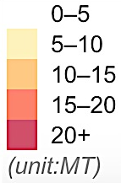

Low
High
1 2 3 4 5 6
0
: N/A

Slide 2
Density Level
Low
Mid
High
Density Level
Low
Mid
High

