Slide 1
Monitoring, Detecting, and Adaptive Response to Data Drift in Machine Learning Systems
Final Project (Dissertation Submission)
Subject Code: MDS-681-RP
Presented by: Sanskruti Joshi
Roll No.: DS25MSL10
Guide: Dr. Omkar Barve
MSc Data Science
Department of Technology

Slide 2
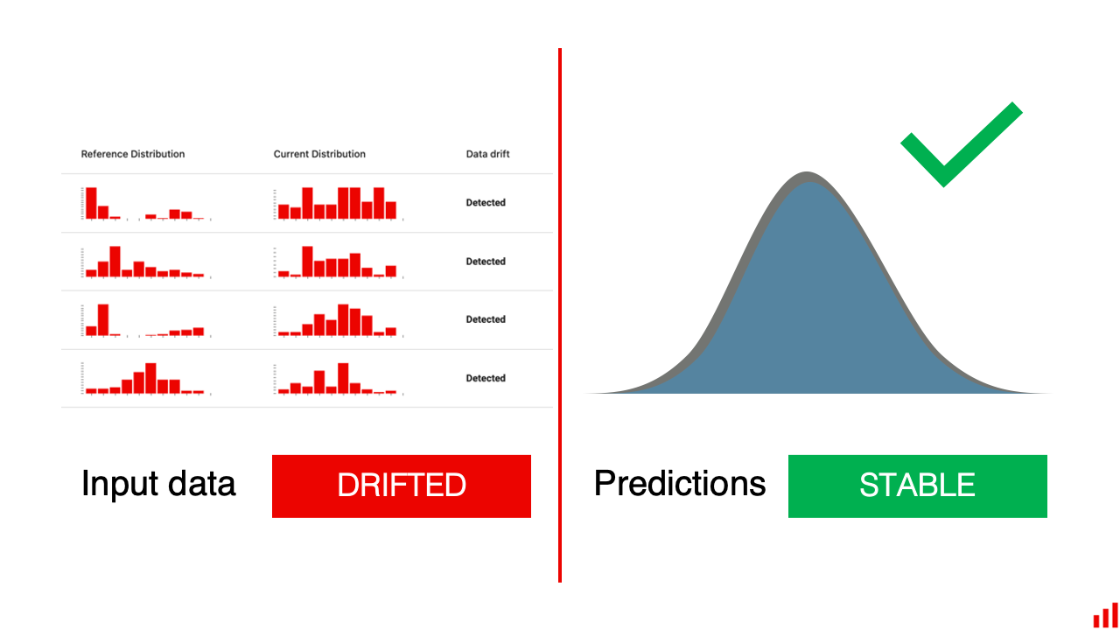
Introduction
Problem Statement
Objectives
Machine learning models degrade over time due to changing data distributions.
This phenomenon is known as Data Drift.
Drift reduces prediction reliability and business effectiveness.
Traditional ML systems often lack continuous monitoring mechanisms.
To develop a framework for:
Drift detection
Performance monitoring
Adaptive retraining
Interactive visualization

Slide 3
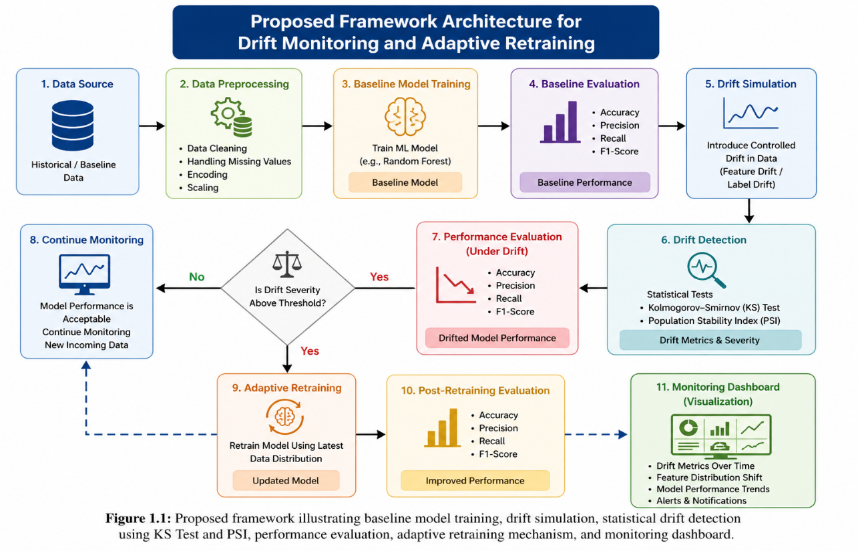

Slide 4
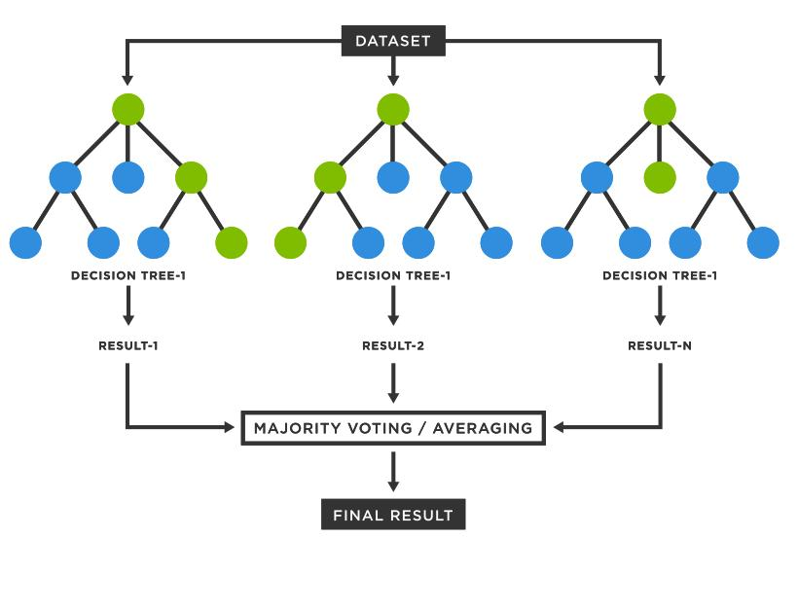
Dataset and Experimental Setup
Dataset
Model
Telecom Customer Churn Dataset
~7000 customer records
21 features
Numerical + categorical attributes
Important features
Tenure
MonthlyCharges
TotalCharges
Contract
PaymentMethod
Random Forest Classifier
Why Random Forest?
Robust and stable
Handles mixed data types
Low preprocessing complexity
Suitable baseline classifier

Slide 5
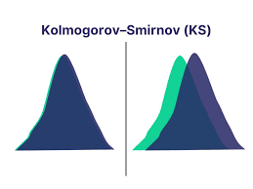
Drift Detection Techniques
Kolmogorov–Smirnov (KS) Test
Population Stability Index (PSI)
Detects statistical distribution changes
Compares distributions
Low p-value indicates drift.
Measures drift severity
Used for retraining trigger
PSI Range | Drift Severity
PSI < 0.1 | Low Drift
0.1 ≤ PSI < 0.25 | Moderate Drift
PSI ≥ 0.25 | High Drift

Slide 6
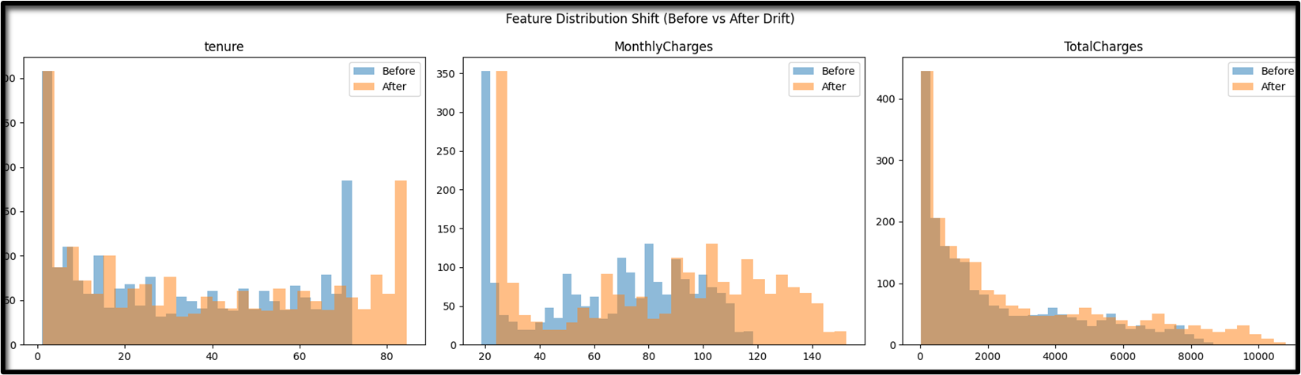
Drift Simulation & Detection Results
Observations
Significant drift introduced in: MonthlyCharges, tenure, TotalCharges
MonthlyCharges showed highest PSI.
Distributional changes reduced model reliability.

Slide 7
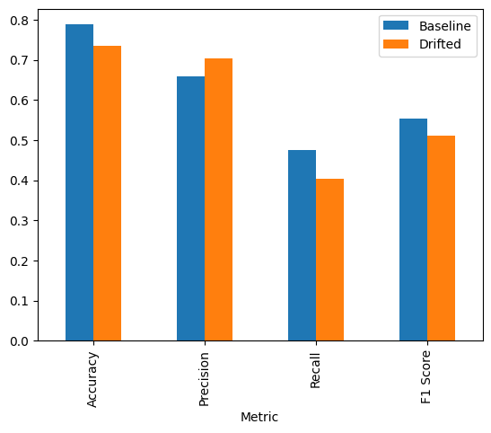
Performance Impact of Drift
Key Findings
Recall and F1-score deteriorated under drift significantly.
Accuracy alone was insufficient to evaluate reliability
Precision increased because the model became more conservative in predicting churn cases.
Higher precision but lower recall indicates more churn customers were missed..
Drift negatively affected churn prediction.

Slide 8
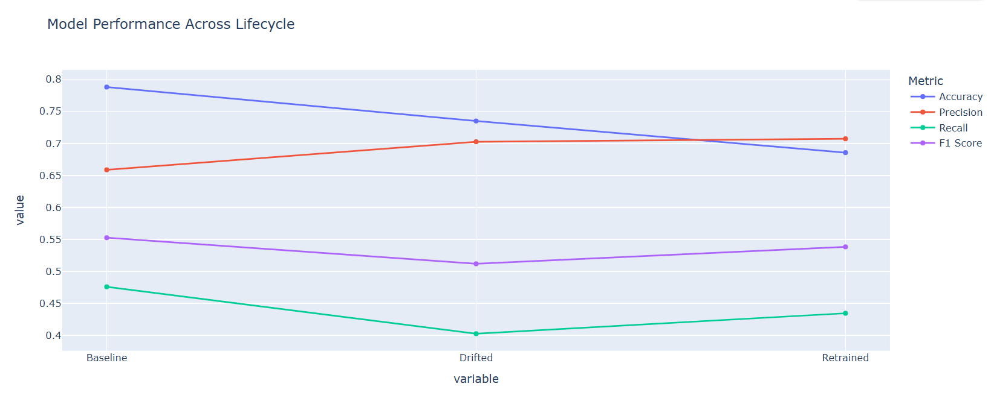
Adaptive Retraining Results
Observations
Retraining improved recall and F1-score.
Retraining improved adaptability, but introduced trade-offs between different evaluation metrics
Full baseline recovery was not achieved.
Demonstrates complexity of maintaining ML performance under evolving data conditions.

Slide 9
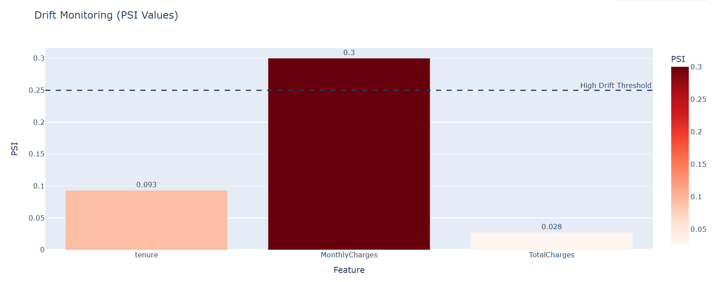
Interactive Dashboard
Dashboard Features
PSI threshold visualization
Feature-level monitoring
Drift severity analysis
Performance comparison
Retraining monitoring
Benefits
Easier monitoring
Faster diagnosis
Better operational usability

Slide 10
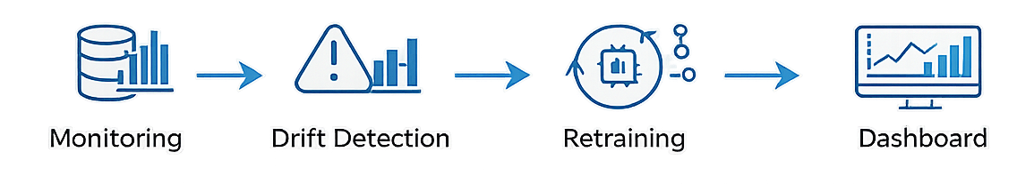
Conclusion
Key Findings
Future Scope
Data drift reduced model reliability
KS Test and PSI effectively detected drift
Retraining improved adaptability
Dashboard enhanced monitoring capability
Real-time drift detection
Streaming data integration
Advanced MLOps deployment
Automated alert systems

Slide 11
THANK YOU

