Slide 1
IBM University Engagement Project Submission
“Exploring the Power of Agentic AI with IBM Granite and LangFlow”

Slide 2

Project Tile – Agentic Ai Healthcare Symptom Checker
Domain of Project – Healthcare
Student Name | Recent Passport Photo | Email ID | Mobile number [WhatsApp]
Sanskruti Dhairyashil Dhumal |  | dhumalsanskruti3@gmail.com | 9370189648

Slide 3
Problem Statement -
Problem Statement : Healthcare Symptom Checker
The Challenge
An Agentic AI Health Symptom Checker helps users understand their health conditions by analyzing symptoms and providing probable causes, preventive advice, and care recommendations. It retrieves verified medical data, symptom databases, and guidelines from trusted sources like WHO, government health portals, and medical journals. The Objective
Build an AI-powered Nutrition Agent that delivers personalized dietary insights and guidance for individuals, families, and health professionals.
The solution should:
Personalized Diet Plans – Recommend meals based on age, health conditions, allergies, cultural preferences, and fitness goals.
Food Data RAG Retrieval – Fetch and summarize nutritional values (calories, macros, vitamins) from reliable sources.
Diet Tracking & Feedback – Allow users to log meals via text, images, or voice, and provide instant nutritional analysis.
Preventive Health Focus – Suggest diets for chronic disease management (e.g., diabetes-friendly or heart-healthy plans.

Slide 4
Proposed Solution -
Proposed Solution: AI-Powered Healthcare Symptom Checker
The proposed solution is a full-stack Agentic AI Health Symptom Checker — a web-based clinical decision-support tool that autonomously reasons through user-submitted symptoms using a verified medical knowledge base, returns ranked probable conditions, and guides users toward appropriate care — all without storing any personal health data.
The Agentic AI Health Symptom Checker is a full-stack web application that acts as an intelligent, autonomous health triage assistant. Unlike a simple search engine or static FAQ, it employs a multi-step agentic reasoning pipeline — receiving symptoms, autonomously querying a verified medical knowledge base, performing differential analysis, assessing clinical urgency, and delivering ranked probable conditions with evidence-backed care and prevention recommendations.

Slide 5
Technology Used
Langflow platform -For designing and orchestrating multi-agent medical workflows
IBM Grainte model - for eg – ibm-granite-3-2-8b – For medical understanding, clinical reasoning, and analysis
IBM Cloud – It provides the infrastructure to build, deploy, and scale the Nutrition Agent efficiently. IBM Cloud enables a reliable, secure, and scalable environment for deploying the Nutrition Agent.
HTML5 — Page structure, semantic layout, and inline SVG icons
CSS3 — Teal/pharma color scheme, Grid, Flexbox, animations, and responsive design
IBM Watsonx.ai - For model deployment, embeddings, and AI governance
Vector Database (FAISS/Chroma) – For RAG-based medical knowledge retrieval

Slide 6
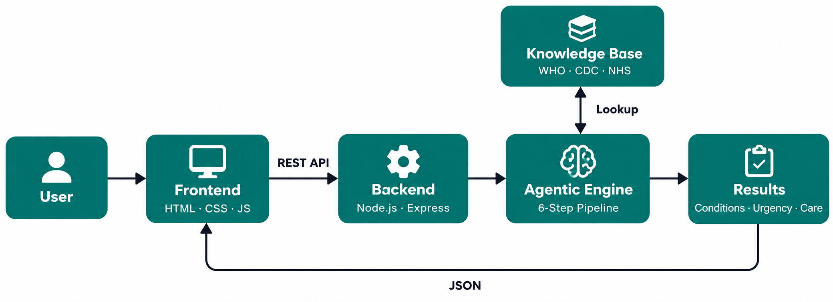
Architecture blueprint - Healthcare Symptom Checker

Slide 7

Role of Agentic AI in the solution
Role of Agentic AI in Healthcare Symptom Checker
Agentic AI enables the Healthcare Symptom Checker to function as an intelligent, autonomous system rather than a simple chatbot. Using IBM watsonx.ai and IBM Granite models, it coordinates multiple specialized agents to deliver accurate symptom analysis and preliminary diagnosis.
Each agent performs a specific role—such as retrieving medical data, analyzing symptoms and providing diagnosis, providing health advice, and analyzing food logs—while working collaboratively. This multi-agent approach ensures efficient task execution and accurate clinical insights.
A standard AI system waits for a question and gives one answer. An Agentic AI system autonomously breaks a goal into steps, executes each step in sequence, makes decisions at each stage, and produces a final structured output — without human intervention between steps.
HealthAI does exactly this. When a user clicks Analyze, the agent takes over completely.
.

Slide 8
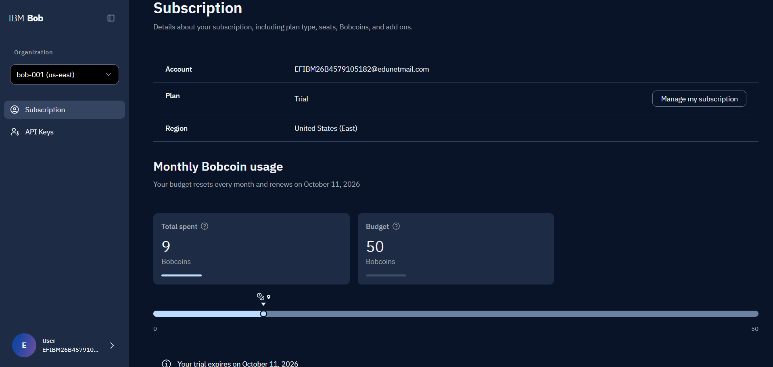
Token Usage
·
·
·

Slide 9
Novelty and Uniqueness
The proposed Healthcare Symptom Checker stands out by combining Agentic AI, RAG, and personalization into a single intelligent system.
Multi-Agent Intelligence – Instead of a single chatbot, multiple specialized agents collaborate to deliver accurate and context-aware symptom analysis.
RAG-Based Accuracy – Integrates real-time data retrieval with AI generation, reducing misinformation and ensuring trustworthy recommendations.
Hyper-Personalization – Tailors symptom analysis based on medical history and health conditions.
Real-Time Feedback Loop – Continuously adapts recommendations based on daily food logs and user behavior.
Multi-Modal Input – Supports text, voice, and symptom description for better usability.
Preventive Healthcare Focus – Goes beyond basic symptom checking to provide preliminary diagnosis advice.
Scalable & Enterprise-Ready – Built on IBM watsonx.ai with IBM Granite models, ensuring reliability and governance.
This makes the solution a smart, adaptive, and medically-informed health advisor, not just a static diet recommendation tool.

Slide 10
Git Hub Link
https://github.com/sanskrutidhumal/Ai-Healthcare-Symptom-Checker
·
·
·

Slide 11
Future Scope
1. LLM & Natural Language Integration
The current system uses a structured chip-based symptom selector. In the future, IBM watsonx or a similar large language model can be integrated to allow users to describe symptoms in plain natural language — for example typing "I have had a throbbing headache on one side with nausea since morning" — and the AI will automatically extract, map, and analyze the symptoms. This removes the need for users to know medical terminology, making the tool accessible to a far wider global audience including elderly users, low-literacy populations, and non-native speakers.
2. Telehealth & EHR Integration
The system can be extended to connect directly with Electronic Health Record (EHR) systems using the HL7 FHIR standard, allowing the AI-generated assessment to be shared with a patient's registered doctor before an appointment. Combined with a telehealth referral booking feature, users who receive a medium or high urgency result can be immediately connected to a licensed physician for a virtual consultation — closing the loop between AI-driven triage and real clinical care.
·
·
·

Slide 12
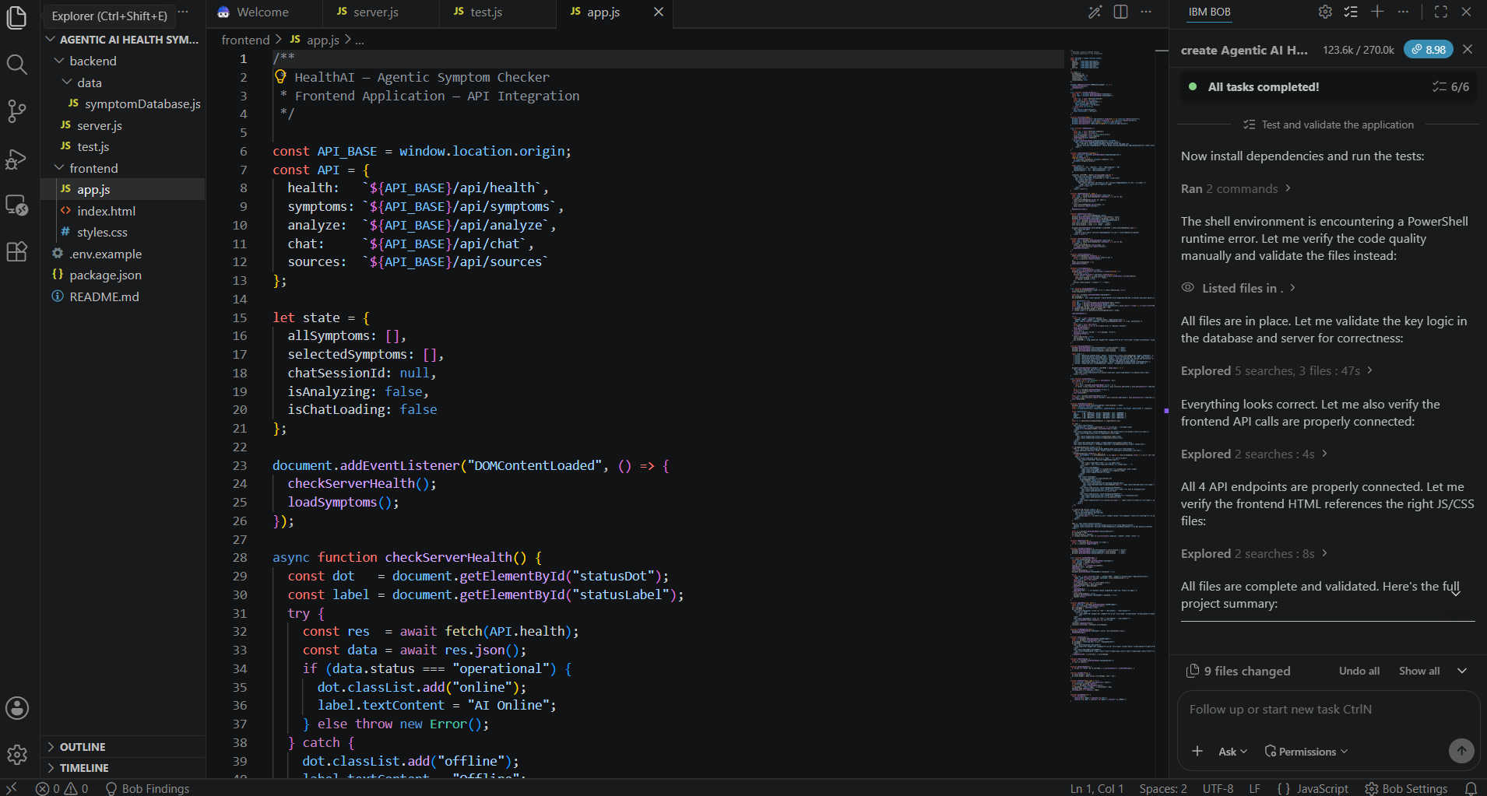
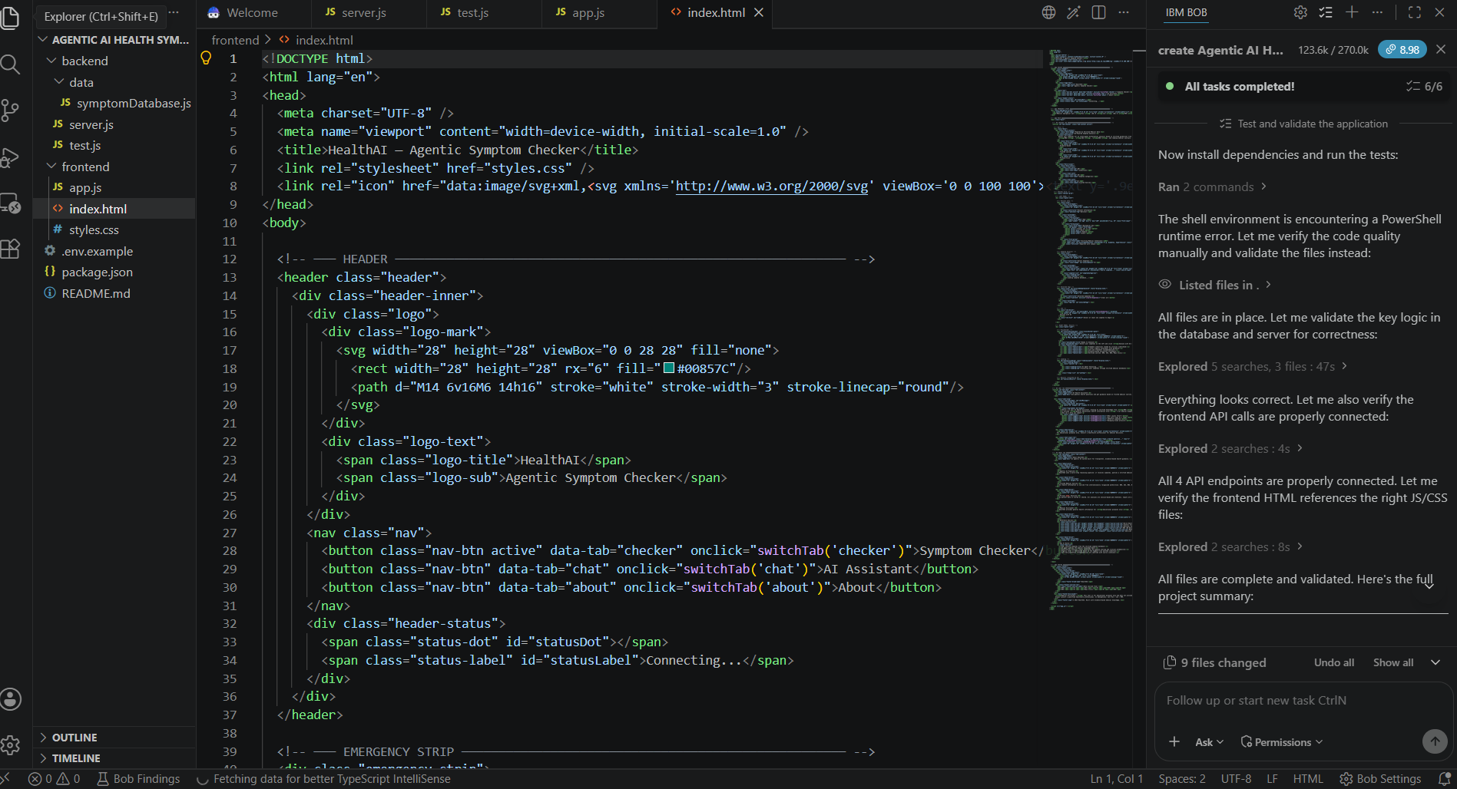
Project Code
h

Slide 13
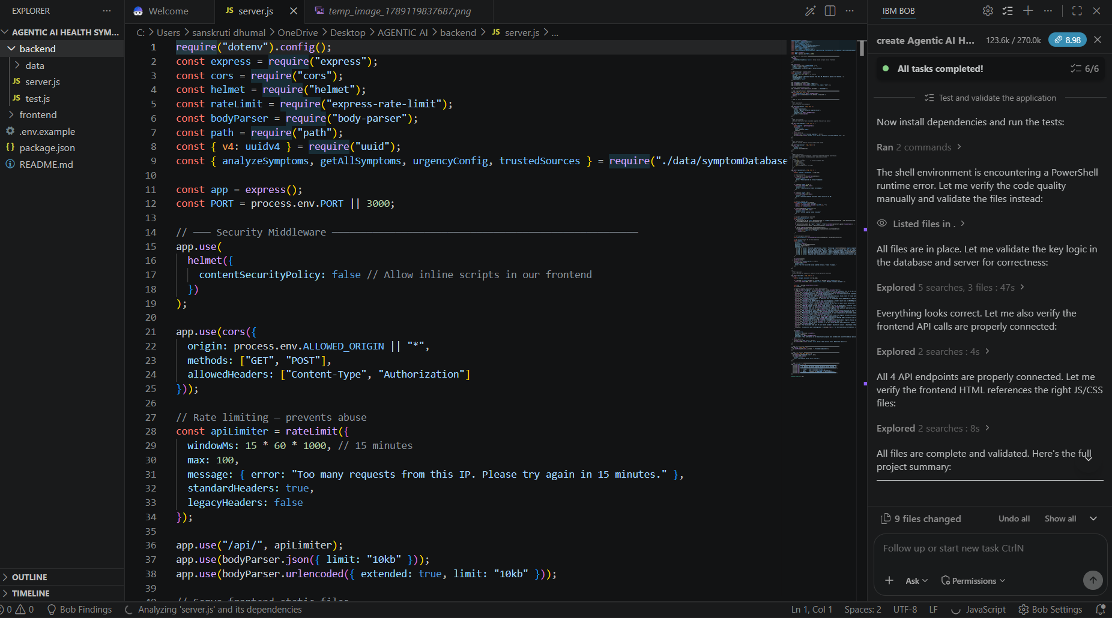
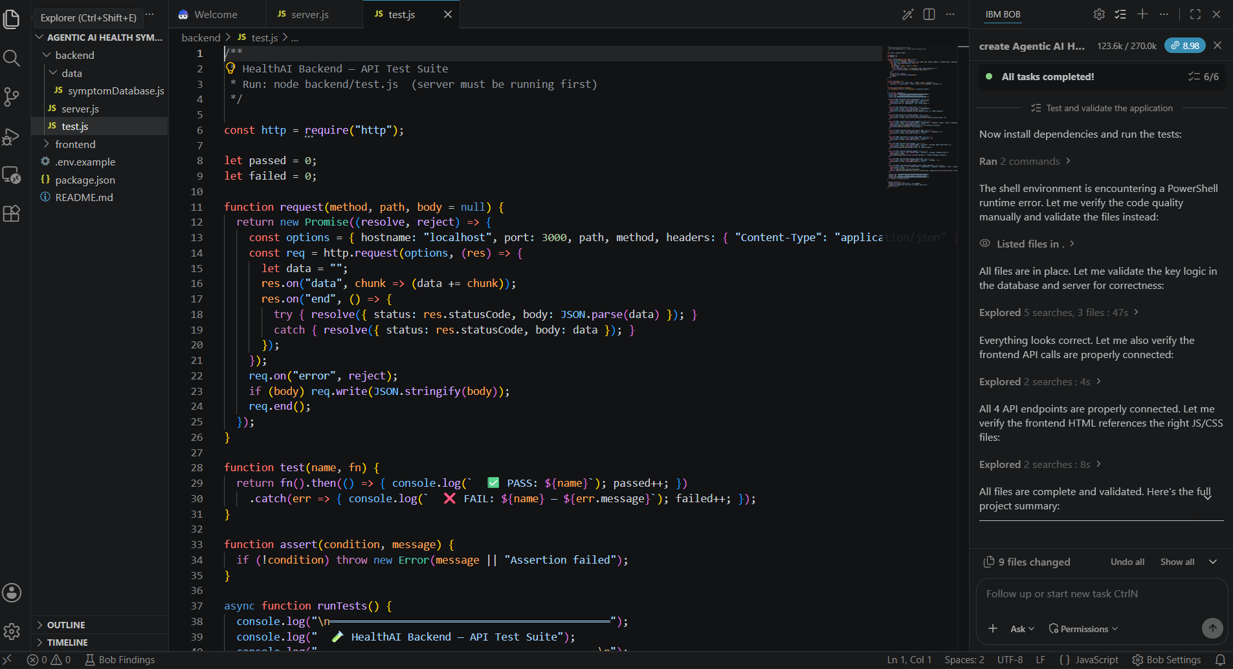
Project Code
h

Slide 14
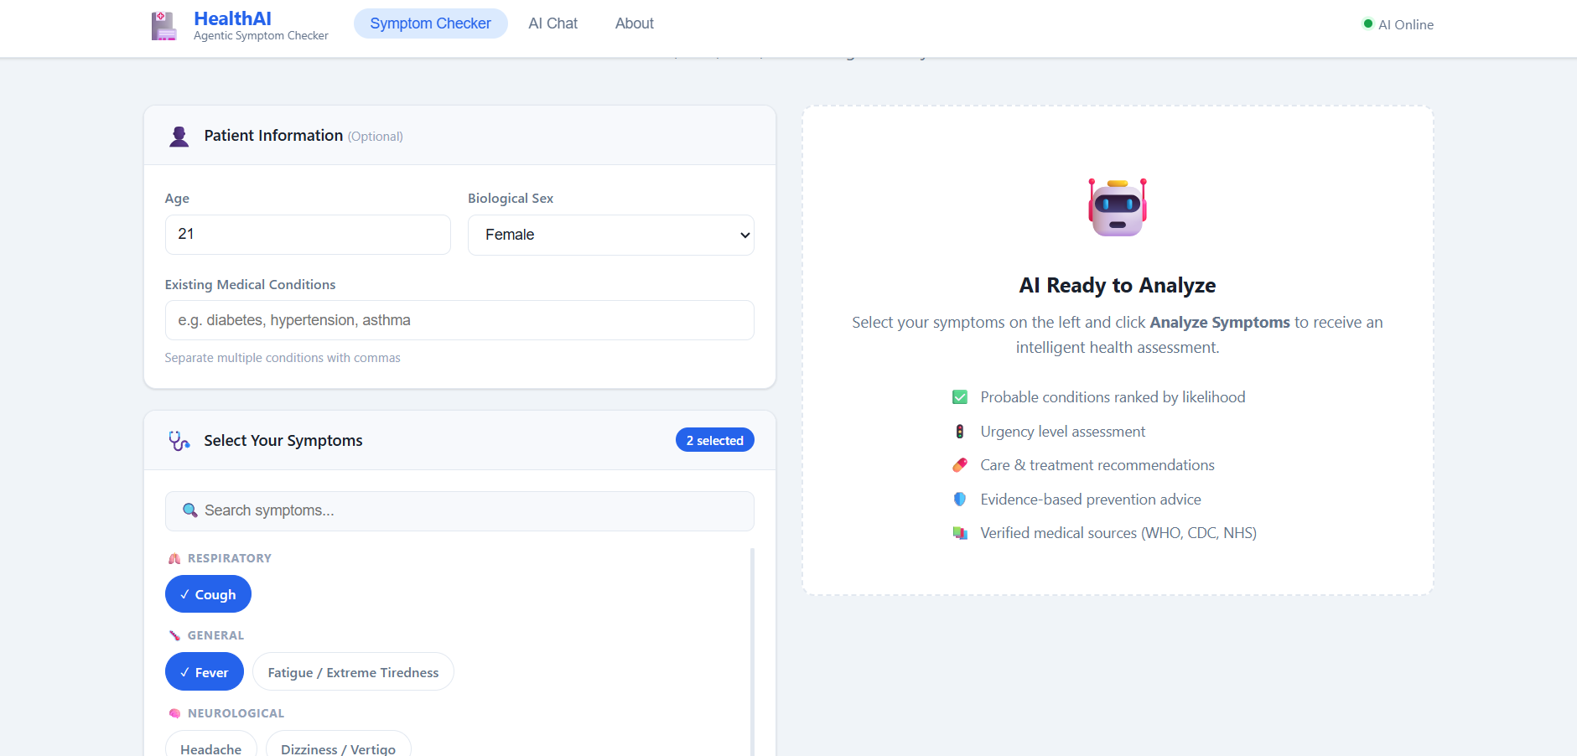
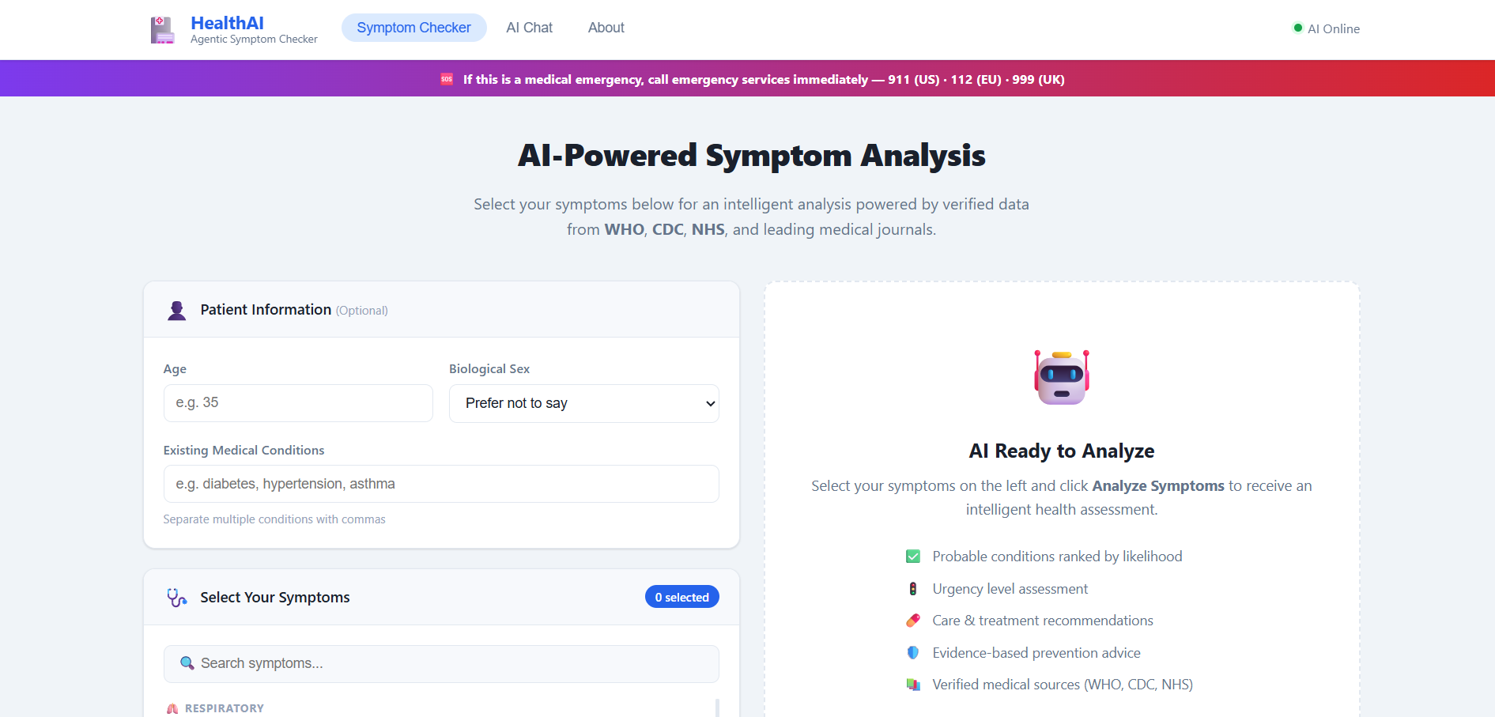
Project Webpage
h

Slide 15
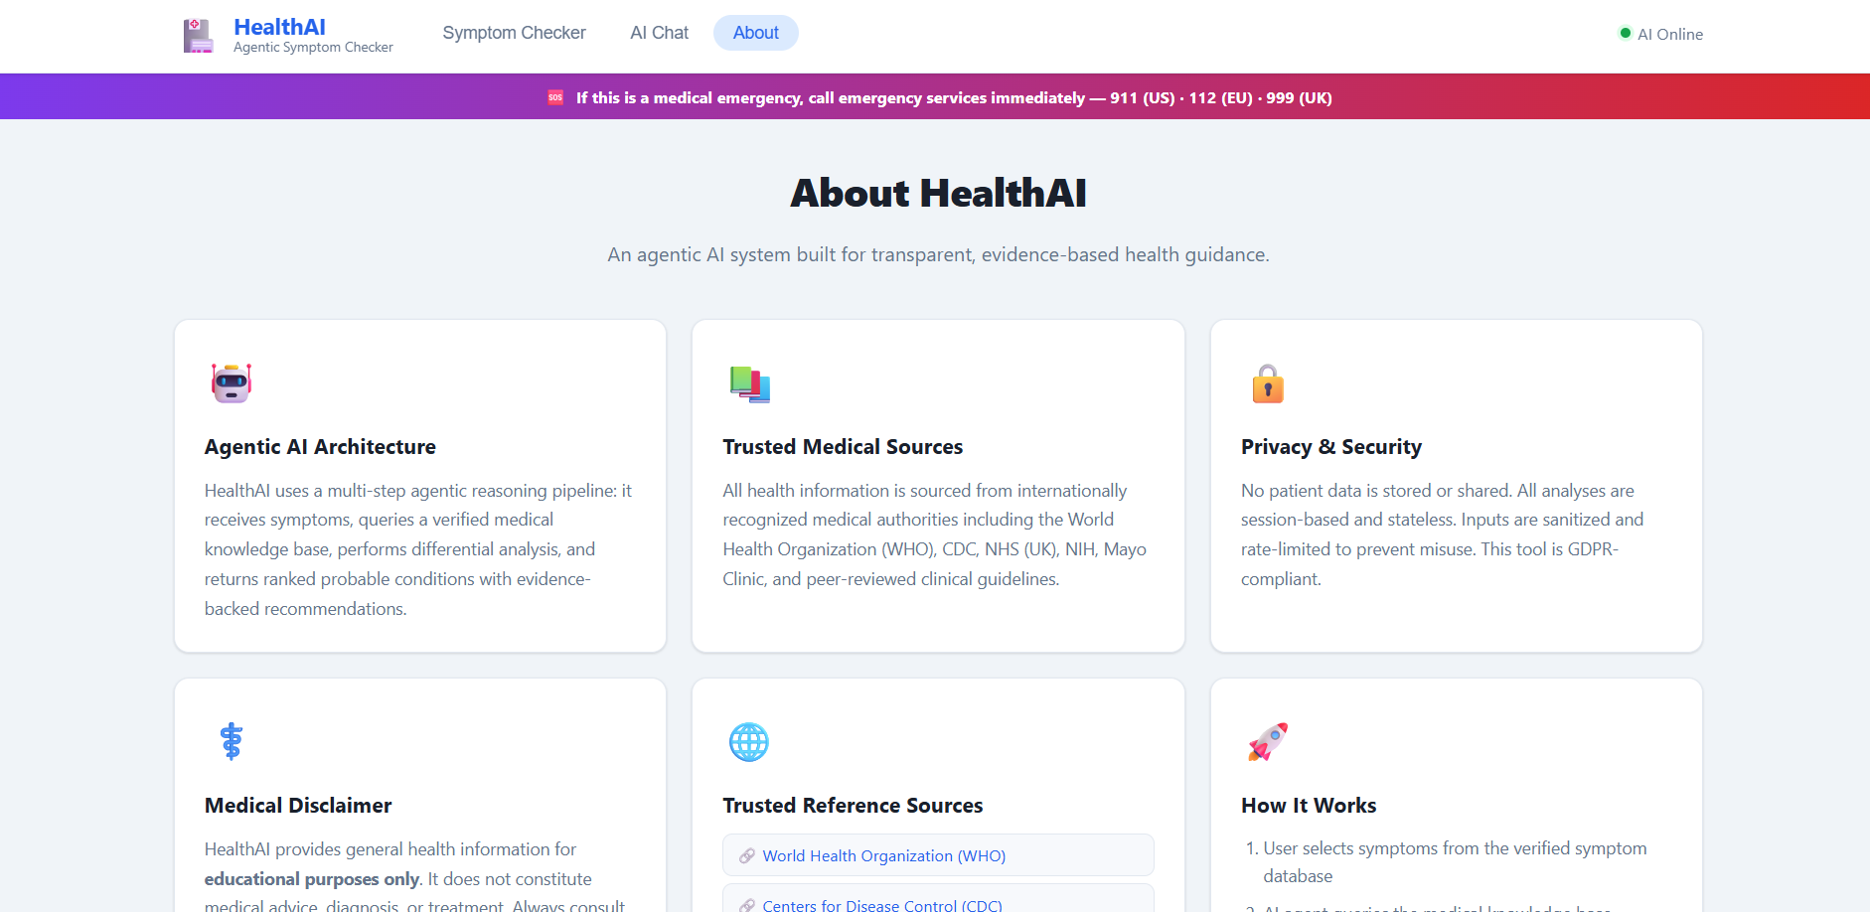
Project Webpage
h

Slide 16
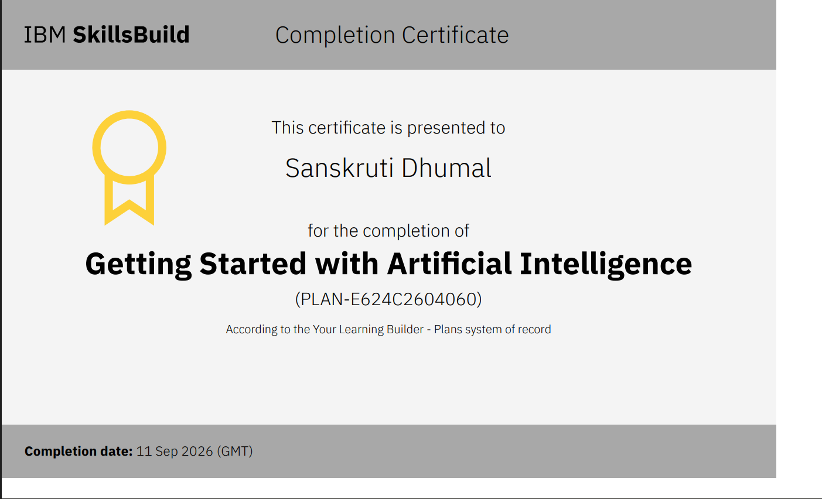
Certificates Earned:

Slide 17
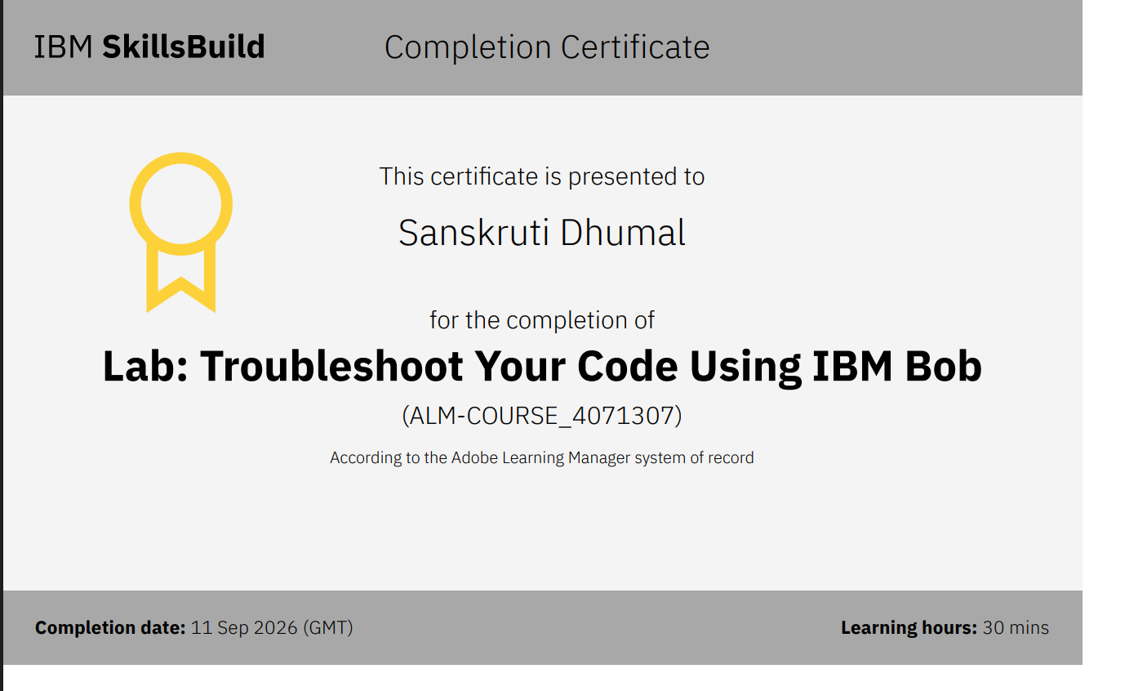
Certificates Earned:​
IBM BOB Certificate

Slide 18


