Slide 1

वै
मा
नि
का:
A
E
R
O
F
E
S
T
2
K
2
5
Priyadarshini College Of Engineering Nagpur
AI Powered detection of Deepfake media with real time insights
Siddhi Chindhalore, Sanskruti Pote, Shreya Walde and Suchita Pawar
Students of Priyadarshini College of Engineering, Nagpur
AERONAUTICAL ENGINEERING DEPARTMENT, PCE

Slide 2
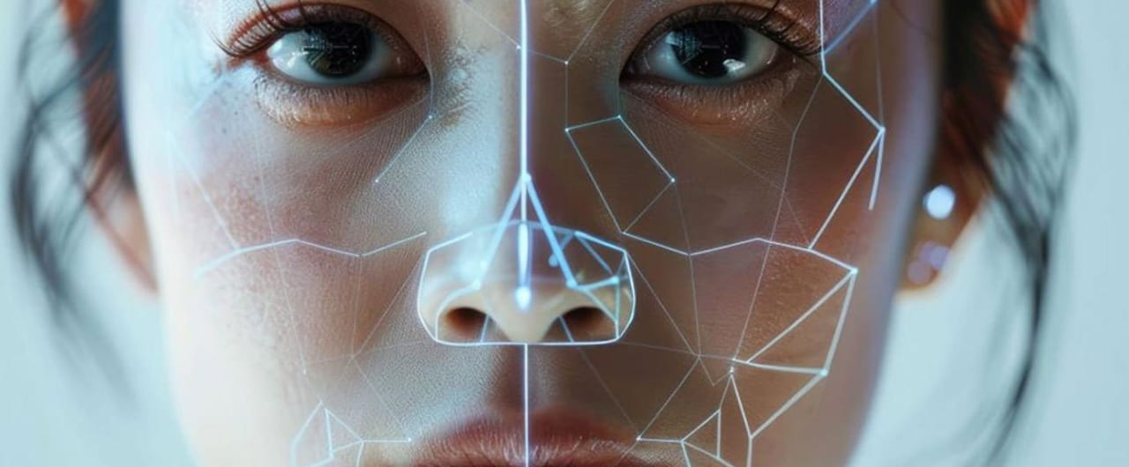
वै
मा
नि
का:
A
E
R
O
F
E
S
T
2
K
2
5
AIM & OBJECTIVE
Aim:
To develop an AI-powered system that can accurately detect deepfake videos and prevent their misuse in fraud, fake news, and cybercrime.
Objectives:
Identify fake videos by analyzing face movements, lip-sync, and textures.
Use deep learning models (CNN, EfficientNetB4) for accurate detection.
Ensure real-time processing for quick and effective detection.
Improve detection accuracy by training on large datasets.
Develop a user-friendly tool that can be used by social media platforms, journalists, and law enforcement.
AERONAUTICAL ENGINEERING DEPARTMENT, PCE

Slide 3
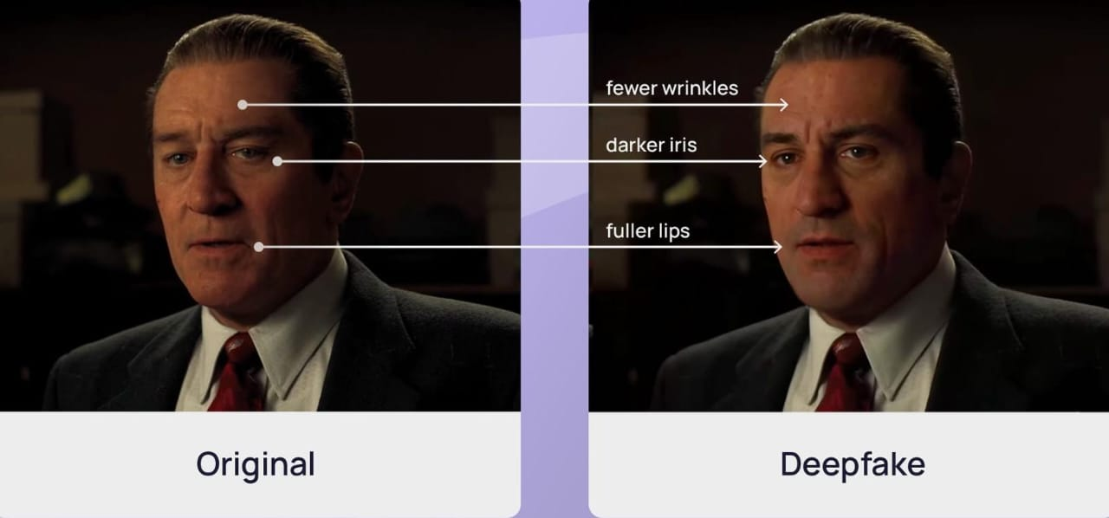
वै
मा
नि
का:
A
E
R
O
F
E
S
T
2
K
2
5
Introduction
What are Deepfakes ?
Deepfakes are essentially manipulated media, most often videos or audio recordings, that use artificial intelligence (AI) to replace one person's likeness with that of another convincingly.
Deepfakes rely heavily on "deep learning," a subset of AI, particularly techniques like Generative Adversarial Networks (GANs).
These algorithms analyze vast amounts of data (images, videos, audio) to learn a person's features and then use that knowledge to create realistic forgeries.
AERONAUTICAL ENGINEERING DEPARTMENT, PCE

Slide 4
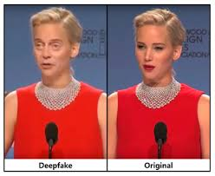
वै
मा
नि
का:
A
E
R
O
F
E
S
T
2
K
2
5
Problem Statement: Detecting Deepfake Media Using AI
Solution – AI-Based Deepfake Detection
We developed an AI model that can:
✔ Analyze faces in videos to find unnatural features.
✔ Check for mismatched lip movements and voice sync issues.
✔ Detect tiny inconsistencies in skin, lighting, and expressions.
✔ Learn from new deepfakes to improve over time.
Goal: Build a detection system that is accurate, fast, and
works in real-world situations.
AERONAUTICAL ENGINEERING DEPARTMENT, PCE

Slide 5
वै
मा
नि
का:
A
E
R
O
F
E
S
T
2
K
2
5
Methodology
Image Input
The user uploads an image file via a web interface.
Image Preprocessing
The image is loaded, resampled, and transformed using the Tensorflow library for analysis.
Feature Extraction
Key image EfficientNetAutoAttB4ST are extracted to represent the image and video signal.
Dataset Comparison
The extracted features are compared with a predefined dataset of real and fake images using Euclidean distance.
Classification
Based on the closest match in the dataset, the image is classified as real or fake with a confidence probability.
Result Display
The classification result and confidence level are displayed to the user.
AERONAUTICAL ENGINEERING DEPARTMENT, PCE

Slide 6
वै
मा
नि
का:
A
E
R
O
F
E
S
T
2
K
2
5
Result
Deepfake detection is improving, but some very advanced deepfakes are still hard to catch.
Scientists are working on better AI models that can detect deepfakes more accurately.
Many researchers are using different neural networks to improve deepfake detection.
There is a need for easy-to-use tools so that everyone can check if a video is real or fake.
AERONAUTICAL ENGINEERING DEPARTMENT, PCE

Slide 7
वै
मा
नि
का:
A
E
R
O
F
E
S
T
2
K
2
5
Conclusion
Deepfake videos are a growing problem, and detecting them is challenging.
AI-powered models can help identify fake videos with high accuracy.
Our approach using CNNs and EfficientNetB4 improves detection performance.
Detection is improving, but deepfakes are also getting better, so research must continue.
Future Goal: Develop faster, more reliable, and user-friendly detection tools for everyone.
AERONAUTICAL ENGINEERING DEPARTMENT, PCE

Slide 8
वै
मा
नि
का:
A
E
R
O
F
E
S
T
2
K
2
5
Algorithms
1) Convolutional Neural Networks (CNNs):
CNNs are used to extract spatial features from images.
They can detect pixel-level inconsistencies, artifacts, and unnatural textures in deepfake images.
Models like EfficientNet, ResNet, and Xception are commonly used for deepfake image classification.
CNNs help identify manipulated facial features, lighting inconsistencies, and compression artifacts.
2) Recurrent Neural Networks (RNNs) – LSTM:
  RNNs, specifically LSTMs, are used for temporal analysis in deepfake videos.
  They analyze frame-by-frame inconsistencies, such as unnatural facial expressions and lip-sync errors.
  LSTMs capture sequential dependencies and detect anomalies in motion patterns.
  They enhance deepfake detection by learning temporal patterns across multiple frames.
AERONAUTICAL ENGINEERING DEPARTMENT, PCE

Slide 9
वै
मा
नि
का:
A
E
R
O
F
E
S
T
2
K
2
5
Reference
Detection: A Literature Review Sayed Shifa Mohd Imran1, Dr. Pallavi Devendra Tawde2 1Student, Department of MSc.IT, Nagindas Khandwala College, Mumbai, Maharashtra, India 2Assistant Professor, Nagindas Khandwala College, Mumbai, Maharashtra, India. Click
Explainable Deepfake Detection Using Deep Learning by Shahzaib Khan DS-072/2020-21 Supervised by Dr. Najeed Ahmed Khan click
Deep fake Detection using Deep Learning Prof. Aparna Bagde1 , Sakshi Fand2 , Kanchan Varma2 , Aditya Gawali2 Dept. of Computer Engineering Professor, Computer Engineering, NBNSTIC, Pune, Maharashtra, India Student, Computer Engineering, NBNSTIC, Pune, Maharashtra, India click
A Survey on Attacks and Their Countermeasures in Deep Learning: Applications in Deep Neural Networks, Federated, Transfer, and Deep Reinforcement Learning click
Deep Learning-Based Assessment Model for Real-Time Identification of Visual Learners Using Raw EEG click
M. Zoller, J. Thies, P. Garrido, D. Bradley, T. Beeler, P. Prez, M. Stamm Inger, M. Niner, and C. Theobald, “State of the art onmonocular 3d face reconstruction, tracking, and applications,” Computer Graphics Forum, vol. 37, pp. 523–550, 2018.
J. Thies, M. Zoll Hofer, M. Stamm Inger, C. Theobald, and M. Neuner, “Face2face: Real-time face capture and reenactment ofgrub videos,” in Proceedings of the IEEE conference on computer vision and pattern recognition, 2016, pp. 2387–2395.
J. Thies, M. Solnhofen, and M. Neuner, “Deferred neural rendering: Image synthesis using neural textures,” ACM Transactionson Graphics (TOG), vol. 38, no. 4, pp. 1–12, 2019.
“Deepfakes GitHub,https://github.com/deepfakes/faceswap.
“Faceswap,” https://github.com/MarekKowalski/FaceSwap/.
AERONAUTICAL ENGINEERING DEPARTMENT, PCE

Slide 10
VAIMANIKA AEROFEST 2K25
THANK YOU
AERONAUTICAL ENGINEERING DEPARTMENT, PCE

