Slide 1
Healthcare Insurance Big Data Analytics Platform End-to-End Data Engineering Capstone PROJECT using AWS S3, PySpark, PyCharm, Amazon Redshift, GitHub, Jira
Prepared By : Keshab Rai
Date : June, 2026

Slide 2
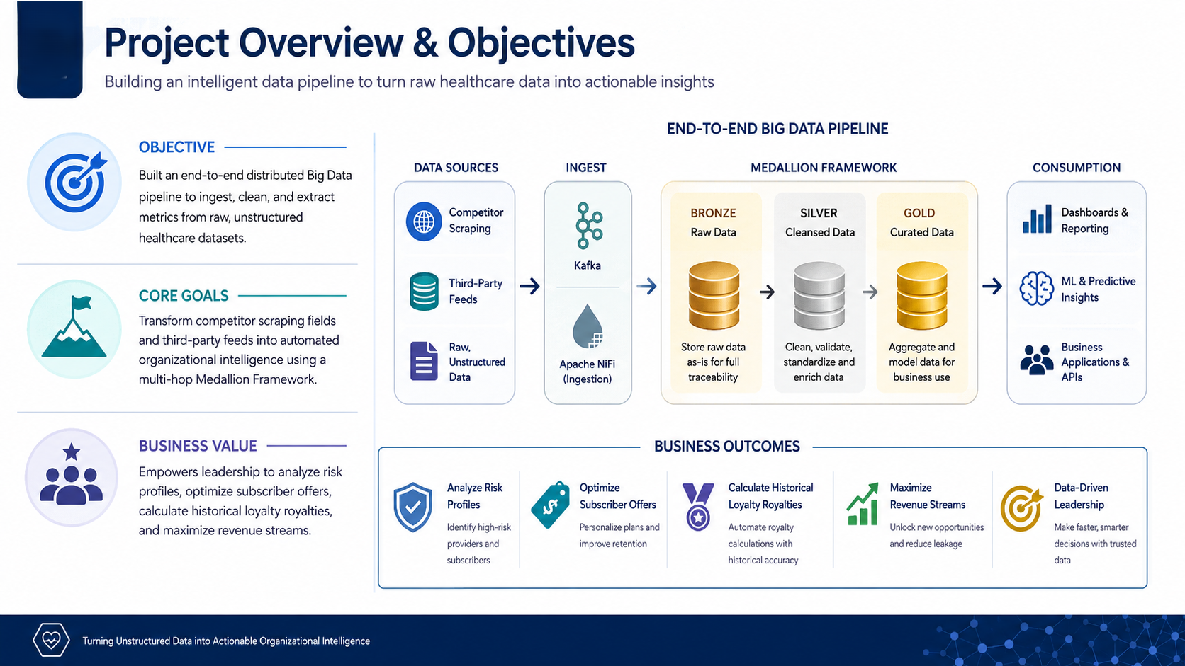
Project Overview & Objectives

Slide 3
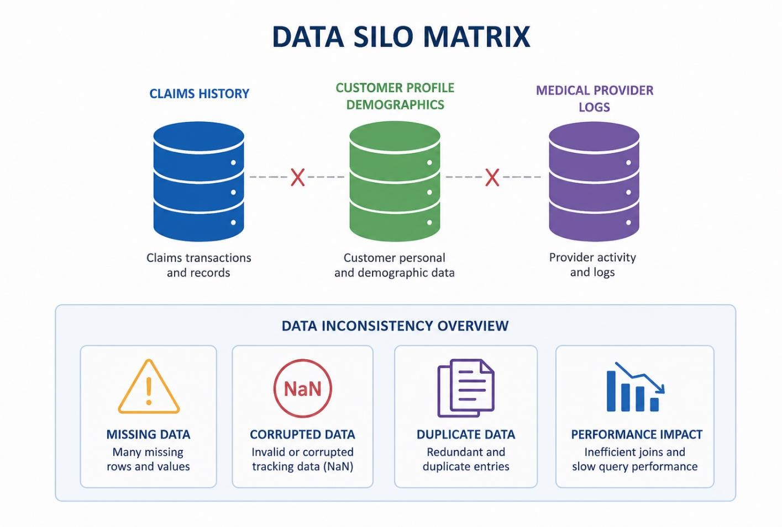
The Business Challenge
Data Silos: Claims histories, customer profile
demographics, and medical provider logs were
disconnected and isolated.
Data Quality Anomalies: High volume of missing
rows, corrupted tracking data (NaN), and redundant
duplicate entries.
Performance Bottlenecks: Traditional row-based
database engines failed to run complex multi-table
analytical joins efficiently over large transaction
data volumes.

Slide 4
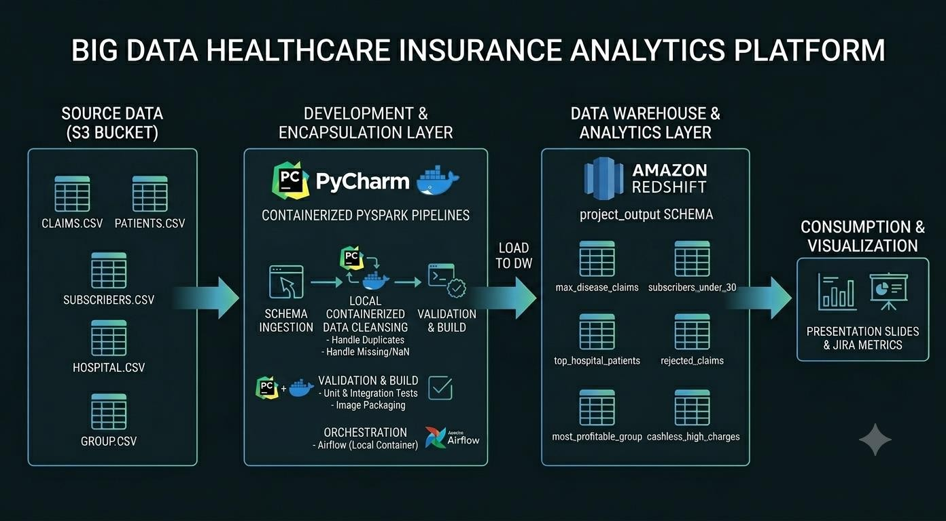
Decoupled Cloud Architecture Diagram & Medallion Layers
Bronze Layer (Landing Zone): Raw source files are
uploaded directly to AWS S3 into an immutable
`input-data` bucket.
Silver Layer (Processing & Enrichment): PySpark
applications were developed in PyCharm and executed
inside Docker-based Spark containers to perform
schema validation, null value handling, duplicate
removal, data standardization and data quality checks
before producing clean datasets for the Gold layer.
Gold Layer (Warehouse Analytics): High-performance,
clean tables are persisted into target Redshift
serverless analytical schemas (`project_output`).

Slide 5
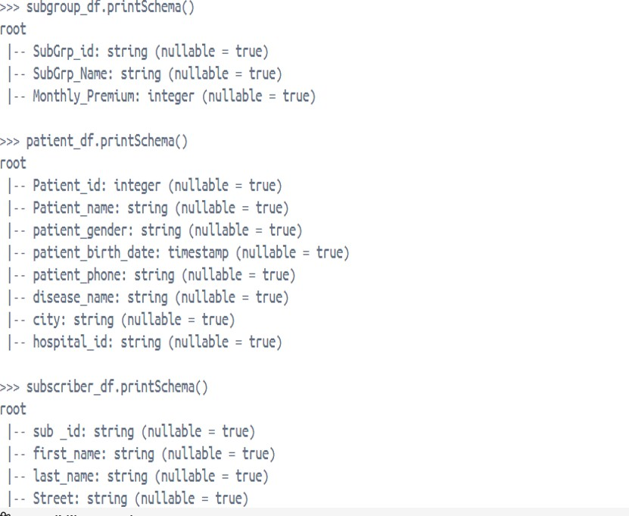
Dataset Description
Patients Dataset: Contains patient tracking details, gender
fields, birth dates, diagnoses, and hospital admission logs.
Subscriber Table: Master profile data tracking age
structures, locations, and linked subgroups.
Claims Log: Transaction ledger tracking claim codes,
amounts, and resolution status (Approved/Rejected/Pending).
Group & Subgroup Profiles: Financial structural logs
tracking written policy premiums and monthly rates.

Slide 6
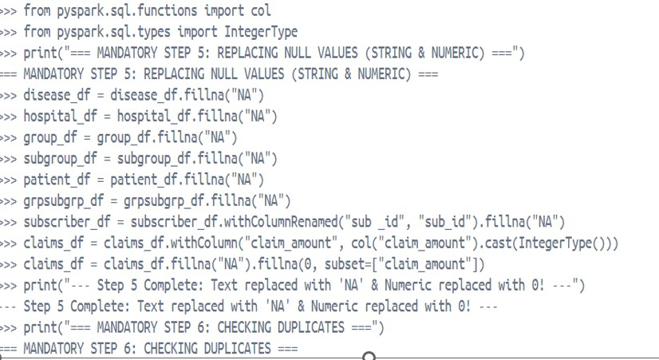
Data Cleaning & Transformation Process
Null Values Audit: Distributed scans implemented via
PySpark to systematically count missing records across all
columns.
Standardization & Imputation: Missing fields and corrupted
values replaced uniformly with standard strings or 'NA' markers.
Deduplication Layer: Row-level evaluation using Spark’s
`.dropDuplicates()` to remove identical redundant transaction
rows.
Data Type Formatting: Forcing correct timestamp types on
birth dates and mapping decimal numeric values onto claim
fields.

Slide 7
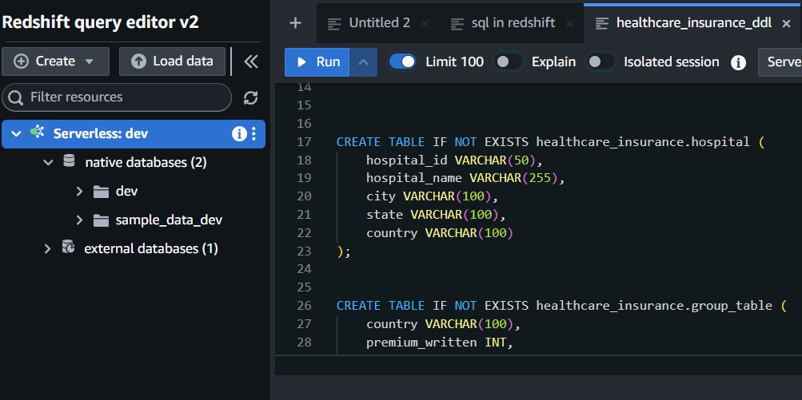
AWS Redshift Target Database Design
Dedicated Target Environment: Formatted inside a
structured schema designated as`project_output`.
Relational Key Constraints: Strict enforcement of
explicit Primary Key (PK) and Foreign Key (FK)
combinations to secure structural mapping rules.
Optimal Storage Optimization: Structured staging tables
stored using clean column- oriented storage parameters
for lightning-fast querying.

Slide 8
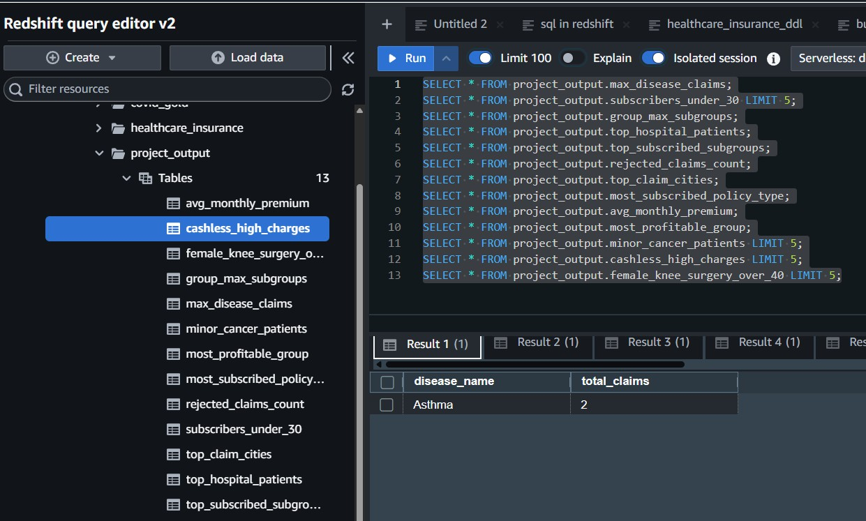
Analytical Use Cases & Insights (13 Use Cases)
High-Cost Disease Tracking: Pinpointed maximum claim
frequencies (e.g., Asthma).
Demographic Risks: Grouping subscribers under age 30
subscribing to subgroups.
Structural Architecture: Mapping which macro group
contains the maximum subgroup
density.
Medical Provider Volume: Identifying top hospitals
serving most patients (e.g., Manipal
Hospitals).
Operational Profitability: Identifying the single most profit
able insurance group category (Profit: 4458).

Slide 9
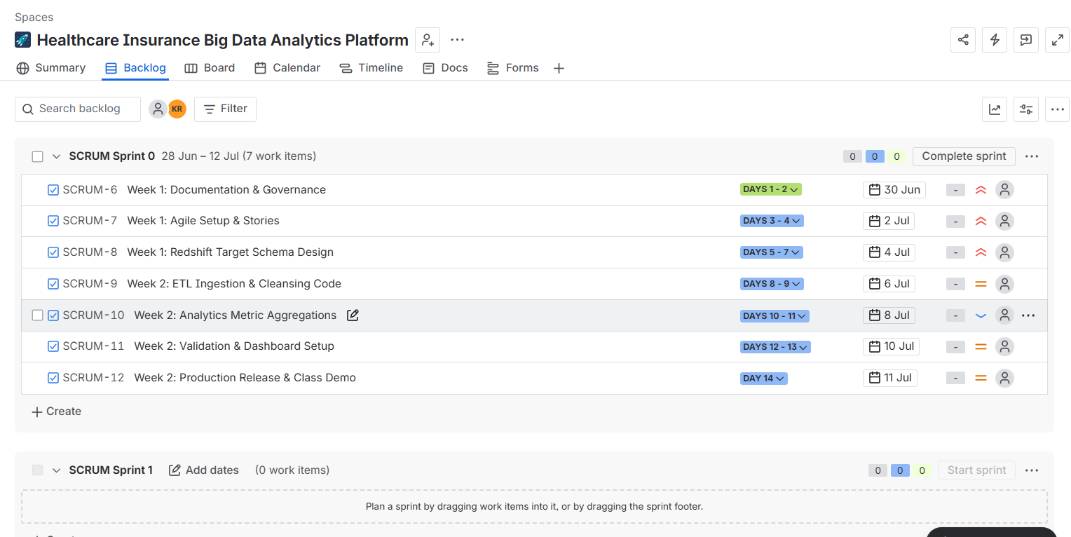
Project Management & Version Control
Jira Agile Framework: Project planned using an explicit
2-week, 14-day Scrum sprint timeline.
Sprint Partitioning: Week 1 dedicated to requirements
baselines & solution design; Week 2 dedicated to
implementation and cloud testing.
Version Control Strategy: Local development organized
inside PyCharm using isolated git tracking before syncing
with remote repositories.

Slide 10
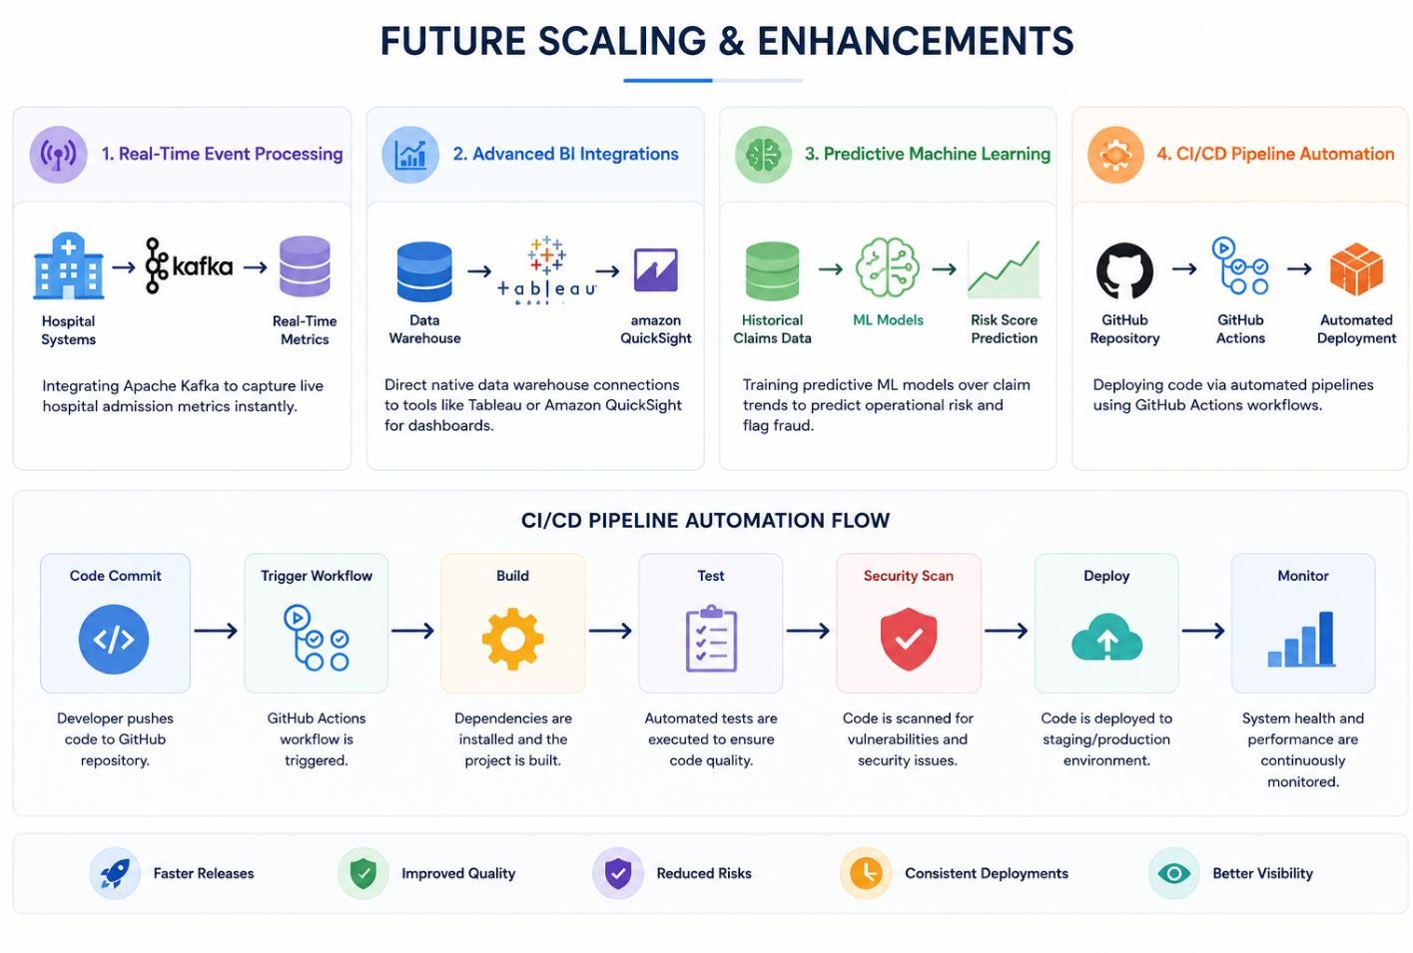
Future Scaling & Enhancements
Real-Time Event Processing: Integrating Apache Kafka
to capture live hospital admission metrics instantly.
Advanced BI Integrations: Direct native data warehouse
connections to tools like Tableau or Amazon QuickSight
for dashboards.
Predictive Machine Learning: Training predictive ML
models over claim trends to predict operational risk and
flag fraud.
CI/CD Pipeline Automation: Deploying code via
automated pipelines using GitHub Actions workflows.

Slide 11
Conclusion
Overall :This project demonstrates practical skills in designing scalable cloud-based ETL pipelines using AWS services, PySpark and Amazon Redshift
Successful Delivery: Built a robust, containerized end-to-end Big Data pipeline for the healthcare insurance sector.
Actionable Insights: Fragmented raw files were transformed into centralized, high-value cloud business models.
Measurable Business Impact: Provides full auditing clarity, empowering immediate strategy modifications to enhance company revenue

