Slide 1
Design

Slide 2
Software Design
Design activity begins with a set of requirements, and maybe an architecture
Design done before the system is implemented
Design focuses on module view – i.e. what modules should be in the system
Module view may have easy or complex relationship with the C&C view
Design of a system is a blue print for implementation
Often has two levels – high level (modules are defined), and detailed design (logic specified)

Slide 3
Design…
Design is a creative activity
Goal: to create a plan to satisfy requirements
Perhaps the most critical activity during system development
Design determines the major characteristics of a system
Has great impact on testing and maintenance
Design document forms reference for later phases
Design methodology – systematic approach for creating a design

Slide 4
Design Concepts
Design is correct, if it will satisfy all the requirements and is consistent with architecture
Of the correct designs, we want best design
We focus on modularity as the main criteria (besides correctness)

Slide 5
Modularity
Modular system – in which modules can be built separately and changes in one have minimum impact on others
Modularity supports independence of models
Modularity enhances design clarity, eases implementation
Reduces cost of testing, debugging and maintenance
Cannot simply chop a program into modules to get modularly
Need some criteria for decomposition – coupling and cohesion are such criteria

Slide 6
Coupling
Independent modules: if one can function completely without the presence of other
Independence between modules is desirable
  Modules can be modified separately
  Can be implemented and tested separately
  Programming cost decreases
In a system all modules cannot be independent
Modules must cooperate with each other
More connections between modules
  More dependent they are
  More knowledge about one module is required to understand the other module.
Coupling captures the notion of dependence

Slide 7
Coupling…
Coupling between modules is the strength of interconnections between modules
In general, the more we must know about module A in order to understand module B the more closely connected is A to B
"Highly coupled" modules are joined by strong interconnection
"Loosely coupled" modules have weak interconnections

Slide 8
Coupling…
Goal: modules as loosely coupled as possible
Where possible, have independent modules
Coupling is decided during high level design
Cannot be reduced during implementation
Coupling is inter-module concept
Major factors influencing coupling
  Type of connection between modules
  Complexity of the interface
  Type of information flow between modules

Slide 9
Coupling – Type of connection
Complexity and obscurity of interfaces increase coupling
Minimize the number of interfaces per module
Minimize the complexity of each interface
Coupling is minimized if
  Only defined entry of a module is used by others
  Information is passed exclusively through parameters
Coupling increases if
  Indirect and obscure interface are used
  Internals of a module are directly used
  Shared variables employed for communication

Slide 10
Coupling – interface complexity
Coupling increases with complexity of interfaces eg. number and complexity of parms
Interfaces are needed to support required communication
Often more than needed is used eg. passing entire record when only a field is needed
Keep the interface of a module as simple as possible

Slide 11
Coupling – Type of Info flow
Coupling depends on type of information flow
Two kinds of information: data or control.
Transfer of control information
  Action of module depends on the information
  Makes modules more difficult to understand
Transfer of data information
  Module can be treated as input-output function
Lowest coupling: interfaces with only data communication
Highest: hybrid interfaces

Slide 12
Coupling - Summary
Coupling Interface Type of Type of
complexity connections commu-
nication
Low Simple to module data
obvious by name
High complicated to internal Hybrid
obscure elements

Slide 13
Coupling in OO Systems
In OO systems, basic modules are classes, which are richer than fns
OO Systems have three types of coupling
  Interaction coupling
  Component coupling
  Inheritance coupling

Slide 14
Coupling in OO - Interaction
Interaction coupling occurs due to methods of a class invoking methods of other classes
  Like calling of functions
  Worst form if methods directly access internal parts of other methods
  Still bad if methods directly manipulate variables of other classes
  Passing info through tmp vars is also bad

Slide 15
Coupling in OO …
Least interaction coupling if methods communicate directly with parameters
  With least number of parameters
  With least amount of info being passed
  With only data being passed
I.e. methods should pass the least amount of data, with least no of parms

Slide 16
Coupling in OO - Component
Component coupling – when a class A has variables of another class C
  A has instance vars of C
  A has some parms of type C
  A has a method with a local var of type C
When A is coupled with C, it is coupled with all subclasses of C as well
Component coupling will generally imply the presence of interaction coupling also

Slide 17
Coupling in OO - Inheritance
Inheritance coupling – two classes are coupled if one is a subclass of other
Worst form – when subclass modifies a signature of a method or deletes a method
Coupling is bad even when same signature but a changed implementation
Least, when subclass only adds instance vars and methods but does not modify any

Slide 18
Cohesion
Coupling characterized the inter-module bond
Reduced by minimizing relationship between elts of different modules
Another method of achieving this is by maximizing relationship between elts of same module
Cohesion considers this relationship
Interested in determining how closely the elements of a module are related to each other
In practice both are used

Slide 19
Cohesion…
Cohesion of a module represents how tightly bound are the elements of the module
Gives a handle about whether the different elements of a module belong together
High cohesion is the goal
Cohesion and coupling are interrelated
Greater cohesion of modules, lower coupling between module
Correlation is not perfect.

Slide 20
Levels of Cohesion
There are many levels of cohesion.
  Coincidental
  Logical
  Temporal
  Communicational
  Sequential
  Functional
Coincidental is lowest, functional is highest
Scale is not linear
Functional is considered very strong

Slide 21
Determining Cohesion
Describe the purpose of a module in a sentence
Perform the following tests
  1. If the sentence has to be a compound sentence, contains more than one verbs, the module is probably performing more than one function. Probably has sequential or communicational cohesion.
  2. If the sentence contains words relating to time, like "first", "next", "after", "start" etc., the module probably has sequential or temporal cohesion.

Slide 22
3. If the predicate of the sentence does not contain a single specific object following the verb, the module is probably logically cohesive. Eg "edit all data", while "edit source data" may have functional cohesion.
4. Words like "initialize", "clean-up" often imply temporal cohesion.
Functionally cohesive module can always be described by a simple statement

Slide 23
Cohesion in OO Systems
In OO, different types of cohesion is possible as classes are the modules
  Method cohesion
  Class cohesion
  Inheritance cohesion
Method cohesion – why diff code elts are together in a method
  Like cohesion in functional modules; highest form is if each method implements a clearly defined function with all elts contributing to implementing this function

Slide 24
Cohesion in OO…
Class cohesion – why diff attributes and methods are together in a class
  A class should represent a single concept with all elts contributing towards it
  Whenever multiple concepts encapsulated, cohesion is not as high
  A symptom of multiple concepts – diff gps of methods accessing diff subsets of attributes

Slide 25
Cohesion in OO…
Inheritance cohesion – focuses on why classes are together in a hierarchy
  Two reasons for subclassing – generalization-specialization and reuse
  Cohesion is higher if the hierarchy is for providing generalization-specialization

Slide 26
Open-closed Principle
Besides cohesion and coupling, open closed principle also helps in achieving modularity
Principle: A module should be open for extension but closed for modification
  Behavior can be extended to accommodate new requirements, but existing code is not modified
  I.e. allows addition of code, but not modification of existing code
  Minimizes risk of having existing functionality stop working due to changes – a very important consideration while changing code
  Good for programmers as they like writing new code

Slide 27
Open-closed Principle…
In OO this principle is satisfied by using inheritance and polymorphism
Inheritance allows creating a new class to extend behavior without changing the original class
This can be used to support the open-closed principle
Consider example of a client object which interacts with a printer object for printing

Slide 28
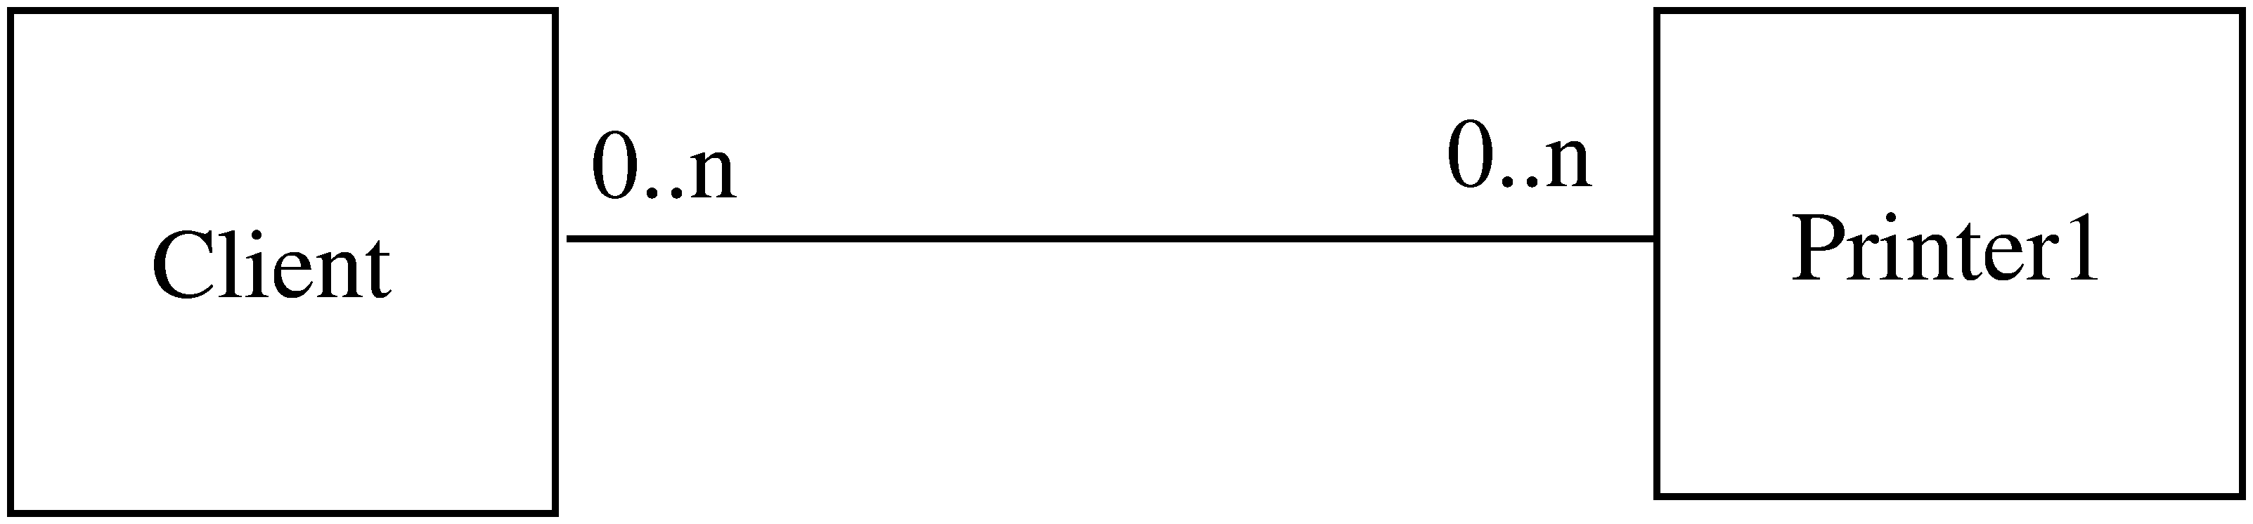
Example

Slide 29
Example..
Client directly calls methods on Printer1
If another printer is to be allowed
  A new class Printer2 will be created
  But the client will have to be changed if it wants to use Printer 2
Alternative approach
  Have Printer1 a subclass of a general Printer
  For modification, add another subclass Printer 2
  Client does not need to be changed

Slide 30
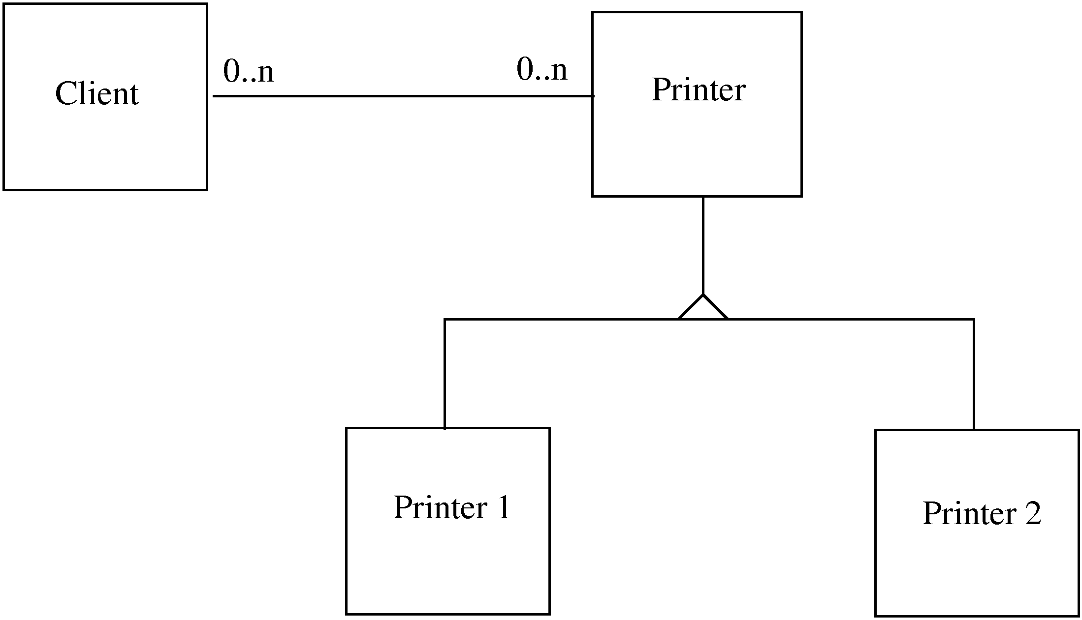
Example…

Slide 31
Liskov’s Substitution Principle
Principle: Program using object o1 of base class C should remain unchanged if o1 is replaced by an object of a subclass of C
If hierarchies follow this principle, the open-closed principle gets supported

Slide 32
Summary
Goal of designing is to find the best possible correct design
Modularity is the criteria for deciding quality of the design
Modularity enhanced by low coupling, high cohesion, and following open-closed principle

Slide 33
Function Oriented Design and Structured Design Methodology

Slide 34
Program Structure and Structure Charts
Every program has a structure
Structure Chart - graphic representation of structure
SC represents modules and interconnections
Each module is represented by a box
If A invokes B, an arrow is drawn from A to B
Arrows are labeled by data items
Different types of modules in a SC
Input, output, transform and coordinate modules
A module may be a composite

Slide 35
Structure charts…
SC shows the static structure, not the logic
Different from flow charts
Major decisions and loops can be shown
Structure is decided during design
Implementation does not change structure
Structure effects maintainability
SDM aims to control the structure

Slide 36
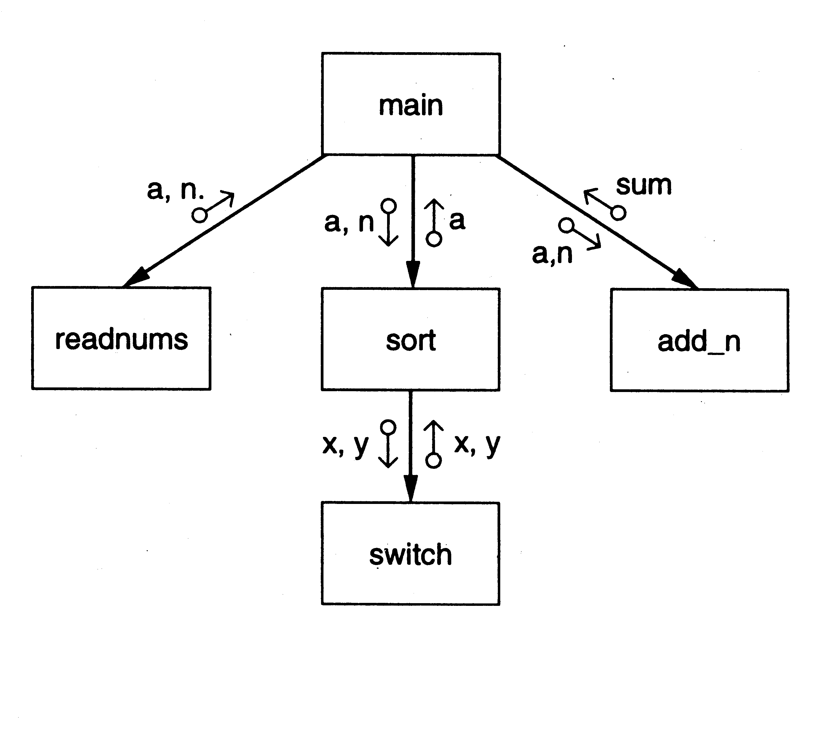
SC of a Sort Program

Slide 37
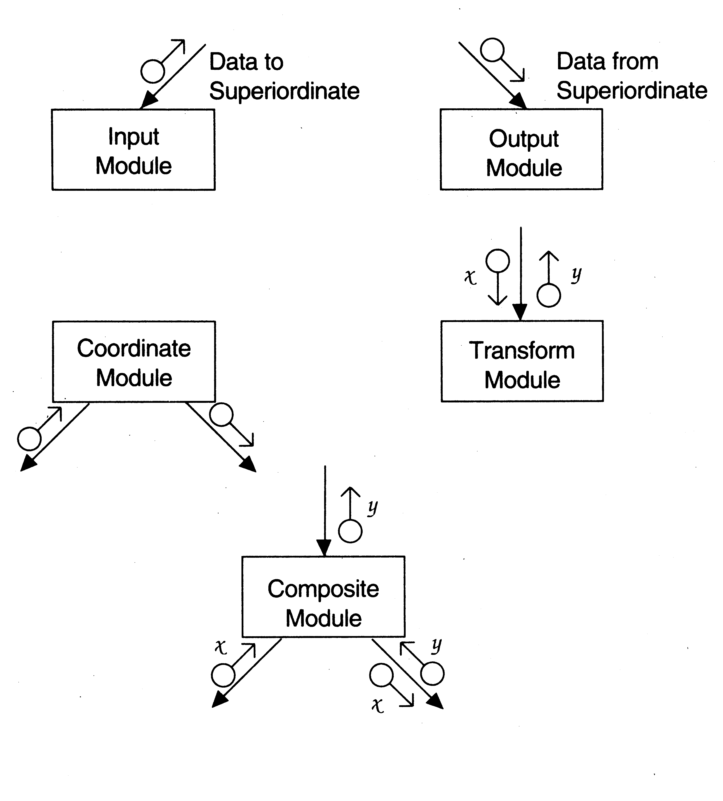
Diff types of modules

Slide 38
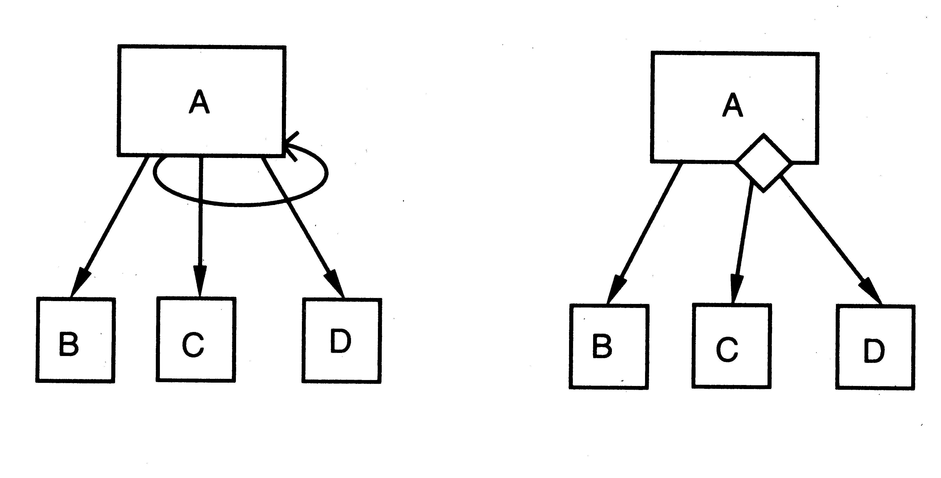
Iteration and decision

Slide 39
STRUCTURED DESIGN METHODOLOGY
SDM views software as a transformation function that converts given inputs to desired outputs
The focus of SD is the transformation function
Uses functional abstraction
Goal of SDM: Specify functional modules and connections
Low coupling and high cohesion is the objective
Transformation
functions
Input
Output

Slide 40
Steps in SD
Draw a DFD of the system
Identify most abstract inputs and most abstract outputs
First level factoring
Factoring of input, output, transform modules
Improving the structure

Slide 41
1. Data Flow Diagrams
SD starts with a DFD to capture flow of data in the proposed system
DFD is an important representation; provides a high level view of the system
Emphasizes the flow of data through the system
Ignores procedural aspects
(Purpose here is different from DFDs used in requirements analysis, thought notation is the same)

Slide 42
Drawing a DFG
Start with identifying the inputs and outputs
Work your way from inputs to outputs, or vice versa
  If stuck, reverse direction
  Ask: "What transformations will convert the inputs to outputs"
Never try to show control logic.
  If thinking about loops, if-then-else, start again
Label each arrow carefully
Make use of * and +, and show sufficient detail
Ignore minor functions in the start
For complex systems, make dfg hierarchical
Never settle for the 1st dfg

Slide 43
Step 2 of SD Methodology
Generally a system performs a basic function
Often cannot be performed on inputs directly
First inputs must be converted into a suitable form
Similarly for outputs - the outputs produced
by main transforms need further processing
Many transforms needed for processing inputs and outputs
Goal of step 2 is to separate such transforms from the basic transform centers

Slide 44
Step 2…
Most abstract inputs: data elements in dfg that are furthest from the actual inputs, but can still be considered as incoming
These are logical data items for the transformation
May have little similarity with actual inputs.
Often data items obtained after error checking, formatting, data validation, conversion etc.

Slide 45
Step 2…
Travel from physical inputs towards outputs until data can no longer be considered incoming
Go as far as possible, without loosing the incoming nature
Similarly for most abstract outputs
Represents a value judgment, but choice is often obvious
Bubbles between mai and mao: central transforms
These transforms perform the basic transformation
With mai and mao the central transforms can concentrate on the transformation

Slide 46
Step 2…
Problem View: Each system does some i/o and some processing
In many systems the i/o processing forms the large part of the code
This approach separates the different functions
  subsystem primarily performing input
  subsystem primarily performing transformations
  subsystem primarily performing output presentation

Slide 47
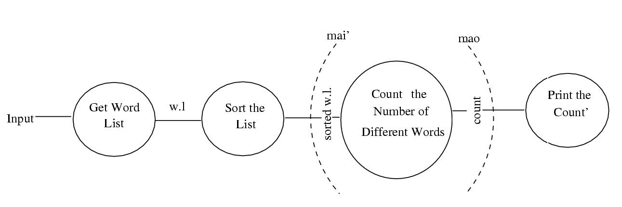
Example 1 – counting the no of different words in a file

Slide 48
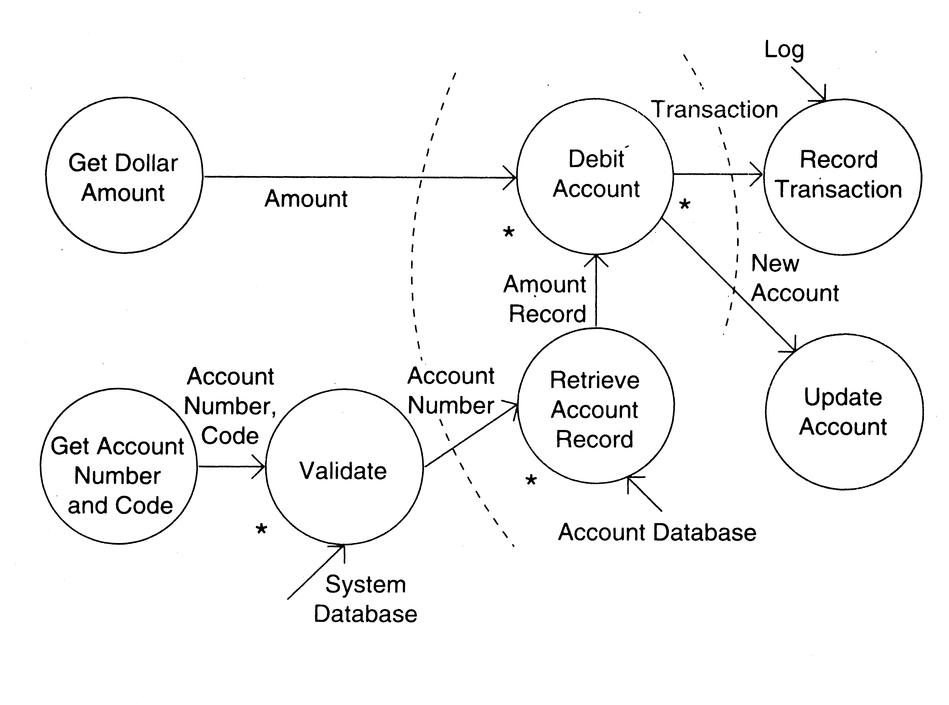
Example 2 – ATM

Slide 49
3. First Level Factoring
First step towards a structure chart
Specify a main module
For each most abstract input data item, specify a subordinate input module
The purpose of these input modules is to deliver to main the mai data items
For each most abstract output data element, specify an output module
For each central transform, specify a subordinate transform module
Inputs and outputs of these transform modules are specified in the DFD

Slide 50
First level factoring is straight forward
Main module is a coordinate module
Some subordinates are responsible for delivering the logical inputs
These are passed to transform modules to get them converted to logical outputs
Output modules then consume them
Divided the problem into three separate problems
Each of the three diff. types of modules can be designed separately
These modules are independent

Slide 51
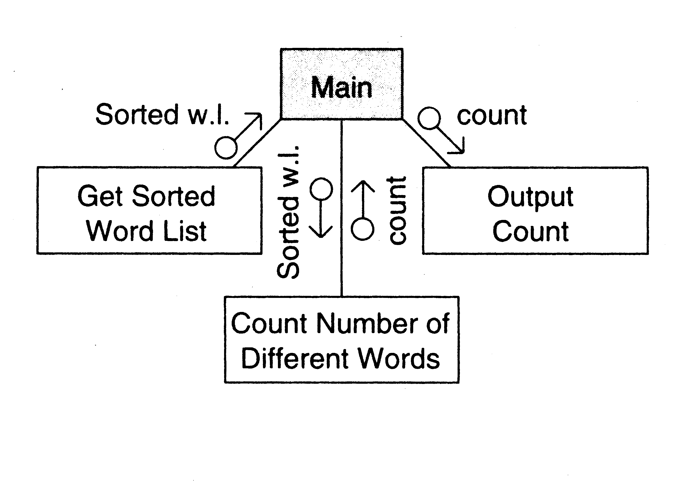
Example 1

Slide 52
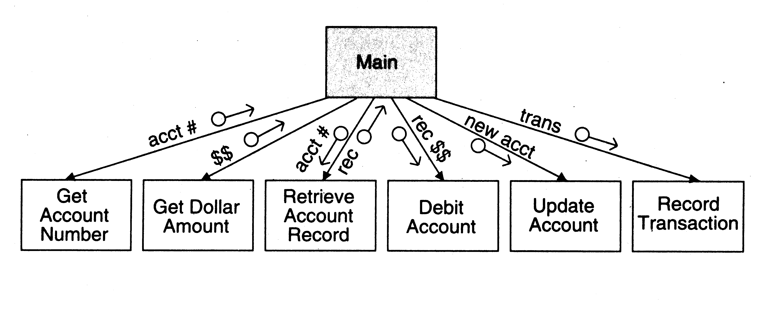
Example 2

Slide 53
4. Factoring Input modules
The transform that produced the mai data is treated as the central transform
Then repeat the process of first level factoring
Input module being factored becomes the main module
A subordinate input module is created for each data item coming in this new central transform
A subordinate module is created for the new central transform
Generally there will be no output modules

Slide 54
The new input modules are factored similarly Till the physical inputs are reached
Factoring of the output modules is symmetrical
Subordinates - a transform and output modules
Usually no input modules

Slide 55
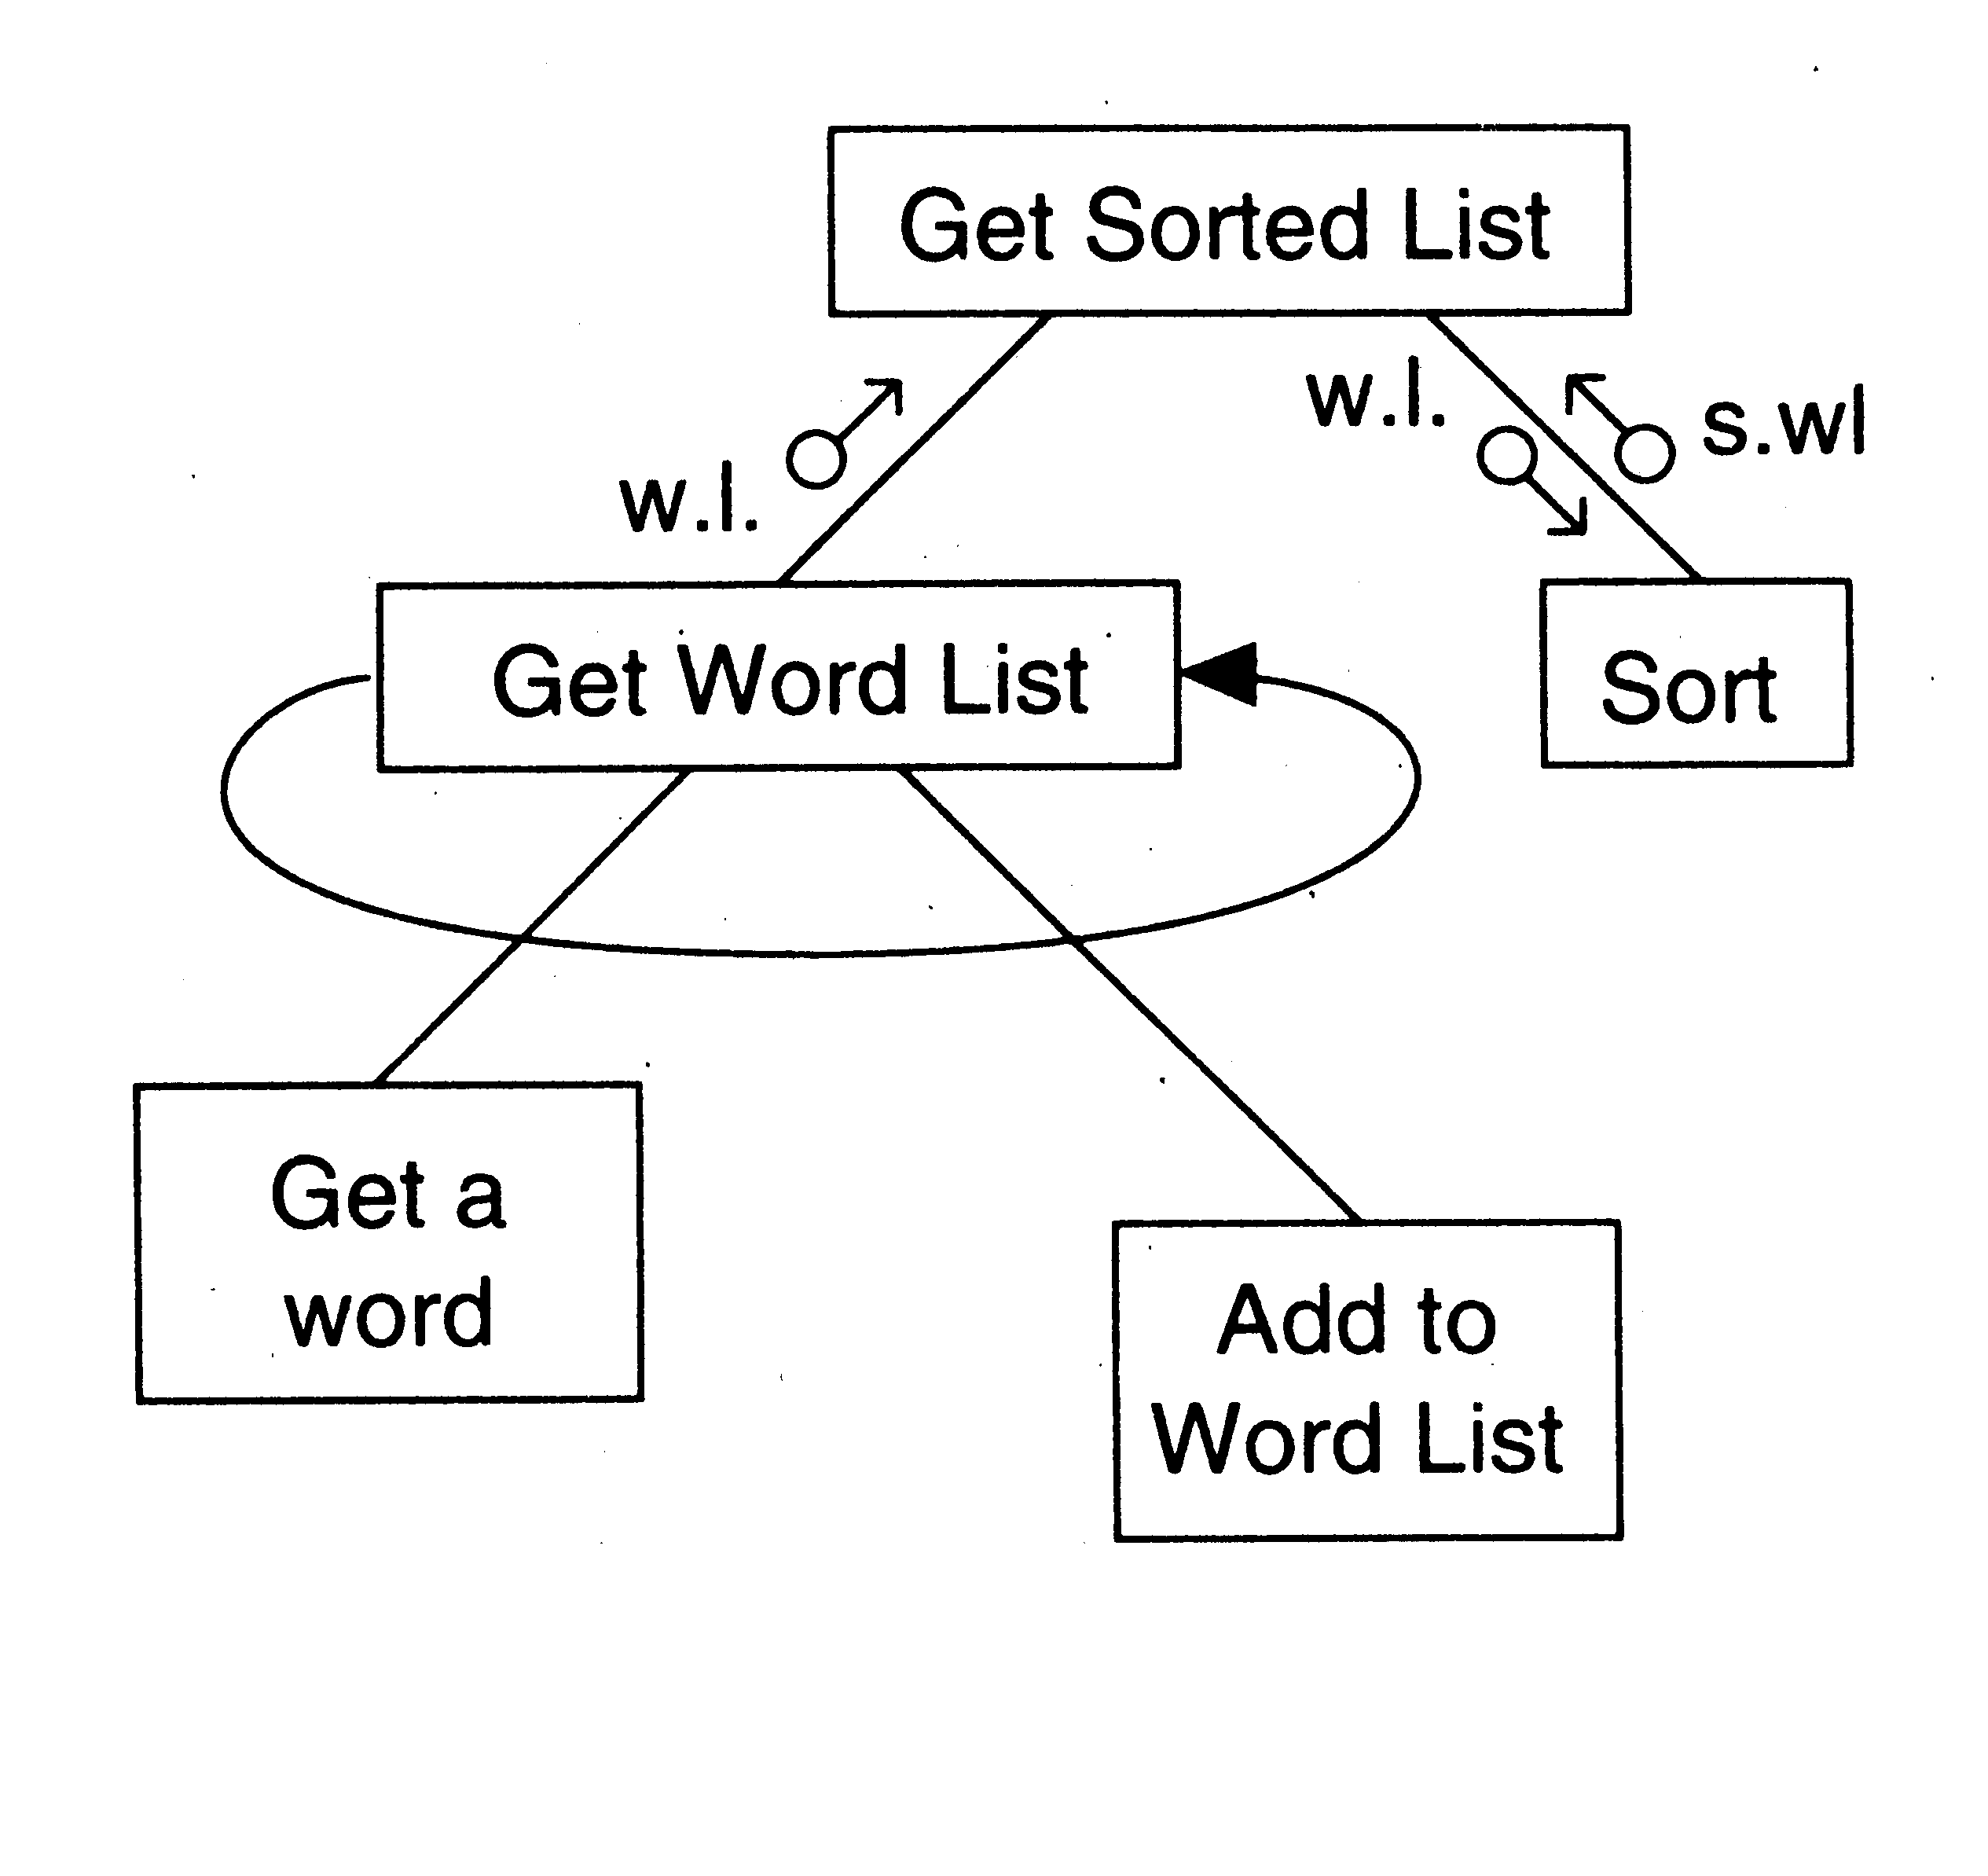
Example 1

Slide 56
Factoring Central Transforms
Factoring i/o modules is straight forward if the DFD is detailed
No rules for factoring the transform modules
Top-down refinement process can be used
Goal: determine sub-transforms that will together compose the transform
Then repeat the process for newly found transforms
Treat the transform as a problem in its own right
Draw a data flow graph
Then repeat the process of factoring
Repeat this till atomic modules are reached

Slide 57
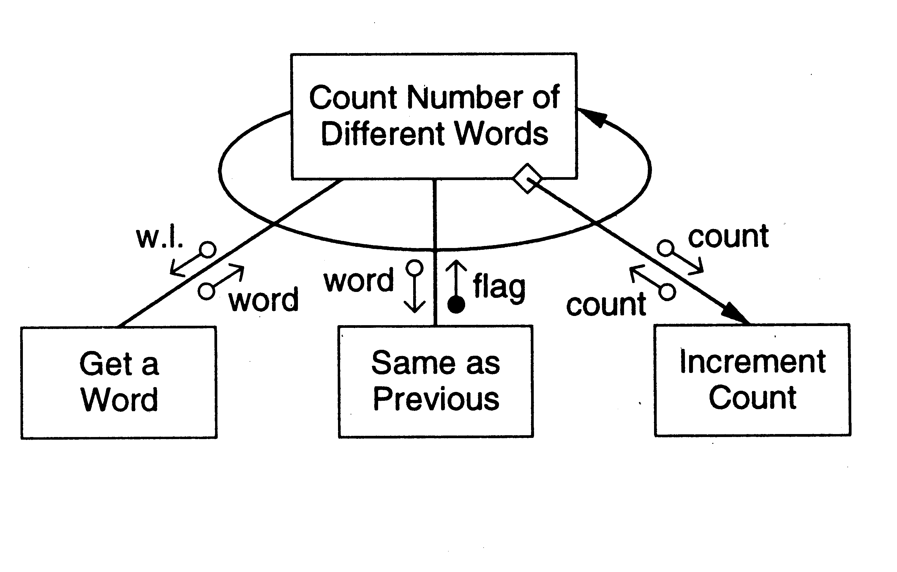
Example 1

Slide 58
5. Improving Design through Heuristics
The above steps should not be followed blindly
The structure obtained should be modified if needed
Low coupling, high cohesion being the goal
Design heuristics used to modify the initial design
Design heuristics - A set of thumb rules that are generally useful
Module Size: Indication of module complexity Carefully examine modules less than a few lines or greater than about 100 lines
Fan out and fan in
A high fan out is not desired, should not be increased beyond 5 or 6
Fan in should be maximized

Slide 59
Scope of effect of a module: the modules affected by a decision inside the module
Scope of control: All subordinates of the module
Good thumb rule:
For each module scope of effect should be a subset of scope of control
Ideally a decision should only effect immediate subordinates
Moving up the decision, moving the module down can be utilized to achieve this

Slide 60
Summary
Structured design methodology is one way to create modular design
It partitions the system into input subsystems, output subsystems & transform subsystems
Idea: Many systems use a lot of code for handling inputs & outputs
SDM separates these concerns
Then each of the subsystems is factored using the DFD
The design is finally documented & verified before proceeding

Slide 61
Object Oriented Design and UML

Slide 62
OO Concepts

Slide 63
OO Concepts
Information hiding – use encapsulation to restrict external visibility
OO encapsulates the data, provides limited access, visibility
Info hiding can be provided without OO – is an old concept

Slide 64
OO Concepts…
State retention – fns, procedures do not retain state; an object is aware of its past and maintains state
Identity – each object can be identified and treated as a distinct entity
Behavior – state and services together define the behavior of an object, or how an object responds

Slide 65
OO Concepts..
Messages – through which a sender obj conveys to a target obj a request
For requesting O1 must have – a handle for O2, name of the op, info on ops that O2 requires
General format O2.method(args)

Slide 66
OO Concepts..
Classes – a class is a stencil from which objects are created; defines the structure and services. A class has
  An interface which defines which parts of an object can be accessed from outside
  Body that implements the operations
  Instance variables to hold object state
Objects and classes are different; class is a type, object is an instance
State and identity is of objects

Slide 67
Relationship among objects
An object has some capability – for other services it interacts with other objects
Some different ways for interaction:
  Supplier object is global to client
  Supplier obj is a parm to some op of the client
  Supplier obj is part of the client obj
  Supplier obj is locally declared in some op
Relationship can be either aggregation (whole-part relationship), or just client server relationship

Slide 68
Inheritance
Inheritance is unique to OO and not there in function-oriented languages/models
Inheritance by class B from class A is the facility by which B implicitly gets the attributes and ops of A as part of itself
Attributes and methods of A are reused by B
When B inherits from A, B is the subclass or derived class and A is the base class or superclass

Slide 69
Inheritance..
A subclass B generally has a derived part (inherited from A) and an incremental part (is new)
Hence, B needs to define only the incremental part
Creates an “is-a” relationship – objects of type B are also objects of type A

Slide 70
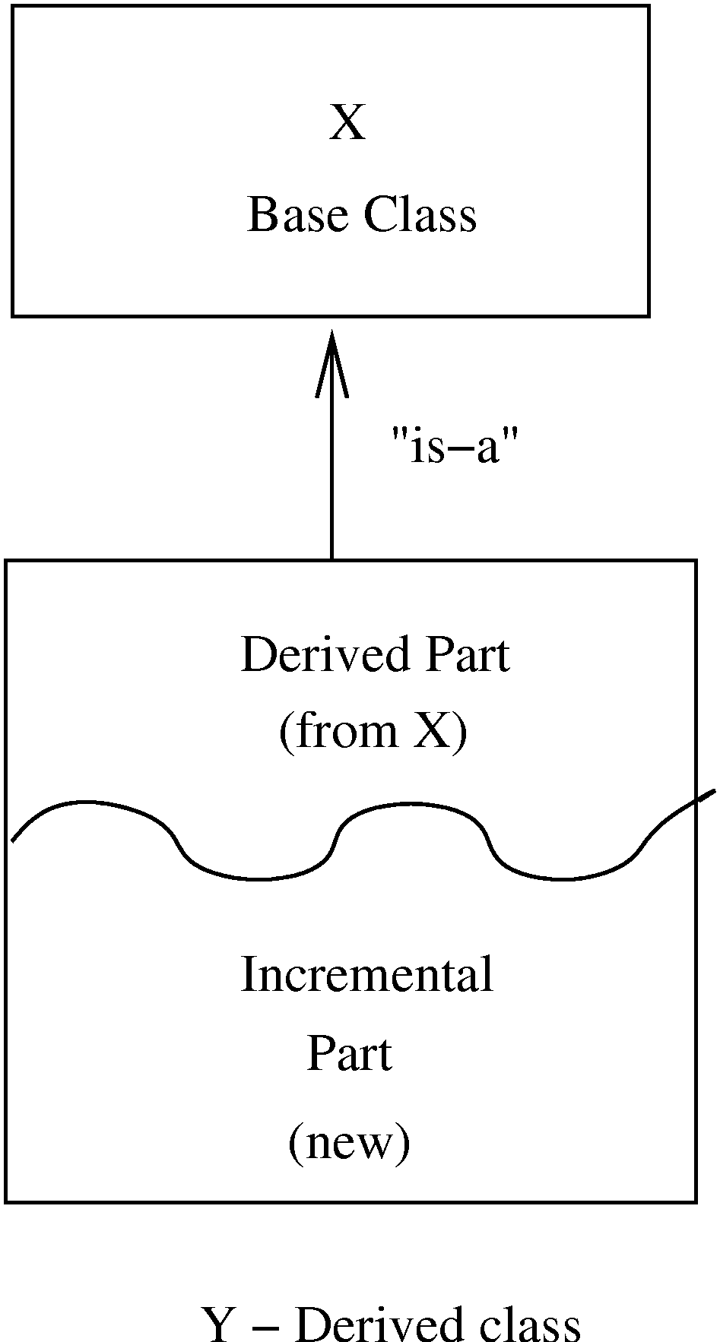
Inheritance…

Slide 71
Inheritance…
The inheritance relationship between classes forms a class hierarchy
In models, hierarchy should represent the natural relationships present in the problem domain
In a hierarchy, all the common features can be accumulated in a superclass
An existing class can be a specialization of an existing general class – is also called generalization-specialization relationships

Slide 72
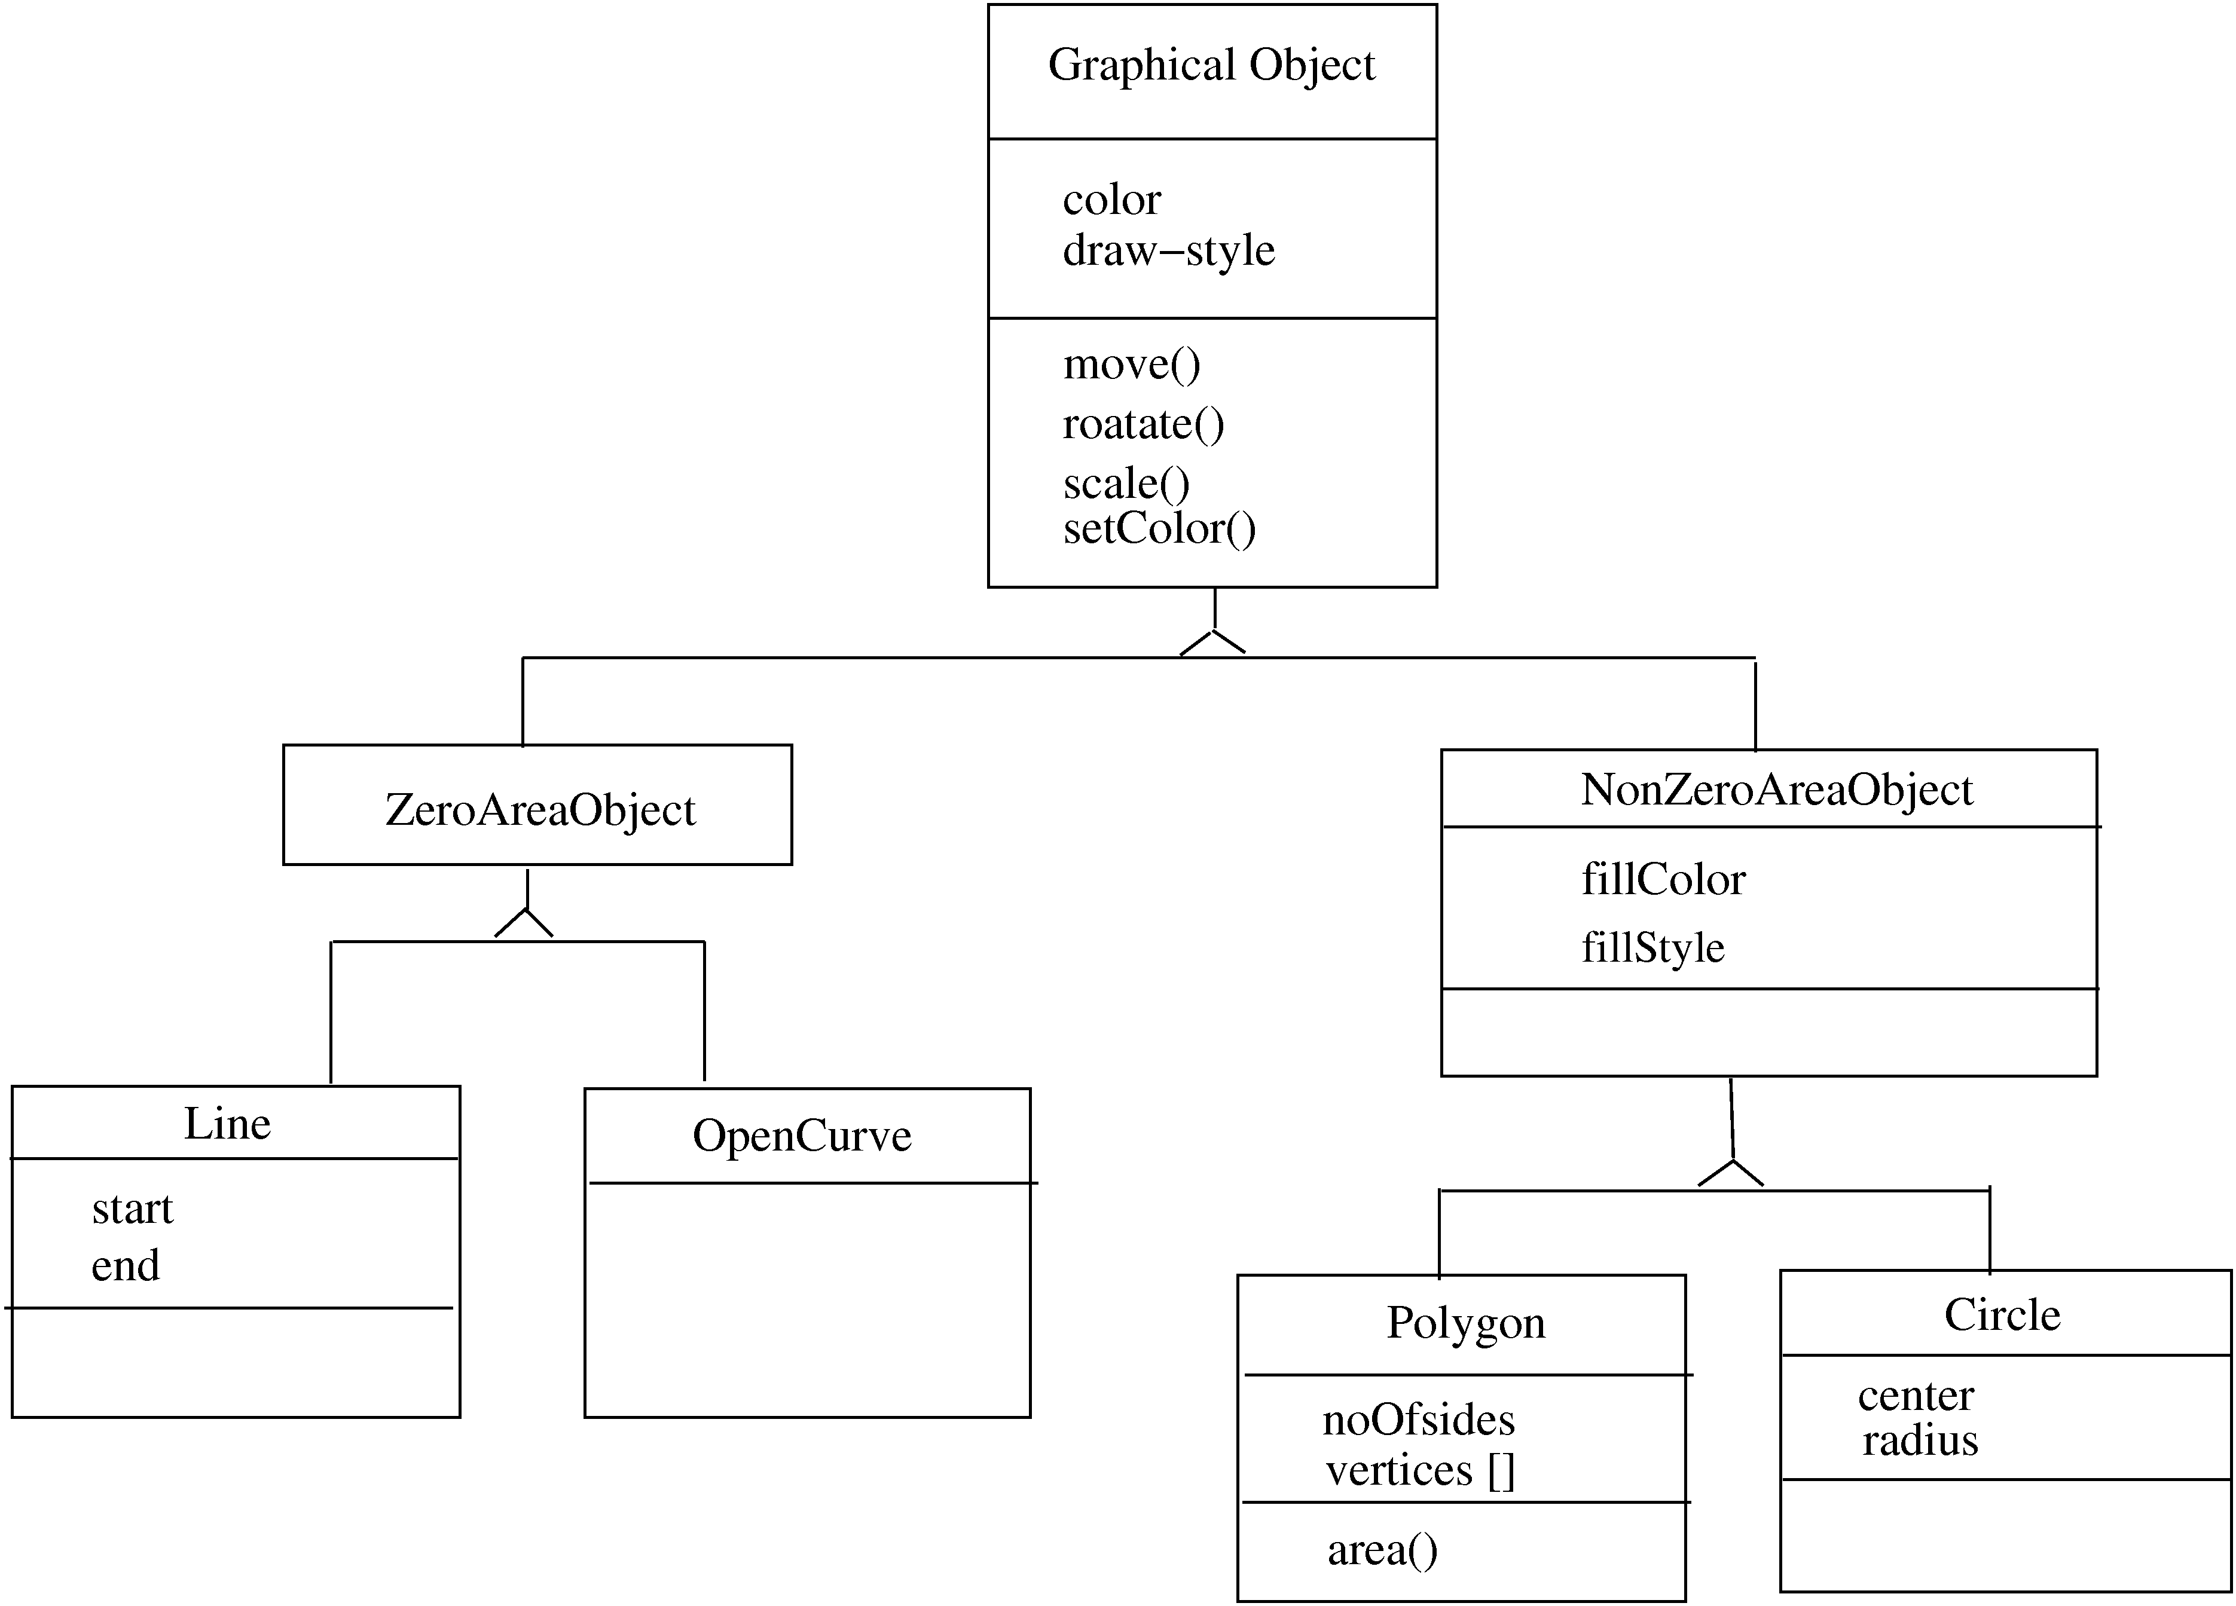

Slide 73
Inheritance…
Strict inheritance – a subclass takes all features of parent class
Only adds features to specialize it
Non-strict: when some of the features have been redefined
Strict inheritance supports “is-a” cleanly and has fewer side effects

Slide 74
Inheritance…
Single inheritance – a subclass inherits from only one superclass
  Class hierarchy is a tree
Multiple inheritance – a class inherits from more than one class
  Can cause runtime conflicts
  Repeated inheritance - a class inherits from a class but from two separate paths

Slide 75
Inheritance and Polymorphism
Inheritance brings polymorphism, i.e. an object can be of different types
An object of type B is also an object of type A
Hence an object has a static type and a dynamic type
  Implications on type checking
  Also brings dynamic binding of operations which allows writing of general code where operations do different things depending on the type

Slide 76
Unified Modeling Language (UML) and Modeling
UML is a graphical notation useful for OO analysis and design
Allows representing various aspects of the system
Various notations are used to build different models for the system
OOAD methodologies use UML to represent the models they create

Slide 77
Modeling
Modeling is used in many disciplines – architecture, aircraft building, …
A model is a simplification of reality
“All models are wrong, some are useful”
A good model includes those elts that have broad effect and omits minor elts
A model of a system is not the system!

Slide 78
Why build models?
Models help us visualize a system
Help specify the system structure
Gives us a template that can guide the construction
Document the decisions taken and their rationale

Slide 79
Modeling
Every complex system requires multiple models, representing diff aspects
These models are related but can be studied in isolation
Eg. Arch view, electrical view, plumbing view of a building
Model can be structural, or behavioral

Slide 80
Views in an UML
A use case view
A design view
A process view
Implementation view
Deployment view
We will focus primarily on models for design – class diagram, interaction diagram, etc.

Slide 81
Class Diagrams
Classes are the basic building blocks of an OO system as classes are the implementation units also
Class diagram is the central piece in an OO design. It specifies
  Classes in the system
  Association between classes
  Subtype, supertype relationship

Slide 82
Class Diagram…
Class itself represented as a box with name, attributes, and methods
There are conventions for naming
If a class is an interface, this can be specified by <<interface>> stereotype
Properties of attr/methods can be specified by tags between { }

Slide 83
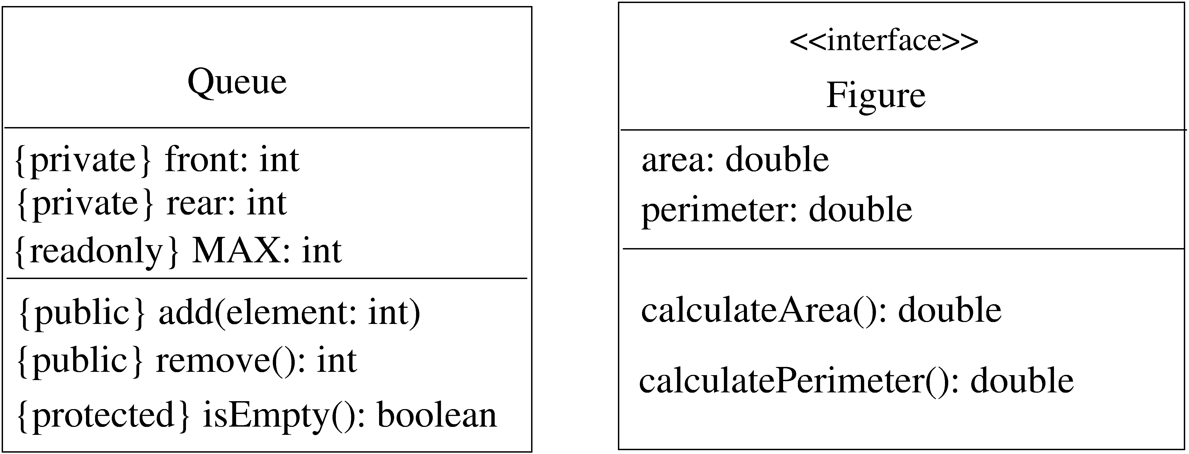
Class – example

Slide 84
Generalization-Specialization
This relationship leads to class hierarchy
Can be captured in a class diagram
  Arrows coming from the subclass to the superclass with head touching super
  Allows multiple subclasses
  If specialization is done on the basis of some discriminator, arrow can be labeled

Slide 85
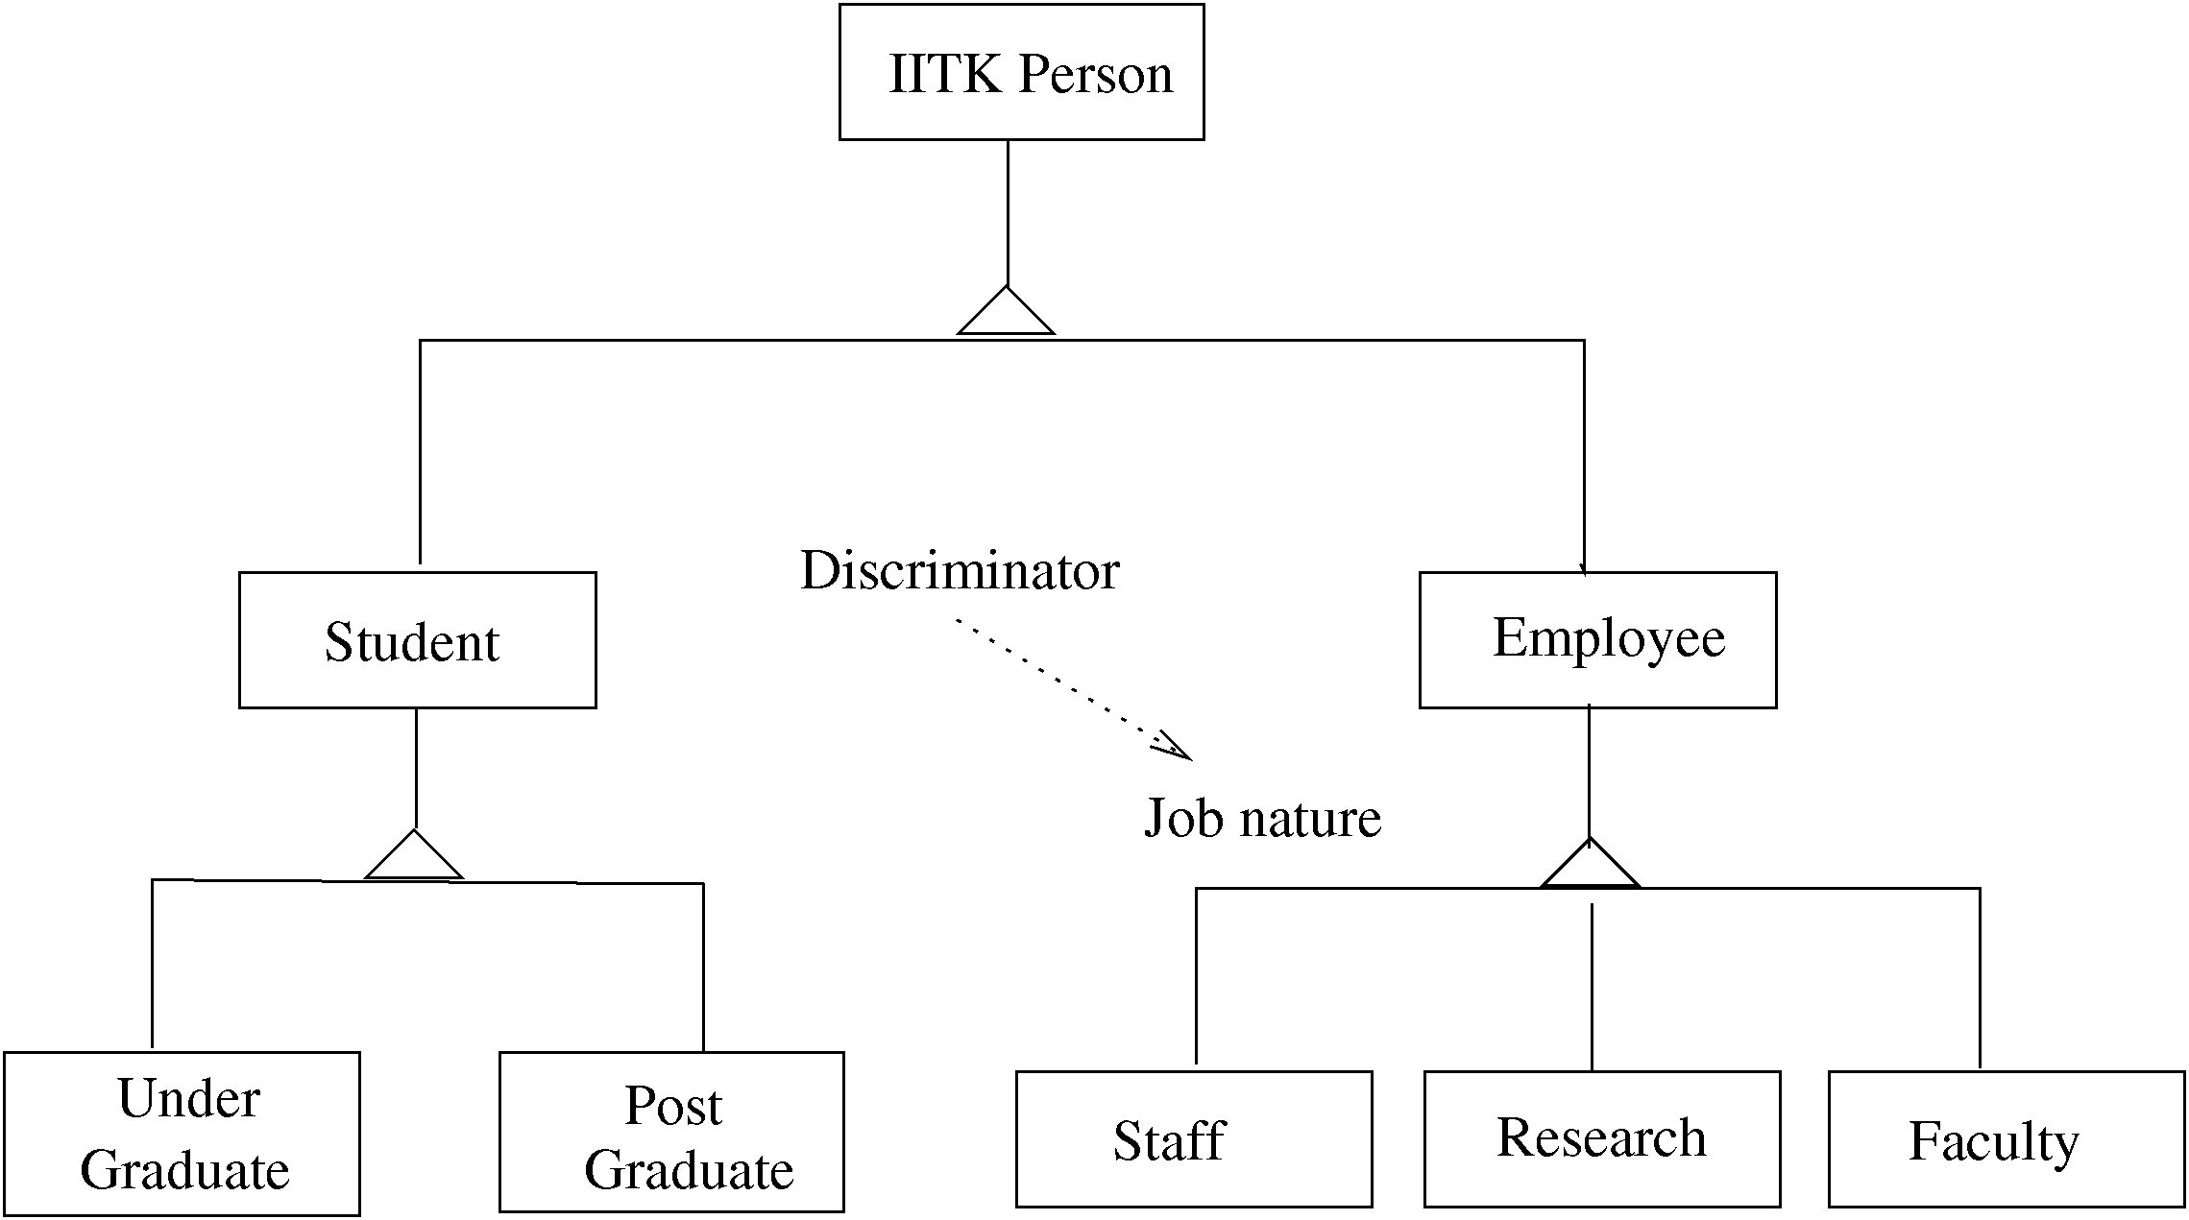
Example – class hierarchy

Slide 86
Association/aggregation
Classes have other relationships
Association: when objects of a class need services from other objects
  Shown by a line joining classes
  Multiplicity can be represented
Aggregation: when an object is composed of other objects
  Captures part-whole relationship
  Shown with a diamond connecting classes

Slide 87
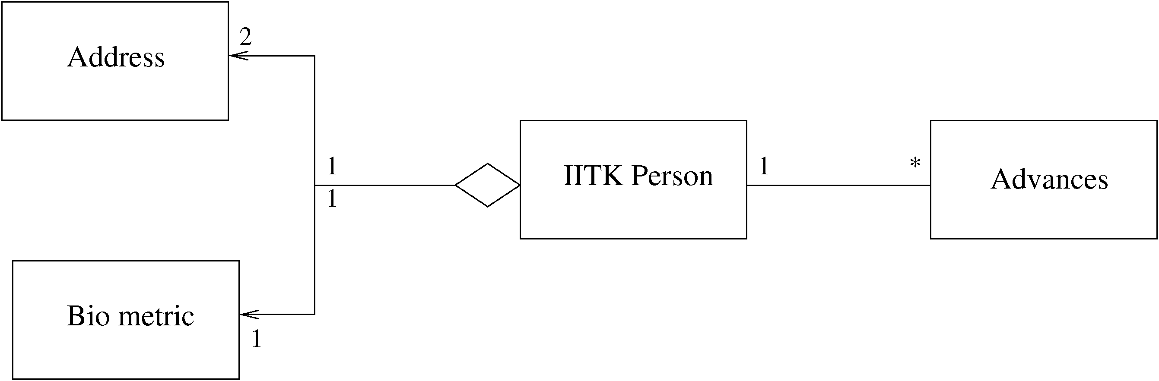
Example – association/aggregation

Slide 88
Interaction Diagrams
Class diagram represent static structure of the system (classes and their rel)
Do not model the behavior of system
Behavioral view – shows how objects interact for performing actions (typically a use case)
Interaction is between objects, not classes
Interaction diagram in two styles
  Collaboration diagram
  Sequence diagram
Two are equivalent in power

Slide 89
Sequence Diagram
Objects participating in an interaction are shown at the top
For each object a vertical bar represents its lifeline
Message from an object to another, represented as a labeled arrow
If message sent under some condition, it can be specified in bracket
Time increases downwards, ordering of events is captured

Slide 90
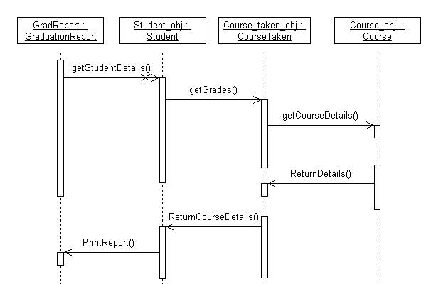
Example – sequence diag.

Slide 91
Collaboration diagram
Also shows how objects interact
Instead of timeline, this diagram looks more like a state diagram
Ordering of messages captured by numbering them
Is equivalent to sequence diagram in modeling power

Slide 92
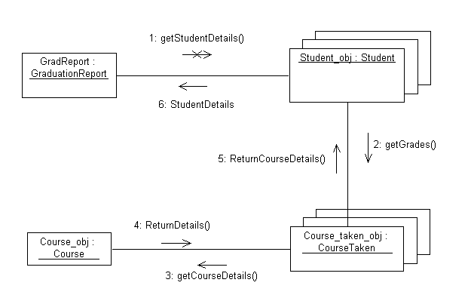
Example – collaboration diag

Slide 93
Other Diagrams
Class diagram and interaction diagrams most commonly used during design
There are other diagrams used to build different types of models

Slide 94
Other Diagrams
Instead of objects/classes, can represent components, packages, subsystems
These are useful for developing architecture structures
UML is extensible – can model a new but similar concept by using stereotypes (by adding <<name>>)
Tagged values can be used to specify additional properties, e.g. private, readonly..
Notes can be added

Slide 95
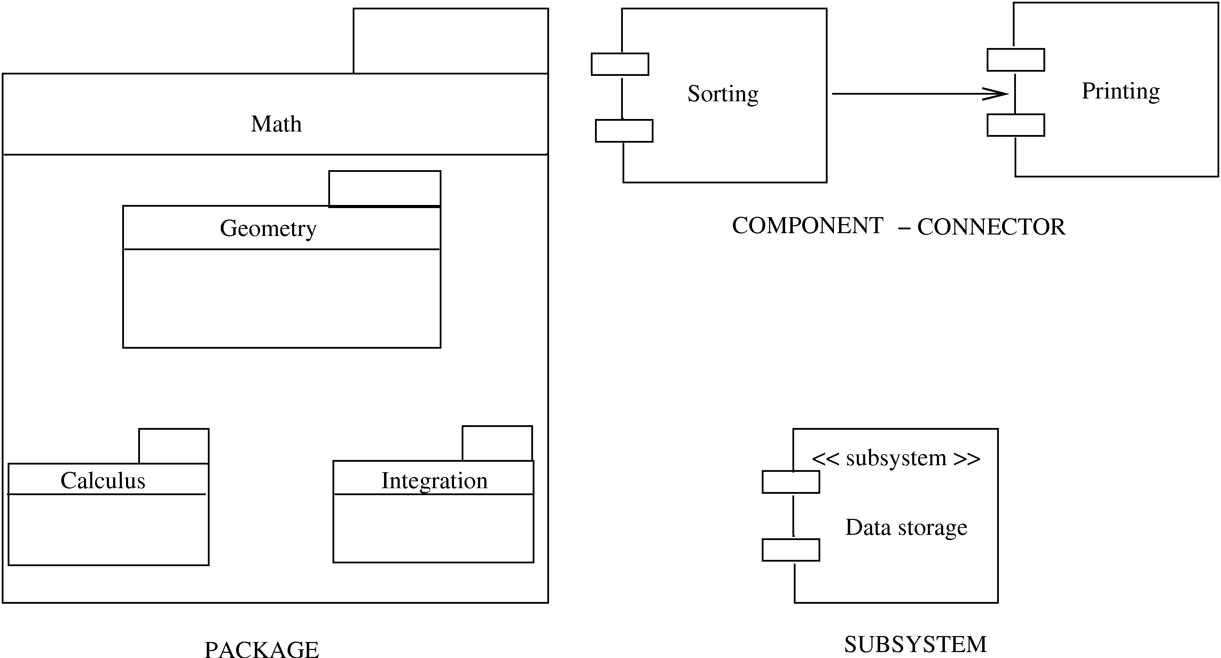
Other symbols

Slide 96
Design using UML
Many OOAD methodologies have been proposed
They provide some guidelines on the steps to be performed
Basic goal is to identify classes, understand their behavior, and relationships
Different UML models are used for this
Often UML is used, methodologies are not followed strictly

Slide 97
Design using UML
Basic steps
  Identify classes, attributes, and operations from use cases
  Define relationships between classes
  Make dynamic models for key use cases and use them to refine class diagrams
  Make a functional model and use it to refine the classes
  Optimize and package
Class diagrams play the central role; class defn gets refined as we proceed

Slide 98
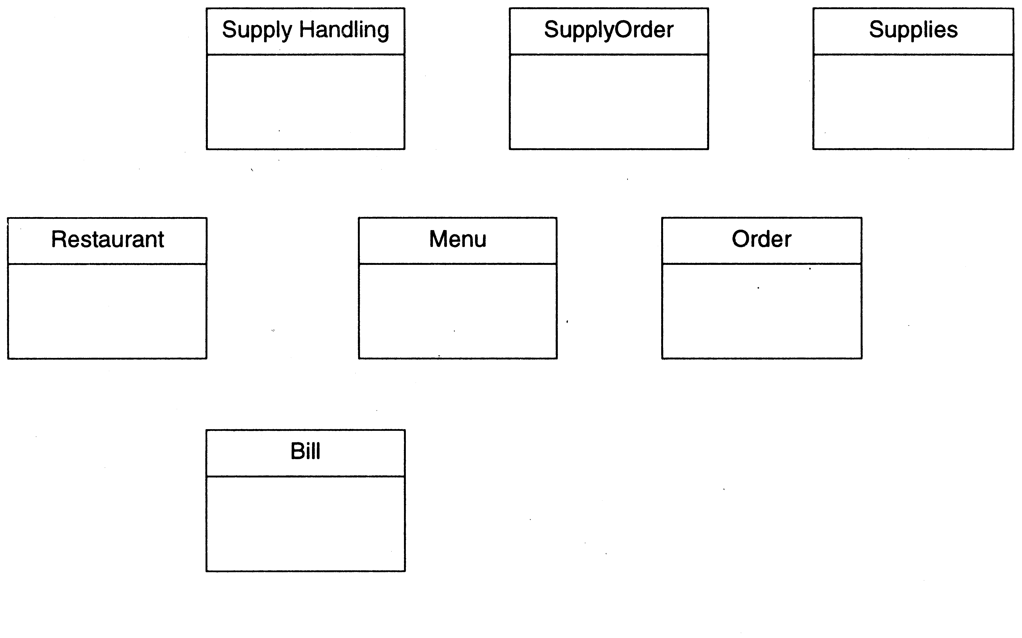
Restaurant example: Initial classes

Slide 99
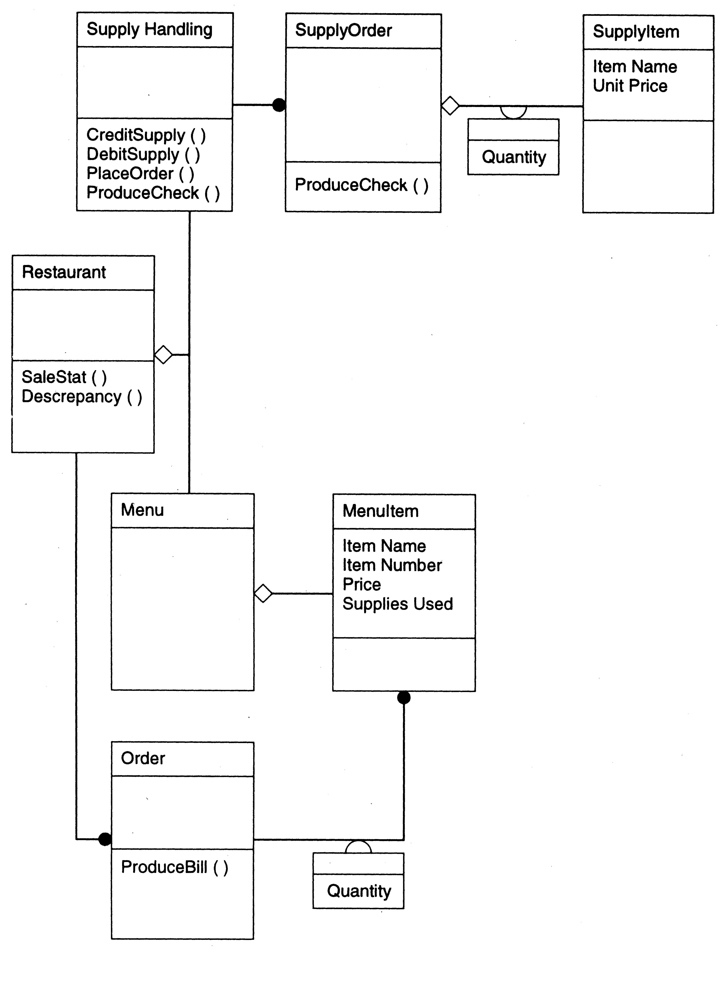

Slide 100
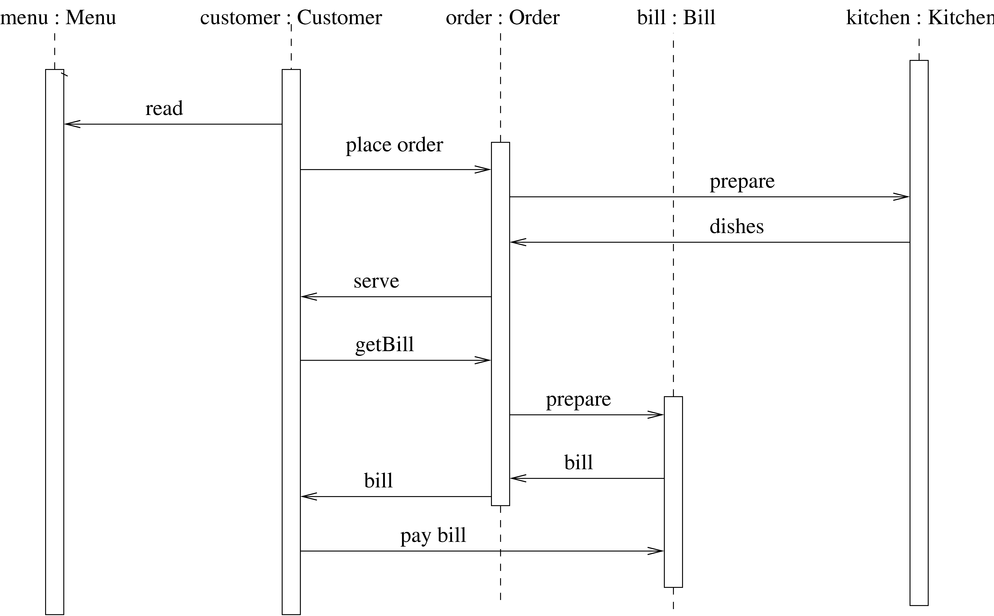
Restaurant example: a seq diag

Slide 101
Detailed Design
HLD does not specify module logic; this is done during detailed design
One way to communicate the logic design: use natural language
Is imprecise and can lead to misunderstanding
Other extreme is to use a formal language
Generally a semi-formal language is used – has formal outer structures but informal inside

Slide 102
Logic/Algorithm Design
Once the functional module (function or methods in a class) are specified, the algo to implement it is designed
Various techniques possible for designing algorithm – in algos course
Stepwise refinements technique is useful here

Slide 103
State Modeling of Classes
Dynamic model to represent behavior of an individual object or a system
Shows the states of an object and transitions between them
Helps understand the object – focus only on the important logical states
State diagrams can be very useful for automated and systematic testing

Slide 104
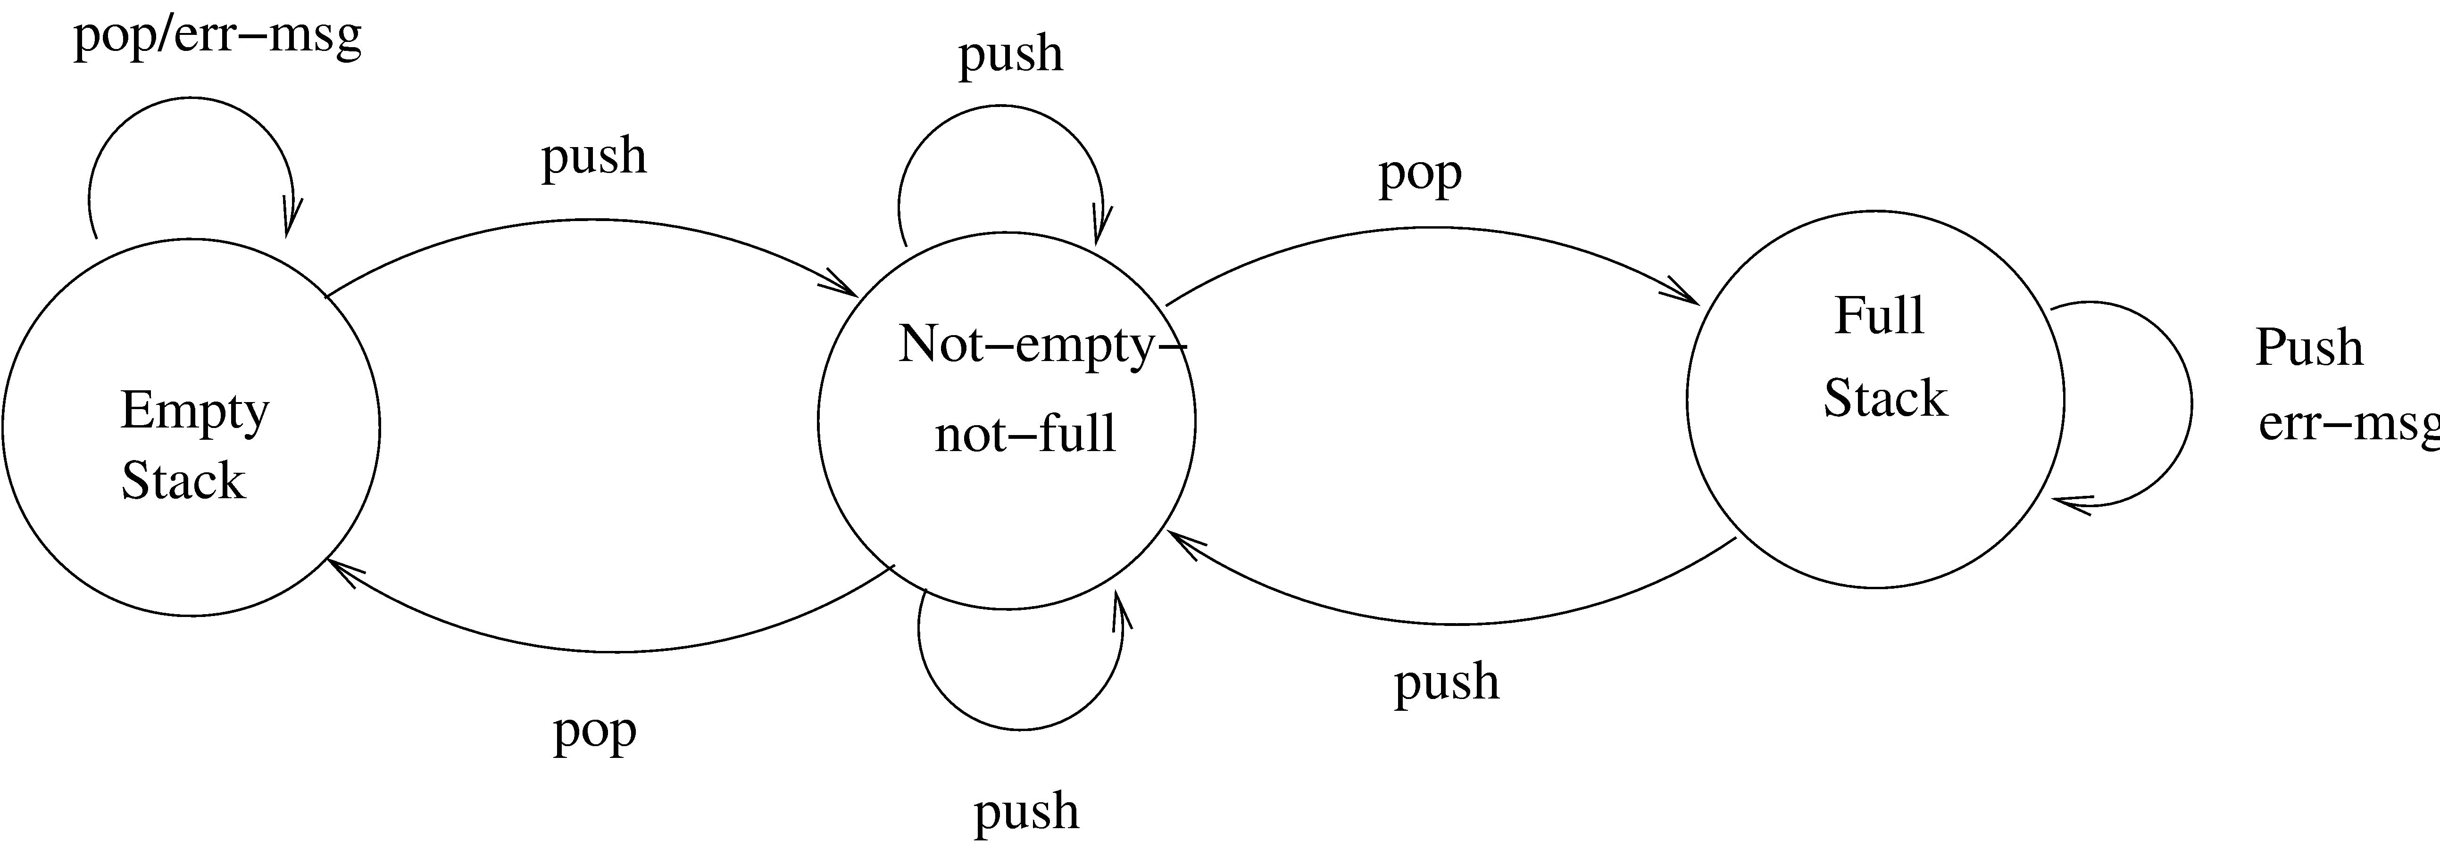
State diagram of a stack

Slide 105
Design Verification
Main objective: does the design implement the requirements
Analysis for performance, efficiency, etc may also be done
If formal languages used for design representation, tools can help
Design reviews remain the most common approach for verification

Slide 106
Metrics

Slide 107
Background
Basic purpose to provide a quantitative evaluation of the design (so the final product can be better)
Size is always a metric – after design it can be more accurately estimated
  Number of modules and estimated size of each is one approach
Complexity is another metric of interest – will discuss a few metrics

Slide 108
Network Metrics
Focus on structure chart; a good SC is considered as one with each module having one caller (reduces coupling)
The more the SC deviates from a tree, the more impure it is
Graph impurity = n – e – 1
n – nodes, e- edges in the graph
Impurity of 0 means tree; as this no increases, the impurity increases

Slide 109
Stability Metrics
Stability tries to capture the impact of a change on the design
Higher the stability, the better it is
Stability of a module – the number of assumptions made by other modules about this module
  Depends on module interface, global data the module uses
  Are known after design

Slide 110
Information Flow Metrics
Complexity of a module is viewed as depending on intra-module complexity
Intramodule estimated by module size and the information flowing
  Size in LOC
  Inflow – info flowing in the module
  Outflow – info flowing out of the module
Dc = size * (inflow * outflow)²

Slide 111
Information flow metrics…
(inflow * outflow) represents total combination of inputs and outputs
Its square reps interconnection between the modules
Size represents the internal complexity of the module
Product represents the total complexity

Slide 112
Identifying error-prone modules
Uses avg complexity of modules and std dev to identify error prone and complex modules:
  Error prone: If Dc > avg complexity + std_dev
  Complex: If avg complexity < Dc < avg + std dev
  Normal: Otherwise

Slide 113
Complexity metrics for OO
Weighted methods per class
  Complexity of a class depends on no of classes and their complexity
  Suppose complexity of methods is c1, c2..; by some functional complexity metric
  WMC = Σ ci
  Large WMC might mean that the class is more fault-prone

Slide 114
OO Metrics…
Depth of Inheritance Tree
  DIT of C is depth from the root class
  Length of the path from root to C
  DIT is significant in predicting fault proneness
Number of Children
  Immediate no of subclasses of C
  Gives a sense of reuse

Slide 115
OO Metrics…
Coupling between classes
  No of classes to which this class is coupled
  Two classes are coupled if methods of one use methods or attr of other
  Can be determined from code
  (There are indirect forms of coupling that cannot be statically determined)

Slide 116
Metrics…
Response for a class
  The total no of methods that can be invoked from this class
  Captures the strength of connections
Lack of cohesion in methods
  Two methods form a cohesive pair if they access some common vars (form a non-cohesive pair if no common var)
  LCOM is the number of method pairs that are non-cohesive – the no of cohesive pairs

Slide 117
Metrics with detailed design
When logic is known, internal complexity metrics can be determined
We will cover all detailed design based metrics along with code metrics

Slide 118
Summary
Design for a system is a plan for a solution – want correct and modular
Cohesion and coupling key concepts to ensure modularity
Structure charts and structured design methodology can be used for function-oriented design
UML can be used for OO design
Various complexity metrics exist to evaluate a design complexity

