Slide 1
50 Ω stranded micro-coax · cryostat wiring
Insertion Loss & Heat-Load Projections
Hard numbers for RF insertion loss and conducted heat load of two candidate micro-coax
cables, at assembly lengths of 3″, 5″, 10″, 15″ and 18″.
Samtec TCF-3450F
NEW N12-42M-100006-1
34 AWG (7×42) SPC / FEP-foam / 46 AWG SPC serve shield, 50 Ω
34 AWG (7×42) C27000 brass / PFA / 44 AWG brass spiral shield, 50 Ω
Z₀
50.5 Ω
Z₀
49.8 Ω
Cable OD
0.56 mm · 22.1 mil
Cable OD
0.71 mm · 28.0 mil
α @ 2 GHz
0.637 dB/m
α @ 2 GHz
4.39 dB/m
RF model: Pozar conductor loss + dielectric loss, with per-conductor stranding factor K_s calibrated to the TCF-3450F insertion-loss curve (1–4
GHz). Heat load: steady-state conduction across each cryostat stage's ΔT, with lay-angle path corrections. Use ← → to navigate.

Slide 2

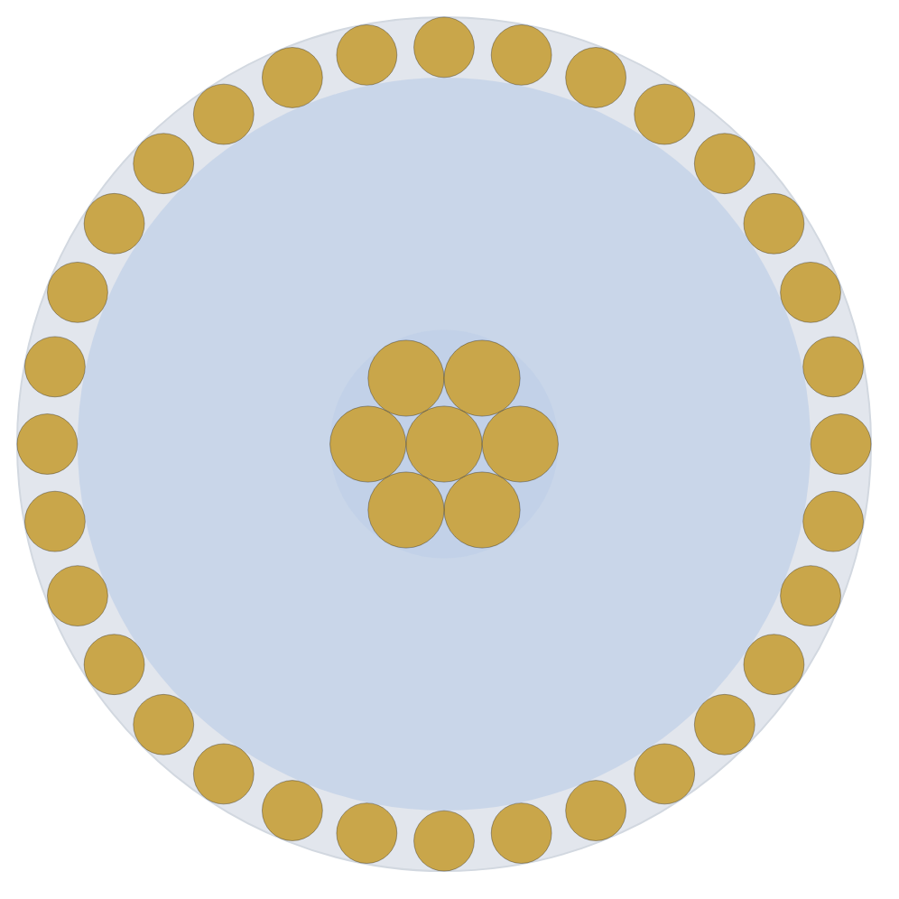
CABLE LENGTH
3″ assembly · 76 mm
Samtec TCF-3450F
NEW N12-42M-100006-1
34 AWG (7×42) SPC / FEP-foam / 46 AWG SPC serve
34 AWG (7×42) C27000 brass / PFA / 44 AWG brass spiral
shield, 50 Ω
shield, 50 Ω
Z₀
50.5 Ω
OD
0.56 mm · 22.1 mil
Z₀
49.8 Ω
OD
0.71 mm · 28.0 mil
RF INSERTION LOSS
RF INSERTION LOSS
0.049
0.335
2 GHz
dB
2 GHz
dB
4 GHz
0.069
dB
4 GHz
0.475
dB
CONDUCTED HEAT LOAD · PER CABLE
CONDUCTED HEAT LOAD · PER CABLE
35.3
533
40 K → 4 K
mW
40 K → 4 K
µW
4 K → 1 K
566
µW
4 K → 1 K
5.1
µW
Trade-off · TCF-3450F 6.9× lower loss · N12-42M 66× lower heat
RF insertion loss = total α(f)·L at the 4–40 K stage (T̄ ≈ 22 K), conductor + dielectric. Heat load = steady-state conduction Q̇ across each stage's ΔT, per cable. Model: Pozar α_c with per-
conductor stranding factor K_s (calibrated to the TCF-3450F IL curve, 1–4 GHz). Both cables 50 Ω.

Slide 3
CABLE LENGTH
5″ assembly · 127 mm
Samtec TCF-3450F
NEW N12-42M-100006-1
34 AWG (7×42) SPC / FEP-foam / 46 AWG SPC serve
34 AWG (7×42) C27000 brass / PFA / 44 AWG brass spiral
shield, 50 Ω
shield, 50 Ω
Z₀
50.5 Ω
OD
0.56 mm · 22.1 mil
Z₀
49.8 Ω
OD
0.71 mm · 28.0 mil
RF INSERTION LOSS
RF INSERTION LOSS
0.081
0.558
2 GHz
dB
2 GHz
dB
4 GHz
0.115
dB
4 GHz
0.791
dB
CONDUCTED HEAT LOAD · PER CABLE
CONDUCTED HEAT LOAD · PER CABLE
21.2
320
40 K → 4 K
mW
40 K → 4 K
µW
4 K → 1 K
339
µW
4 K → 1 K
3.1
µW
Trade-off · TCF-3450F 6.9× lower loss · N12-42M 66× lower heat
RF insertion loss = total α(f)·L at the 4–40 K stage (T̄ ≈ 22 K), conductor + dielectric. Heat load = steady-state conduction Q̇ across each stage's ΔT, per cable. Model: Pozar α_c with per-
conductor stranding factor K_s (calibrated to the TCF-3450F IL curve, 1–4 GHz). Both cables 50 Ω.

Slide 4
CABLE LENGTH
10″ assembly · 254 mm
Samtec TCF-3450F
NEW N12-42M-100006-1
34 AWG (7×42) SPC / FEP-foam / 46 AWG SPC serve
34 AWG (7×42) C27000 brass / PFA / 44 AWG brass spiral
shield, 50 Ω
shield, 50 Ω
Z₀
50.5 Ω
OD
0.56 mm · 22.1 mil
Z₀
49.8 Ω
OD
0.71 mm · 28.0 mil
RF INSERTION LOSS
RF INSERTION LOSS
0.162
1.12
2 GHz
dB
2 GHz
dB
4 GHz
0.230
dB
4 GHz
1.58
dB
CONDUCTED HEAT LOAD · PER CABLE
CONDUCTED HEAT LOAD · PER CABLE
10.6
160
40 K → 4 K
mW
40 K → 4 K
µW
4 K → 1 K
170
µW
4 K → 1 K
1.5
µW
Trade-off · TCF-3450F 6.9× lower loss · N12-42M 66× lower heat
RF insertion loss = total α(f)·L at the 4–40 K stage (T̄ ≈ 22 K), conductor + dielectric. Heat load = steady-state conduction Q̇ across each stage's ΔT, per cable. Model: Pozar α_c with per-
conductor stranding factor K_s (calibrated to the TCF-3450F IL curve, 1–4 GHz). Both cables 50 Ω.

Slide 5
CABLE LENGTH
15″ assembly · 381 mm
Samtec TCF-3450F
NEW N12-42M-100006-1
34 AWG (7×42) SPC / FEP-foam / 46 AWG SPC serve
34 AWG (7×42) C27000 brass / PFA / 44 AWG brass spiral
shield, 50 Ω
shield, 50 Ω
Z₀
50.5 Ω
OD
0.56 mm · 22.1 mil
Z₀
49.8 Ω
OD
0.71 mm · 28.0 mil
RF INSERTION LOSS
RF INSERTION LOSS
0.243
1.67
2 GHz
dB
2 GHz
dB
4 GHz
0.346
dB
4 GHz
2.37
dB
CONDUCTED HEAT LOAD · PER CABLE
CONDUCTED HEAT LOAD · PER CABLE
7.07
107
40 K → 4 K
mW
40 K → 4 K
µW
4 K → 1 K
113
µW
4 K → 1 K
1.0
µW
Trade-off · TCF-3450F 6.9× lower loss · N12-42M 66× lower heat
RF insertion loss = total α(f)·L at the 4–40 K stage (T̄ ≈ 22 K), conductor + dielectric. Heat load = steady-state conduction Q̇ across each stage's ΔT, per cable. Model: Pozar α_c with per-
conductor stranding factor K_s (calibrated to the TCF-3450F IL curve, 1–4 GHz). Both cables 50 Ω.

Slide 6
CABLE LENGTH
18″ assembly · 457 mm
Samtec TCF-3450F
NEW N12-42M-100006-1
34 AWG (7×42) SPC / FEP-foam / 46 AWG SPC serve
34 AWG (7×42) C27000 brass / PFA / 44 AWG brass spiral
shield, 50 Ω
shield, 50 Ω
Z₀
50.5 Ω
OD
0.56 mm · 22.1 mil
Z₀
49.8 Ω
OD
0.71 mm · 28.0 mil
RF INSERTION LOSS
RF INSERTION LOSS
0.291
2.01
2 GHz
dB
2 GHz
dB
4 GHz
0.415
dB
4 GHz
2.85
dB
CONDUCTED HEAT LOAD · PER CABLE
CONDUCTED HEAT LOAD · PER CABLE
5.89
89
40 K → 4 K
mW
40 K → 4 K
µW
4 K → 1 K
94
µW
4 K → 1 K
0.8
µW
Trade-off · TCF-3450F 6.9× lower loss · N12-42M 66× lower heat
RF insertion loss = total α(f)·L at the 4–40 K stage (T̄ ≈ 22 K), conductor + dielectric. Heat load = steady-state conduction Q̇ across each stage's ΔT, per cable. Model: Pozar α_c with per-
conductor stranding factor K_s (calibrated to the TCF-3450F IL curve, 1–4 GHz). Both cables 50 Ω.

Slide 7
SUMMARY
All lengths at a glance
Samtec TCF-3450F
NEW N12-42M-100006-1
Q̇ PER CABLE
208 (13 CABLES OF 16 LINES)
Q̇ PER CABLE
208 (13 CABLES OF 16 LINES)
Length
LOSS
40→4 K
4→1 K
40→4 K
4→1 K
LOSS
40→4 K
4→1 K
40→4 K
4→1 K
2 GHz
2 GHz
3″
0.049 dB
35.3 mW
566 µW
7.35 W
117.6 mW
0.335 dB
533 µW
5.1 µW
110.9 mW
1.06 mW
5″
0.081 dB
21.2 mW
339 µW
4.41 W
70.6 mW
0.558 dB
320 µW
3.1 µW
66.6 mW
636 µW
10″
0.162 dB
10.6 mW
170 µW
2.20 W
35.3 mW
1.12 dB
160 µW
1.5 µW
33.3 mW
318 µW
15″
0.243 dB
7.07 mW
113 µW
1.47 W
23.5 mW
1.67 dB
107 µW
1.0 µW
22.2 mW
212 µW
18″
0.291 dB
5.89 mW
94 µW
1.22 W
19.6 mW
2.01 dB
89 µW
0.8 µW
18.5 mW
177 µW
Insertion loss quoted at 2 GHz, 4–40 K stage. Heat load is conducted Q̇ across each stage's ΔT — shown per cable and for the full 208-cable harness (13 × 16). See per-length slides for 4
GHz figures and inner/outer/dielectric breakdowns.

Slide 8

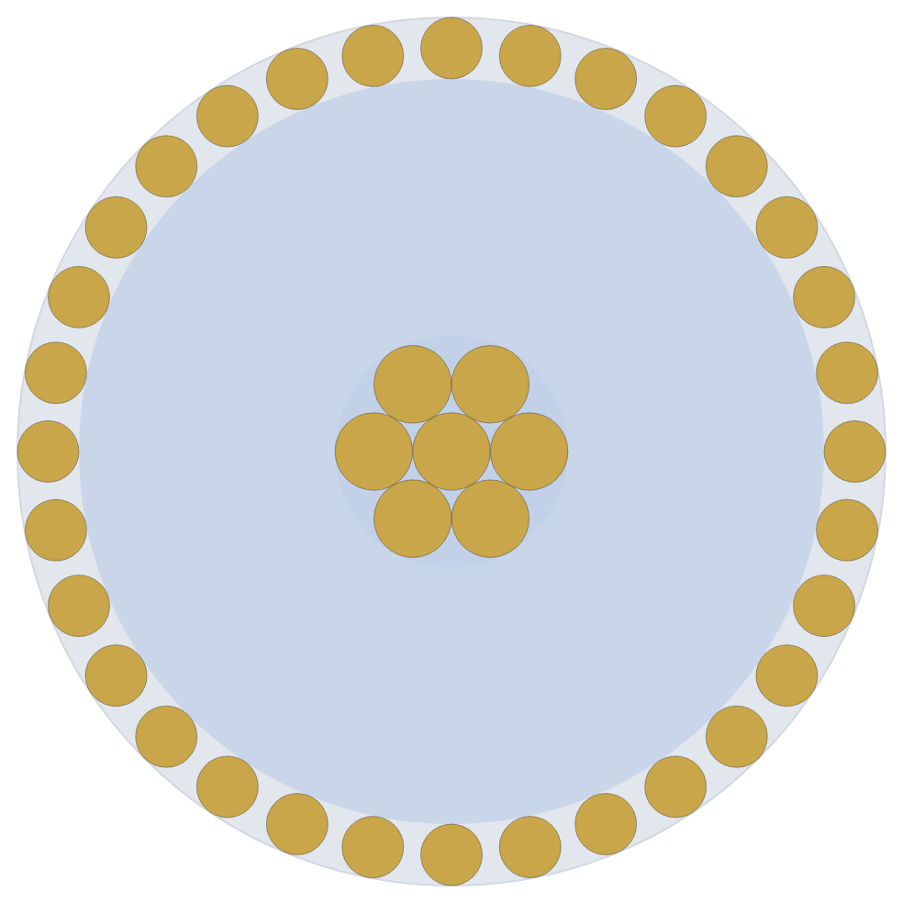
RADIUS SCALING · 40 K → 4 K
NEW-Doubled vs baseline · 5″ assembly · 127 mm
NEW N12-42M-100006-1
NEW-Doubled
34 AWG (7×42) C27000 brass / PFA / 44 AWG brass spiral
2× N12-42M scale — 28 AWG (7×36) brass / PFA / 38 AWG
shield, 50 Ω
brass spiral shield, 50 Ω
Z₀
49.8 Ω
OD
0.71 mm · 28.0 mil
Z₀
49.7 Ω
OD
1.42 mm · 55.9 mil
CONDUCTED HEAT LOAD · 40 K → 4 K
CONDUCTED HEAT LOAD · 40 K → 4 K
320
1.29
per cable
µW
per cable
mW
× 208 harness
66.6 mW
× 208 harness
267.5 mW
RF INSERTION LOSS
RF INSERTION LOSS
2 GHz
0.558
dB
2 GHz
0.281
dB
4 GHz
0.791
dB
4 GHz
0.399
dB
Trade-off · NEW-Doubled 4.0× the heat · 2.0× lower loss · 2.00× the OD
Heat load = steady-state conduction Q̇ across the 40 K → 4 K ΔT, per cable and for the full 208-cable harness (13 × 16). RF insertion loss = α(f)·L with ρ, ε_r and tan δ taken at this stage's T̄.
NEW-Doubled is the N12-42M construction (brass / PFA / spiral shield) scaled up, re-sized to hold 50 Ω and 0.78 shield coverage; its OD is 2.00× the baseline.

Slide 9
RADIUS SCALING · 4 K → 1 K
NEW-Doubled vs baseline · 5″ assembly · 127 mm
NEW N12-42M-100006-1
NEW-Doubled
34 AWG (7×42) C27000 brass / PFA / 44 AWG brass spiral
2× N12-42M scale — 28 AWG (7×36) brass / PFA / 38 AWG
shield, 50 Ω
brass spiral shield, 50 Ω
Z₀
49.8 Ω
OD
0.71 mm · 28.0 mil
Z₀
49.7 Ω
OD
1.42 mm · 55.9 mil
CONDUCTED HEAT LOAD · 4 K → 1 K
CONDUCTED HEAT LOAD · 4 K → 1 K
3.1
12
per cable
µW
per cable
µW
× 208 harness
636 µW
× 208 harness
2.56 mW
RF INSERTION LOSS
RF INSERTION LOSS
2 GHz
0.553
dB
2 GHz
0.277
dB
4 GHz
0.783
dB
4 GHz
0.393
dB
Trade-off · NEW-Doubled 4.0× the heat · 2.0× lower loss · 2.00× the OD
Heat load = steady-state conduction Q̇ across the 4 K → 1 K ΔT, per cable and for the full 208-cable harness (13 × 16). RF insertion loss = α(f)·L with ρ, ε_r and tan δ taken at this stage's T̄.
NEW-Doubled is the N12-42M construction (brass / PFA / spiral shield) scaled up, re-sized to hold 50 Ω and 0.78 shield coverage; its OD is 2.00× the baseline.

Slide 10
RADIUS SCALING · 40 K → 4 K
NEW-Doubled vs baseline · 10″ assembly · 254 mm
NEW N12-42M-100006-1
NEW-Doubled
34 AWG (7×42) C27000 brass / PFA / 44 AWG brass spiral
2× N12-42M scale — 28 AWG (7×36) brass / PFA / 38 AWG
shield, 50 Ω
brass spiral shield, 50 Ω
Z₀
49.8 Ω
OD
0.71 mm · 28.0 mil
Z₀
49.7 Ω
OD
1.42 mm · 55.9 mil
CONDUCTED HEAT LOAD · 40 K → 4 K
CONDUCTED HEAT LOAD · 40 K → 4 K
160
643
per cable
µW
per cable
µW
× 208 harness
33.3 mW
× 208 harness
133.8 mW
RF INSERTION LOSS
RF INSERTION LOSS
2 GHz
1.12
dB
2 GHz
0.561
dB
4 GHz
1.58
dB
4 GHz
0.798
dB
Trade-off · NEW-Doubled 4.0× the heat · 2.0× lower loss · 2.00× the OD
Heat load = steady-state conduction Q̇ across the 40 K → 4 K ΔT, per cable and for the full 208-cable harness (13 × 16). RF insertion loss = α(f)·L with ρ, ε_r and tan δ taken at this stage's T̄.
NEW-Doubled is the N12-42M construction (brass / PFA / spiral shield) scaled up, re-sized to hold 50 Ω and 0.78 shield coverage; its OD is 2.00× the baseline.

Slide 11
RADIUS SCALING · 4 K → 1 K
NEW-Doubled vs baseline · 10″ assembly · 254 mm
NEW N12-42M-100006-1
NEW-Doubled
34 AWG (7×42) C27000 brass / PFA / 44 AWG brass spiral
2× N12-42M scale — 28 AWG (7×36) brass / PFA / 38 AWG
shield, 50 Ω
brass spiral shield, 50 Ω
Z₀
49.8 Ω
OD
0.71 mm · 28.0 mil
Z₀
49.7 Ω
OD
1.42 mm · 55.9 mil
CONDUCTED HEAT LOAD · 4 K → 1 K
CONDUCTED HEAT LOAD · 4 K → 1 K
1.5
6.1
per cable
µW
per cable
µW
× 208 harness
318 µW
× 208 harness
1.28 mW
RF INSERTION LOSS
RF INSERTION LOSS
2 GHz
1.11
dB
2 GHz
0.555
dB
4 GHz
1.57
dB
4 GHz
0.786
dB
Trade-off · NEW-Doubled 4.0× the heat · 2.0× lower loss · 2.00× the OD
Heat load = steady-state conduction Q̇ across the 4 K → 1 K ΔT, per cable and for the full 208-cable harness (13 × 16). RF insertion loss = α(f)·L with ρ, ε_r and tan δ taken at this stage's T̄.
NEW-Doubled is the N12-42M construction (brass / PFA / spiral shield) scaled up, re-sized to hold 50 Ω and 0.78 shield coverage; its OD is 2.00× the baseline.

Slide 12

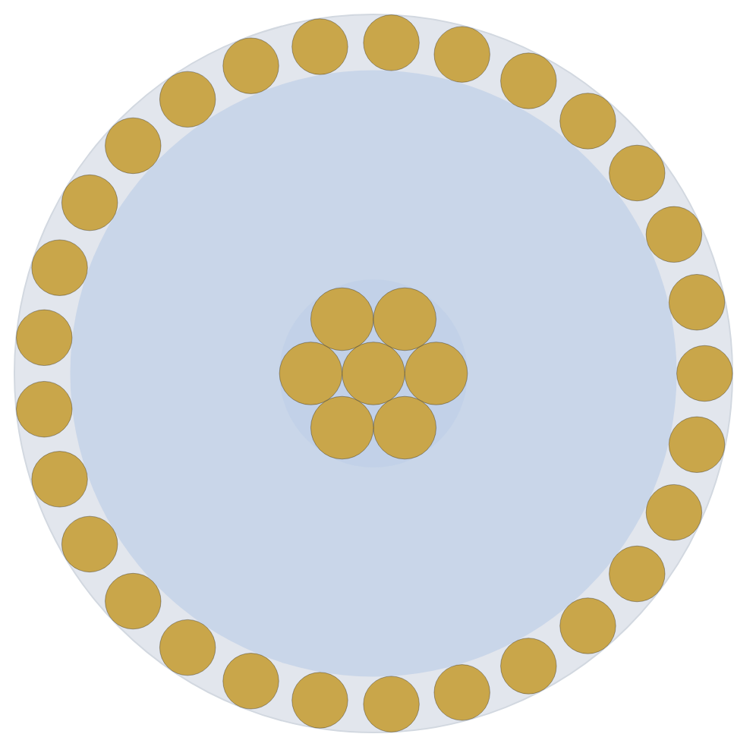
RADIUS SCALING · 40 K → 4 K
NEW-Tripled vs baseline · 5″ assembly · 127 mm
NEW N12-42M-100006-1
NEW-Tripled
34 AWG (7×42) C27000 brass / PFA / 44 AWG brass spiral
≈3× N12-42M scale — 25 AWG (7×33) brass / PFA / 34
shield, 50 Ω
AWG brass spiral shield, 50 Ω
Z₀
49.8 Ω
OD
0.71 mm · 28.0 mil
Z₀
50.0 Ω
OD
2.06 mm · 81.1 mil
CONDUCTED HEAT LOAD · 40 K → 4 K
CONDUCTED HEAT LOAD · 40 K → 4 K
320
2.84
per cable
µW
per cable
mW
× 208 harness
66.6 mW
× 208 harness
590.9 mW
RF INSERTION LOSS
RF INSERTION LOSS
2 GHz
0.558
dB
2 GHz
0.197
dB
4 GHz
0.791
dB
4 GHz
0.281
dB
Trade-off · NEW-Tripled 8.9× the heat · 2.8× lower loss · 2.90× the OD
Heat load = steady-state conduction Q̇ across the 40 K → 4 K ΔT, per cable and for the full 208-cable harness (13 × 16). RF insertion loss = α(f)·L with ρ, ε_r and tan δ taken at this stage's T̄.
NEW-Tripled is the N12-42M construction (brass / PFA / spiral shield) scaled up, re-sized to hold 50 Ω and 0.78 shield coverage; its OD is 2.90× the baseline.

Slide 13
RADIUS SCALING · 4 K → 1 K
NEW-Tripled vs baseline · 5″ assembly · 127 mm
NEW N12-42M-100006-1
NEW-Tripled
34 AWG (7×42) C27000 brass / PFA / 44 AWG brass spiral
≈3× N12-42M scale — 25 AWG (7×33) brass / PFA / 34
shield, 50 Ω
AWG brass spiral shield, 50 Ω
Z₀
49.8 Ω
OD
0.71 mm · 28.0 mil
Z₀
50.1 Ω
OD
2.06 mm · 81.1 mil
CONDUCTED HEAT LOAD · 4 K → 1 K
CONDUCTED HEAT LOAD · 4 K → 1 K
3.1
27
per cable
µW
per cable
µW
× 208 harness
636 µW
× 208 harness
5.65 mW
RF INSERTION LOSS
RF INSERTION LOSS
2 GHz
0.553
dB
2 GHz
0.194
dB
4 GHz
0.783
dB
4 GHz
0.276
dB
Trade-off · NEW-Tripled 8.9× the heat · 2.8× lower loss · 2.90× the OD
Heat load = steady-state conduction Q̇ across the 4 K → 1 K ΔT, per cable and for the full 208-cable harness (13 × 16). RF insertion loss = α(f)·L with ρ, ε_r and tan δ taken at this stage's T̄.
NEW-Tripled is the N12-42M construction (brass / PFA / spiral shield) scaled up, re-sized to hold 50 Ω and 0.78 shield coverage; its OD is 2.90× the baseline.

Slide 14
RADIUS SCALING · 40 K → 4 K
NEW-Tripled vs baseline · 10″ assembly · 254 mm
NEW N12-42M-100006-1
NEW-Tripled
34 AWG (7×42) C27000 brass / PFA / 44 AWG brass spiral
≈3× N12-42M scale — 25 AWG (7×33) brass / PFA / 34
shield, 50 Ω
AWG brass spiral shield, 50 Ω
Z₀
49.8 Ω
OD
0.71 mm · 28.0 mil
Z₀
50.0 Ω
OD
2.06 mm · 81.1 mil
CONDUCTED HEAT LOAD · 40 K → 4 K
CONDUCTED HEAT LOAD · 40 K → 4 K
160
1.42
per cable
µW
per cable
mW
× 208 harness
33.3 mW
× 208 harness
295.4 mW
RF INSERTION LOSS
RF INSERTION LOSS
2 GHz
1.12
dB
2 GHz
0.394
dB
4 GHz
1.58
dB
4 GHz
0.562
dB
Trade-off · NEW-Tripled 8.9× the heat · 2.8× lower loss · 2.90× the OD
Heat load = steady-state conduction Q̇ across the 40 K → 4 K ΔT, per cable and for the full 208-cable harness (13 × 16). RF insertion loss = α(f)·L with ρ, ε_r and tan δ taken at this stage's T̄.
NEW-Tripled is the N12-42M construction (brass / PFA / spiral shield) scaled up, re-sized to hold 50 Ω and 0.78 shield coverage; its OD is 2.90× the baseline.

Slide 15
RADIUS SCALING · 4 K → 1 K
NEW-Tripled vs baseline · 10″ assembly · 254 mm
NEW N12-42M-100006-1
NEW-Tripled
34 AWG (7×42) C27000 brass / PFA / 44 AWG brass spiral
≈3× N12-42M scale — 25 AWG (7×33) brass / PFA / 34
shield, 50 Ω
AWG brass spiral shield, 50 Ω
Z₀
49.8 Ω
OD
0.71 mm · 28.0 mil
Z₀
50.1 Ω
OD
2.06 mm · 81.1 mil
CONDUCTED HEAT LOAD · 4 K → 1 K
CONDUCTED HEAT LOAD · 4 K → 1 K
1.5
14
per cable
µW
per cable
µW
× 208 harness
318 µW
× 208 harness
2.82 mW
RF INSERTION LOSS
RF INSERTION LOSS
2 GHz
1.11
dB
2 GHz
0.389
dB
4 GHz
1.57
dB
4 GHz
0.552
dB
Trade-off · NEW-Tripled 8.9× the heat · 2.8× lower loss · 2.90× the OD
Heat load = steady-state conduction Q̇ across the 4 K → 1 K ΔT, per cable and for the full 208-cable harness (13 × 16). RF insertion loss = α(f)·L with ρ, ε_r and tan δ taken at this stage's T̄.
NEW-Tripled is the N12-42M construction (brass / PFA / spiral shield) scaled up, re-sized to hold 50 Ω and 0.78 shield coverage; its OD is 2.90× the baseline.

