Slide 1
ninai
Case 1
The Repeat Caller
LOW
Case 2
The Team Storm
Intelligent Memory for
Support & Engineering Teams
LOW–MEDIUM
Case 3
The Fix That Wasn't
5 real scenarios. One system that connects the dots.
MEDIUM
Case 4
The Monday Crash
HIGH
Case 5
The Slow Boil
VERY HIGH
All demos run on real Kaggle data · Self-hosted · No data leaves your infra

Slide 2
ninai
The Problem
Why support teams keep fighting the same fires every week
1
Tickets don't talk to each other
A customer calls 3 times about the same broken login. Each CSR sees only their own ticket. No one connects the pattern. No escalation. No resolution.
2
Incidents get closed before they're actually fixed
An incident is marked 'Resolved' at 09:00. By end of day 30 customers still can't log in. There is no link between the closed ticket and the open complaints.
3
Trends go unnoticed until they become a crisis
A ticket subcategory grows 2 → 4 → 7 → 12 → 19 over 5 days. No single day looks alarming. Day 7 projects to 89 — above SLA limit of 50. The signal was there. Nobody was looking at the right data.

Slide 3
ninai
How Ninai Works
Memory-native intelligence — each ticket runs a full agent pipeline before a human reads it
Memory
Ingestion
Agent
Pipeline
Cross-Record
Fusion
Briefing
Card
→
→
→
Tickets, incidents,
notes → structured
memory records
17 specialist agents
run on each memory;
parallel enrichment
Entity, timeline,
credibility & causal
chain resolved
CSR / SRE gets the
full picture before
they press Assign
17 Specialist Agents:
EntityResolution · TemporalReasoning · Credibility · FeedbackIntegration
EpisodicGrouping · SiloPropagation · OrgAttention · ConflictDetection
CausalReasoning · AdaptiveConflictResolution · AnomalyDetection
GoalDecomposition · Playbook · PredictiveMonitor · AutonomousGoalGeneration
MetaCognitivePlanning · NarrativeSynthesis
17
< 2 s
5
SLA-aware
100%
specialist agents
pipeline latency
complexity tiers
predictions
self-hosted

Slide 4
ninai
Case 1: The Repeat Caller
Complexity: LOW · Emma Chen has called support 3× in 8 days about the same broken login
Question | Without Ninai | With Ninai ✓
Is this a new issue? | Looks new — only this ticket is in view | No — this is contact #3 on the same unresolved login failure
Has this person called before? | No cross-ticket visibility in a standard portal | Yes — 3 calls in 8 days; all same root cause
Did the previous fix work? | Unknown — no follow-up linked to this ticket | No — password reset (day 1) and cache clear (day 3) both failed within 3 days
How urgent is this? | Medium — that's the priority label on the form | CAUTION — repeat-failure pattern triggers escalation protocol
What should the CSR do? | Start from scratch; attempt another basic reset | Escalate to L2 immediately. Do not attempt another band-aid fix.

Slide 5
ninai
Case 2: The Team Storm
Complexity: LOW–MEDIUM · 5 DevOps engineers file 8 separate tickets in one week — all converging on one root cause
Question | Without Ninai | With Ninai ✓
Are these 8 tickets related? | Unknown — each ticket looks isolated | Yes — all 8 grouped into episode DEVOPS-AUTH-CRISIS-2026
Is the DevOps team in crisis? | Unknown — no team-level visibility in the portal | Yes — 5 of 5 DevOps members affected in 7 days
What is the common cause? | Unknown — each ticket describes a different symptom | Auth/cert expiry cascading: pipeline → cert → permissions → SSO
Who needs to be alerted urgently? | Unknown — no cross-team escalation is triggered | VP Engineering + DevOps lead paged; status page updated
Should support or engineering own this? | Support handles each one; no signal to escalate | Engineering owns this; support closes with a P1 handoff

Slide 6
ninai
Case 3: The Fix That Wasn't
Complexity: MEDIUM · Incident closed Monday. 4 customer tickets show it is still broken Thursday.
Question | Without Ninai | With Ninai ✓
Was the incident really resolved? | Yes — ticket INC-2026-0318 is marked Closed | No — Ninai detected 2 contradictions between close note and live complaints
Why are customers still reporting failures? | Unknown — these look like new, separate tickets | Key rotation applied to primary node only — replica us-east-1b still uses old key
What is the actual root cause? | Unknown — each ticket just says 'login fails' | LDAP users on replica → token validation failure → login loop
Who closed the incident incorrectly? | Unknown — the DevOps team closed the ticket | Alex Rivera (DevOps) — rotation script skipped replica node
Who needs to be contacted right now? | Unknown — no escalation target visible from the tickets | James Kim (security), Alex Rivera (DevOps), Oliver Smith (L2) — all 3 paged

Slide 7
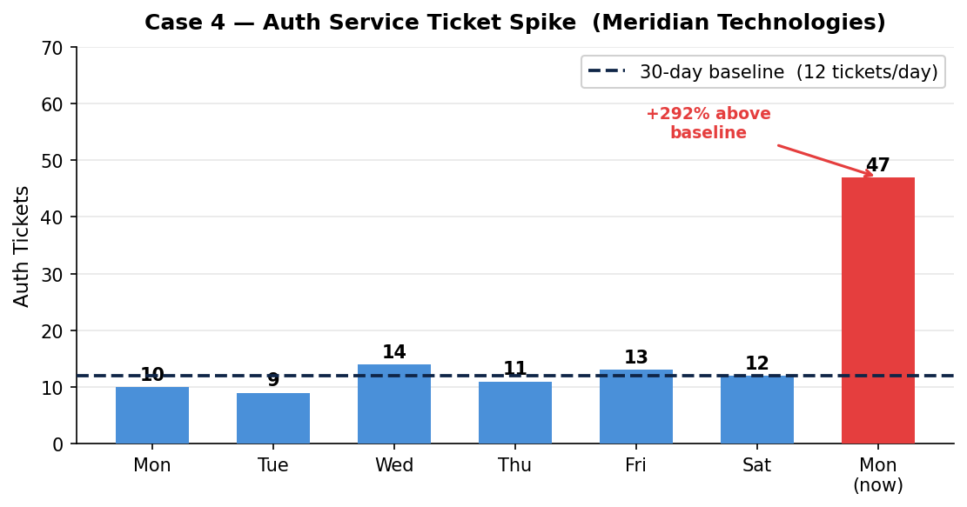
ninai
Case 4: The Monday Morning Crash
Complexity: HIGH · 47 tickets in 2 hours. A human is still reading ticket #3.
What Ninai did in < 2 minutes
🔴
Detected +292% anomaly vs 30-day baseline
🏢
Identified company-wide scope — 3 departments
📋
Matched playbook MAJOR-INCIDENT-RESPONSE-v3
📊
Decomposed into 5 subtasks; found blocker
🚨
Declared P1, paged infra on-call at 09:01
"47 individual complaints are one incident.
Ninai declared it before a human read ticket #3."

Slide 8
ninai
Case 4: Monday Morning Crash — Response Detail
Complexity: HIGH · Auth service authentication failure — 3 departments — Monday 09:00
Question | Without Ninai | With Ninai ✓
What is this queue of 47 tickets? | A busy Monday — read each one individually | +292% spike vs 12/day baseline (30-day avg) — this is a P1 incident
Is this normal volume for a Monday? | Unknown — no historical baseline visible in the portal | No — 47 tickets in 2 hours vs 12/day average = +292% above normal
Which departments are affected? | Unknown — each ticket is from one person | Engineering, Operations, Finance — all 3 departments, company-wide
What should the on-call do first? | Unknown — start reading and manually triage | Declare P1 and page infra on-call (blocking subtask #1 of 5)
Is there a playbook for this situation? | No automatic matching — on-call must recall from memory | MAJOR-INCIDENT-RESPONSE-v3 matched at 91% confidence

Slide 9
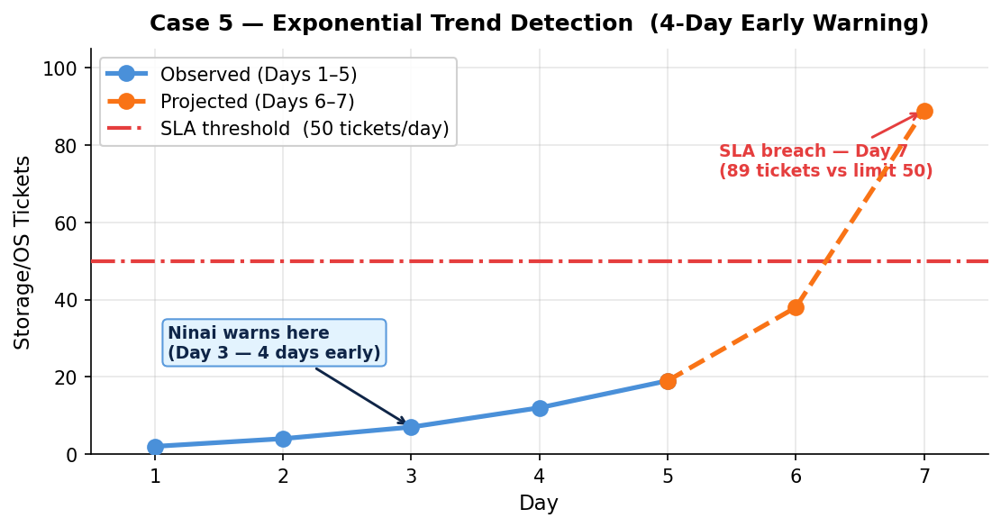
ninai
Case 5: The Slow Boil
Complexity: VERY HIGH / PREDICTIVE · Detected on Day 3. Crisis would hit Day 7.
Ninai's Proactive Warning
Day 3
Ninai detects exponential trend
Day 7
Projected breach: 89 tickets (SLA = 50)
4 days
Lead time before the crisis hits
0
Human escalations that triggered this
78%
Prediction confidence
"Ninai warned you on Day 3.
You had 4 days to fix it before it became a crisis."

Slide 10
ninai
Case 5: The Slow Boil — Prediction Accuracy
Complexity: VERY HIGH / PREDICTIVE · Storage/OS ticket trend: 2 → 4 → 7 → 12 → 19 over 5 days
Question | Without Ninai | With Ninai ✓
Is this trend concerning? | No — no single day crosses an alert threshold | Yes — exponential growth at 1.9× velocity per 1.5 days
When will it become a crisis? | Unknown — no forecasting in the ticket portal | Day 7: projected 89 tickets — SLA breach in 4 days
Was any alert generated? | No — no SLA threshold crossed yet on any individual day | Yes — AutonomousGoalGenerationAgent raised proactive investigation
What should the team do today? | Continue processing the normal support queue | Investigate storage/OS health + check this week's OS patches
What is the root cause hypothesis? | Unknown — tickets list many different symptoms | Storage subsystem + recent OS patches — 78% confidence

Slide 11
ninai
All 5 Cases at a Glance
From a repeat caller to a company-wide crash — one intelligence layer handles them all
Case | Complexity | Key Agents | What Ninai Detects | Outcome
Case 1 The Repeat Caller | LOW | EntityResolution Temporal Credibility Feedback | 3rd contact on same unresolved issue — prior fixes failed; escalation required | Escalated to L2 before CSR opens the form
Case 2 The Team Storm | LOW–MEDIUM | EpisodicGrouping SiloPropagation OrgAttention | 8 isolated DevOps tickets grouped into 1 auth/cert cascade episode (5 engineers) | VP Engineering paged; P1 incident opened
Case 3 The Fix That Wasn't | MEDIUM | ConflictDetect Credibility CausalReasoning AdaptiveConflict | 2 contradictions between 'Closed' incident and 4 live customer complaints | Incident reopened; 3 teams simultaneously paged
Case 4 Monday Crash | HIGH | AnomalyDetect Temporal OrgAttention GoalDecomp Playbook | +292% auth ticket spike; company-wide scope; P1 playbook matched at 91% | P1 declared at 09:01 AM (ticket #1 of 47)
Case 5 Slow Boil | VERY HIGH PREDICTIVE | Temporal PredictiveMonitor AutonomousGoal MetaCognitive | Exponential trend on Day 3; SLA breach projected Day 7 (89 vs limit 50) | 4-day early warning; proactive goal raised

Slide 12
ninai
Memory-native intelligence for ops teams.
✓ Self-hosted — your data never leaves your infrastructure
✓ 17 specialist agents — every ticket runs a full intelligence pipeline
✓ SLA-aware predictions — warns you before the threshold is crossed
✓ Connects tickets, incidents and internal notes across all teams
✓ REST API — integrates with any ticket system in hours
All 5 demo cases run end-to-end in under 10 seconds on local hardware · Open source core
Try the live notebook demo · Ask for a walkthrough of any case · apache-2.0 licensed

