Slide 1
Design of an Encryption Co-Processor for a 802.11 Wireless LAN System-on-Chip
ECE 260C:VLSI ADVANCED TOPICS
Adithya Suresh
Santosh Krishnan

Slide 2
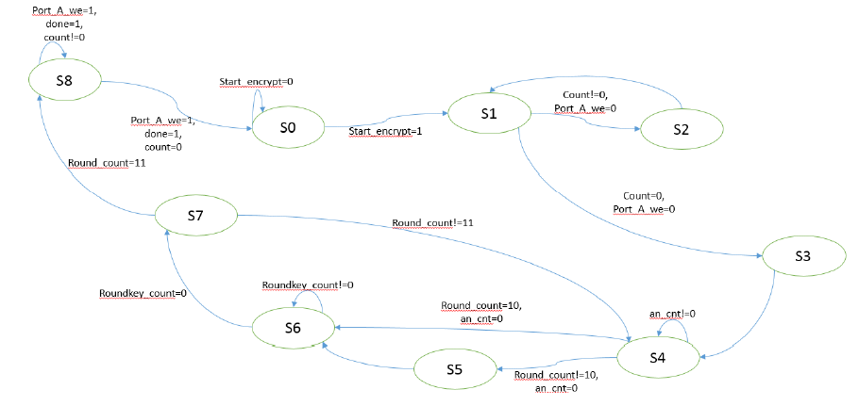
Part A
State Diagram:

Slide 3
Part A
In part A, reducing the area was the only concern. Hence, the design was made to use ample number of clock cycles and a large period. While coding, each state had non-blocking assignments inside the states to reduce hardware and states (hardware) were reused to avoid generating hardware for similar operations.
A mix column function, and a Galois field multiplier were written as modules to be called upon whenever required. Hence, the hardware was reused.
However, the sbox values did take up more hardware since it had to be hardcoded.

Slide 4
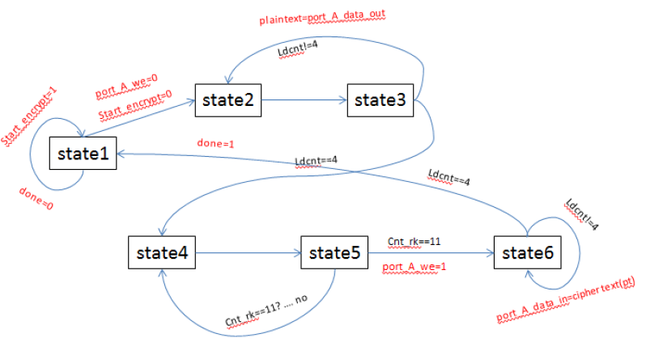
Part B
State Diagram

Slide 5
Part B
For this part of the question since the delay is the most important factor out entire focus was to reduce the number of clock cycles to as low as possible and implement it in an efficient manner.
Keeping in mind the tradeoff between Area and delay, we zeroed on one of the two resource allocations: 4 sboxes,16 galois fields multipliers and 36 XOR gates and 20 sboxes, 64 galois field multipliers and 144 XOR gates.
We choose to go with the second implementation because we were able to execute the operation three times faster with a limited penalty on area. The optimizations in this stage involved taking advantage of the highly parallelized nature of the encryption algorithm to minimize number registers needed.

Slide 6
Results
Part A: the total cell area=7743 um2.
Part B:
Number of clock cycles=1680/20=84 clock cycles.
clock period is 12.31ns
Total Cell area = 15223.350um2
Area delay product= 15745.7578um2-us

