Slide 1
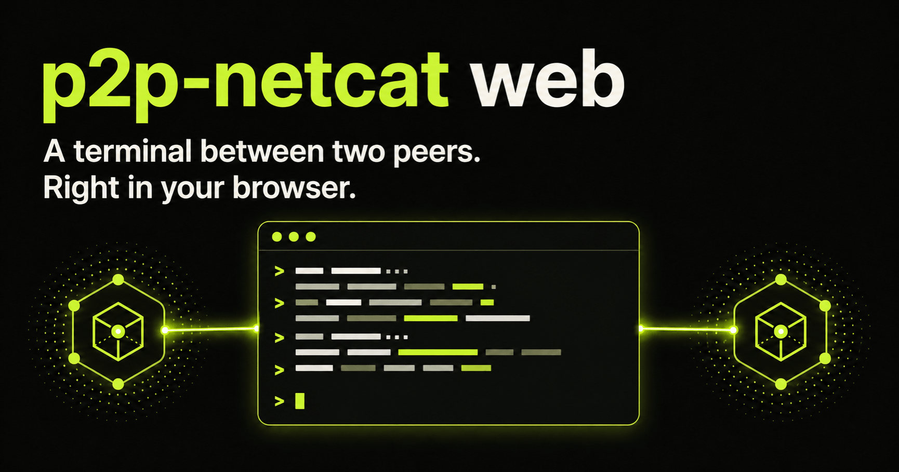
PEER-TO-PEER ACCESS
p2p-netcat
Netcat addressed by PeerId
One cryptographic address for terminal, TCP, UDP, and proxy access across NAT.
IDENTITY
ROUTE
SESSION
PeerId instead of IP
First authenticated route
TCP · UDP · PTY · SOCKS
Source: README.md · github.com/santaklouse/go-p2p-netcat
01 / 17

Slide 2
A REAL PROBLEM
Your home server has no public address — but you still need SSH.
WITHOUT P2P-NETCAT
WITH P2P-NETCAT
The network edge is not yours
The server keeps one identity
Laptop
›
Home router
CGNAT
12D3KooW…YXdUfbR9
discover · authenticate · connect
Port forwarding is unavailable. Dynamic DNS does not help. A hosted VPN adds another control plane.
Run a listener at home. From anywhere, dial its PeerId and forward local port 2222 to SSH.
Story: home lab or NAS behind CGNAT
02 / 17

Slide 3
A REAL PROBLEM
A full Internet tunnel should still work when the gateway is behind NAT.
TRAVEL · LAPTOP
HOME · GATEWAY
WireGuard
p2p-nc
UNTRUSTED NETWORK
p2p-nc
WireGuard
Endpoint
127.0.0.1:15182
keeps carrier
outside wg0
hotel · airport · mobile hotspot
no inbound port required
UDP listener
→ UDP :51820
home gateway
10.66.66.1/24
policy route protects the carrier
FORWARD + MASQUERADE
ONE ROUTE
bring up carrier
›
wg-quick up wg0
›
public IP = home
The P2P carrier reaches the home peer first; WireGuard then routes all Internet traffic through it.
Story: private browsing through a home gateway
03 / 17

Slide 4
WHY IT EXISTS
The same need keeps repeating: reach a private service without owning its network edge.
Home lab
Remote work
Legacy VPN
SSH · NAS
PostgreSQL · dev API
OpenVPN
TCP
TCP
STREAM
1
2
3
4
5
6
Family support
Private browsing
Full tunnel
RDP · web UI
SOCKS5h
WireGuard
TCP
SOCKS
UDP
One stable PeerId replaces per-network IP addresses, port mappings, and temporary VPN control planes.
Product motivation: recurring access across NAT
04 / 17

Slide 5
ROUTING PROBLEM
PeerId solves identity. The route still has to be found.
CLASSIC FORWARDING
P2P-NETCAT
The IP changes — access breaks
Identity stays stable
192.0.2.10:22
›
NAT / CGNAT
12D3KooW…YXdUfbR9
mDNS · DHT · signaling · relay hints
DNS, port forwarding, a VPN concentrator, or manually operated infrastructure.
PeerId selects the right peer; discovery and route racing select a reachable path.
Source: docs/ARCHITECTURE.md
05 / 17

Slide 6
ARCHITECTURE
The first route to complete authentication wins.
DISCOVERY / SIGNALING
PARALLEL ROUTE RACE
CLIENT
PUBLIC ROUTING
LIBP2P PLANE
LISTENER
CLI or browser PWA
PeerId + logical port
mDNS · GossipSub · DHT
QUIC · WebRTC Direct · WSS · TCP · Relay
AUTH GATE
Persistent Ed25519 identity
logical service
1…65535
Expected PeerId
admission handshake
NATIVE SIGNALING
PION WEBRTC
Nostr + WebTorrent
ICE/STUN · ordered DataChannel
SESSION AFTER AUTH
raw / exec
TCP forward
UDP frames
SOCKS
PTY / ConPTY
Sources: docs/ARCHITECTURE.md · docs/WEBRTC_MIGRATION.md
06 / 17

Slide 7
ROUTE POLICY
Relay-only keeps the PeerId local — and makes ‘no direct path’ enforceable.
DEFAULT ROUTING
STRICT RELAY-ONLY
Fastest authenticated route wins
Only explicit Circuit Relay routes exist
direct TCP · QUIC
›
WebRTC · DHT
LOCAL PEERID · E2E NOISE/TLS
TCP/WSS relay → p2p-circuit
Direct and relayed candidates can race. Reachability is maximized, but the host may expose a direct route.
Requires an explicit relay; disables DHT, mDNS, PubSub, direct QUIC/WebRTC and fails closed if the relay is unavailable.
Proposal: docs/FUTURE_IDEAS.md
07 / 17

Slide 8
THIN CLIENT
A trusted WSS gateway moves the P2P host — and the trust boundary — to the VPS.
LOCAL DEVICE
REMOTE PEER
p2p-nc-lite
WSS agent
TRUSTED GATEWAY
p2p-nc
Circuit Relay
PTY · TCP · UDP
local session owner
one outbound link
TCP 443
per-device hosted PeerId
full P2P route selection
ordinary client/listener
exact PeerId + port
shared WSS :443
no random ports
pairing + admission stay in the agent
GATEWAY MAY SEE APPLICATION PLAINTEXT
ONE FIXED PORT
agent opens WSS
›
gateway hosts PeerId
›
P2P stream reaches peer
Data, EOF, reset, and flow credit are multiplexed; local -i still starts the PTY on the device.
Proposal: docs/FUTURE_IDEAS.md
08 / 17

Slide 9
MODES
One CLI covers terminals, streams, datagrams, and proxies.
MODE
LOCAL INTERFACE
REMOTE ACTION
WHAT IS PRESERVED
FLAG
RAW / EXEC
stdin/stdout
stream or command
byte stream
-e
TCP FWD
127.0.0.1:PORT
dial TCP target
connection
-p
UDP FWD
127.0.0.1:PORT/udp
connected UDP socket
packet boundaries
-u -p
SOCKS
SOCKS4/4a/5
CONNECT remotely
remote DNS
-S
PTY
interactive TTY
Unix PTY / ConPTY
resize + EOF
-i
LISTENER
logical port
multiple sessions
identity + policy
-l -k
Wire protocol compatibility
/p2p-netcat/1.0.0/<port> · /p2p-netcat/udp/1.0.0/<port>
Sources: README.md · docs/USE_CASES.md
09 / 17

Slide 10
TRUST BEFORE DATA
Application bytes flow only after the expected PeerId is proven.
AFTER AUTH
1
2
3
4
5
6
256
KiB
Offer
DataChannel
Challenge
Signature
PeerId check
AUTH_READY
Client creates SDP
p2p-netcat-v2
32 random bytes
Ed25519 + service
Exact match
Session allowed
end-to-end flow window
120 sec
reconnect on the same logical stream
An unverified WebRTC candidate cannot start the listener's PTY or application stream.
Source: docs/WEBRTC_MIGRATION.md
10 / 17

Slide 11
UDP OVER STREAM
UDP packet boundaries survive even over TCP/WSS/relay.
DATAGRAM ASSOCIATION
LOCAL SOURCE
00 84
uint16 BE length
P2P STREAM
FIXED UDP TARGET
›
›
›
127.0.0.1:15182
association per endpoint
authenticated + encrypted
ordered reliable carrier
WireGuard · DNS · game service
exact reply to original source
exact UDP payload bytes
FALLBACK LADDER
Native WebRTC
QUIC / WebRTC Direct
ICE/STUN direct
TCP / WSS
Circuit Relay v2
direct UDP path
UDP-over-stream
Tor + TCP relay
fallback path
restricted networks
Fallback cost: ordered delivery can introduce head-of-line blocking.
Source: docs/DATAGRAM_PROTOCOL.md
11 / 17

Slide 12
WIREGUARD FULL TUNNEL
The carrier stays outside the default route, so the tunnel cannot consume itself.
NAT A · CLIENT
NAT B · GATEWAY
WireGuard
p2p-nc
PUBLIC INTERNET
p2p-nc
WireGuard
Endpoint
127.0.0.1:15182
UDP carrier
special UID
Nostr/WebTorrent signaling + STUN/ICE
application packets travel over selected P2P carrier
UDP listener
→ UDP :51820
wg0 gateway
10.66.66.1/24
ip rule uidrange → lookup main
FORWARD + MASQUERADE
E2E CHECK
two NAT namespaces
›
WireGuard handshake
›
HTTP egress = full-tunnel-ok
Start the carrier first, then wg-quick up wg0 — policy routing protects DNS, signaling, STUN, and reconnect.
Sources: docs/USE_CASES.md · scripts/full_tunnel_netns_test.sh
12 / 17

Slide 13
USE CASES
One primitive operation powers many working tools.
OpenSSH
RDP
OpenVPN
ProxyCommand / :2222
:13389 → :3389
tcp-client
TCP
TCP
STREAM
1
2
3
4
5
6
PostgreSQL
SOCKS5h
WireGuard
:15432 → :5432
remote DNS
full Internet tunnel
TCP
SOCKS
UDP
The logical port selects the P2P service; it does not have to match the local TCP/UDP port.
Source: docs/USE_CASES.md
13 / 17

Slide 14
DELIVERY
One installation command; four delivery surfaces.
VERIFIED DEPLOY
RELEASE BINARIES
BROWSER PWA
Linux · macOS · Windows · Android
amd64 / arm64
curl -fsSL …/deploy.sh | bash
Static
GitHub Pages
detects OS + architecture
GHCR CONTAINER
downloads the release
ghcr.io/santaklouse/go-p2p-netcat
non-root · /config identity
React UI
Web Worker
IndexedDB routes
Native WebRTC
verifies SHA256SUMS
installs p2p-nc + pnc
GO INSTALL
cmd/p2p-nc + cmd/pnc
CGO is not required
Sources: README.md · docs/INSTALLATION.md
14 / 17

Slide 15
RELIABILITY
Tests target the exact failure boundaries introduced by the architecture.
CI COVERAGE
NATIVE WEBRTC SOAK
Go tests
WHAT SOAK DOES NOT PROVE
60 / 60
Linux · macOS · Windows
public Nostr/tracker availability
Race detector
intercontinental latency
workload iterations
Linux · ./...
Full tunnel
every NAT and firewall type
2 NAT + WireGuard + HTTP
background browser tabs and sleep
1 152 MiB
Docker
transferredBytes in a fresh JSON report
buildx + runtime checks
100% relay-free connectivity
WebRTC soak
Pion DataChannel · SHA-256 · reconnect
weekly Ubuntu + macOS
Sources: cmd/webrtc-soak · .github/workflows/ci.yml · webrtc-soak.yml
15 / 17

Slide 16
COMMANDS
Three command pairs cover the highest-value use cases.
Every example uses the documentation PeerId and real ports.
SSH THROUGH A LOCAL PORT
server$ p2p-nc -l -k -d 127.0.0.1 -p 22 22022
client$ p2p-nc -p 2222 12D3KooWQ3uxpHgjDKE6vGmvzKS8RPbxUDLwJ7XCLaD6YXdUfbR9 22022
client$ ssh -p 2222 alice@127.0.0.1
TCP PORT FORWARDING
server$ p2p-nc -l -k -d 127.0.0.1 -p 5432 25432
client$ p2p-nc -p 15432 12D3KooWQ3uxpHgjDKE6vGmvzKS8RPbxUDLwJ7XCLaD6YXdUfbR9 25432
WIREGUARD CARRIER FOR A FULL TUNNEL
server$ p2p-nc -u -l -k -d 127.0.0.1 -p 51820 35182
client$ sudo wireguard-full-tunnel.sh -- /usr/local/bin/p2p-nc -u --udp-idle-timeout 0 \
-p 15182 12D3KooWQ3uxpHgjDKE6vGmvzKS8RPbxUDLwJ7XCLaD6YXdUfbR9 35182
client$ sudo wg-quick up wg0
Source: docs/USE_CASES.md
16 / 17

Slide 17
DECISION
Use p2p-netcat
when identity should
outlive the address.
GOOD FIT
access to home and edge hosts
SSH and private TCP services
UDP/WireGuard across NAT
temporary tunnels without a control plane
PeerId is the stable entry point. Route racing and fallback are the delivery mechanism.
PLAN B REQUIRED
symmetric NAT or blocked UDP
guaranteed enterprise ingress
github.com/santaklouse/go-p2p-netcat
unsupported SOCKS UDP ASSOCIATE
TURN · Circuit Relay v2 · reachable TCP/WSS route
Sources: docs/ARCHITECTURE.md · docs/WEBRTC_MIGRATION.md
17 / 17

