Slide 1
Predicting Yelp User Reviews
Michael Santana William Shepherd Brent Halen Amer Ganady
STAT 5307
University of Houston-Downtown

Slide 2
Introduction Methodology Models Conclusion
Introduction
Methodology
Models
Conclusion

Slide 3
Introduction Methodology Models Conclusion
Project Description
Motivation
Yelp has hosted the “Yelp Dataset Challenge” since 2014
Currently in the 8th Round
“We challenge you to use this data in an innovative way and break ground in research”
Project Goal
Gain insight into yelp user reviews over time
Describe historical events in relation to trends

Slide 4
Introduction Methodology Models Conclusion
Introduction
Methodology
Models
Conclusion

Slide 5
Introduction Methodology Models Conclusion
Data Structuring
The Yelp dataset consists of 2.7M reviews and 649K tips by 687K users for 86K businesses.
Process:
Download JSON Files
Create Relational Database
Generate Query to Group Reviews by Month and Year
Final dataset contains 141 samples and 2 records

Slide 6
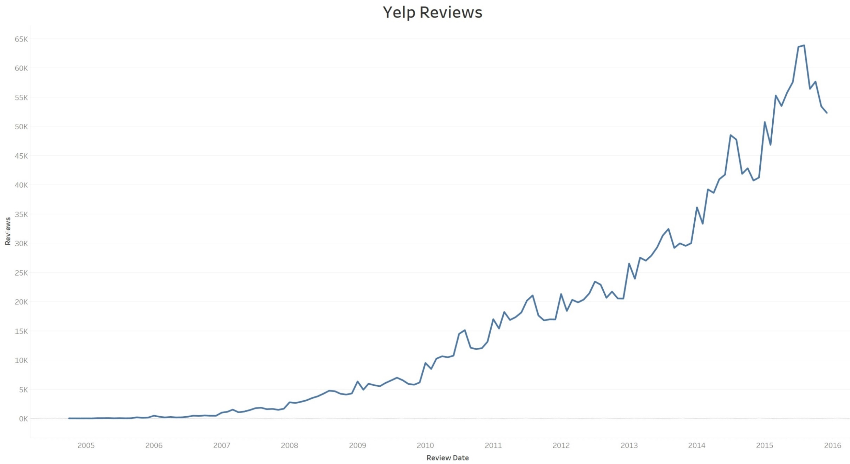
Introduction Methodology Models Conclusion
Final Dataset

Slide 7
Introduction Methodology Models Conclusion
Introduction
Methodology
Models
Conclusion

Slide 8
Introduction Methodology Models Conclusion
ARIMA
Process:
BC2 Function
Bulkfit Function
Create Model
Generate Prediction

Slide 9
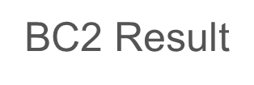

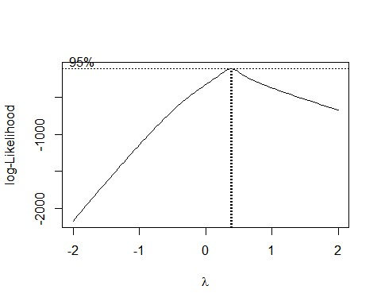
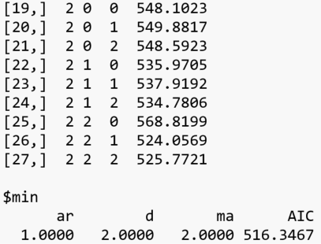

Introduction Methodology Models Conclusion
ARIMA

Slide 10
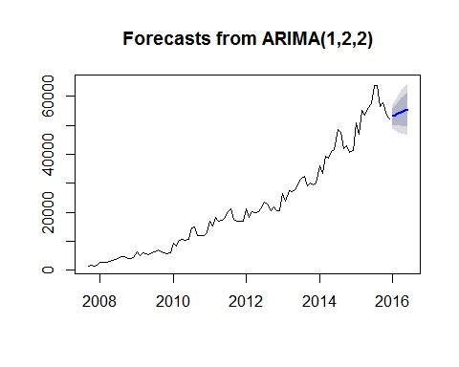
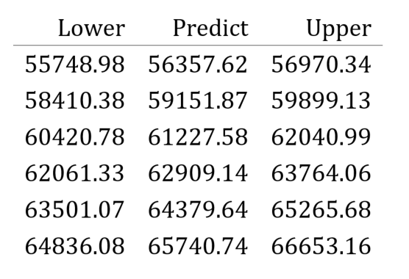
Introduction Methodology Models Conclusion
ARIMA

Slide 11
Introduction Methodology Models Conclusion
Seasonal ARIMA
Process:
Modify Bulkfit Function to include Seasonality
Create Model
Generate Prediction

Slide 12
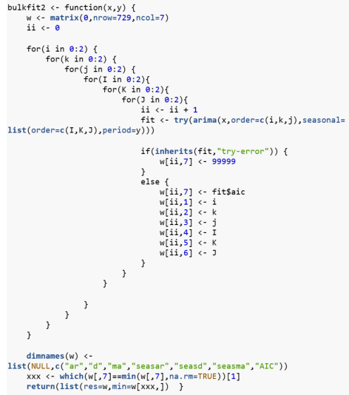

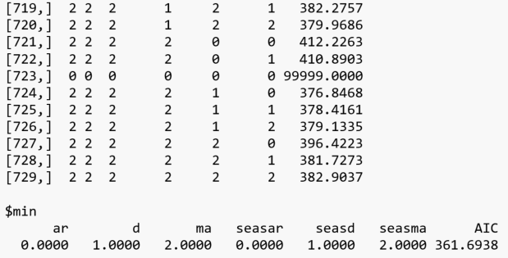
Introduction Methodology Models Conclusion
Seasonal ARIMA

Slide 13
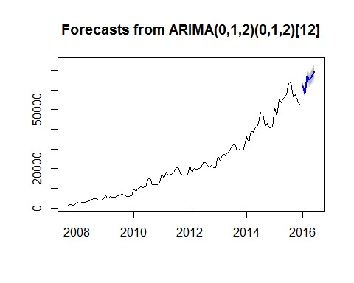
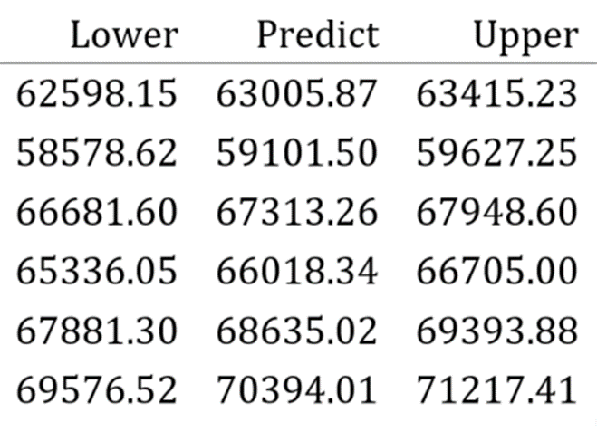
Introduction Methodology Models Conclusion
Seasonal ARIMA

Slide 14
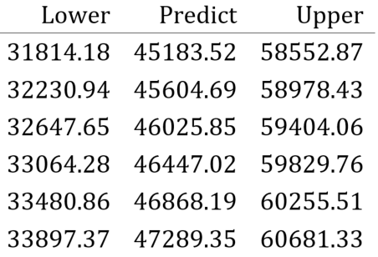
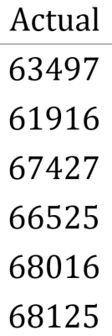
Introduction Methodology Models Conclusion
Model Comparison
Decom1 Result

Slide 15
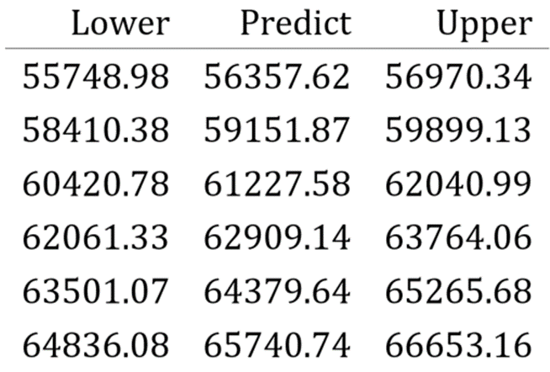
Introduction Methodology Models Conclusion
Model Comparison
Non-Seasonal ARIMA

Slide 16

Introduction Methodology Models Conclusion
Model Comparison
Seasonal ARIMA

Slide 17
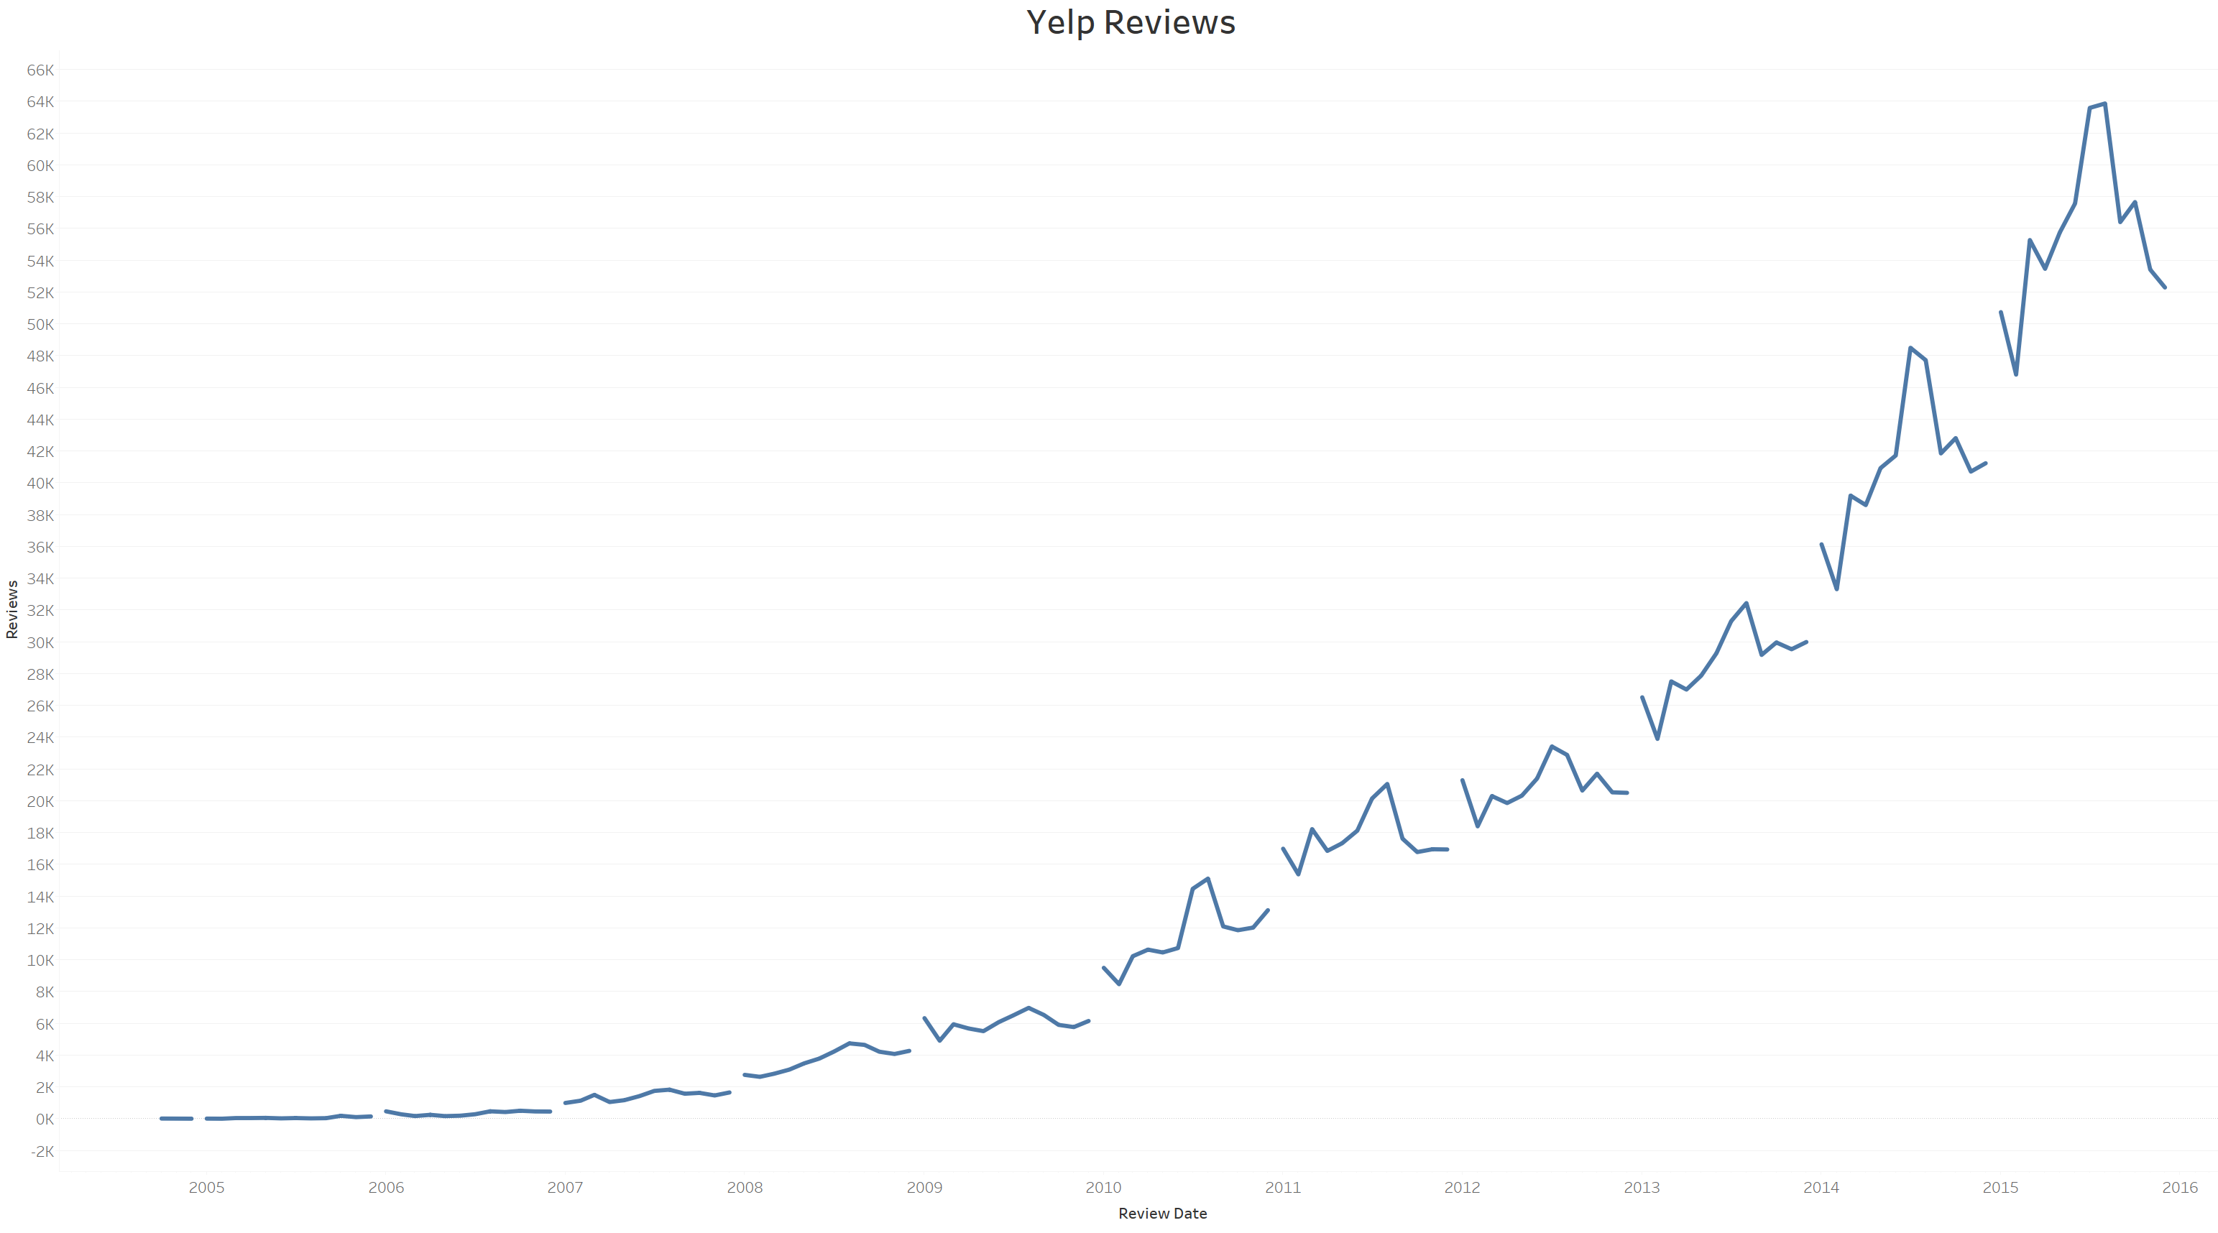
Introduction Methodology Models Conclusion
Discussion

Slide 18
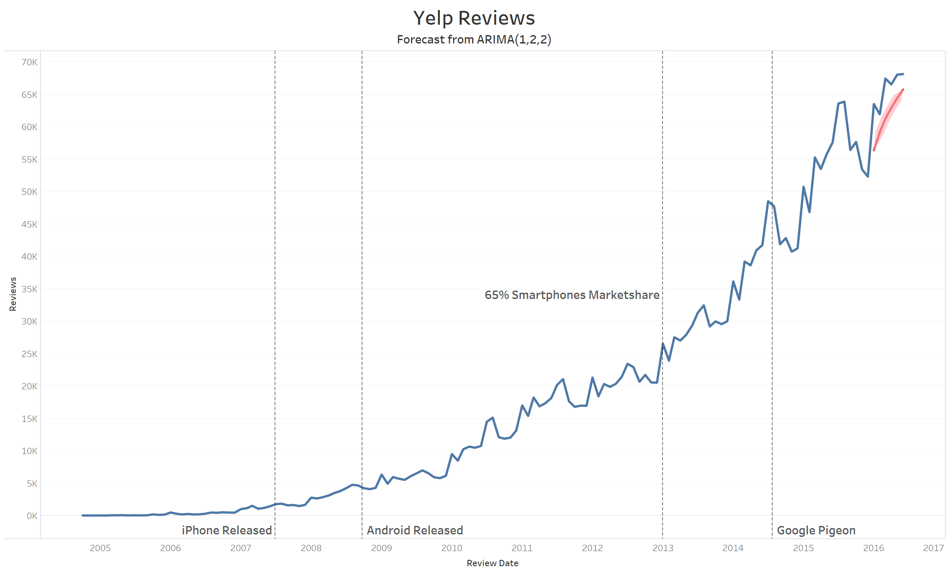
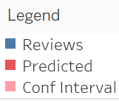
Introduction Methodology Models Conclusion
Discussion

Slide 19
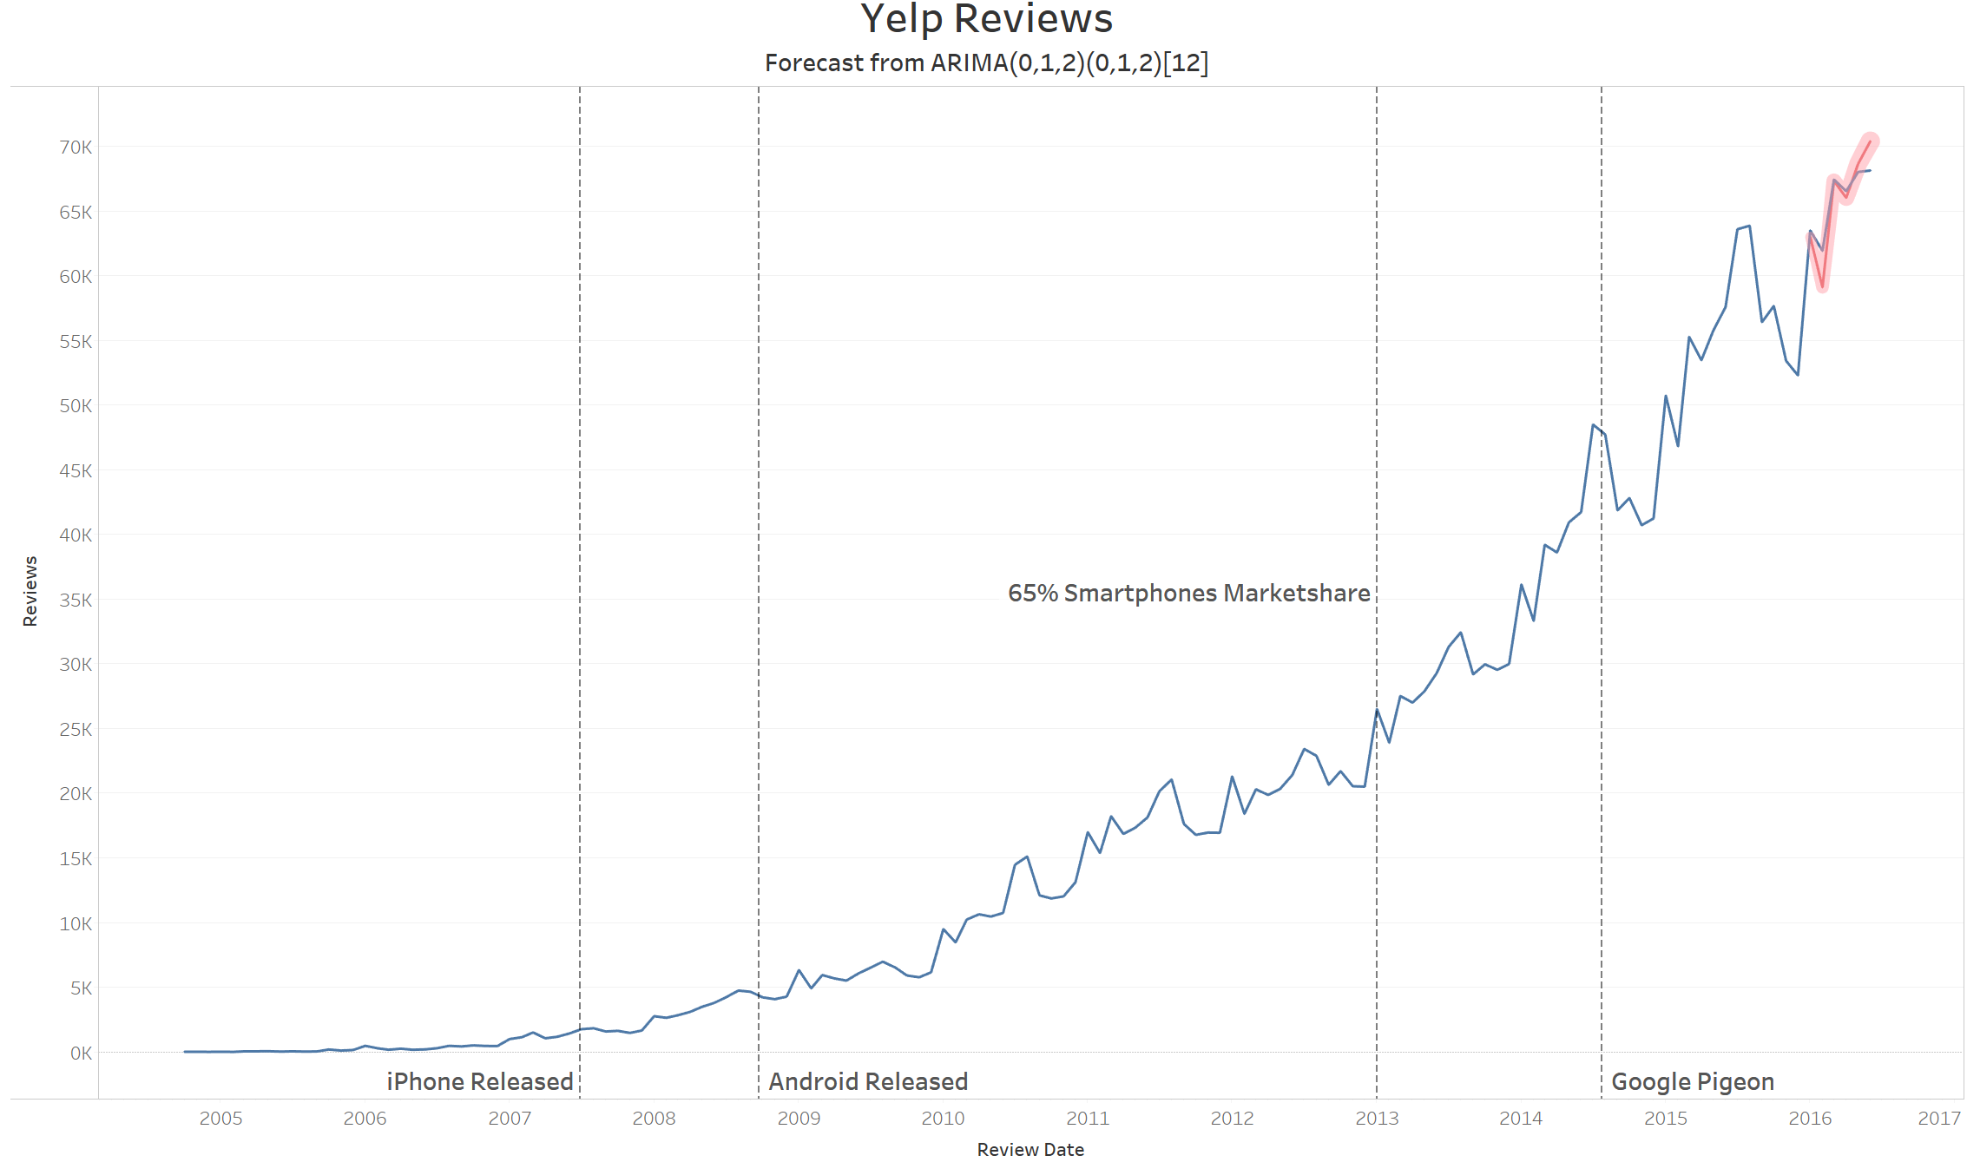
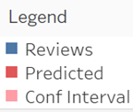
Introduction Methodology Models Conclusion
Discussion

Slide 20
Introduction Methodology Models Conclusion
Introduction
Methodology
Models
Conclusion

Slide 21
Introduction Methodology Models Conclusion
References
Yelp, "Yelp Dataset Challenge," August 2016. [Online]. Available: https://www.yelp.com/dataset_challenge. [Accessed 1 November 2016].
Zeileis A, Grothendieck G (2005). “zoo: S3 Infrastructure for Regular and Irregular Time Series.” Journal of Statistical Software, 14(6), 1–27. URL http://www.jstatsoft.org/ v14/i06/.

Slide 22
Introduction Methodology Models Conclusion
Questions

