Slide 1
Flow Join
Adaptive Skew Handling for Distributed Joins
UTN - CloudDB Project SS24
Irene Santana Martin, Tim Leonard, Luca Heller

Slide 2

Agenda
Problematic
What problem are we trying to solve?
Introduction
What is a Flow-Join?
What is our task?
1
2
Implementation
How does our solution look like?
Evaluation
What are our results?
What do they show?
3
4
Conclusion
5

Slide 3
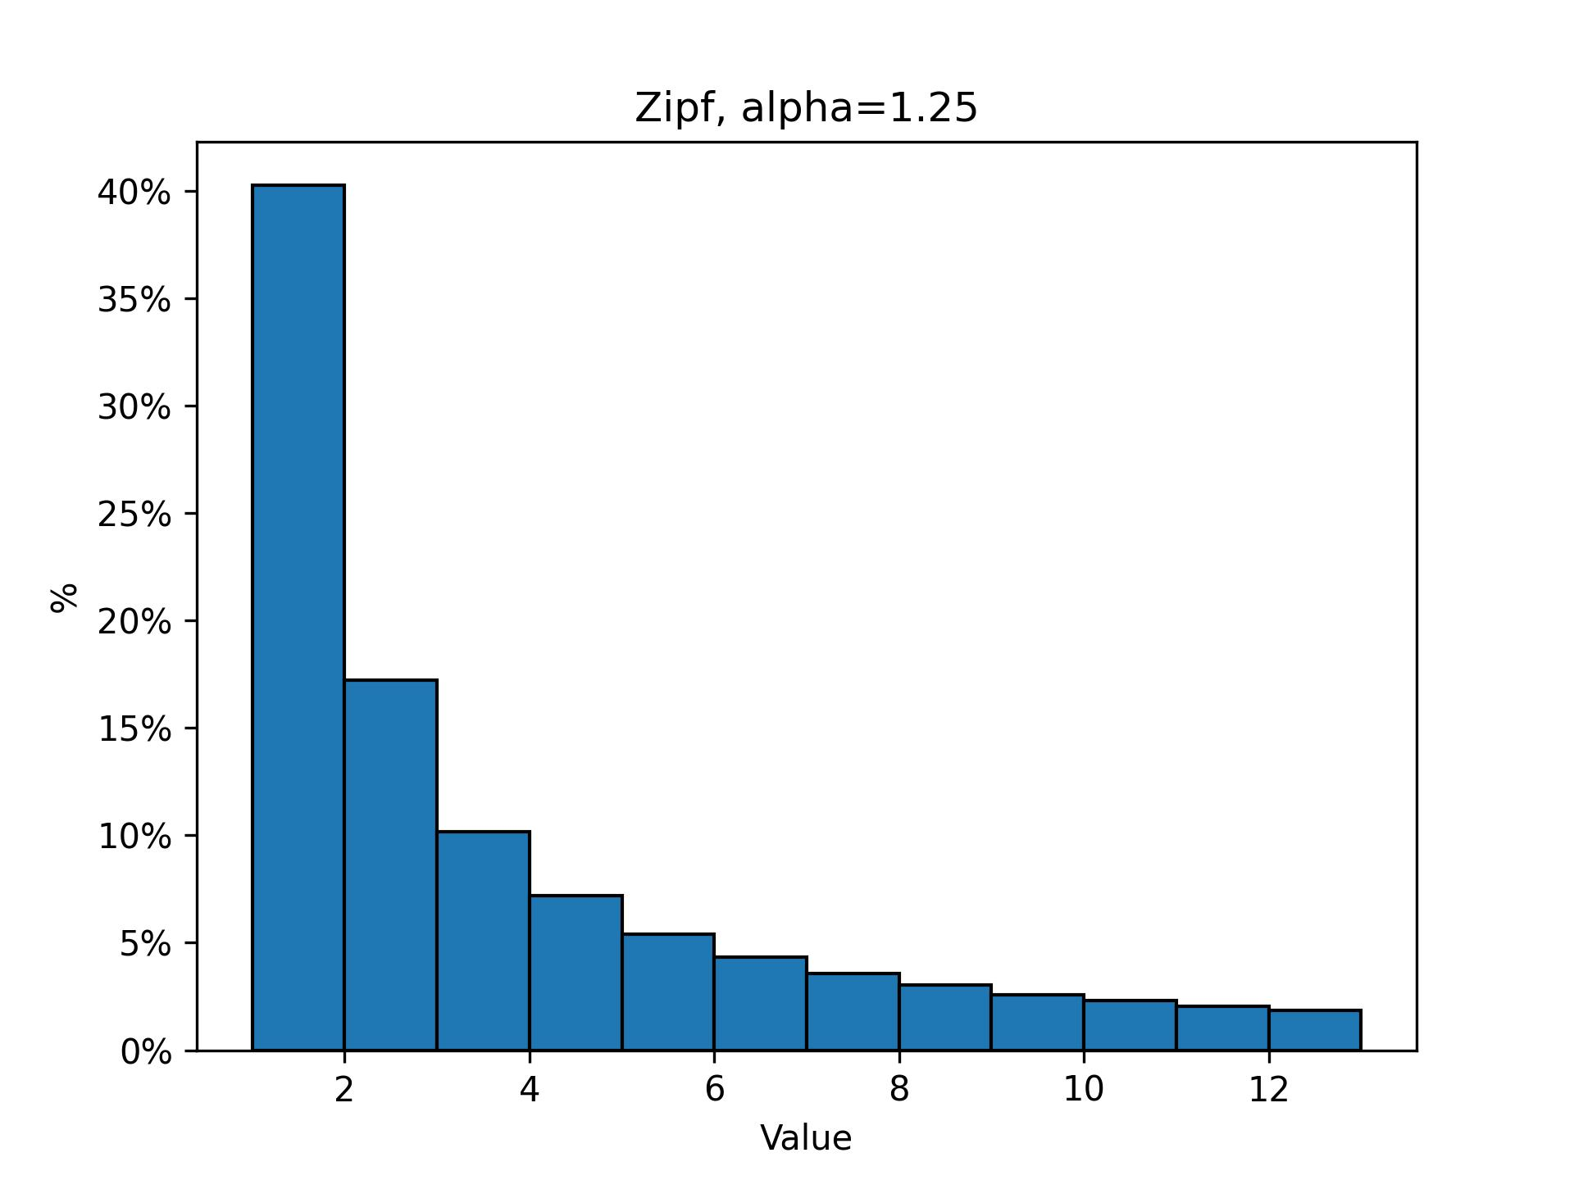
The Problem of Skewed Data

Slide 4
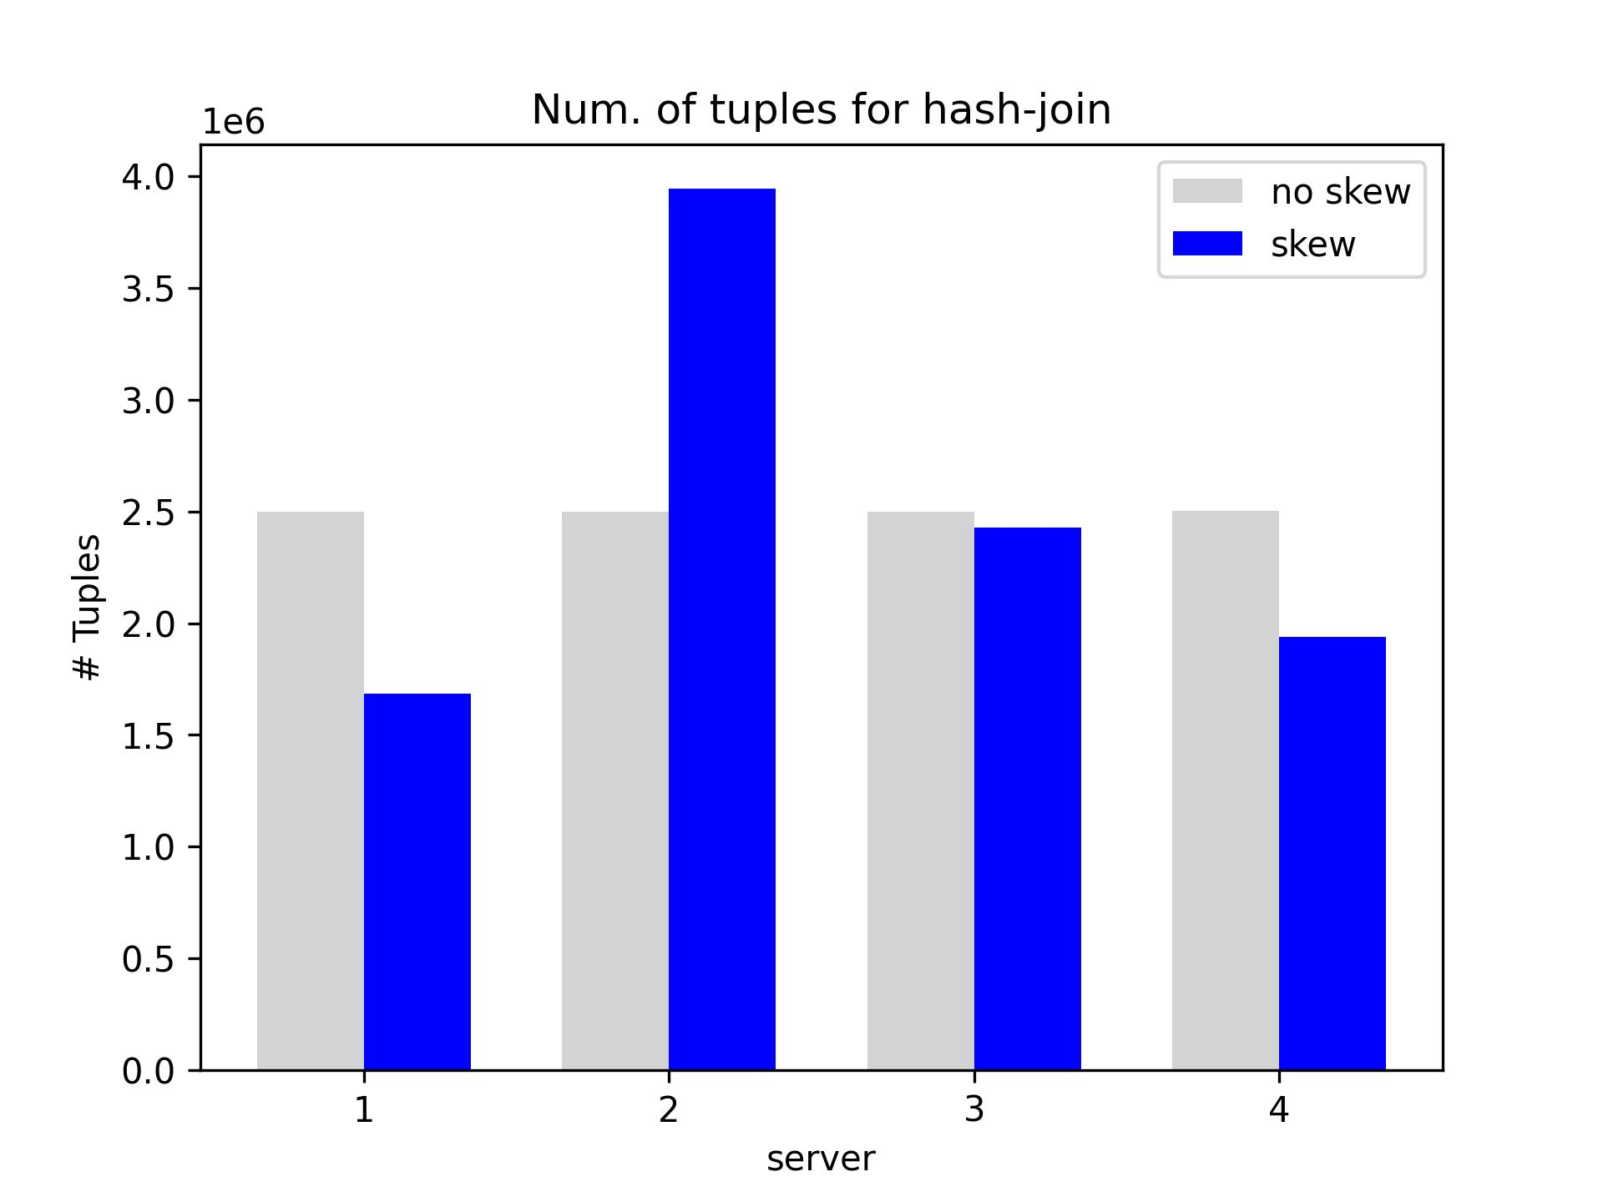
The Problem of Skewed Data
Notes:
or we add an image here or just have a title page

Slide 5
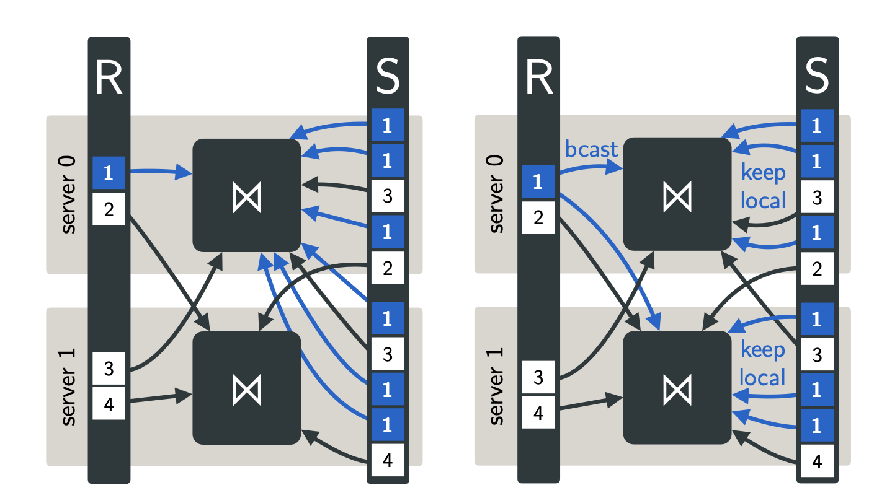
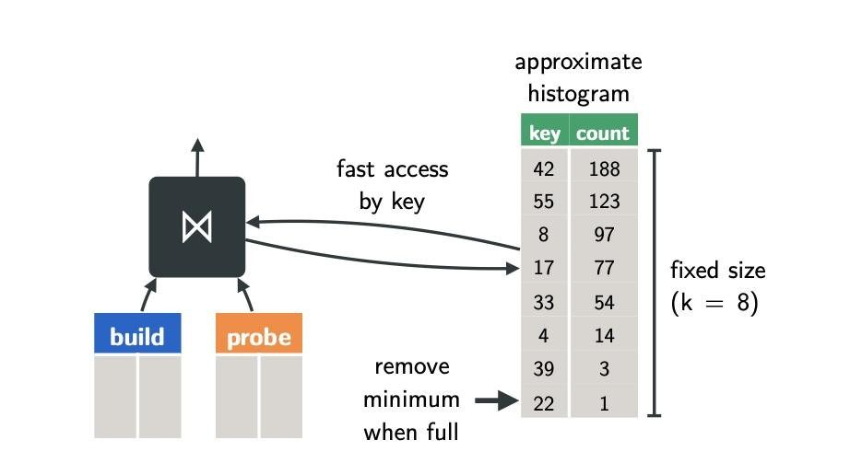
Flow Join (Rödiger W. et al.)
Source [1], Fig. 4
Source [1], Fig. 5

Slide 6
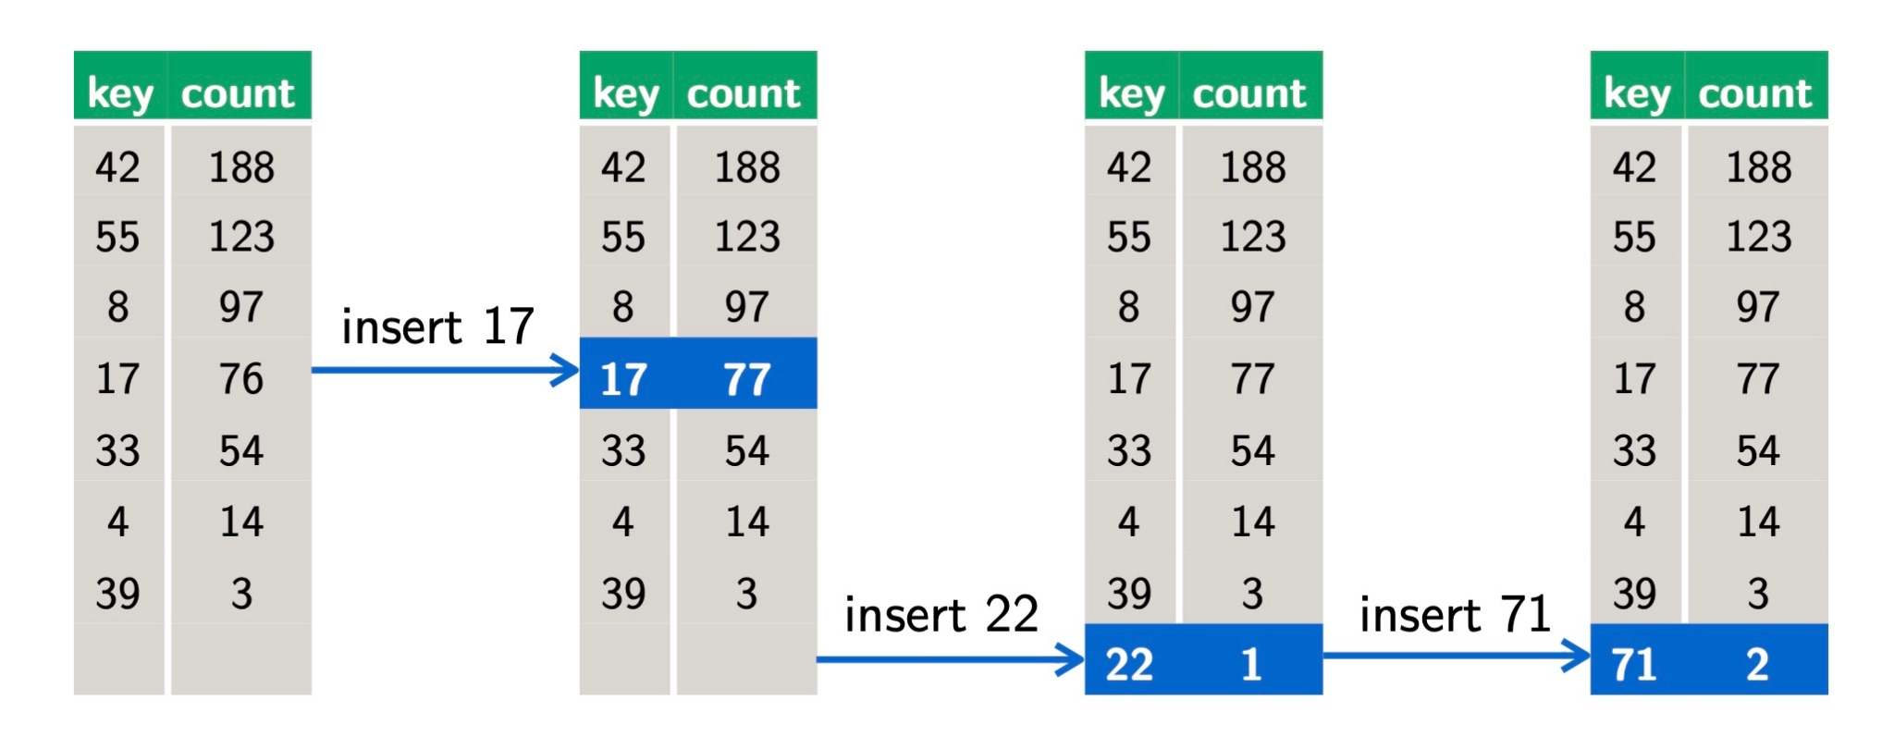
SpaceSaving Algorithm (Metwally A. et al.)
Source [1], Fig. 7

Slide 7
Implementation

Slide 8
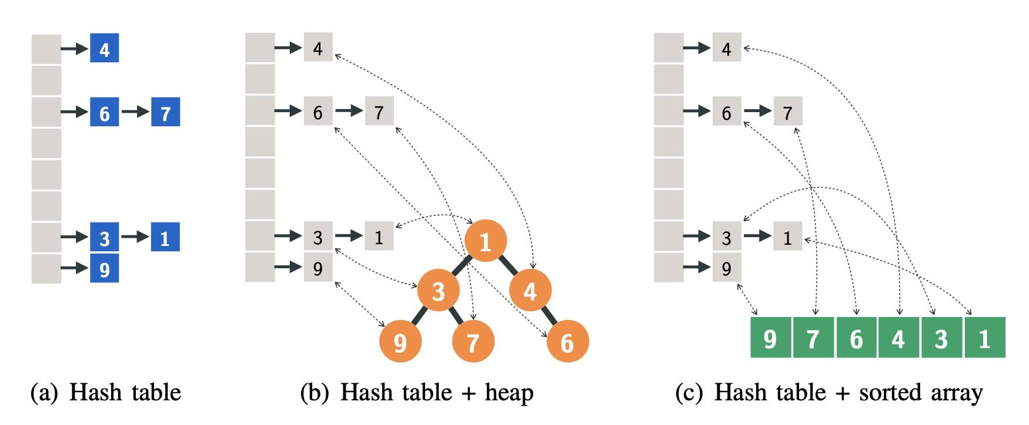
Comparison Data Structures
Source [1], Fig. 6

Slide 9
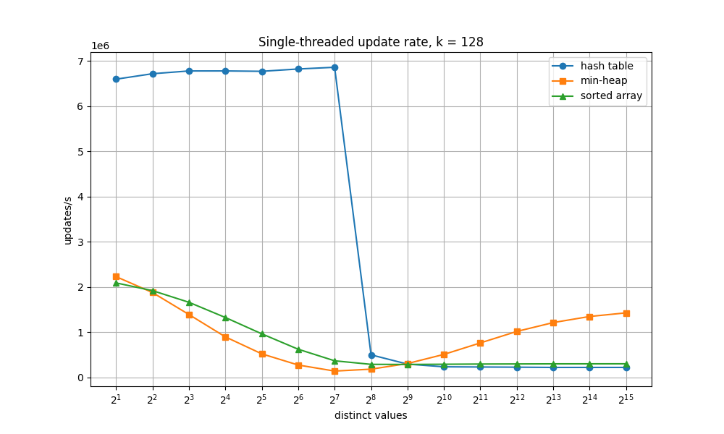
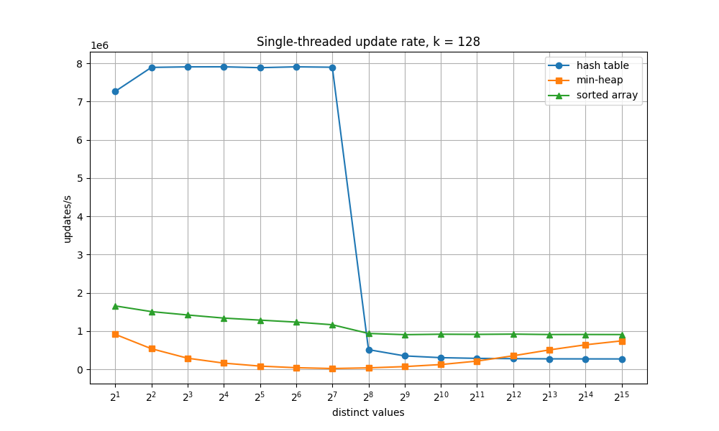
Comparison Data Structures
Performance: Python vs. C++
Python
C++

Slide 10
Results

Slide 11
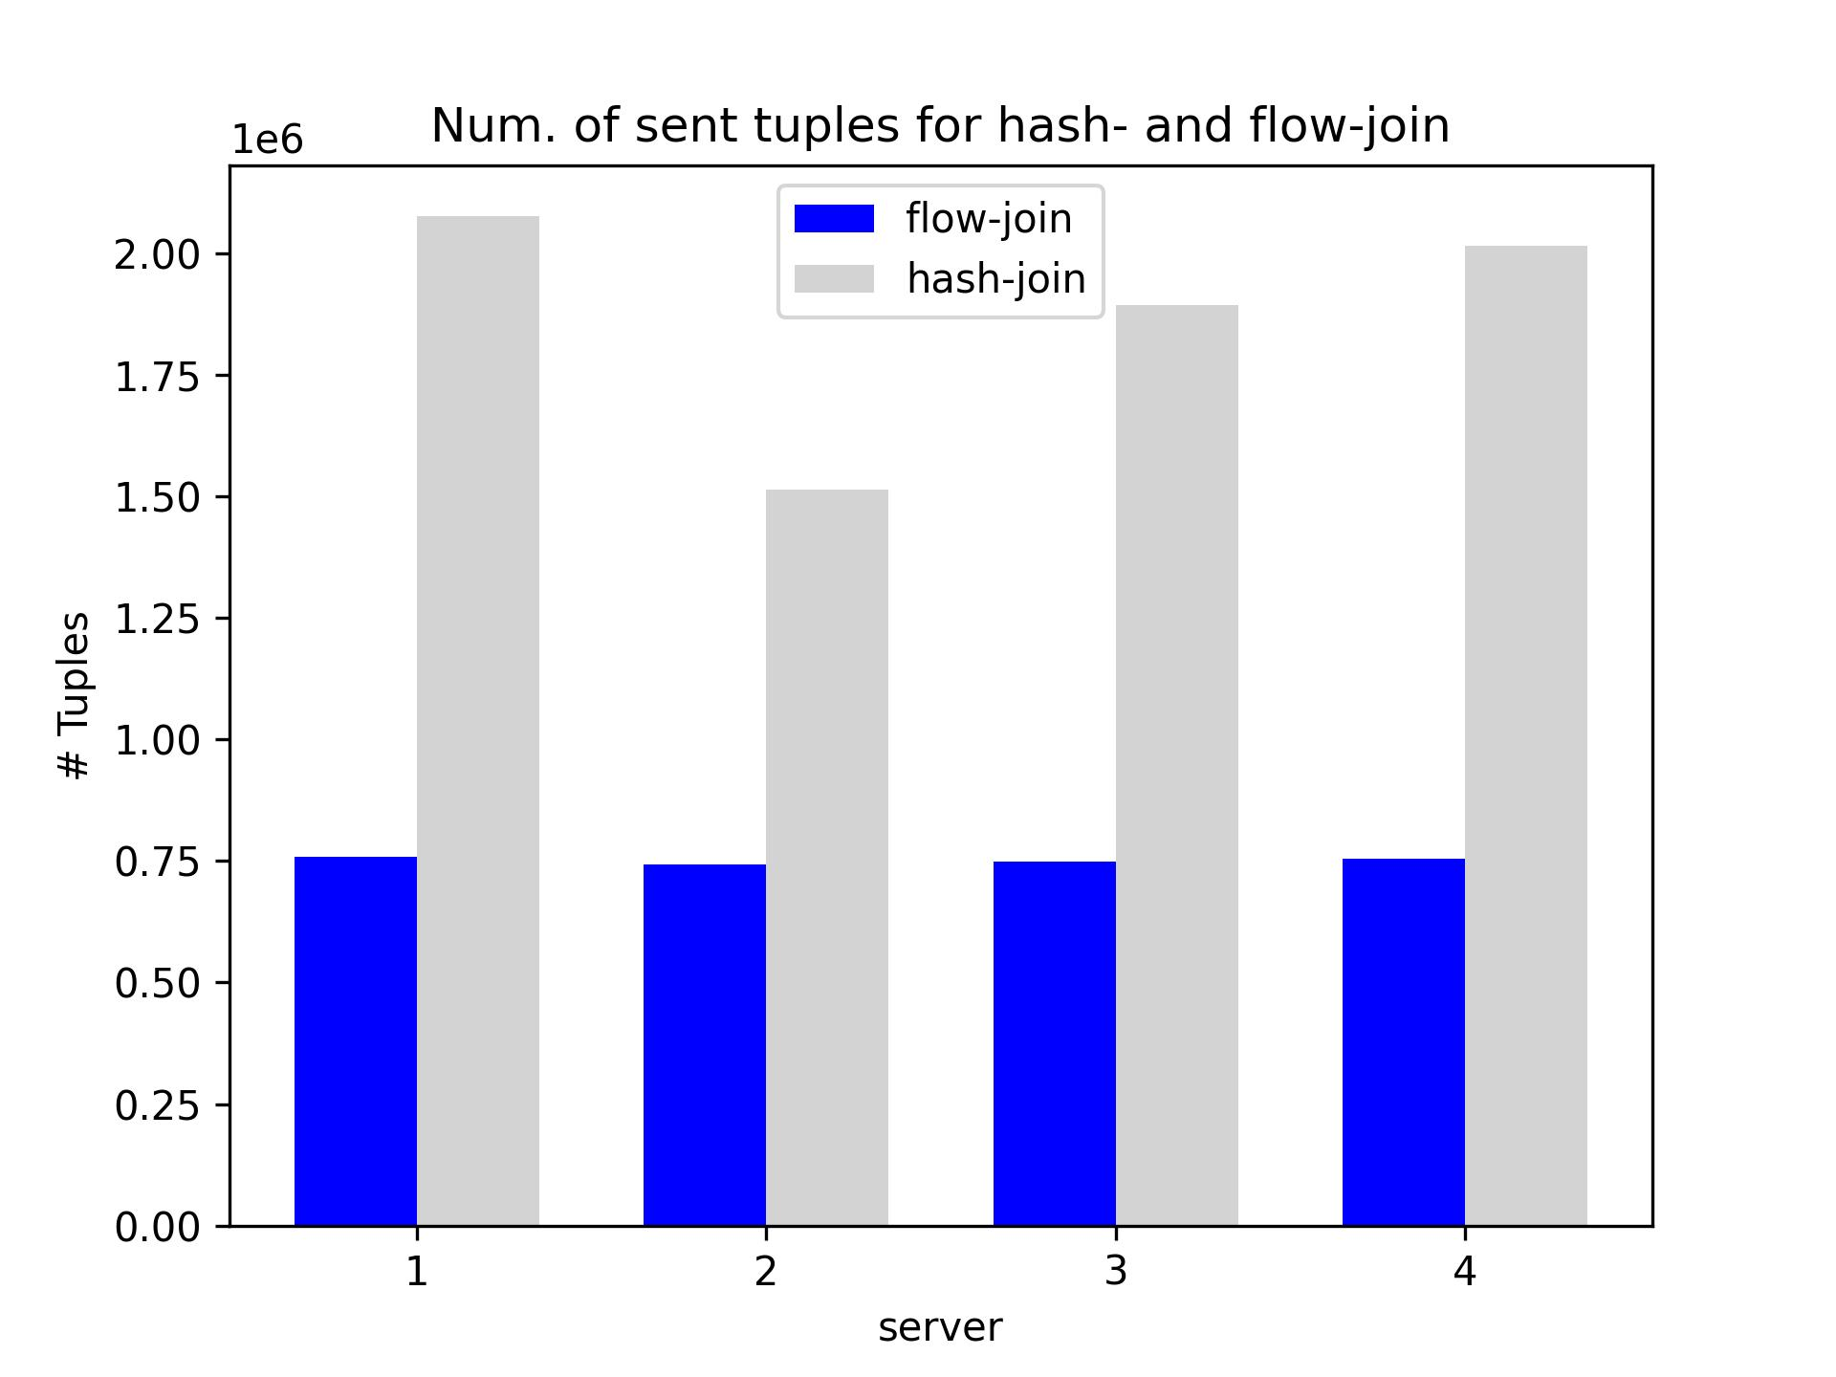
Results
Comparison Hash Join vs Flow Join
Number of tuples sent

Slide 12
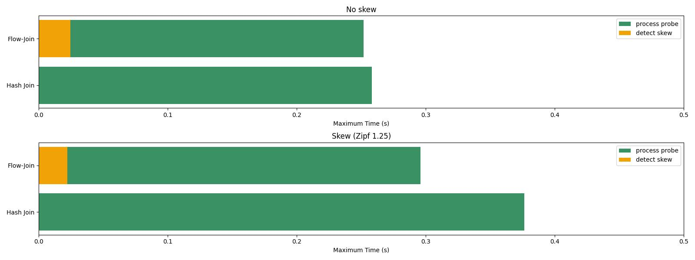
Results
Comparison Hash Join vs Flow Join
Execution Time

Slide 13
Conclusion

Slide 14
Thank you for your attention!
Q&A

Slide 15
Resources
[1] Roediger W. et al. Flow-Join: Adaptive Skew Handling for Distributed Joins over High-Speed Networks. 2016
[2] Metwally A. et al. Efficient Computation of Frequent and Top-k Elements in Data Streams. In ICDT, pages 398-412, 2005

