Slide 1
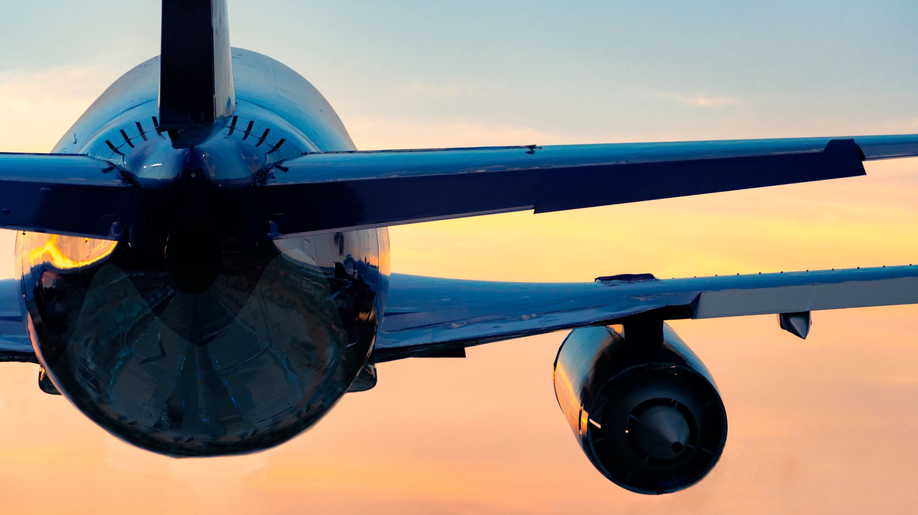
Airline Safety & How Media Has Impacted Us
An Executive Summary for Delta Airlines
By Monica Santana

Slide 2
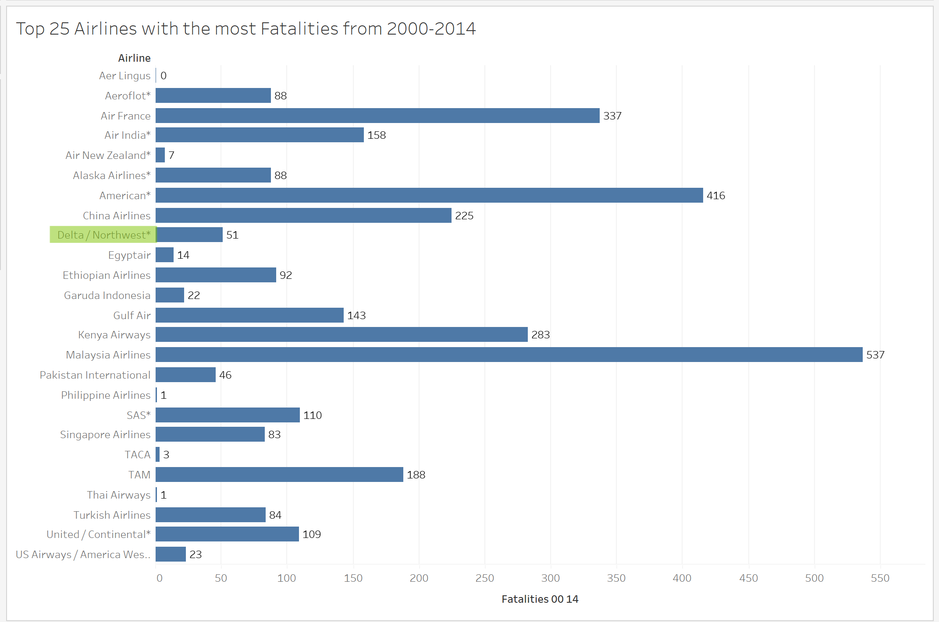
Is the Media Correct?
The answer is NO. Yes, there has been recent airline crashes, but does this show that overall airlines are no longer safe? Let’s look at the facts!
Delta Airlines is highlighted here in green and shows in 14 years from 2000-2014 there has been 51 fatalities. Overall, we have less fatalities than the top 25 airlines with the most fatalities from 2000-2014.

Slide 3
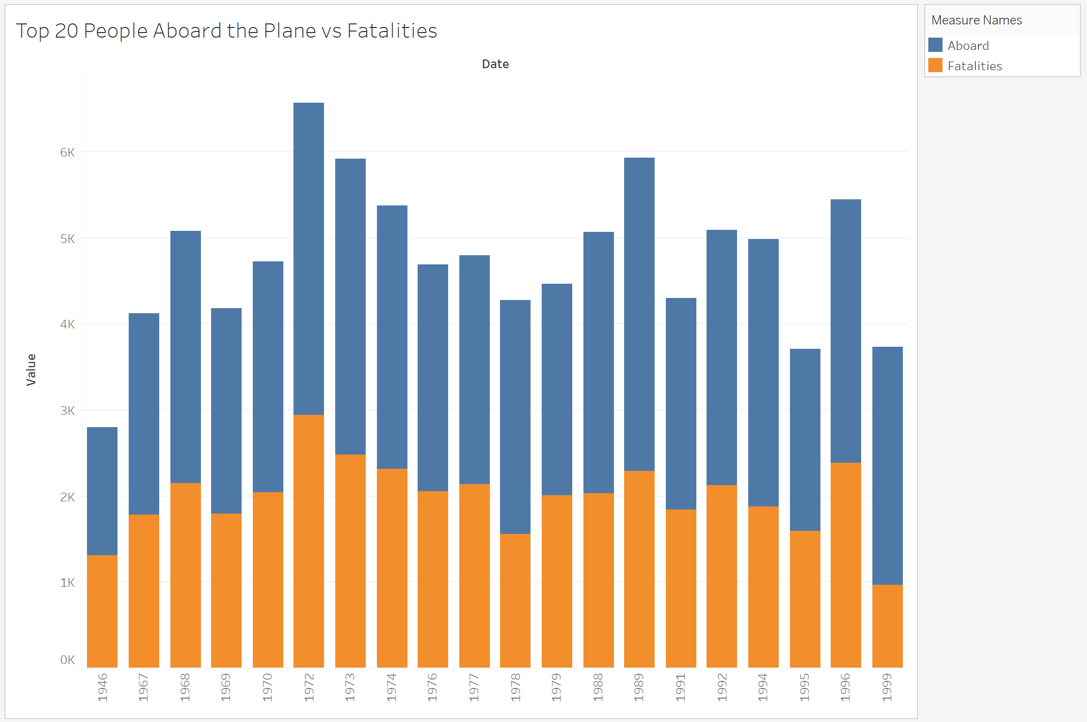
Not only is Delta safe, but all airlines
Here we can see in the top 20 airline crashes, most people survive the crash. Blue shows aboard and orange shows the fatalities, the aboard bars are always longer!
So even if the airline crashes, passengers aboard have a higher chance of surviving.

Slide 4
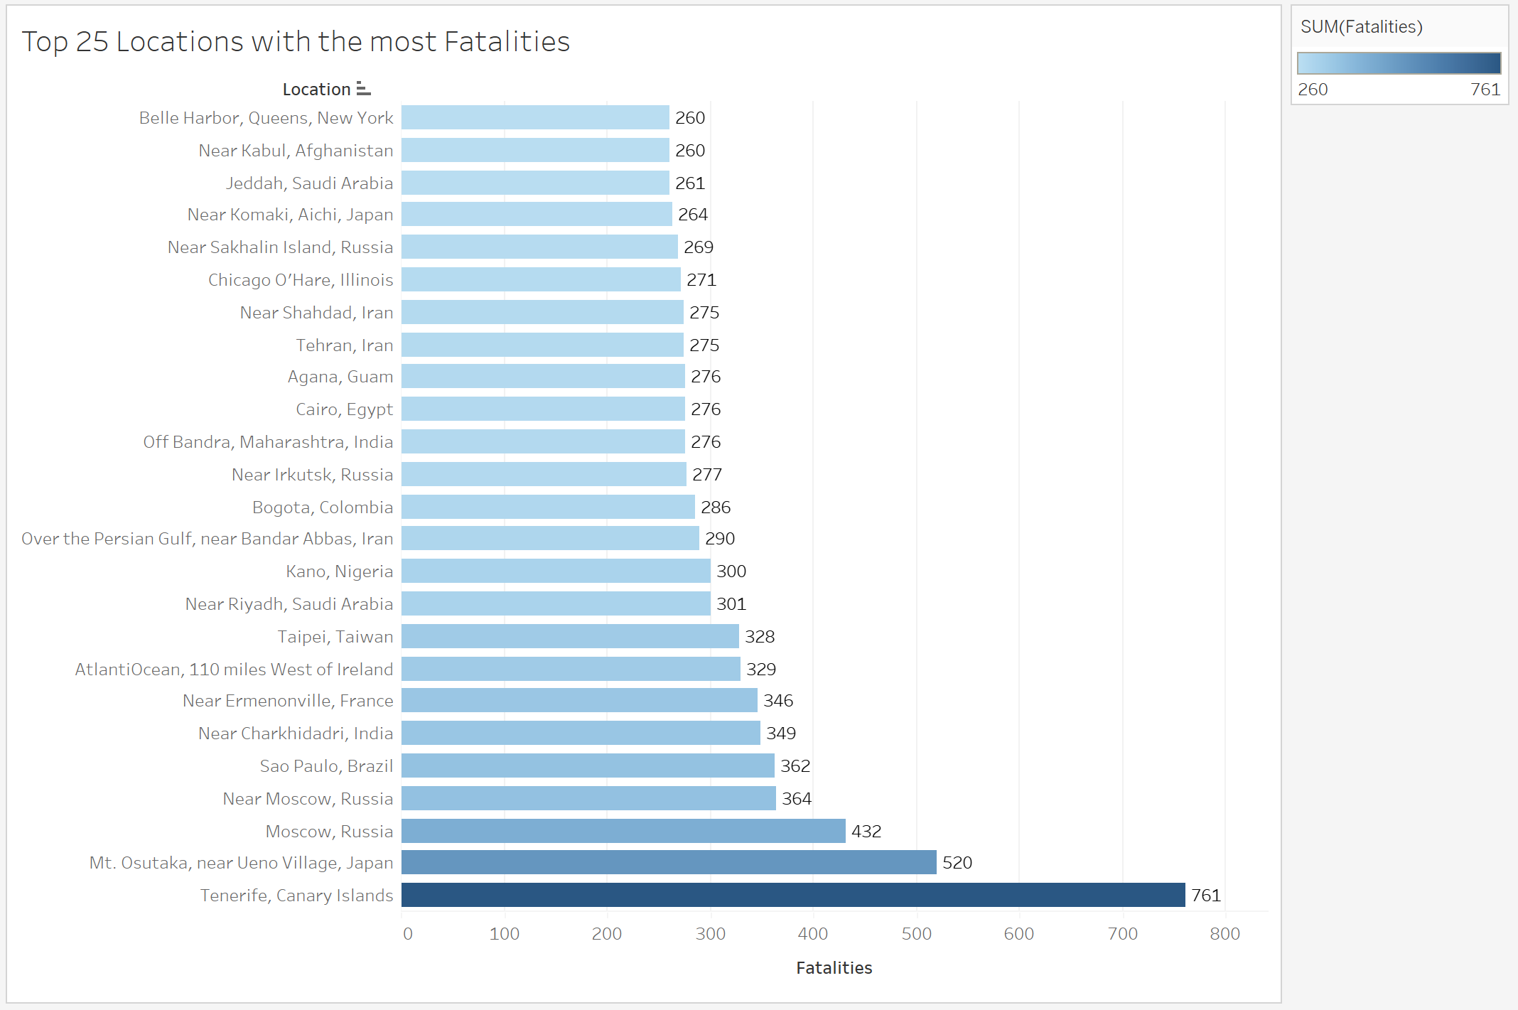
Where are most of these fatalities?
As a United States airline, we are concerned with primary fatalities in the U.S. Lets look at the data for the top 25 locations with the most fatalities.
This bar graph shows that the top location with the most is Canary Islands, and the least in this graph is New York. The only other state here is Illinois, so most fatal accidents are not even based in the U.S.

Slide 5
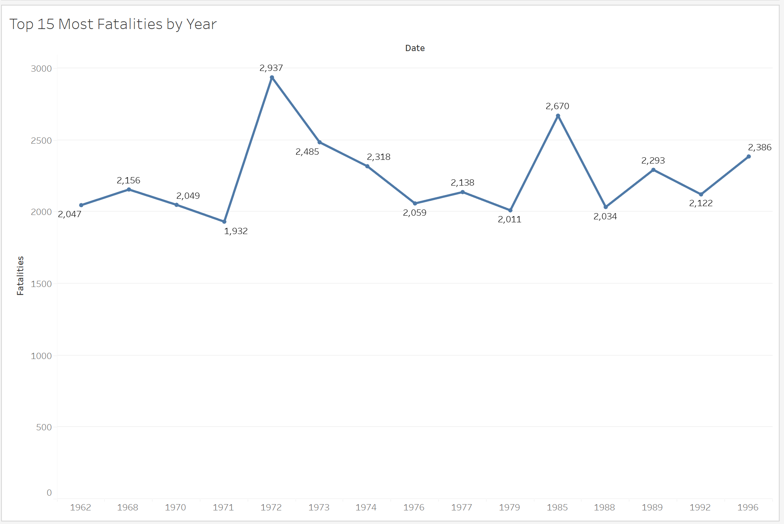
In fact, Airlines continue to get SAFER
Looking at the line graph by top 15 most fatalities by year, we can see that all these fatalities were between 1962-1996.
The media is distorting 1 recent airline crash and making it seem it happens all the time when it is NOT the case as shown here.

Slide 6
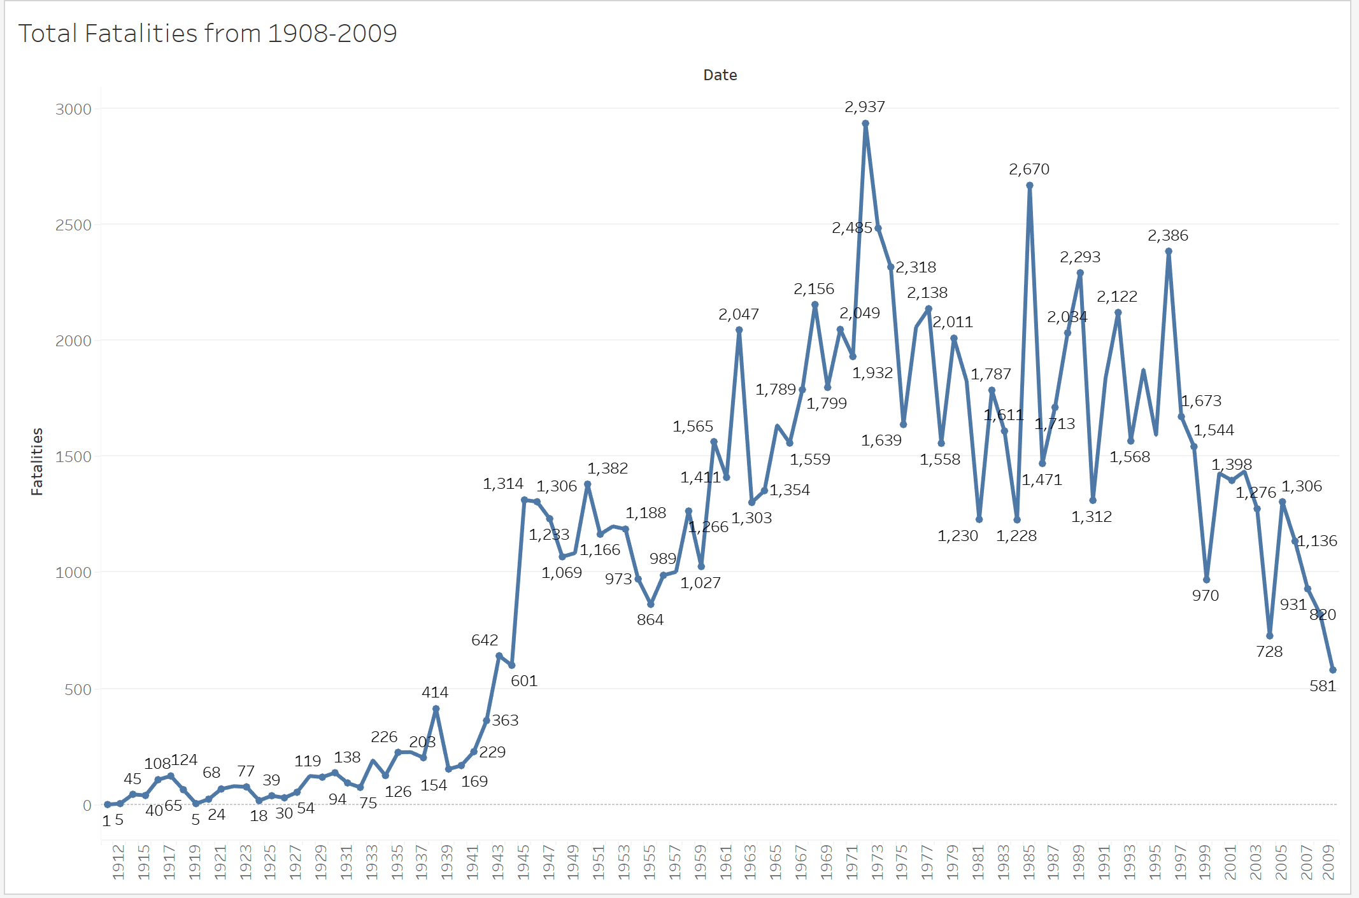
Let’s look at fatalities between 1908-2009
Here we can see that airplane fatalities have gotten less and less! This data accounts for all airlines not just Delta, so this goes to show how airline safety in general continues to improve each year!

Slide 7
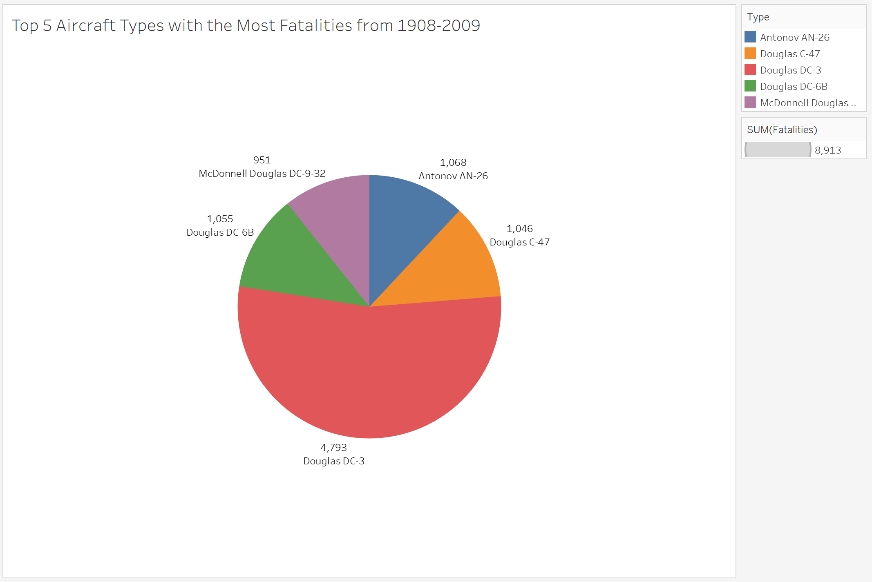
Types of Aircrafts
Delta Air Lines airplanes are manufactured by Airbus and Boeing. In fact, most commercial airplanes are.
The planes with the most fatalities from 1908-2009 were smaller aircraft types that commercial airlines do not use.
Which only strengthens the analysis of commercial air travel being safer than ever before.

Slide 8
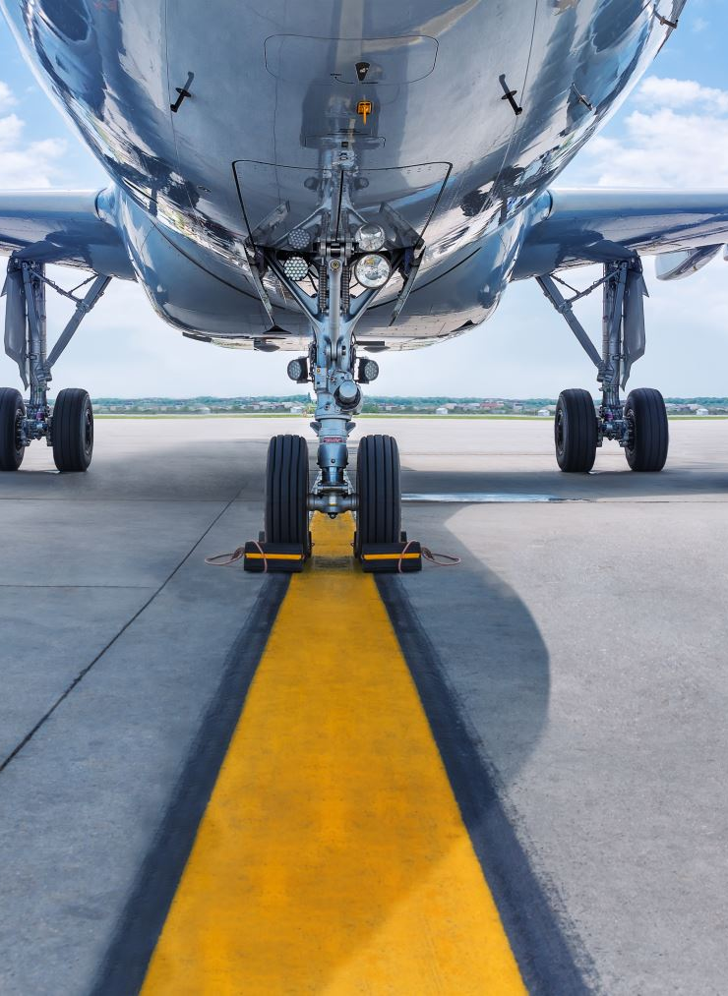
Portrayal of the Airline Industry
Delta Air Lines is the oldest operating airline in the United States. We take pride in this, and media has distorted our image and the industry.
“Air travel is the safest form of transit in the US. Injury and death rates in air travel in the US have been near zero each year since 2002.”
This executive summary shows proof of this with factual datasets and analysis shown through these graphs/visualizations.

Slide 9
References
USAFacts. (2023, December 19). Is flying safer than driving?
Is flying safer than driving? (usafacts.org)
Wikipedia. Delta air lines. Delta Air Lines – Wikipedia
Wikipedia. Delta air lines fleet. Delta Air Lines fleet - Wikipedia

