Slide 1
Best Practices in Nematology, Finding Nemo! -sampling for success -establishing nematode gardens
Jon Hamill, Product Biology Jan 2018

Slide 2
Currently
SYT BR&D Scientists have good capability to conduct internal Herbicide, Fungicide, and Insecticide trials.
We do have some capability to conduct some Nematode trials internally, this capacity is increasing, but still remains limited.

Slide 3
Future Plans- Why do we need more capacity?
Continued screening of compounds for Nematicidal activity in Stein
Early Stage compounds cannot go to COI’s- IP/Secrecy
Immediate need-
continued development of CLEO (100+ trials in BioPlan for CP/seedcare)
Submission still 3 years away
Support needed until/after registration (2024 and beyond)
CLEO (peak sales) potential could be a $200M business (US)

Slide 4
Goal- To Expand Internal Capacity
Guidance
Transfer expertise to locations that may have capability (climate, soils, and crops), but lack the experience to conduct the trials
By establishing new on-farm nematode sites for trials (RKN)
Looking for grower fields with strong nematode history (SCN, RKN, Others)
Internal Support
Eliminate the perception that nematode trials are too difficult
Provide inoculum and direction for Internal scientists to conduct trials in small field experiments and infesting fields
TIME
MONEY
PERSISTANCE

Slide 5
Agronomic Crops
Prospecting
Look for Symptoms in Fields
Ask Growers, Crop Advisers, University for leads….
Sample
Sample
Sample (we need money and time to do this)
GPS and Mapping of potential trial sites
Timing
Corn- Lesion numbers blow up at end of season (soil and roots)
Soybean- Cyst counts highest around harvest, eggs most important
Wheat- Lesion/Cyst counts highest in late spring when crop is present
Cotton- for RKN, just pull up plants. For Reniform, mid-August
Peanut- look at pods and pegs at harvest

Slide 6
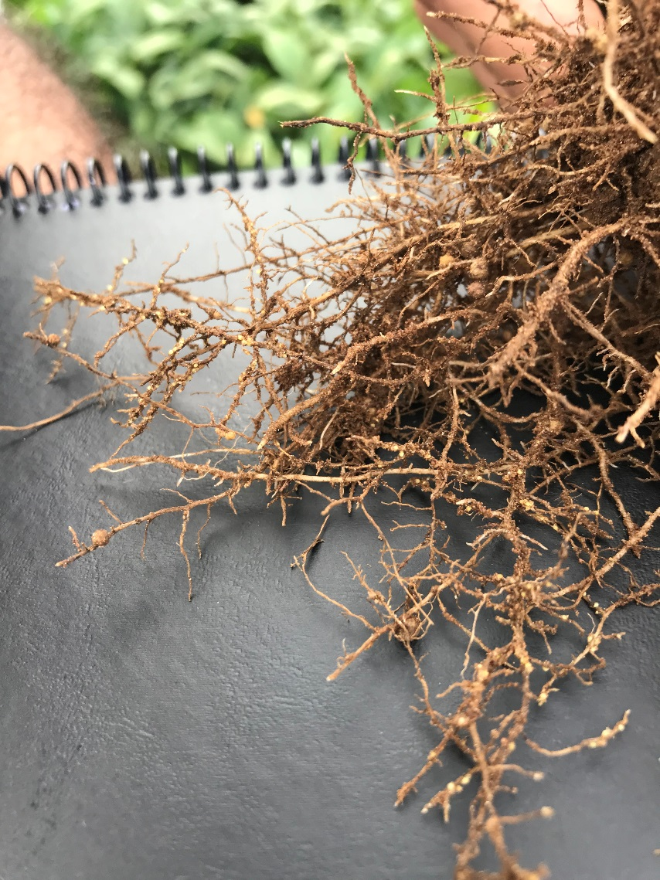
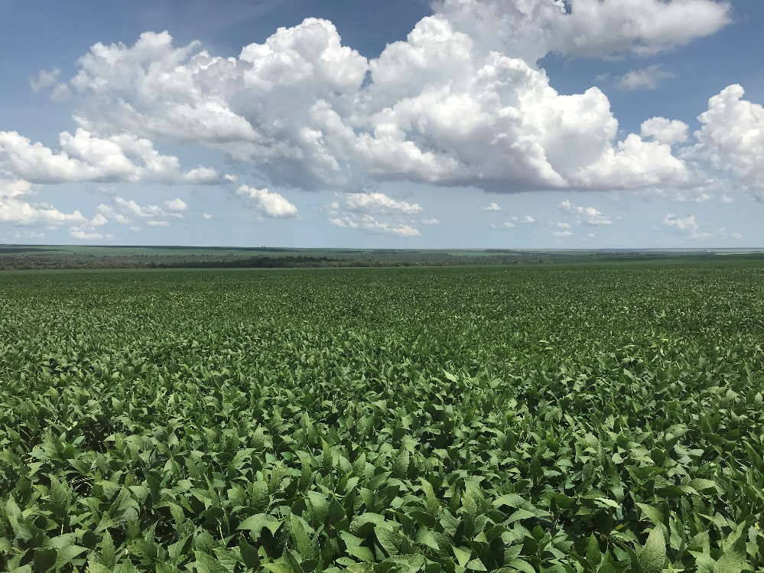
Do we need to Sample? Soybean Example.

Slide 7
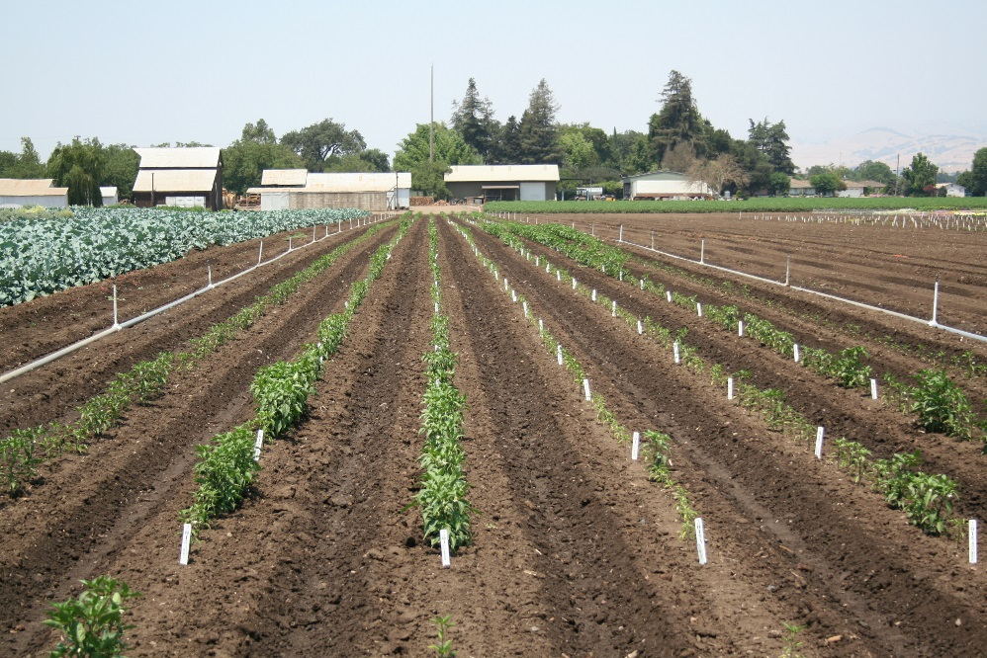
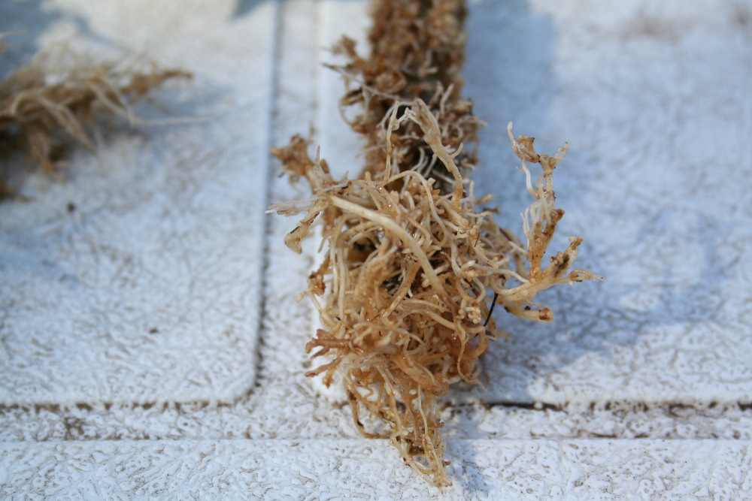
Do we need to Sample? Pepper Example.

Slide 8
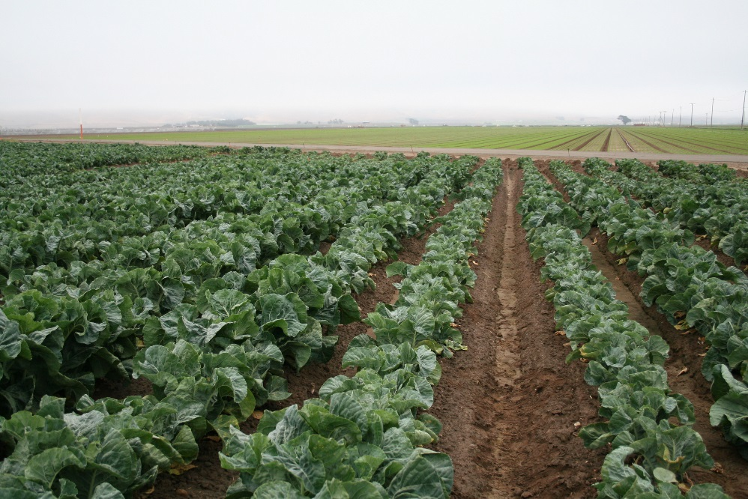
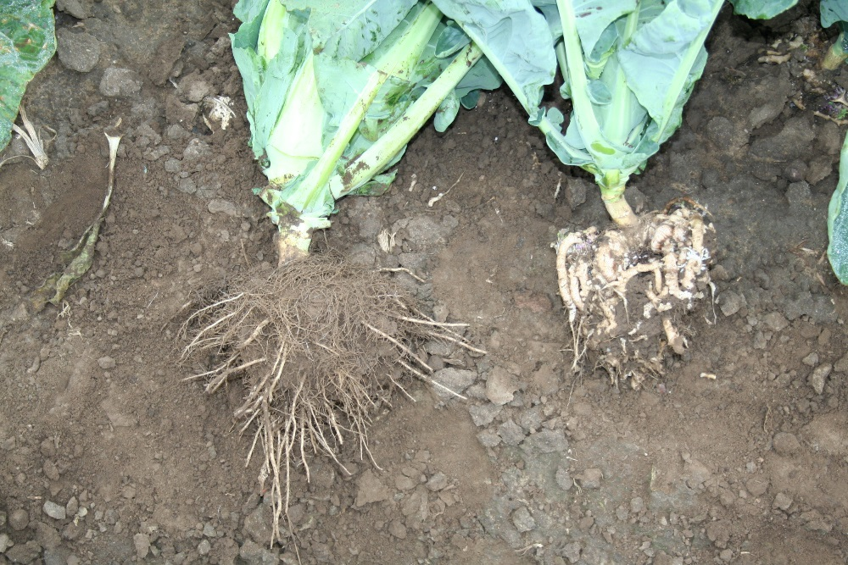
Do we need to Sample? Cauliflower Example.

Slide 9
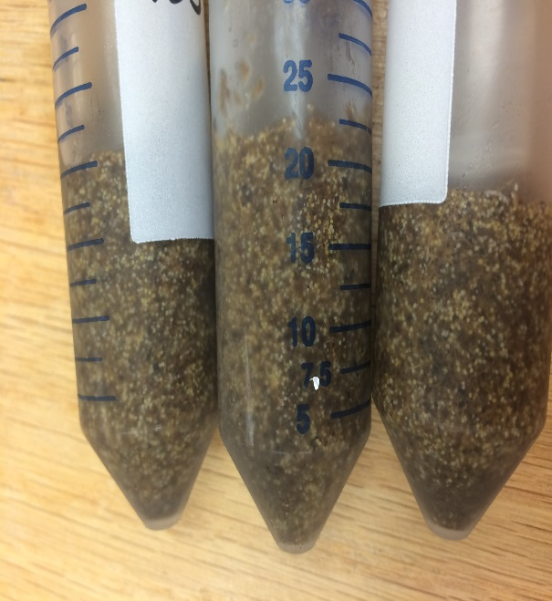
Horticultural Crops (RKN-using eggs)
Production of Cysts, Eggs, and J2’s to inoculate micro-plots and small field experiments. Production of nematodes at Vero Beach in greenhouse and ready to ship in the spring to Scientists.
Root Knot
M. incognita
M. javanica
M. arenaria
M. hapla
Soybean Cyst (microplot only)
Lesion Nematodes (microplot only)
Other Ectoparasites (?)
Requires Aphis Permits!

Slide 10
Horticultural Crops (using eggs)
RKN and Cyst nematodes are different
A cyst is a survival mechanism, eggs retained in the cyst can require a hatching factor (host plant) to become active
For RKN, the survival stage is a J2. It must live off its fat reserves to survive. If no host is present, it moves downward to find cooler temperatures to slow metabolism
For RKN, if the plant host is stressed, the nematode is stressed
Best to apply eggs when the soil temperature is cooler
Make sure the soil is moist
Placement of the eggs deeper in the soil instead of in the upper rhizosphere (#2 pencil)

Slide 11
Horticultural Crops (using eggs)
Inoculating a crop to increase the nematodes before conducting the trial
Eg. On plastic mulched beds, plant a crop of cucumber, inoculate with nematode eggs, grow crop for 42-60 days. At end of duration, cut off plants and remove, plant trial into same beds, adjacent plant holes.
Innovation- Inoculating eggs via the drip system.
Cover cropping (Feeding your nematodes)
Always!
During fall and winter clover and vetch works well. During summer do not leave fallow, okra makes a good cover crop.

Slide 12
Horticultural Crops (using roots)
To start nematode fields consider gathering inoculum locally from “terminated fields”
Scouting and maintaining touch with growers/ASR’s/Sales/Channel
Dig roots once crop has been abandoned, but prior to tillage
Root-Knot easy to discern, collect root masses in back of pick-up truck or store in coolers/totes (short term)-quickly move them to desired field site
Apply infected root systems to your own site
Use middle plow or shovels to open trench
Distribute infected root systems in trench
Cover with soil –(Can also bed bedded over and mulch laid on top)
Cover Crop! Multiple times if necessary
Summer- Okra
Fall- Clover and vetch

Slide 13
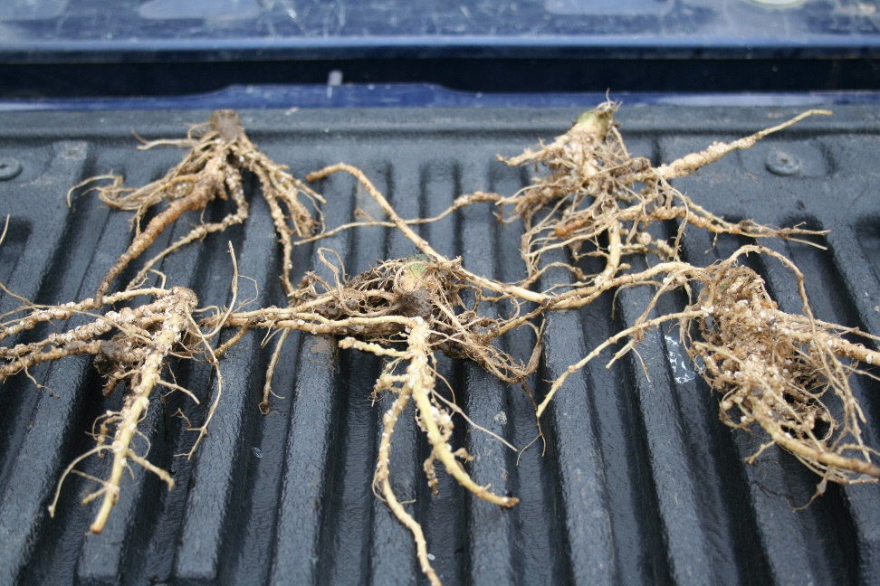
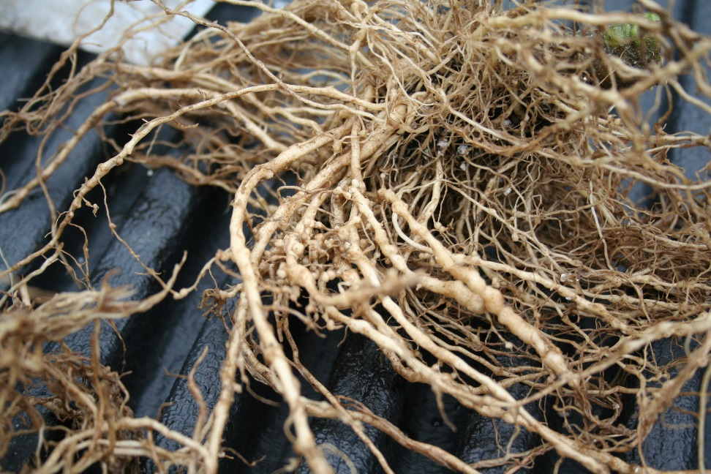
Using a primary crop to increase nematode populations before planting a trial
Squash 6 Weeks after Planting
Tomato 6 Weeks after Planting

Slide 14
Summary
Row crops- Need to Prospect and Sample, nematodes are out there…somewhere….
We can help you with inoculum, we just need advanced notice. 130 days is ideal (42 for transplant, 90 days of cook time)
Nematode eggs are fragile, need to be babied.
Cover Cropping- Feed your todes!
Questions or Comments?

