Slide 1
Current EDC Hardware
Survey results compiled from 12 Field Scientist currently using Surface Pro 7

Slide 2
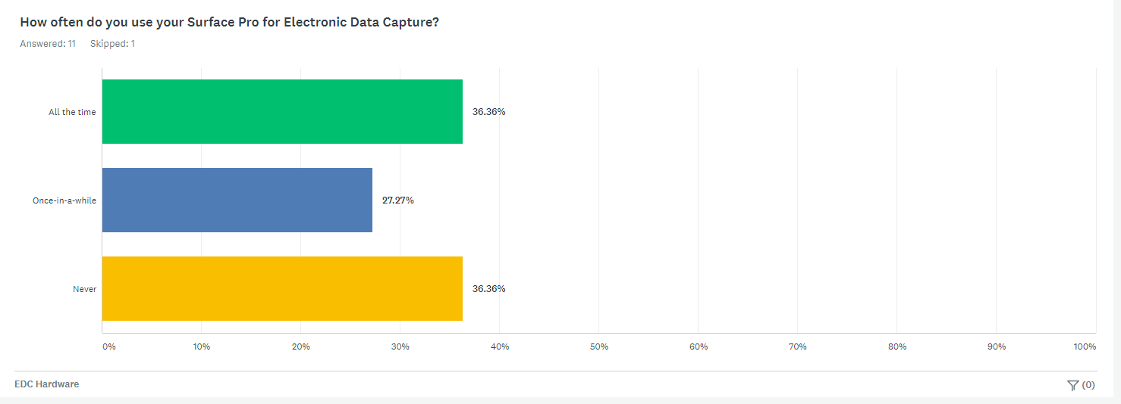
Device Adoption – Surface Pro

Slide 3
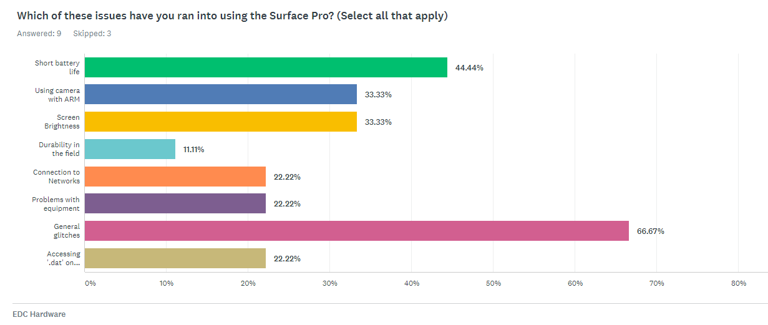
Surface Pro Painpoints

Slide 4






User Comments

