Slide 1
Home Value Evolution (2016-2020)
Student: Renata Sant’Anna
Final Project – Part 1: Time series analysis using JavaScript, HTML.
Final Project – Part 2: Analysis using scikit-learn library to run regressions and predictions (All ML tools).

Slide 2
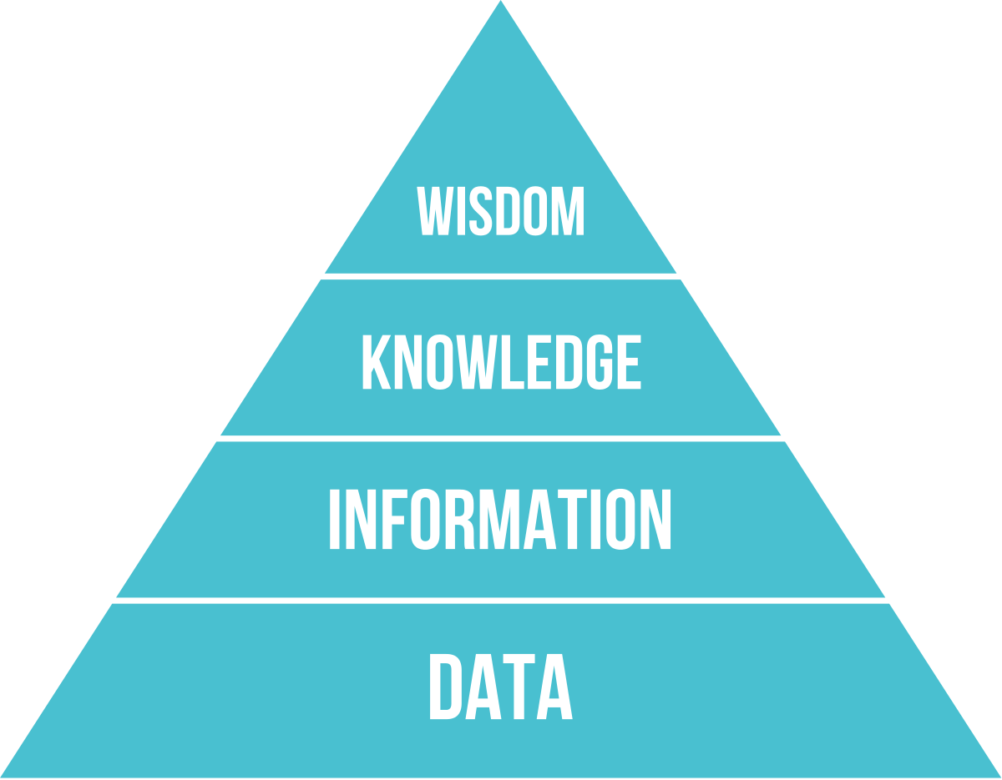

Slide 3
Analysis – Part 1
Data:
Zillow Home Value Index (ZHVI): A smoothed, seasonally adjusted measure of the typical home value.
CSV files -> json
Filtered Data:
Tennessee > Metro Area: Nashville, Davidson, Murfreesboro, Franklin > Counties
Counties Analyzed (14):
Davidson, Rutherford, Williamson, Sumner, Wilson, Maury, Robertson, Dickson, Cheatham, Hickman Macon, Smith, Cannon and Trousdale.
Time period:
Monthly data from Jan/2016 – Mar/2020
How home values have evolved between 2016 to 2020?
Answer:
http://santannarenata.github.io/

Slide 4
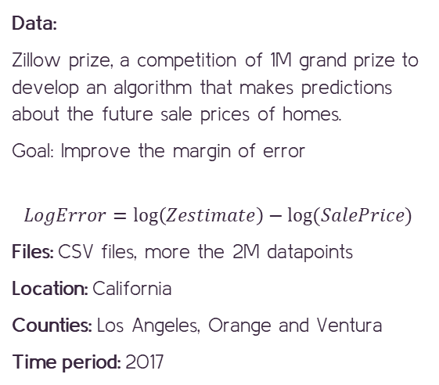
Analysis – Part 2
Data:
Zillow prize, a competition of 1M grand prize to develop an algorithm that makes predictions about the future sale prices of homes.
Goal: Improve the margin of error
$$LogError=\log\left(Zestimate\right)−log⁡(SalePrice)$$
Files: CSV files, more the 2M datapoints
Location: California
Counties: Los Angeles, Orange and Ventura
Time period: 2017
Data dictionary:
Id
Bedroom count
Bathroom count
Calculated finished square feet
Lot size square feet
Year built
Region id county
Tax value ($)

Slide 5
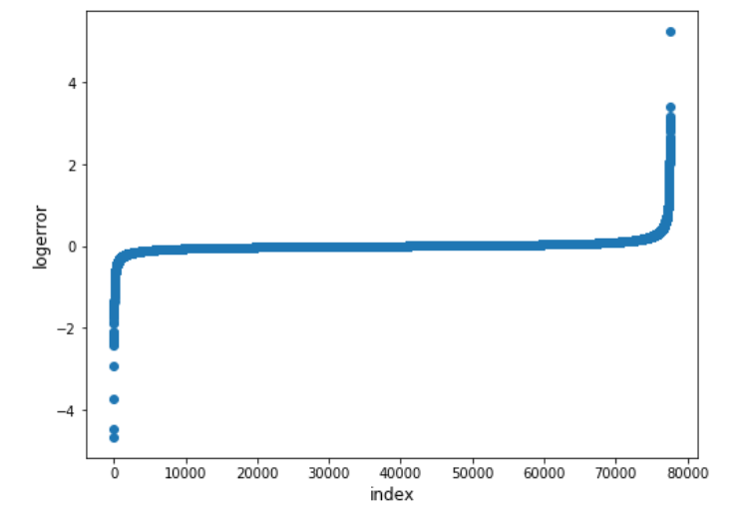
$$LogError=\log\left(Zestimate\right)−log⁡(SalePrice)$$

Slide 6
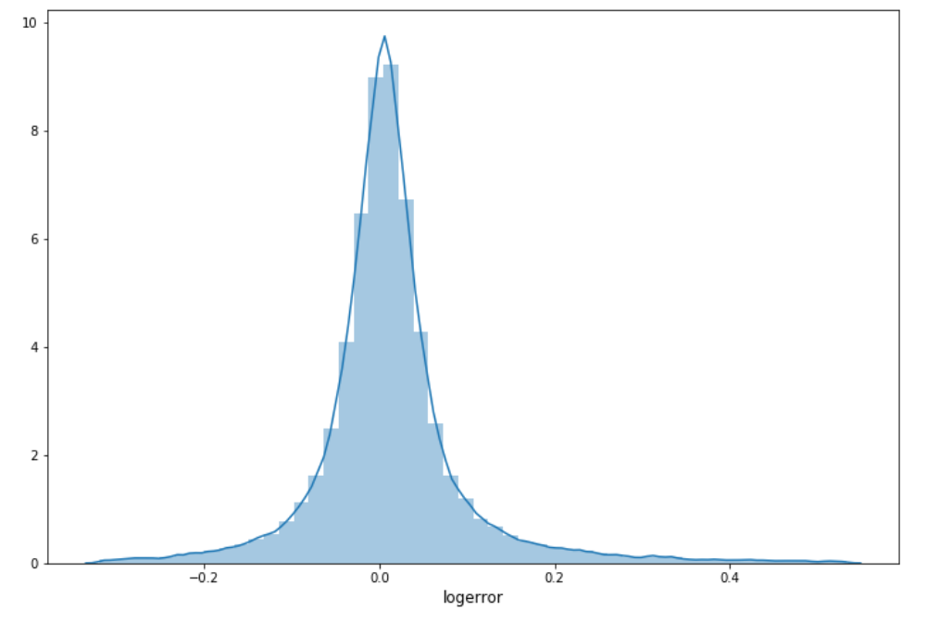
Log Error Histogram

Slide 7
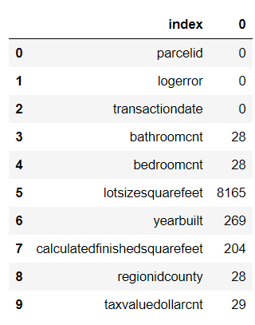
Covariates Missing Values

Slide 8
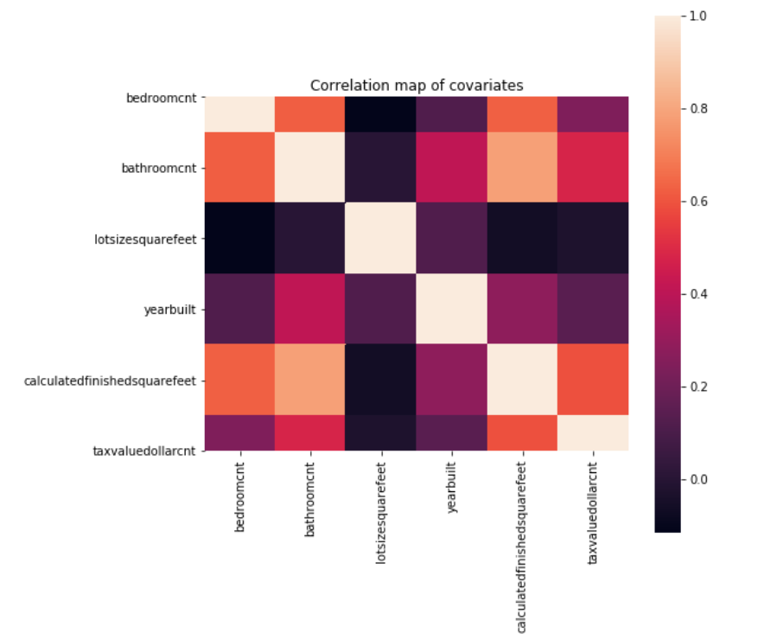
Covariates Missing Values

Slide 9
Regression Analysis Steps
Split sample into training and testing
Run linear regression on training sample
Use estimated coefficients to predict on testing sample

Slide 10
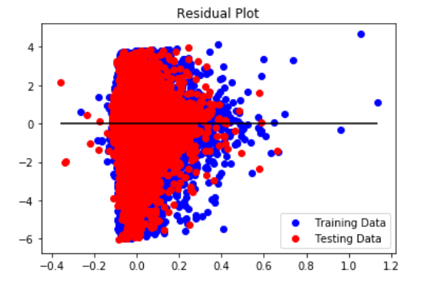
Goodness-of-fit

Slide 11
.
Thank You!

