Slide 1
Autograding Server
Atul Kumar, Santanu Sahoo ( 23M0764 & 23M0777 )

Slide 2

Coding Choices
Version2
-used thread id to differentiate between different file names.
Version3
-used thread id along with a counter to differentiate between different file names.
-used signal(SIGALRM, alarm_handler) to handle timeouts

Slide 3
Implementation Challenges & Solution
Challenges
Solution
In the multithreaded server design, we found that different threads were working on the same socket file descriptor.
We used an array of socket descriptor instead of it just being a variable which solved the problem.

Slide 4
Version 4 :Software Design
Client
Server
Generate new request ID
Create a text file with this ID which store the state of the request.
Check the status of the request and reply accordingly.

Slide 5
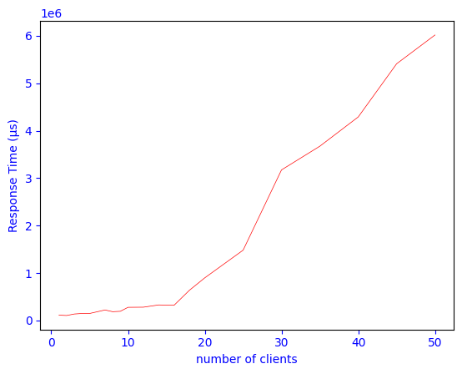
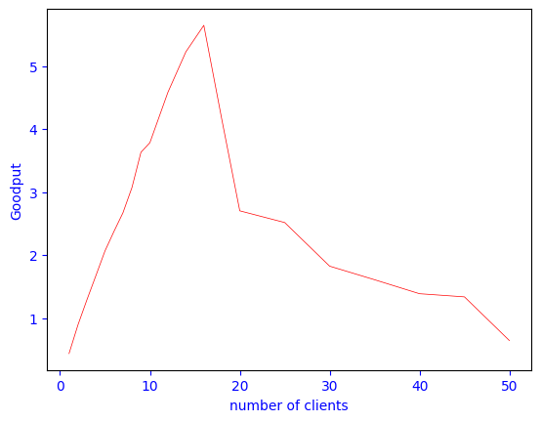
Performance Analysis : Version 1

Slide 6
For the single-threaded server:
We performed our experiment keeping number of iterations = 5 and sleep time = 2 seconds
Throughput for 1 client = 0.43, it increased upto 14 clients where the throughput became 5.82 and then declined. One of the reason for this drop is the server dropping some requests because it is single threaded. Another important reason in our case seems to be that the client performance is becoming bad because of so many clients running on the same system.
Ideally, however the throughput should become constant as server is only single threaded.
The reason for increase in response time seems again to be because of multiple clients running on the same system (because we are calculating the response time on the client.)

Slide 7
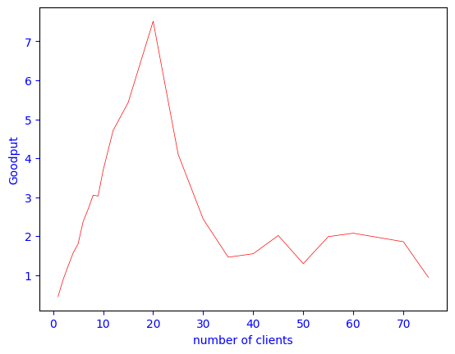
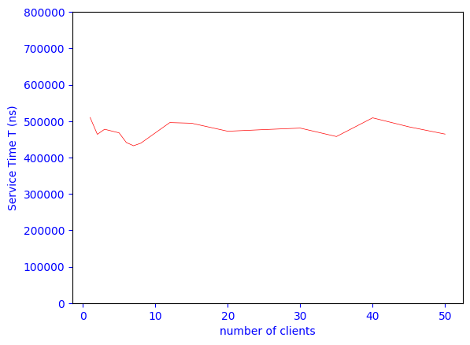
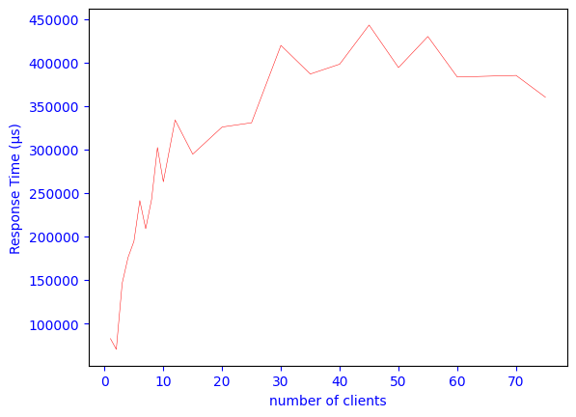
Performance Analysis : Version 2

Slide 8
For the multi-threaded server:
We performed our experiment keeping number of iterations = 5 and sleep time = 2 seconds and time out=1 second
Throughput for 1 client = 0.43, it increased upto 20 clients where the throughput became 7.5 and then declined. One of the reason for this drop is the increase in timed-out responses . Another important reason seems to be too many server thread getting created .
The reason for increase in response time seems to be because of multiple threads getting created in the server as well as all clients running on the same system (because we are calculating the response time on the client.)

Slide 9
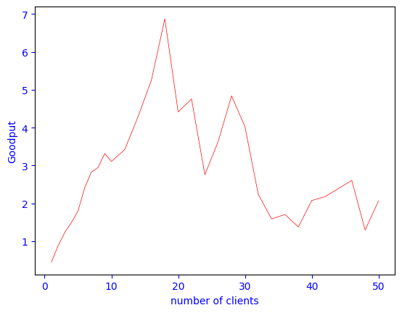
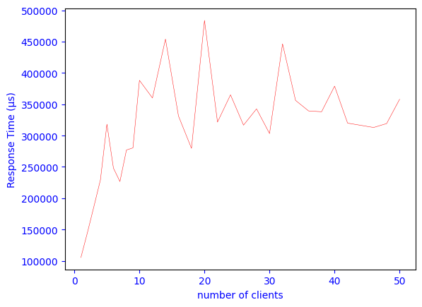
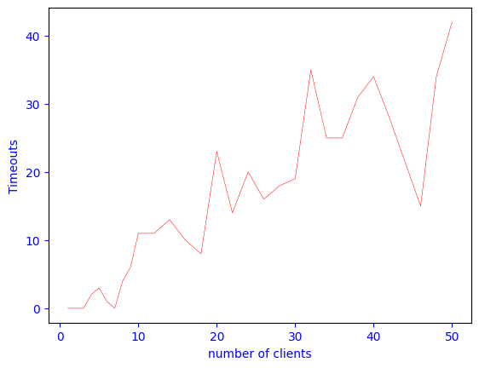
Performance Analysis: Version 3

Slide 10
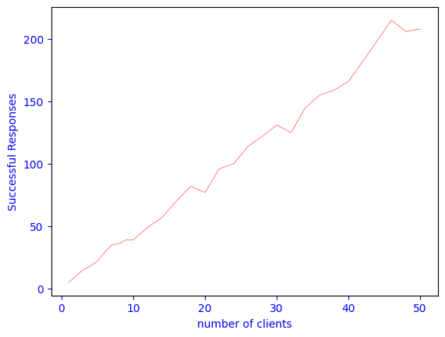
Performance Analysis : Version 3

Slide 11
For the thread pool server:
We performed our experiment keeping number of iterations = 5 and sleep time = 2 seconds and time out =1 second
Throughput for 1 client = 0.43, it increased upto 18 clients where the throughput became 6.8 and then declined. One of the reason for this drop is the increase in timed-out responses . Another important reason seems to be too many clients running on the same system .
The reason for increase in response time seems to be because of all clients running on the same system (because we are calculating the response time on the client.)

Slide 12
Thank You

