Slide 1
Customer Behavior Analysis – Power BI Dashboard
Power BI Project Presentation
Prepared by Shantanu Roy

Slide 2
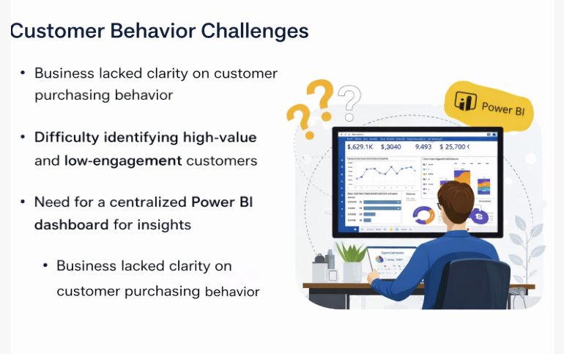
Business Problem
Business lacked clarity on customer purchasing behavior
  Difficulty identifying high-value and low-engagement customers
  Need for a centralized Power BI dashboard for insights

Slide 3
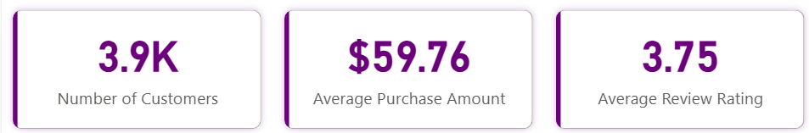
Project Objective
Analyze customer behavior using Power BI
  Track key performance indicators (KPIs)
  Enable data-driven marketing and retention strategies

Slide 4
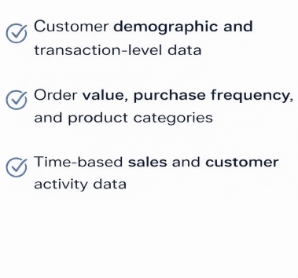
Data Overview

Slide 5
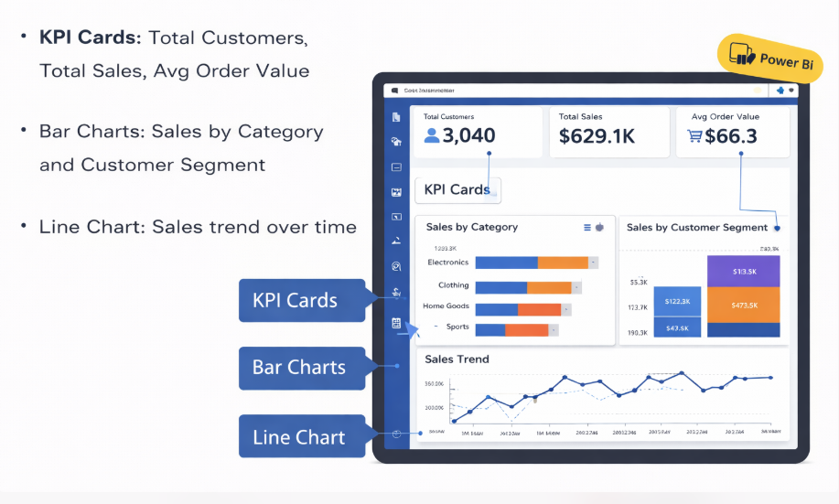
Power BI Dashboard Structure

Slide 6
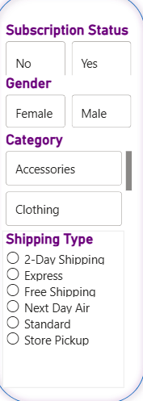
Filters & Slicers Used
Date range slicer for time-based analysis
  Customer segment slicer
  Product category slicer for drill-down analysis

Slide 7
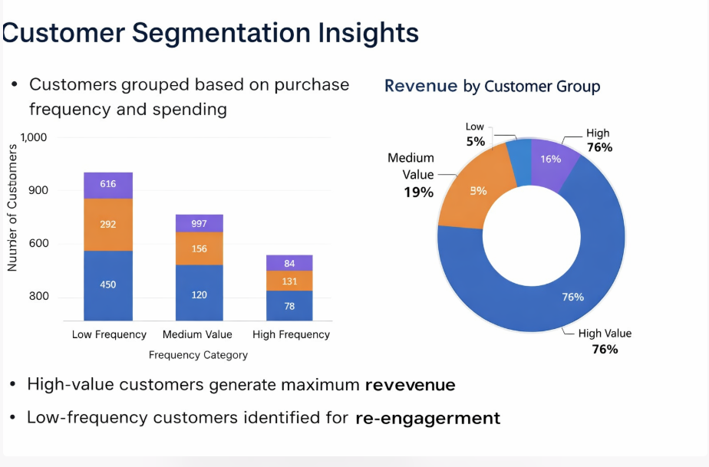
Customer Segmentation Analysis
Customers grouped based on purchase frequency and spending
  High-value customers generate maximum revenue
  Low-frequency customers identified for re-engagement

Slide 8
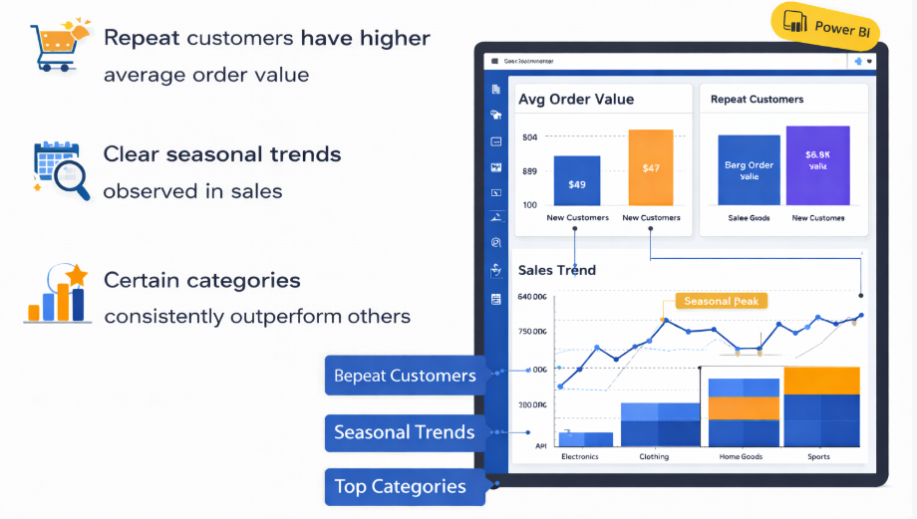
Sales & Behavior Insights
Repeat customers have higher average order value
  Clear seasonal trends observed in sales
  Certain categories consistently outperform others

Slide 9
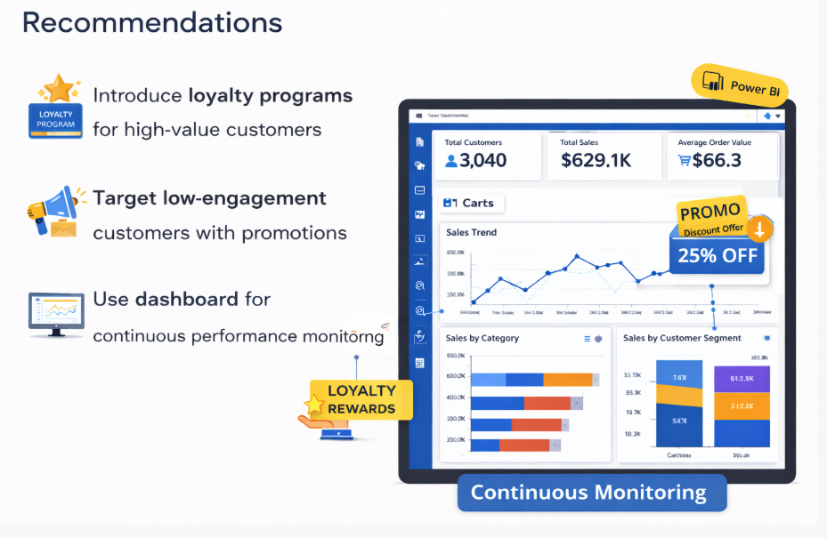
Business Recommendations
Introduce loyalty programs for high-value customers
  Target low-engagement customers with promotions
  Use dashboard for continuous performance monitoring

Slide 10
Conclusion
Power BI dashboard provides real-time customer insights
  Improves decision-making through interactive visuals
  Supports marketing, sales, and retention strategies

Slide 11
