Slide 1
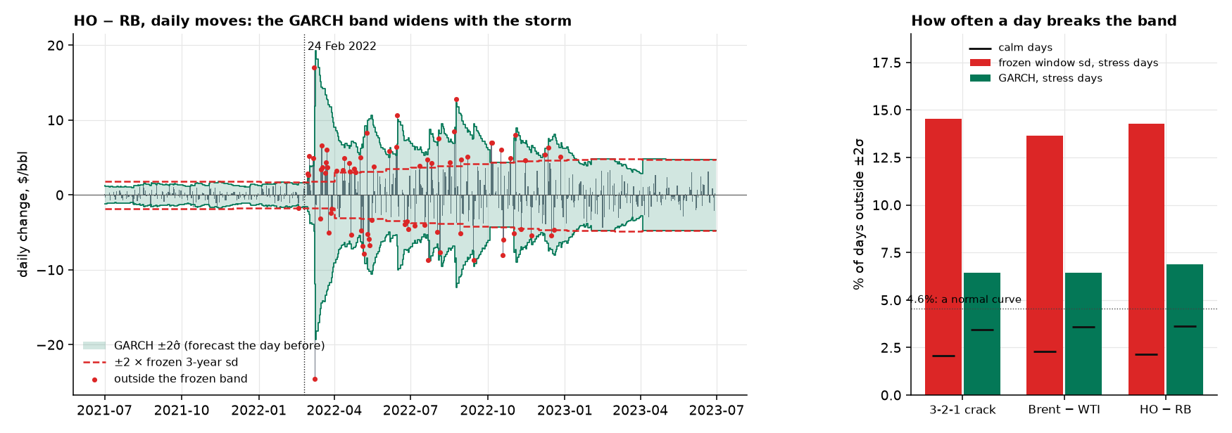
Step 8: we can forecast the size of a move (GARCH)
In plain English. We cannot say whether tomorrow's move is up or down, but after a stormy day another is likely. On 24 Feb 2022 the frozen 3-year band is still set by calm years, so HO − RB breaks it almost daily (red dots); the GARCH band widens the day after.
On stress days a move breaks the frozen ±2 sd band 14–15% of the time, the GARCH band 6–7% (a normal curve: 4.6%). A shock halves in 26–38 trading days; GARCH beats the 3-year sd out of sample on all three spreads (t −2.6 to −4.9).
For a trade σ̂ is tomorrow's expected move size. It is the input to every position size in this deck.
Notes:
## Step 8: we cannot forecast the direction, but we can forecast the size (GARCH)
In plain English. Like the weather: we cannot say whether tomorrow's move is up or down, but after a stormy day another stormy day is likely. GARCH turns that into one number, σ̂, tomorrow's expected move size in $/bbl.
σ̂²t+1 = ω + a · (today's surprise)² + b · σ̂²t
- What the chart shows. On 24 February 2022 the frozen 3-year band is still set by calm years, and for months HO − RB breaks it almost daily (red dots). The GARCH band widens the day after the first big move and narrows as the storm fades.
- Across all three spreads, on stress days a move breaks the frozen ±2 sd band 14% to 15% of the time, and the GARCH band 6% to 7%. A normal curve would give 4.6%. On calm days the frozen band is too wide (2%), and GARCH is close to right (3% to 4%).
- a (0.08 to 0.15) is how much one big day raises tomorrow's forecast, and b (0.83 to 0.89) how much of today's forecast carries over. With a + b of 0.97 to 0.98 (2020–26), a volatility shock halves in about 26, 36 and 38 trading days (crack, Brent − WTI, HO − RB).
- It forecasts and it absorbs. Out of sample, GARCH beats the 3-year sd on all three spreads (QLIKE loss lower, t = −4.9, −2.6 and −2.7). Each day's move divided by σ̂ has a kurtosis of 5.4 to 6.2, against 13, 102 and 79 when divided by the window sd.
- Limits. Refit monthly on the previous 756 days with Student-t errors. In 14% to 22% of months the fit fails and σ̂ falls back to the window sd (the flat stretch from April 2023). Some clustering remains (Ljung–Box on squared moves still rejects).
For a trade: σ̂ is the input to every position size, in every strategy in this deck.

Slide 2
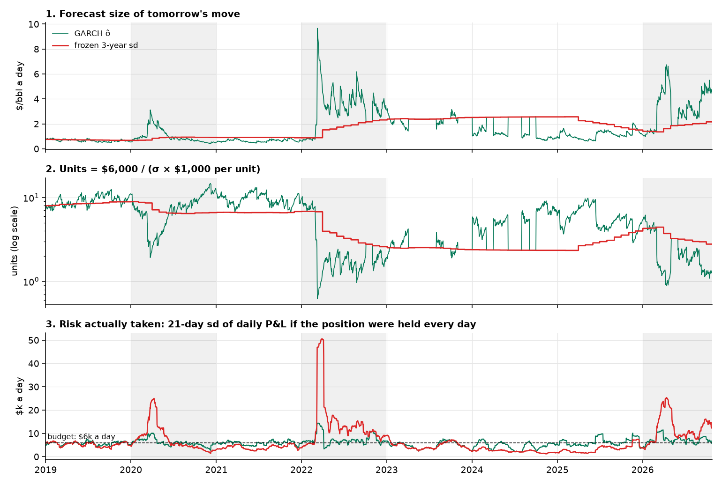
Step 8b: size on the forecast, so each day risks the same
Same trades, only the sizing changes (net, 2010–26)
Spread | Sharpe | Max drawdown
3-2-1 crack | 0.36 → 0.32 | −$159k → −$156k
Brent − WTI | −0.55 → −0.47 | −$321k → −$307k
HO − RB | −0.07 → +0.02 | −$356k → −$182k
Crack, Johansen | −0.27 → −0.17 | −$224k → −$159k
The rule: units = $6,000 ÷ (σ̂ × $ per unit).
After 24 Feb 2022 GARCH halves the units in 6 trading days; the frozen sd takes 89.
Risk above twice the budget: 0.4–0.9% of days with GARCH, 5.7–6.3% with the frozen sd.
Today σ̂ is at the 96th, 57th and 97th percentile of its history, so the rule allows 1.0, 16.2 and 1.4 units (crack, Brent − WTI, HO − RB).
For a trade risk control, not a signal: GARCH halves HO − RB's drawdown, and cannot turn a losing signal into a winner.
Notes:
## Step 8b: size on the forecast, so every day risks about the same dollars
The rule. units = R / (σ̂ · M), with R = $6,000 of risk a day and M the dollars per $1/bbl per unit ($3,000 for the crack, $1,000 for the others). The integer book also applies a $40k stop limit, floors, and caps at 3.
- Read it top to bottom. (1) The forecast jumps in March 2022 and the frozen sd climbs a step a month. (2) So GARCH cuts the units in half within 6 trading days of 24 February 2022; the frozen sd takes 89. (3) If the rule's position were held every day, its 21-day risk with GARCH stays near the $6k budget, and with the frozen sd it reaches $51k a day in 2022.
- Across all three spreads, that 21-day risk exceeds twice the budget on 0.4% to 0.9% of days with GARCH, against 5.7% to 6.3% with the frozen sd (15% to 18% of stress days).
| Registered ladder: same trades, only the sizing changes (net) | Sharpe, window sd → GARCH | Max drawdown, window sd → GARCH |
|---|---|---|
| 3-2-1 crack | 0.36 → 0.32 | −$159k → −$156k |
| Brent − WTI | −0.55 → −0.47 | −$321k → −$307k |
| HO − RB | −0.07 → +0.02 | −$356k → −$182k |
| Crack, Johansen weights | −0.27 → −0.17 | −$224k → −$159k |
- Risk control, not a signal. GARCH sizing halves HO − RB's drawdown and improves three of four Sharpes, and costs the crack 0.04. It cannot turn a losing signal into a winner.
- Today (26 October). σ̂ is at the 96th, 57th and 97th percentile of its history, so the rule allows 1.0, 16.2 and 1.4 units (crack, Brent − WTI, HO − RB), against roughly 2 to 5 for the crack and 5 to 10 for HO − RB in calm years.
For a trade: the size falls automatically when markets get wild, and today it is near its minimum on the crack and HO − RB.

Slide 3
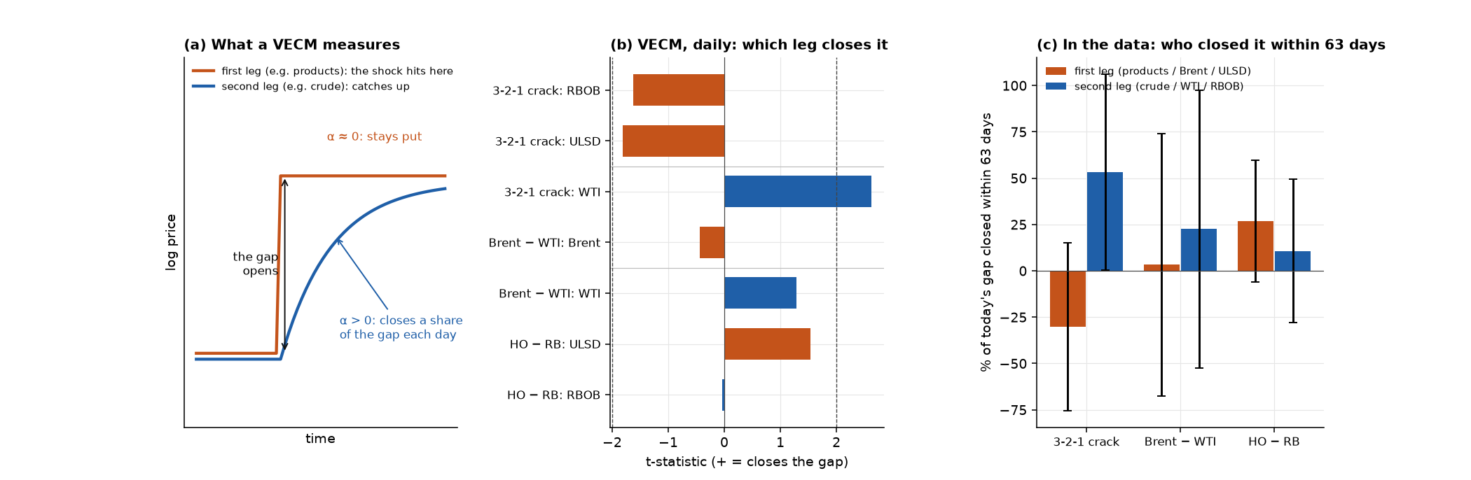
Step 9: when a gap opens, which leg closes it? (VECM)
In plain English. Two dogs on one leash: when it goes tight, one steps back. α is the share of yesterday's gap a leg closes today. Crack: crude closes ~53% of a gap in 63 days while the products move ~30% further away. HO − RB: ULSD closes ~27%.
Brent − WTI: no clear leader. Rolling fits agree: crude is the significant corrector in 16% (crack) and 29% (Brent − WTI) of windows, diesel in 24% of HO − RB.
For a trade trade the spread as one unit, not one leg. Who moves is clear only for the crack, and the pull is slow.
Notes:
## Step 9: when the gap opens, which leg closes it, and how fast? (VECM)
In plain English. Two dogs on one leash. When the leash goes tight, one of them has to step back. A VECM (vector error-correction model) measures, for each leg, how much of yesterday's gap it closes today. That share is α. A leg with α near zero leads, and the other follows.
Δ ln Pi,t = αi · ℓt−1 + (lagged changes) + εi,t, where ℓ is the log-ratio, the gap, with the weights fixed at the traded ones.
- The crack: crude closes the gap. In logs, on held-contract returns, the leg that adjusts is crude (WTI α = +0.017 a day, t = 2.6, in the crack; t = 1.3 in Brent/WTI). Gasoline and diesel have the wrong sign. In the data (panel c), crude closes about 53% of a crack gap within 63 days while the products move about 30% further away: shocks start in the products, and crude follows.
- HO − RB: diesel closes it. ULSD has the right sign (t = 1.5) and RBOB none. In the data ULSD closes about 27% within 63 days, RBOB about 11%.
- Brent − WTI: no clear leader. WTI leans toward correcting (t = 1.3, 22% in 63 days) and Brent does nothing, but the bands in panel c cover zero for both legs.
- The rolling fits agree. With the traded dollar weights and a 3-year window, crude is the significant corrector in 16% of crack windows and 29% of Brent − WTI windows, and diesel in 24% of HO − RB windows. The other legs rarely are (0.5% to 9% of windows). The unrestricted Johansen VECM in dollars picks RBOB (t = −2.9), but its fitted vectors are not the 3-2-1 crack.
- Panel (c) bands are wide (±33 to ±75 points): it confirms the direction, not the split.
For a trade: trade the spread as one unit, not one leg. Who moves is clear only for the crack, and the pull is slow.

Slide 4
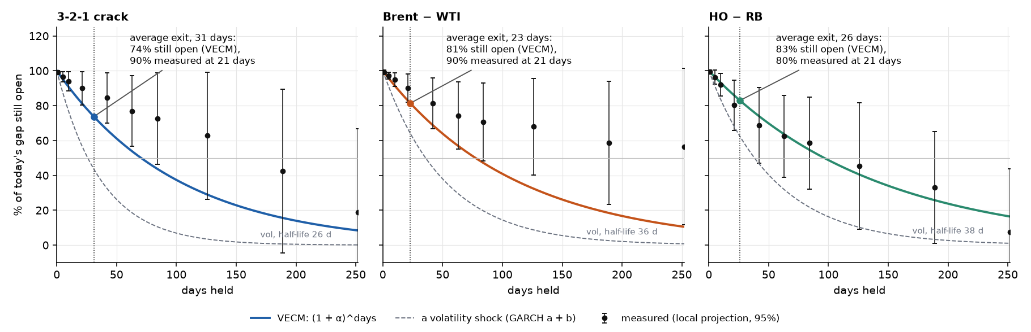
Step 9b: at the average exit, most of the gap is still open
Measured: the held-contract return over the next h days regressed on today's gap. Closure at 63 days is significant for all three (t = 2.2, 2.6, 3.1).
At the average exit (23–31 days), 80–90% of the gap is still open.
Volatility halves in 26–38 days; the gap in 70–96.
VECM / measured | Gap half-life | Still open at exit | After 3 months | After 1 year
3-2-1 crack | 70 days | 74% / 90% | 54% / 77% | 8% / 19%
Brent / WTI | 77 days | 81% / 90% | 57% / 74% | 10% / 57%
HO / RB | 96 days | 83% / 80% | 64% / 62% | 16% / 8%
For a trade daily mean reversion exits too early. Volatility fades faster than the gap, so size by σ̂, not by how wide the gap is.
Notes:
## Step 9b: what the VECM means for a trade: the gap is still mostly open when we exit
| Spread | Gap half-life (VECM, held) | Still open at the average exit: VECM / measured at 21 days | After 3 months: VECM / measured | After 1 year: VECM / measured |
|---|---|---|---|---|
| 3-2-1 crack | 70 days | 74% (31 days) / 90% | 54% / 77% | 8% / 19% |
| Brent / WTI | 77 days | 81% (23 days) / 90% | 57% / 74% | 10% / 57% |
| HO / RB | 96 days | 83% (26 days) / 80% | 64% / 62% | 16% / 8% |
- Measured is a local projection: the held-contract log-ratio return over the next h days, regressed on today's gap (HAC errors). It is the VECM's α read at every horizon, with no AR(1) shape imposed. Closure at 63 days is significant for all three (t = 2.2, 2.6 and 3.1).
- The exit comes too early. At the daily ratio strategy's average exit (23 to 31 days), 74% to 90% of the gap is still open (VECM curve and measured). Collecting most of it takes most of a year.
- The VECM curve is optimistic for two of three. HO/RB follows it, or runs slightly ahead. The crack closes more slowly throughout (19% still open after a year, against 8%), and Brent/WTI still has 57% of the gap open after a year: the moving anchor of Step 4b.
- What a holder earns is slower than the market ratio suggests. The VECM uses held-contract returns: half-lives of 70 to 96 days, against 35 to 50 on the market ratio. The difference is the roll (Step 6).
- The two models meet in the size. Volatility halves in 26 to 38 days (dashed line), the gap in 70 to 96. A trade held for the gap sits through more than one volatility cycle, so its size is set by σ̂, not by how wide the gap is.
For a trade: the VECM explains the horizon problem in one number. Daily mean reversion exits too early, and GARCH sizing keeps the long wait affordable.

Slide 5
Test 6b: GARCH in full, parameters and checks
Median fit by era (rolling 756 days, refit monthly): a / b / ν
Era | 3-2-1 crack | Brent − WTI | HO − RB | Vol-shock half-life (crack / B − W / HO − RB)
2007–13 | 0.14 / 0.85 / 113 | 0.15 / 0.84 / 10 | 0.11 / 0.87 / 26 | 99 / 48 / 40 days
2014–19 | 0.09 / 0.83 / 18 | 0.08 / 0.88 / 21 | 0.08 / 0.89 / 14 | 9 / 16 / 20 days
2020–26 | 0.11 / 0.87 / 10 | 0.15 / 0.83 / 10 | 0.10 / 0.88 / 12 | 26 / 36 / 38 days
Each day's move divided by the forecast
Spread | Kurtosis: window sd → GARCH | Lag-1 ACF of squared move | QLIKE gain (t)
3-2-1 crack | 13.4 → 5.4 | 0.31 → 0.04 | −0.43 (−4.9)
Brent − WTI | 101.6 → 6.2 | 0.19 → 0.04 | −1.15 (−2.6)
HO − RB | 79.2 → 5.9 | 0.39 → 0.11 | −0.76 (−2.7)
a + b near 1 means storms persist; ν of 10–26 means fat tails. Half-life = ln 2 ÷ (−ln(a + b)).
The fit converges in 86%, 78% and 84% of months; otherwise σ̂ falls back to the window sd. Clustering is reduced, not removed: Ljung–Box on squared moves still rejects.
For a trade σ̂ is a good, not perfect, size forecast: it removes most of the fat tail and clustering that a frozen sd leaves in.
Notes:
## Test 6b: GARCH in full: parameters, checks and the forecast race
| Median fit, by era | 3-2-1 crack: a / b / ν | Brent − WTI: a / b / ν | HO − RB: a / b / ν | Vol-shock half-life (crack / B−W / HO−RB) |
|---|---|---|---|---|
| 2007–13 | 0.14 / 0.85 / 113 | 0.15 / 0.84 / 10 | 0.11 / 0.87 / 26 | 99 / 48 / 40 days |
| 2014–19 | 0.09 / 0.83 / 18 | 0.08 / 0.88 / 21 | 0.08 / 0.89 / 14 | 9 / 16 / 20 days |
| 2020–26 | 0.11 / 0.87 / 10 | 0.15 / 0.83 / 10 | 0.10 / 0.88 / 12 | 26 / 36 / 38 days |
| Each day's move divided by the forecast | Kurtosis: window sd → GARCH | Lag-1 ACF of squared move: window sd → GARCH (converged fits) | QLIKE, GARCH minus window sd (t) |
|---|---|---|---|
| 3-2-1 crack | 13.4 → 5.4 | 0.31 → 0.04 | −0.43 (−4.9) |
| Brent − WTI | 101.6 → 6.2 | 0.19 → 0.04 | −1.15 (−2.6) |
| HO − RB | 79.2 → 5.9 | 0.39 → 0.11 | −0.76 (−2.7) |
- a + b near 1 means storms are persistent. ν of 10 to 26 means fat tails (ν = 113 in the crack's first era is close to normal).
- Fits do not always converge. The fit is usable in 86%, 78% and 84% of months for the spreads. Otherwise σ̂ falls back to the window sd, which is why Brent − WTI has flat stretches in 2020–21.
- Clustering is reduced, not removed. On the spreads, Ljung–Box on squared standardised moves still rejects (p < 0.001). The products (Brent p = 0.27) are absorbed better than the spreads.
- Vol-shock half-life = ln 2 / (−ln(a + b)), from the era medians of a and b.
- The ladder table in Step 8b changes only the sizing. A version that keeps the gated trades and swaps only the units (gross of costs) gives the same picture: HO − RB's drawdown falls from −$330k to −$157k, the crack's rises slightly (−$139k to −$158k).

Slide 6
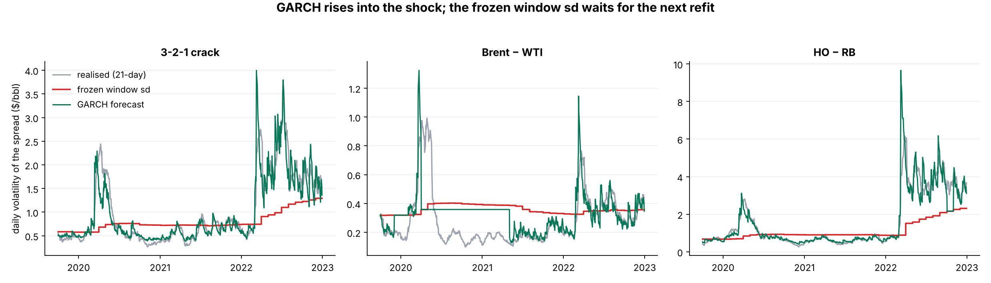
Test 6c: GARCH forecast against realised volatility
In 2020 and 2022 the GARCH forecast tracks realised volatility within days; the frozen sd steps up a month at a time.
Brent − WTI's flat stretch in 2020–21 is a run of months where the fit failed and σ̂ fell back to a constant.
Same gated trades, only the units swapped (gross): HO − RB's drawdown falls from −$330k to −$157k; the crack's rises slightly (−$139k to −$158k).
For a trade size on σ̂, not on a frozen window: it reacts in days, not months.
Notes:
## Test 6: can't predict direction, can predict size (ARCH and GARCH)
In plain English. We cannot say whether tomorrow's move is up or down, but we can say whether it is likely to be big. Calm days follow calm days, and storms follow storms.
- The ARCH test rejects "no volatility clustering" for all three spreads (p < 0.001).
- In oil this is natural: news, inventory data and supply shocks arrive in clusters.
- The ARCH test also rejects on daily log-ratio returns (p < 0.001), so the same sizing logic applies to the ratio strategies.
- GARCH forecasts beat a constant standard deviation out of sample on all three spreads.
For a trade: size each position by forecast volatility, so a calm day and a stormy day risk about the same dollars.

Slide 7
Test 7b: VECM in full, three specifications
Known vector: logs (full sample) and dollars (rolling 3 years)
Unrestricted Johansen, dollars: α (t)
Spread: leg | Logs: α a day (t) | Rolling: corrects in
Crack: WTI | +0.017 (2.6) | 16%
Crack: RBOB | +0.007 (1.6), wrong sign | 0.5%
Crack: ULSD | +0.007 (1.8), wrong sign | 2%
Brent / WTI: WTI | +0.012 (1.3) | 29%
Brent / WTI: Brent | +0.003 (0.4), wrong sign | 5%
HO / RB: ULSD | −0.007 (−1.5) | 24%
HO / RB: RBOB | −0.000 (−0.0), wrong sign | 9%
Gap on itself | −0.010 / −0.009 / −0.007 | half-lives 70 / 77 / 96 d
Leg | Vector 1 | Vector 2
WTI | −0.0008 (−1.2) | −0.0017 (−1.1)
RBOB | −0.0022 (−2.9) | −0.0046 (−2.6)
ULSD | −0.0008 (−1.0) | −0.0007 (−0.4)
Vector | CL − 1.74 HO | RB − 0.05 HO
Gap = ln A − ln B: the first leg corrects with α < 0, the second with α > 0.
The unrestricted VECM picks RBOB, but its fitted vectors are not the traded crack.
Local projection, 63 days: crack crude +53% (±53), products −30% (±45); ULSD in HO − RB +27% (±33).
For a trade the correcting leg depends on the specification, so trade the spread as one unit.
Notes:
## Test 7b: VECM in full: three specifications, one reading
| Spread, leg | Logs, full sample: α a day (t) | Dollars, traded weights, rolling 3 years: share of windows the leg corrects (t beyond ±2, right sign) |
|---|---|---|
| Crack: WTI | +0.017 (2.6) | 16% |
| Crack: RBOB | +0.007 (1.6), wrong sign | 0.5% |
| Crack: ULSD | +0.007 (1.8), wrong sign | 2% |
| Brent / WTI: WTI | +0.012 (1.3) | 29% |
| Brent / WTI: Brent | +0.003 (0.4), wrong sign | 5% |
| HO / RB: ULSD | −0.007 (−1.5) | 24% |
| HO / RB: RBOB | −0.000 (−0.0), wrong sign | 9% |
| Gap on itself (crack / B−W / HO−RB) | −0.010 / −0.009 / −0.007 (t −2.3 / −1.8 / −1.2) | |
| Unrestricted Johansen VECM, crack legs in dollars, rank 2 | α on vector 1 (t) | α on vector 2 (t) |
|---|---|---|
| WTI | −0.0008 (−1.2) | −0.0017 (−1.1) |
| RBOB | −0.0022 (−2.9) | −0.0046 (−2.6) |
| ULSD | −0.0008 (−1.0) | −0.0007 (−0.4) |
| Fitted vectors | CL − 1.74 HO | RB − 0.05 HO |
- Right sign: in logs the gap is ln A − ln B, so the first leg corrects with α < 0 and the second with α > 0. In dollars the same rule applies to the spread.
- Two of three specifications say crude (and diesel in HO − RB). The unrestricted VECM says RBOB, but its vectors are not the traded spread, so it answers a different question.
- Local projection, 63 days (Step 9, panel c): share of a gap closed by each side, ±95%. Crack: products −30% (±45), crude +53% (±53). Brent − WTI: Brent +3% (±71), WTI +22% (±75). HO − RB: ULSD +27% (±33), RBOB +11% (±39). Full table in `output/exploratory/garch_vecm/tables/local_projection.csv`.
- Roll-clean. The log VECM uses held-contract returns, so its half-lives (70 to 96 days) are what a position earns. The market ratio's 35 to 50 days include the roll.

Slide 8
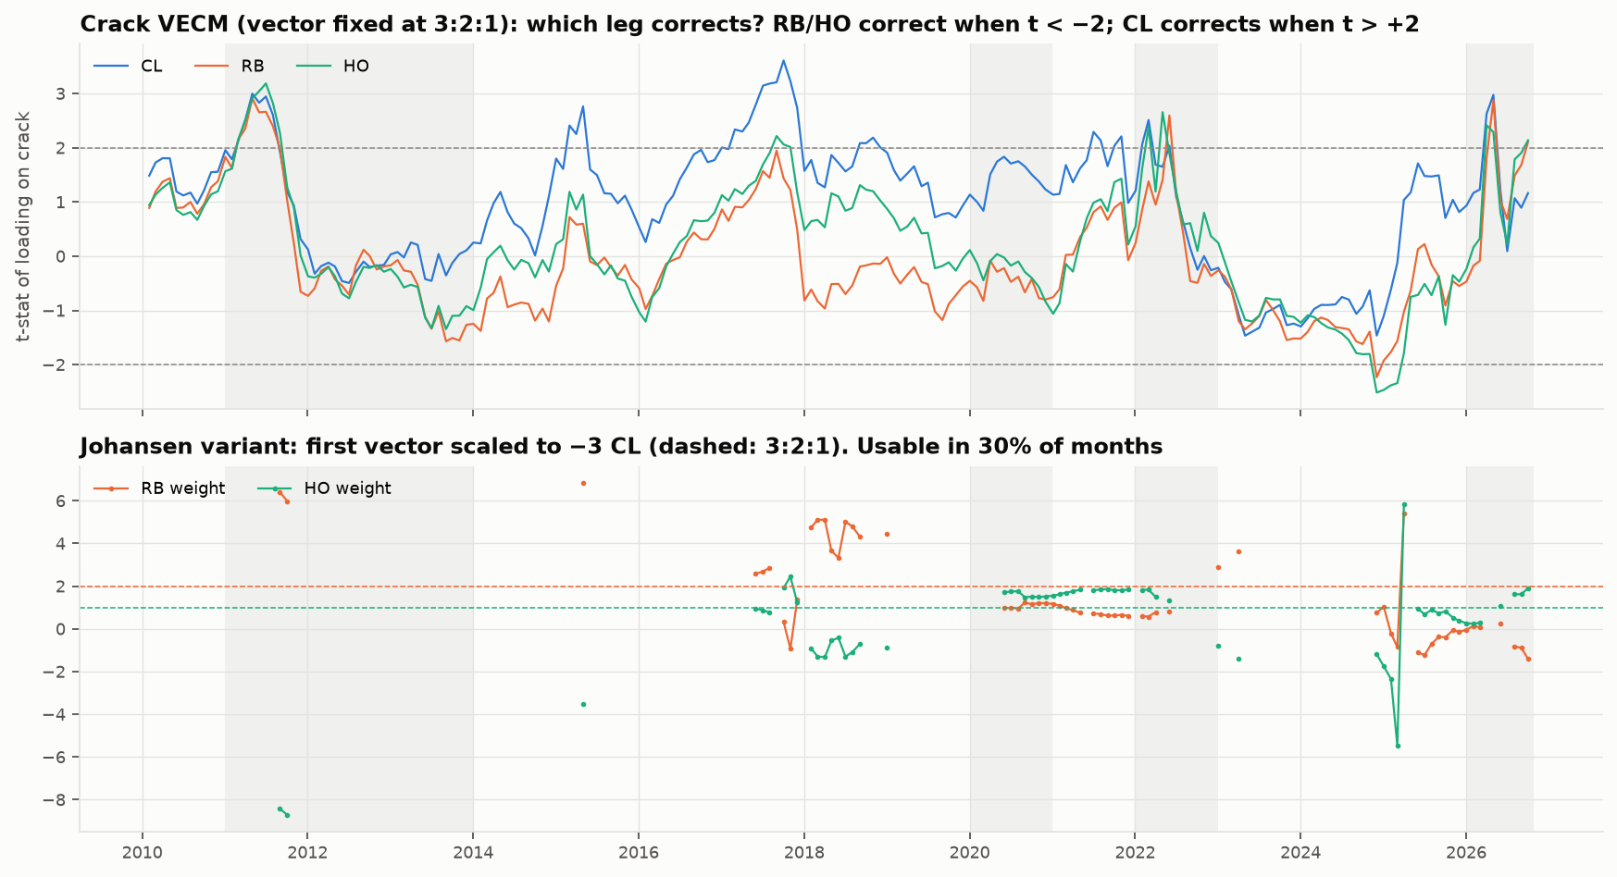
Test 7c: rolling VECM loadings on the crack
Top: t-statistic of each leg's loading, rolling 3 years. CL corrects when t > +2; RB and HO when t < −2.
CL crosses +2 in 16% of windows; RB and HO cross −2 in 0.5% and 2%.
In 2011, 2022 and 2026 all three legs jump together: a common shock, not a correction.
Bottom: the free Johansen vector is usable in only 30% of months, and its weights jump.
For a trade one more reason not to trade a single leg: the leader changes, and the free vector is unstable.
Notes:
## Test 7: when the gap is off, who moves? (VECM)
In plain English. If two legs are tied by a rope, one of them must give. A VECM estimates how fast each leg pulls back.
- On futures, only RBOB shows a clearly significant adjustment speed (t = −2.9). Crude and diesel adjust slowly or not at all.
- Plausibly because gasoline is the most seasonal leg, so its price has to do the adjusting.
- In logs, with the log-ratio as the error-correction term and each leg's held-contract log return as the dependent variable, the answer changes: the leg that adjusts is crude (WTI α = +0.017 a day, t = 2.6, in the crack; t = 1.3 in Brent/WTI). The product legs have the wrong sign or are not significant.
- The log-ratio's own pull is −0.010, −0.009 and −0.007 a day (t = −2.3, −1.8 and −1.2), half-lives of 70, 77 and 96 days.
- Who moves depends on the specification (dollars: RBOB, logs: WTI), so we do not build a strategy on it.
For a trade: any reversion is slow (median half-lives of 92 to 125 days in the rolling fits), so trades are held for weeks and costs and risk limits matter.

