Slide 1
Data Analyst Nanodegree
Session 10
Conducted by: Hamza
Notes:
https://udacity.zoom.us/j/7991233356
<number>

Slide 2
agenda
Good news
Links
Project

Slide 3
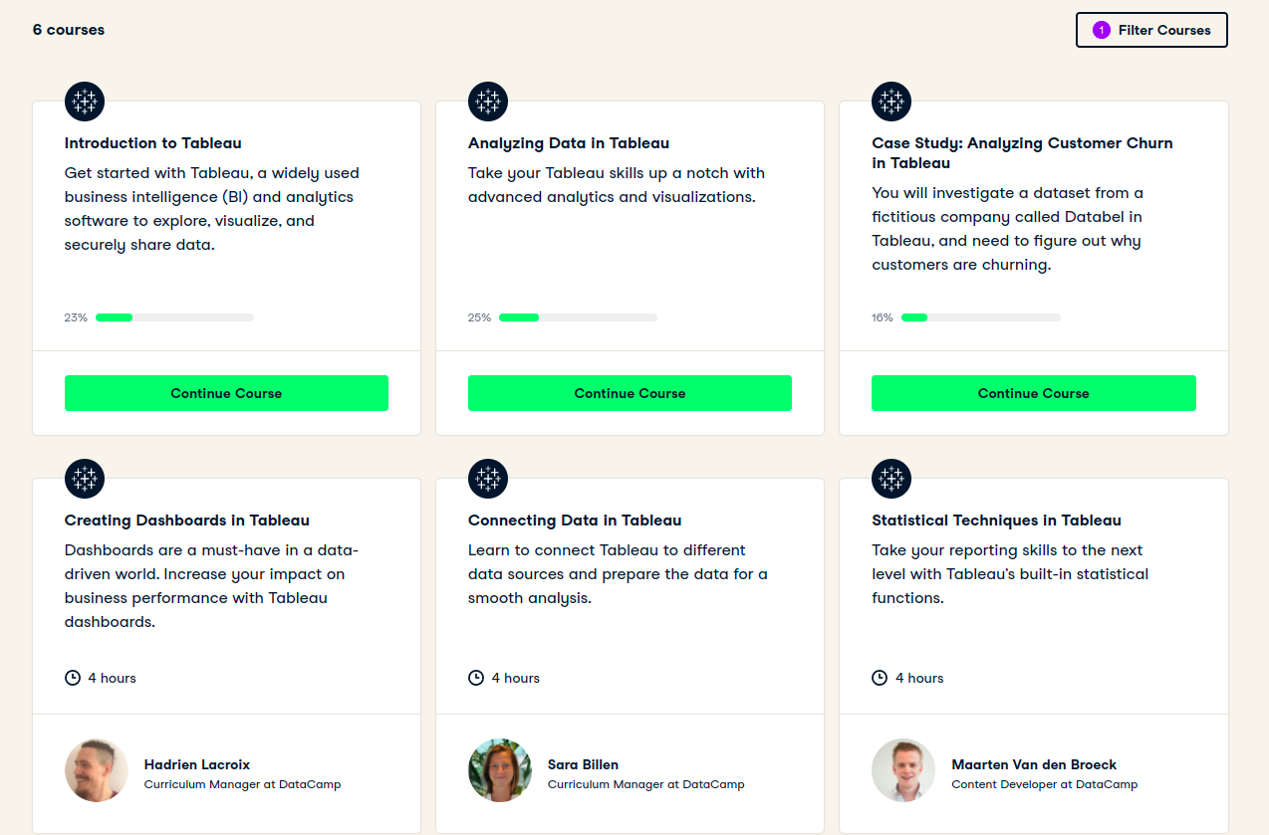

Slide 4
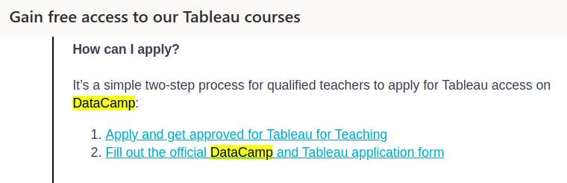

Slide 5
