Slide 1

Correlation
عيشة فل

Slide 2


Slide 3
Visualize data
Notes:
Check how many times, packets and adverts are on the same side of the line( the mean)

Slide 4

If constantly on same side, +ve
If constantly on opposite side -ve
Otherwise .. NULL

Slide 5
Logical quantification
Variance 1 | Variance 2 | Output
+ve | +ve | +ve
-ve | -ve | +ve
+ve | -ve | -ve
Notes:
relation between each point and the corresponding

Slide 6
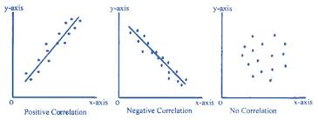
Pearson correlation
±.1 small effect
±.3 medium effect
±.5 large effect revisit literature !

Slide 7
Visualize the correlation
https://statistics.calpoly.edu/shiny

Slide 8

Teaser...
Notes:
Can having a lighter with u increase ur risk of developing lung cancer

Slide 9
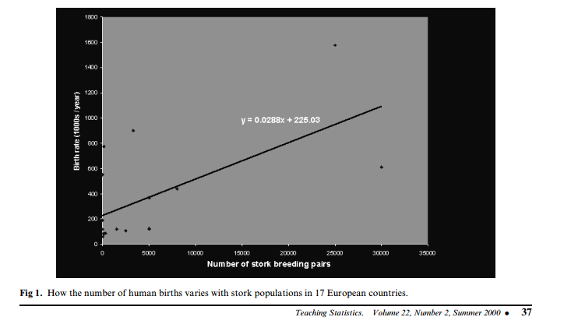

Storks Deliver Babies (p  0.008)
r = 0.62
Notes:
There is a high correlation between the number of storks in an area and the number of babies born. This was observed in the city of Copenhagen by looking at records of number of births and the number of storks over a 10-year period after World War II.1 It turns out that after the war, more people moved to Copenhagen (so more babies were born there) and more construction was going on in the city (so storks had more places, thus more storks).

Slide 10
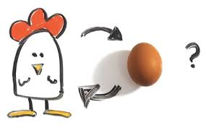

Correlation vs causality
Direction
3rd variable
Partial correlation ?? Adjustment ?

Slide 11
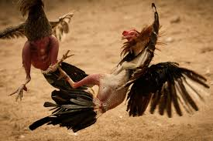
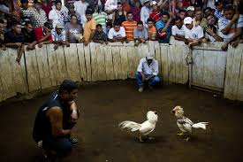
Bivariate vs partial
partial correlation : while ‘controlling’ the effect of one or more additional variables.
Notes:
U are correlating the weight of the 1st chicken, with the score in the match
´
2nd picture: Making the coach effect constant

Slide 12
Coefficient of determination R²
a measure of the amount of variability in one variable that is shared by the other
Convert to percentage
100-% variability
Notes:
i.e. To which extent the variability of the score in the fight, is shared by the weight of the chicken

Slide 13
Notes:
model sum of squares tells us how much of the total variation can be explained by the fact that different data points come from different groups

Slide 14

pitfall
Causality ??
‘the variance in y accounted for by x’, or ‘the variation in one variable explained by the other’.

Slide 15
What we have covered?
Correlation coefficient (r)
Coefficient of determination (R²)
Correlation vs causality
Now …
Types of correlation coefficient

Slide 16
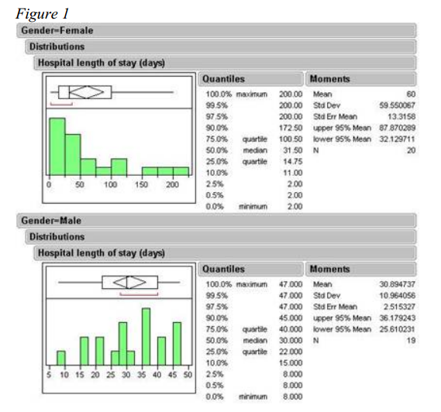
P value parametric: 0.04
P value non par. : 0.63
Notes:
Look at mean and median for both males and female
Look how females are right skewed

Slide 17
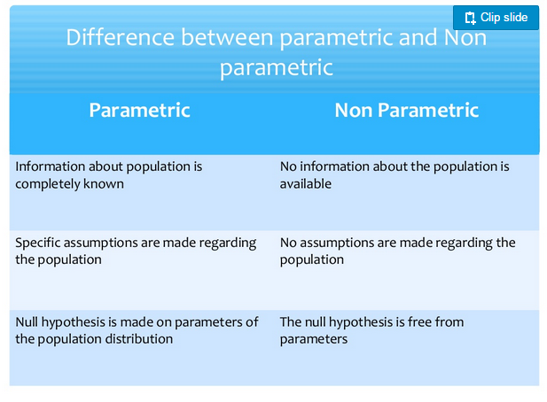

Notes:
Nonparametric statistics are used when the data do not have to be normally distributed and are ordinal (i.e., can be sorted in order, but the distances between any two values do not have to be the same).
In the literal meaning of the terms, a parametric statistical test is one that makes assumptions about the parameters (defining properties) of the population distribution(s), (eg. Normal distribution ) from which one's data are drawn, while a non-parametric test is one that makes no such assumptions.
Non-parametric tests are sometimes spoken of as "distribution-free" tests, although this too is something of a misnomer.

Slide 18
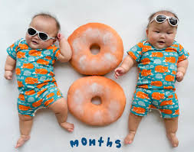
spearmen
Non parametric
Ranks then pearson
Similar equation

Slide 19
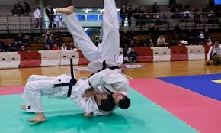

Kendall tau
Non parametric
small data & tied ranks.
Kendall better than spearmen
more accurate generalizations from Kendall’s statistic than from Spearman’s

Slide 20
How to choose??
Pearson - spearmen – kendall tau

Slide 21
Sample size and statistical significance, correlation coefficient
The minimum correlation coefficient that will be statistically significant for various sample sizes. Calculated using the approximation,
Sample Size | Minimum correlation coefficient that will be statistically significant, p<.05
10 | 0.63
100 | 0.20
1000 | 0.06
10,000 | 0.02
100,000 | 0.006
1,000,000 | 0.002
Sainani KL. Clinical versus statistical significance. PM&R. 2012;4:442-5.
Notes:
Statistical significance tells you that the correlation you observed is not likely due to chance, but does not tell you anything about the strength of the association.

Slide 22
Food for thought
If r = .8 , p=0.2
probably r not equal 0.8 ,, then what 0.7? 0.75 ? P for hypothesis ….. Yes/No
P for correlation ….. 0,0.1,0.2,…1
Notes:
Hypothessis is binary
Correlation is continuous then why p value is not high ?? Probably due to low sample size

Slide 23
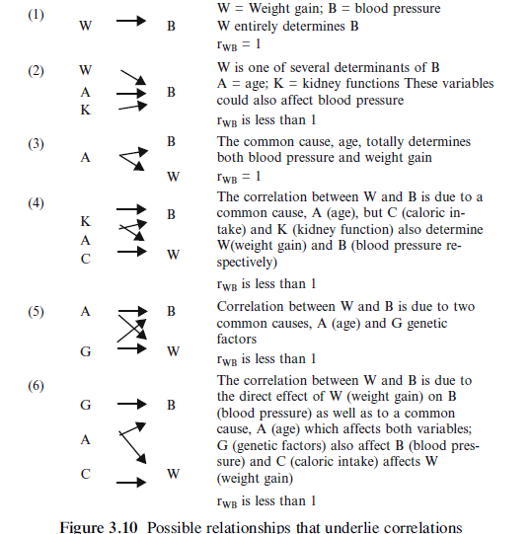
Exercise

Slide 24


Comparing correlations
Notes:
Correlation between number of times I have beaten the cat and cat suicidal attempts
Correlation : no of teeth in the little boy’s mouth and number of girls he has made friends with.

Slide 25
Calculating the effect size
Is it ok to compare r from different methods ?
Pearson’s
Spearman’s rs same equation ?
Notes:
U can compare the two since they share a similar equation.

Slide 26

Kendall Tau
Diff equations

Slide 27

Problem 2
Tau 66–75% smaller
Don’t compare
Don’t square
Notes:
Don’t’ square: u can’t get the r squared from kendall tau

Slide 28
https://istats.shinyapps.io/Association_Quantitative/

Slide 29

Biserial correlations

Slide 30
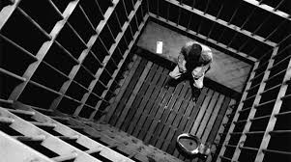

Biserial and point-biserial correlations
point-biserial correlation coefficient (rpb)
biserial correlation coefficient (rb)
Huge difference in calculations…!
Notes:
The difference is that the point-biserial correlation is used when the dichotomous variable is a true or discrete dichotomy. He either goes to jail or not.
Biserial is for the exam test, the person may succeed with 80% or 50%. The dichotomous variable is continuous

Slide 31

Sizes not equal
Biserial > point biserial
Tau < r and rs

Slide 32
How to report correlation coefficents
.02 not 0.02 nothing else before the “.”
coefficients are reported to 2 decimal places
each correlation coefficient is represented by a different letter (rpb,, rb, rs, r, tau)
Notes:
You can use a one-tailed t-test if you are only interested in one directionality of the correlation but not in the other (e.g. only positive but not negative, or only negative but not positive).

Slide 33

pitfalls

Slide 34
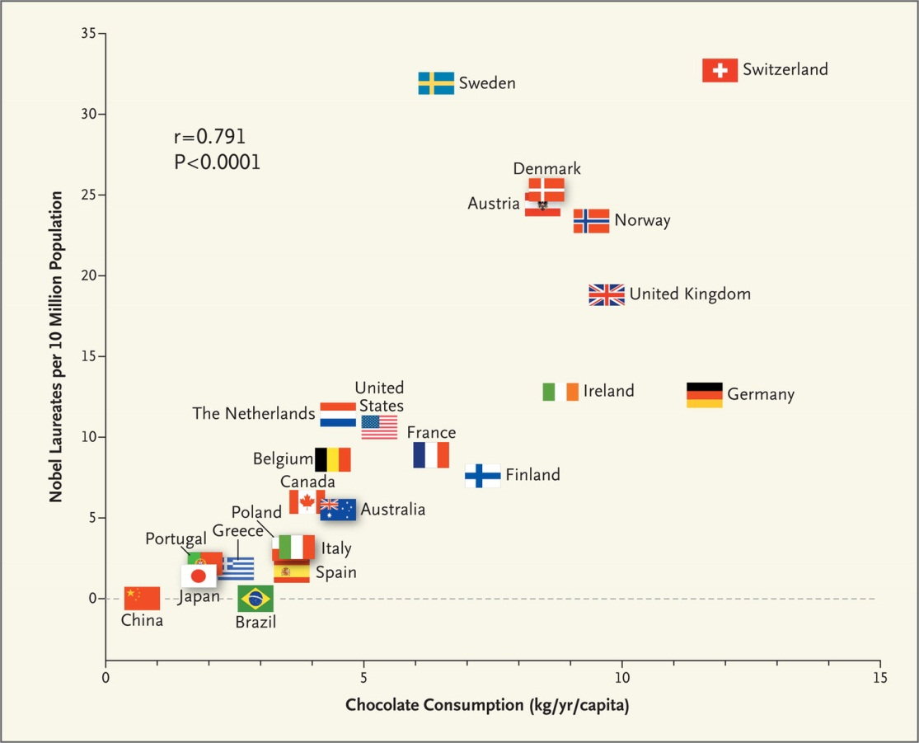
Chocolate and Nobel prize winners!
Notes:
**** anytime u see 2 variables correlate over time, u should be skeptical of the role time can play as a confounder, the same as space ( place )
This is a different example
Imagine a country which over the past 10 years, alcohol consumption increased greatly. Also number of people of went to elections increased greatly in the same 10 years.
Is time a confounder?

Slide 35
Spurious correlations
http://www.tylervigen.com/spurious-correlations

Slide 36
Example: between-patient comparison
Results from a hypothetical trial in which 50 subjects were randomized to receive active drug (n=25) or placebo (n=25) in both eyes.
Analysis | N (%) of eyes improving in the control group | N (%) of eyes improving in the treatment group | p-value
Assuming eyes are independent* | 17/50 (34%) | 27/50 (54%) | .046
Correcting for within-subject correlation** | 17/50 (34%) | 27/50 (54%) | .11
*Data were analyzed with unconditional logistic regression.
**Data were analyzed using a generalized estimating equation, correcting for within-subject correlation.
Reprinted from Table 3 of: Sainani K. The importance of accounting for correlated observations. PM&R 2010 Sep;2:858-61.
Notes:
When correlated, it is about 8 patients in comparison with 13 patients who have responded.
Simply the idea is that when u are having eye drops, it is not likely that one eye would respond to treatment, however the other won’t ( if we are treating inflammation)

Slide 37
summary
Correlation coefficient (r)
Coefficient of determination (R²)
Correlation vs causality
Types of correlation coefficients
Sample size dilemma
How to report?
Pitfalls

Slide 39
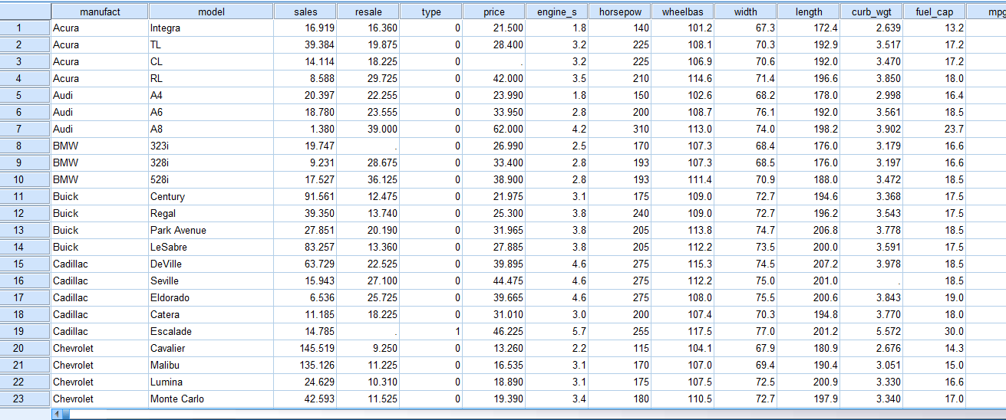
CASE STUDY
Fuel efficiency and sales

Slide 40
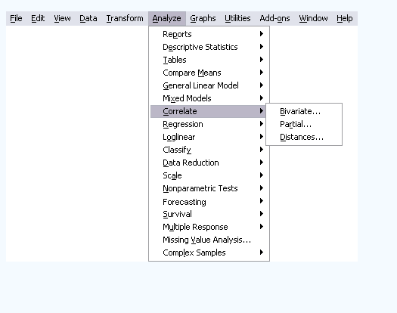

Slide 41
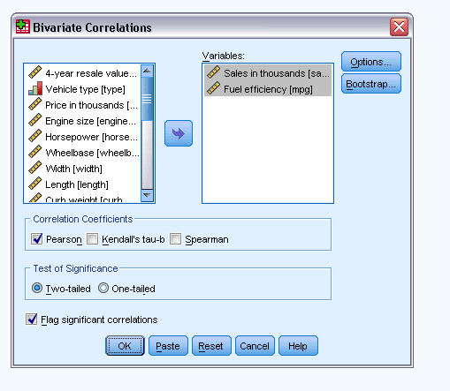

Slide 42
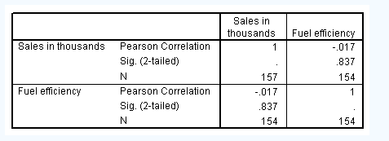

Slide 43
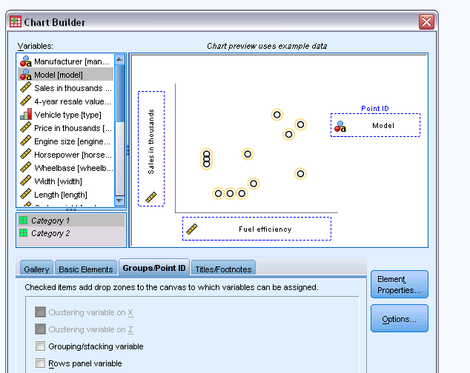

Slide 44
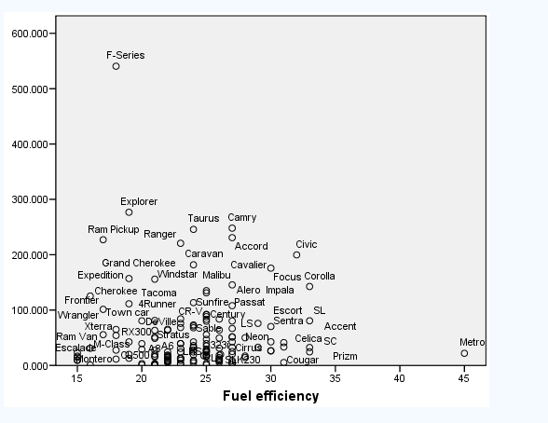

Slide 45
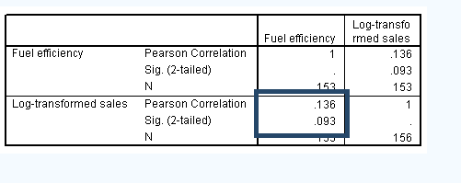

Slide 46
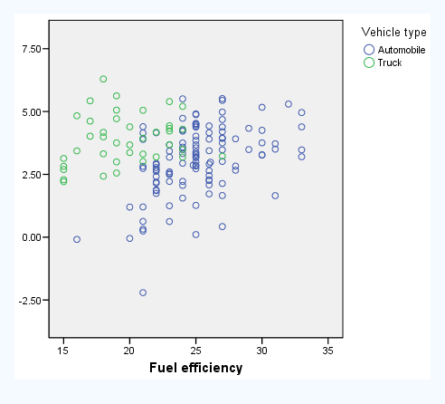

Slide 47
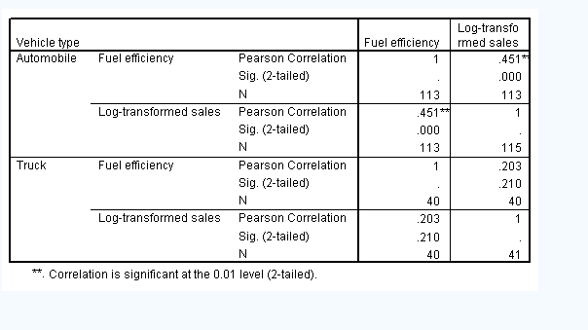

Slide 48
Key references
Andy Field, Jeremy Miles, Zoë Field-Discovering Statistics Using R-SAGE Publications Ltd (2012)
Statistics in Medicine, Stanford online course
Biostatistics and Epidemiology Sylvia Wassertheil-Smoller Jordan Smoller A Primer for Health and Biomedical Professionals Fourth Edition

