Slide 1

Sample size

Slide 2




Slide 3
If the sample is too small ? N=30
P-value : >0.05 → Insignificant

Slide 4
When Increasing Sample Size… N=60
P-value : <0.05 → Significant

Slide 5
Sample size
Effect size
β-error/ power
α-error
Notes:
Type I error or α-error is failure to accept the null hypothesis when it is actually true. Usually it is set at 5%. The sample size has to be increased if this value has to be lowered. Type II error or β-error is failure to reject the null hypothesis when it is not true. By convention, it can be set at 20%, 10% or 5%. Power of the study is equal to 1-type II error; hence any study should be at least 80% powered. The sample size increases when the power of study is increased from 80% to 90% or 95%. The third factor is the effect size. A small clinically significant difference is difficult to identify and needs a larger sample size as compared to a study with a larger clinically significant difference. The other factors which need to be considered are standard deviation for quantitative measurements, margin of error and attrition rate. These values are either known from literature or can be decided by a pilot study or by reasonable guess work

Slide 6

Alpha error

Slide 7

Power

Slide 8
Sample size
Effect size
β-error/ power
α-error
Notes:
Type I error or α-error is failure to accept the null hypothesis when it is actually true. Usually it is set at 5%. The sample size has to be increased if this value has to be lowered. Type II error or β-error is failure to reject the null hypothesis when it is not true. By convention, it can be set at 20%, 10% or 5%. Power of the study is equal to 1-type II error; hence any study should be at least 80% powered. The sample size increases when the power of study is increased from 80% to 90% or 95%. The third factor is the effect size. A small clinically significant difference is difficult to identify and needs a larger sample size as compared to a study with a larger clinically significant difference. The other factors which need to be considered are standard deviation for quantitative measurements, margin of error and attrition rate. These values are either known from literature or can be decided by a pilot study or by reasonable guess work

Slide 9
https://blakemcshane.shinyapps.io/pces/

Slide 10


Slide 11
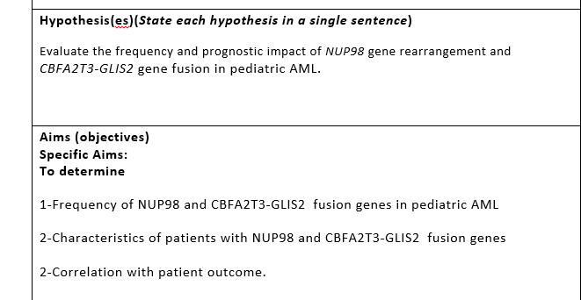

Slide 12
Descriptive

Slide 13
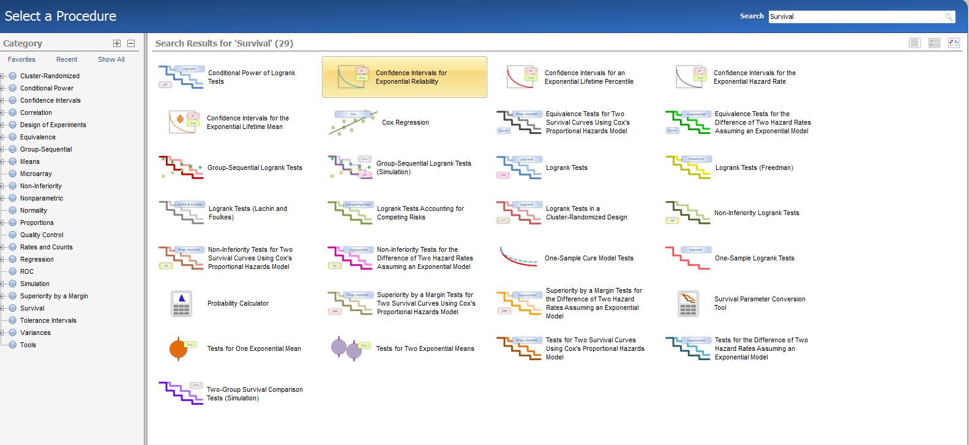

Slide 14
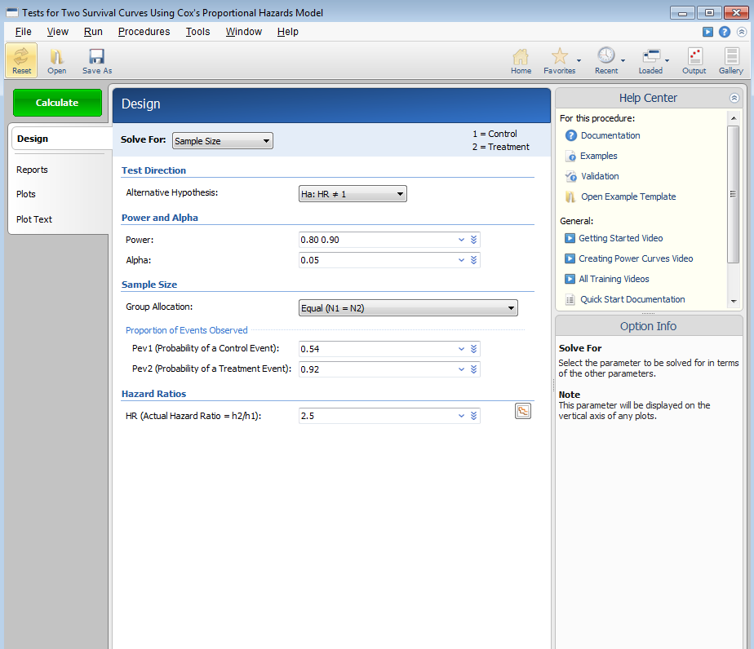

Slide 15
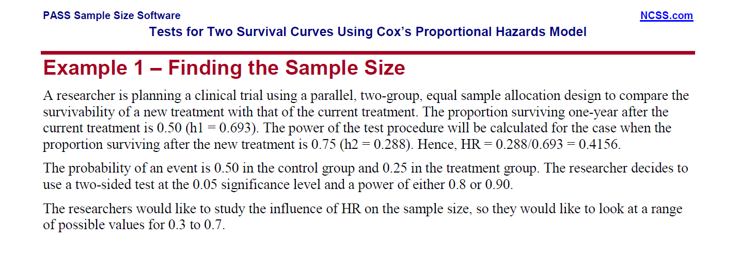

Slide 20


Slide 21


Slide 22
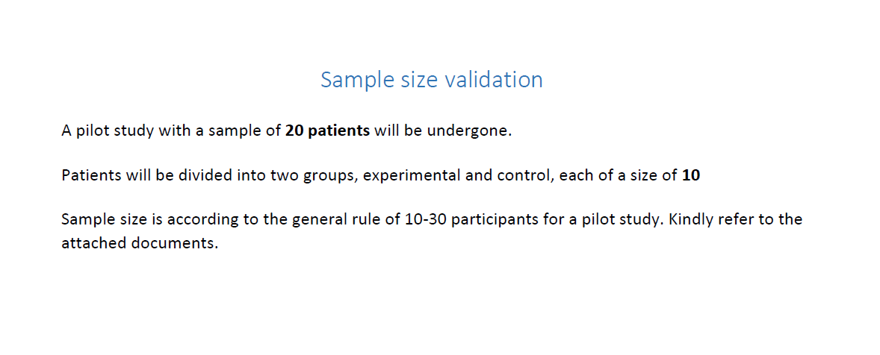

Slide 23


Slide 24
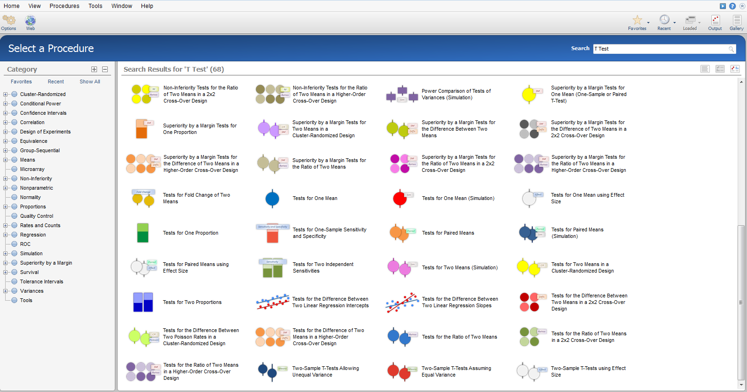

Slide 25
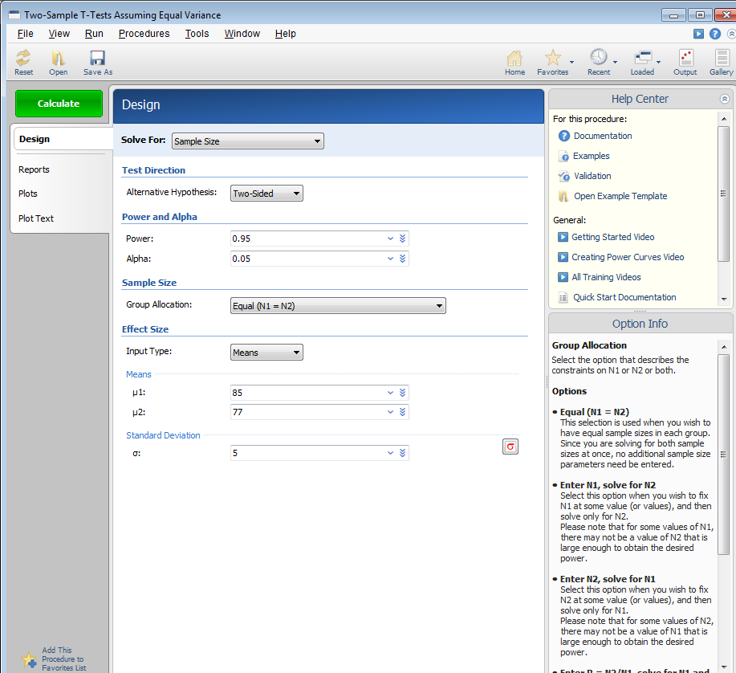

Slide 26
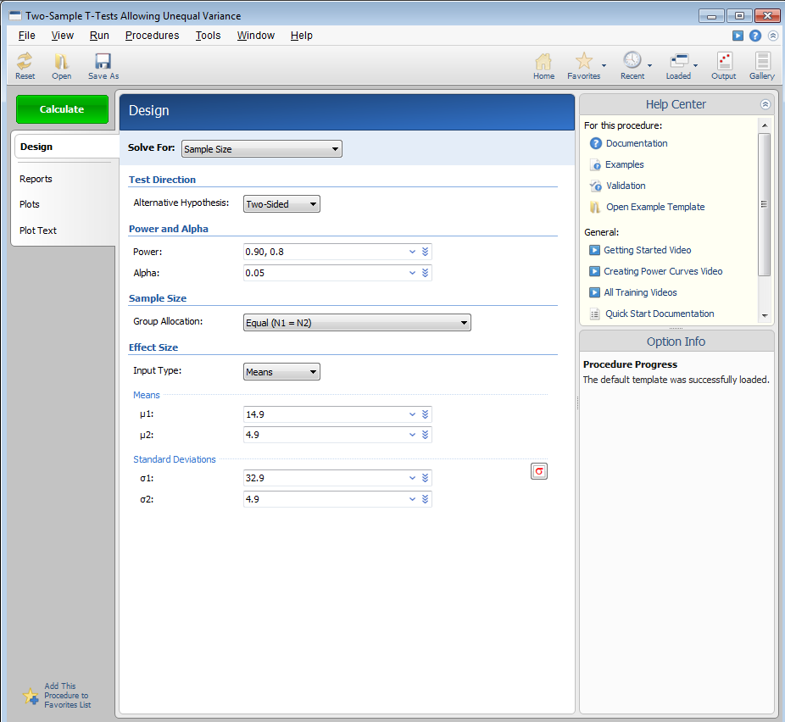

Slide 27
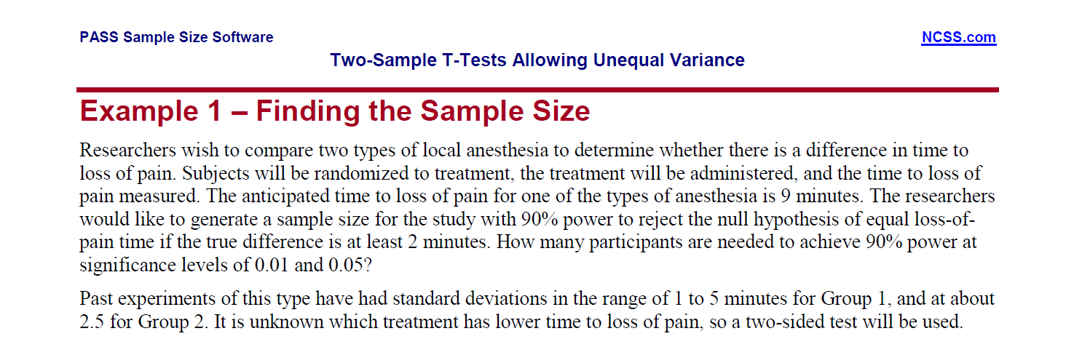

Slide 28
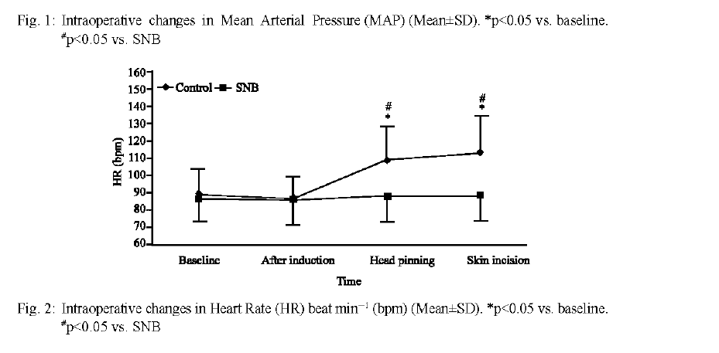

Slide 30
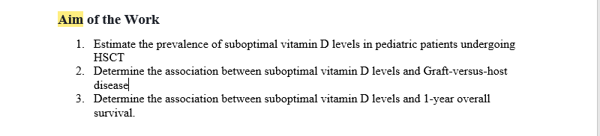

Slide 31
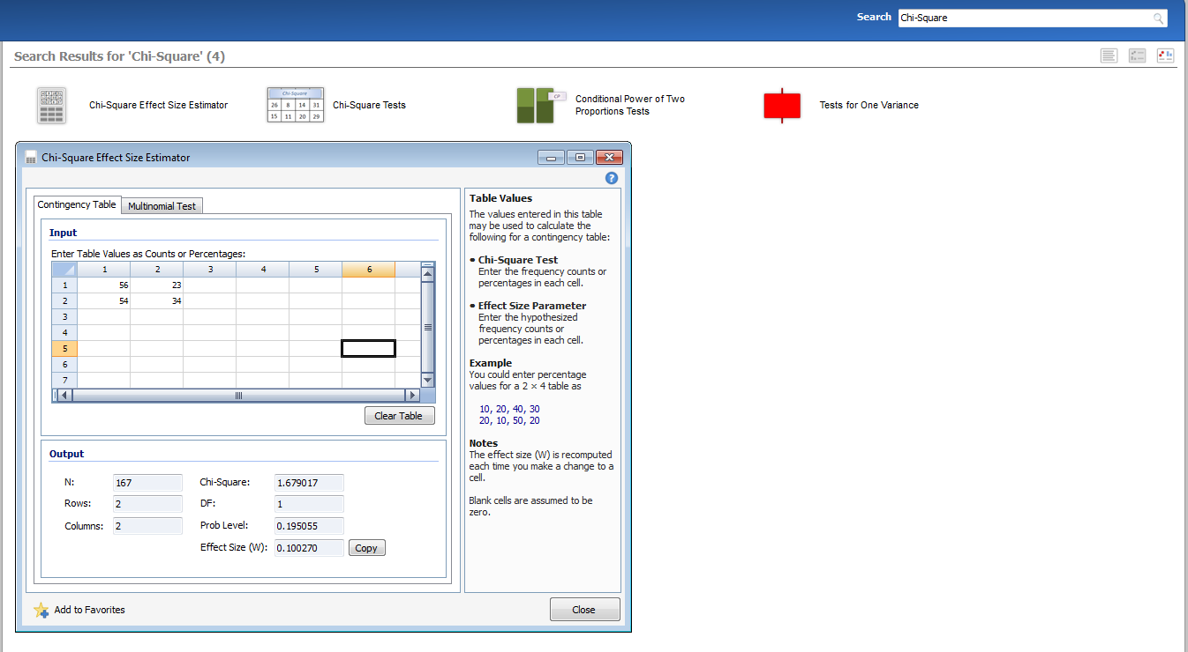

Slide 32
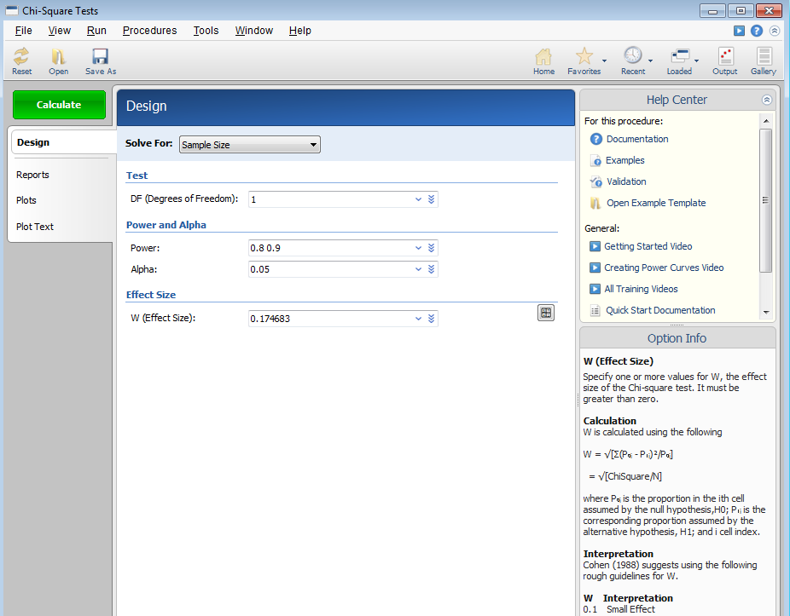

Slide 33
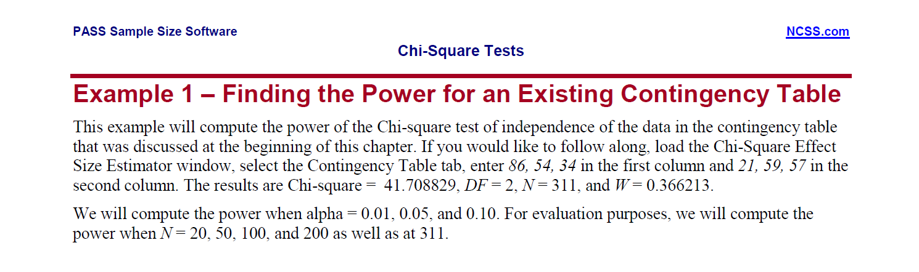

Slide 34
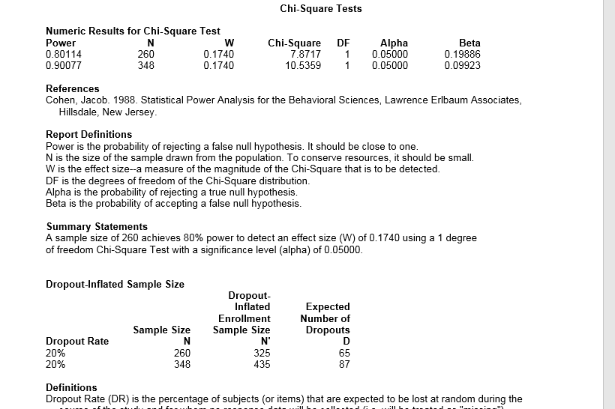

Slide 35


Slide 36


Slide 37


Slide 38
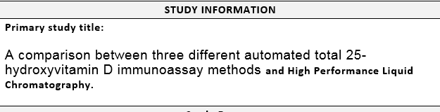

Slide 39
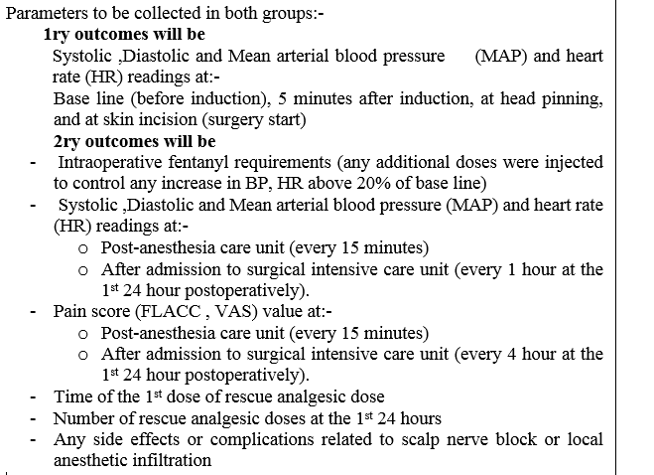

Slide 40
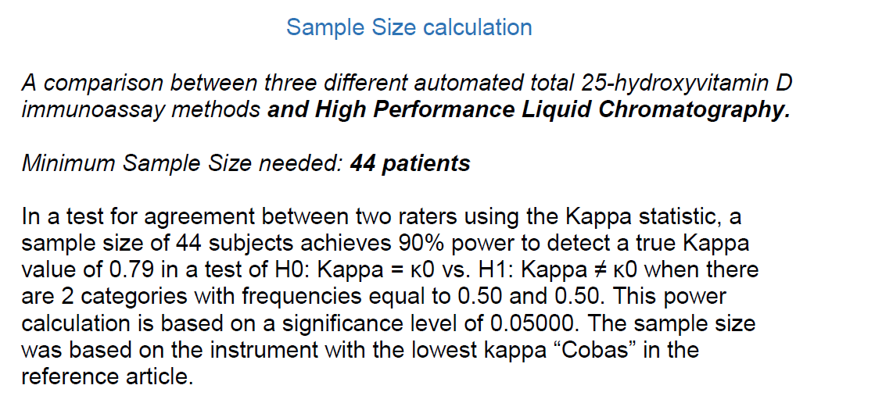

Slide 41
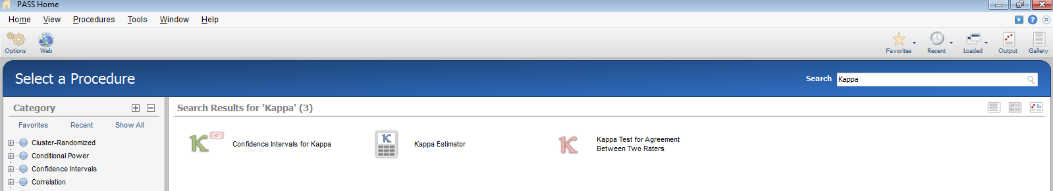

Slide 42
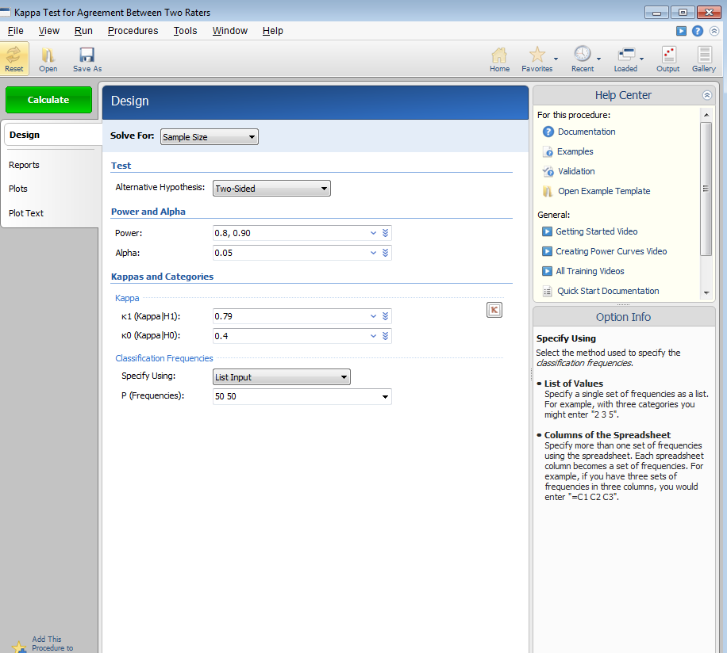

Slide 43
