Slide 1
Behavior Driven Development
Tamas Santa
Software Engineer
tamas_santa@epam.com

Slide 2
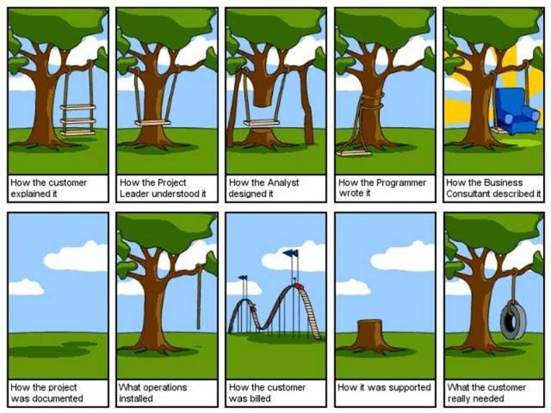
Real life development

Slide 3
Definition
In software engineering, behavior-driven development (abbreviated BDD) is a software development process based on test-driven development (TDD). Behavior-driven development combines the general techniques and principles of TDD with ideas from domain-driven design and object-oriented analysis and design to provide software development and management teams with shared tools and a shared process to collaborate on software development.

Slide 4
Basics
What is BDD?
Behavior Driven Development
Agile software development technique
A common language between developers, QA and BA
What advantages has it got?
Facilitates communication between team members
Uses very specific (and small) common vocabulary to minimize miscommunication
Focuses on the behavioral aspects rather than testing and implementation:
Unit test: „Build the thing right.”
Acceptance test: „Build the right thing.”
Can be easily maintained

Slide 5
Behavior Driven Development practices
Establishing the goals of different stakeholders required for a vision to be implemented
Drawing out features which will achieve those goals using feature injection
Involving stakeholders in the implementation process(acceptance criteria, features)
Using examples to describe the behavior of the application, or of units of code
Automating those examples to provide quick feedback and regression testing

Slide 6
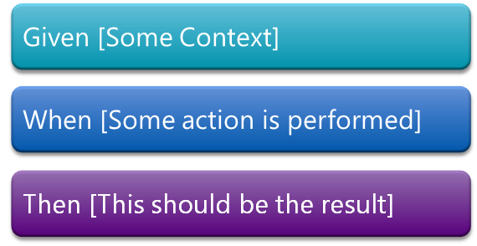
Gherkin
Given-When-Then format is popular because:
it enables us to express our requirements in plain English
it forces us to express each scenario clearly in terms of interactions with the system

Slide 7
After cutting the fancy bullsh*t
Inadequate acceptance criteria
Business doesn’t care about reusability
Dozens of differently worded yet the same steps
Implementation might require additional and/or reworded steps
Business split the mergeable
Business merge the separate

Slide 8
How a good BDD looks like?
The naming is detailed and precise
The steps are thorough and describing clearly (Where? What? How?)
The steps are parameterized
The Givens are merged into one step, if possible
Doesn’t want to test too many different outcomes in one test
Doesn’t chain When-Thens
Uses examples instead of scenario duplication
Uses the right amount of examples

Slide 9
Principles of BDD implementation
Revise business BDD’s
Keep control on steps
Write reusable Givens and Whens
Use enums instead of string parameters
Use custom classes instead of Table parameters
Create methods for atomic steps
Build Givens and Whens from atomic steps
Do not use Assert in Givens and Whens
Use ScenarioContext to pass data between steps
Write proper error messages

Slide 10
Practical example
Requirement: create and test a calculator which is able to add two numbers and print out the result.
Scenario: Add two numbers
Given the input 2+2
When the calculator is run
Then the output should be 4

Slide 11
Practical example
Requirement: create and test a calculator which is able to add two numbers and print out the result.
Scenario Outline: Add two numbers
Given the input <input>
When the calculator is run
Then the output should be <result> Examples: |input|result| | 2+2 | 4 |
| 3+4 | 7 |

Slide 12
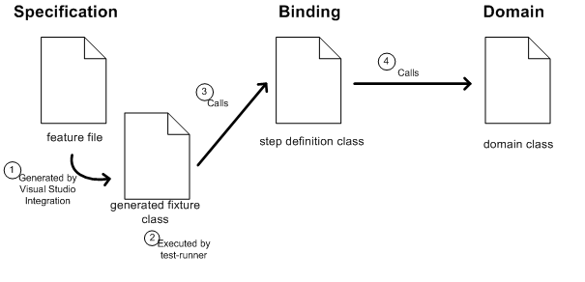
Specflow

Slide 13
Demo
Specflow in practice
http://www.specflow.org/getting-started/

Slide 14
Questions?

Slide 15
Thanks for Your attention!
EPAM Systems — Behavior Driven Development
By Tamas Santa
Software Engineer
EPAM Systems
41 University Drive, Suite 202 | Newtown, PA 18940
p: +1 267 759 9000 | f: +1 +1 267 759 8989 | e: info@epam.com | w: www.epam.com

