Slide 1
Continuous Integration …and delivery
Tamas Santa
Software Engineer
tamas_santa@epam.com

Slide 2
Agenda
Discussion: Why do we need CI and CD?
Suggested course materials
Agile development process VS waterfall
Overview of CI
Version Control Systems
Build Systems
Automated deployment
Continuous status checking
Walking skeleton
Costs and benefits
Demo

Slide 3


Suggested course materials
http://www.beautifulbuilds.com/
http://www.visualstudio.com/en-us/get-started/

Slide 4
Why do we need CI and CD?
Notes:
Itt egy par perces beszelgetes/kozvelemenykutatast szeretnek. Ki szerint szuksegesek a tesztek, ki szerint nem. Felmerni nagyjabol a kozonseg tapasztalatat, hasznalt-e teszteket esetleg valaki munkahelyen, sajat projecten, stb. Ha igen, akkor veluk, ha nem, akkor egyedul elmagyarazni/ravezetni a diakokat miert is jo ha a projecten vannak tesztek (es jo tesztek). Lehet hozni par eletszeru peldat arra, hogy mit okozott az ha nem volt megfelelo unit teszt lefedettseg (regression, egyebek).
Ez egyben ismerkedos szakasz is. Nem tobb, mint 5-10 perc.

Slide 5
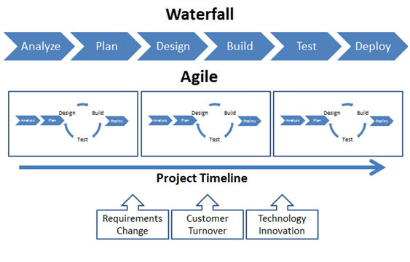
Agile vs Waterfall
http://www.greenlinesystems.com/agile-software-development/

Slide 6
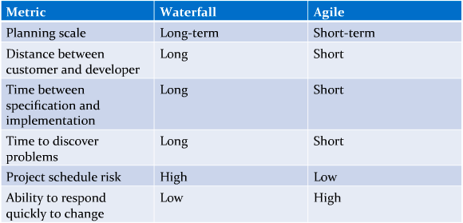
Agile vs Waterfall
http://www.venveo.com/

Slide 7
Overview of Continuous Integration
Continuous integration (CI) is the practice, in software engineering, of merging all developer working copies with a shared mainline several times a day.
Continuous integration involves integrating early and often, so as to avoid the pitfalls of "integration hell". The practice aims to reduce rework and thus reduce cost and time.
A complementary practice to CI is that before submitting work, each programmer must do a complete build and run (and pass) all unit tests. Integration tests are usually run automatically on a CI server when it detects a new commit. All programmers should start the day by updating the project from the repository. That way, they will all stay up to date.
http://en.wikipedia.org/wiki/Continuous_integration

Slide 8
CI and CD Pipeline
Version Control System
Build System
Automated Deployment
Hosting and Status check

Slide 9
Version Control Systems

Slide 10
Build Systems

Slide 11
Automated Deployment

Slide 12
Continuous status checking

Slide 13
Walking Skeleton

Slide 14
Costs and benefits
Benefits:
Integration bugs are detected early and are easy to track down due to small change sets. This saves both time and money over the lifespan of a project.
Avoids last-minute chaos at release dates, when everyone tries to check in their slightly incompatible versions
Easy to revert codebase in case of committed bugs or failures
Constant availability of a "current" build for testing, demo, or release purposes
Frequent code check-in pushes developers to create less complex code.
Enforces discipline of frequent automated testing
Immediate feedback on system-wide impact of local changes
Metrics generated from automated testing and CI focus developers on developing functional, quality code

Slide 15
Costs and benefits
Costs:
Can be enormous if introduced late in the project’s lifetime -> Walking skeleton!
Constructing and maintaining an automated test suite requires a considerable amount of work
There are off-the-shelf CI software solutions which can be used (both proprietary and open-source)
http://en.wikipedia.org/wiki/Comparison_of_continuous_integration_software

Slide 16
Demo
Using Visual Studio Online

Slide 17
Questions?

Slide 18
Thanks for Your attention!
EPAM Systems — Continuous Integration and delivery
By Tamas Santa
Software Engineer
EPAM Systems
41 University Drive, Suite 202 | Newtown, PA 18940
p: +1 267 759 9000 | f: +1 +1 267 759 8989 | e: info@epam.com | w: www.epam.com

