Slide 1
Continuous Integration …and delivery
Tamas Santa
Software Engineer
tamas_santa@epam.com

Slide 2


Suggested course materials
http://www.beautifulbuilds.com/
http://www.visualstudio.com/en-us/get-started/

Slide 3
Why do we need CI and CD?
Notes:
Itt egy par perces beszelgetes/kozvelemenykutatast szeretnek. Ki szerint szuksegesek a tesztek, ki szerint nem. Felmerni nagyjabol a kozonseg tapasztalatat, hasznalt-e teszteket esetleg valaki munkahelyen, sajat projecten, stb. Ha igen, akkor veluk, ha nem, akkor egyedul elmagyarazni/ravezetni a diakokat miert is jo ha a projecten vannak tesztek (es jo tesztek). Lehet hozni par eletszeru peldat arra, hogy mit okozott az ha nem volt megfelelo unit teszt lefedettseg (regression, egyebek).
Ez egyben ismerkedos szakasz is. Nem tobb, mint 5-10 perc.

Slide 4
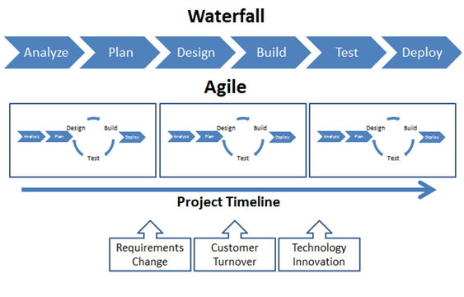
Agile vs Waterfall
http://www.greenlinesystems.com/agile-software-development/

Slide 5
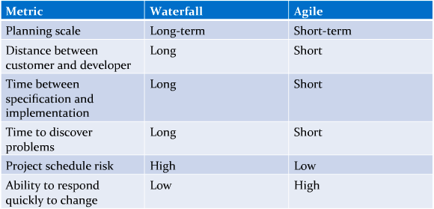
Agile vs Waterfall
http://www.venveo.com/

Slide 6
Overview of Continuous Integration
Continuous integration (CI) is the practice, in software engineering, of merging all developer working copies with a shared mainline several times a day.
Continuous integration involves integrating early and often, so as to avoid the pitfalls of "integration hell". The practice aims to reduce rework and thus reduce cost and time.
A complementary practice to CI is that before submitting work, each programmer must do a complete build and run (and pass) all unit tests. Integration tests are usually run automatically on a CI server when it detects a new commit. All programmers should start the day by updating the project from the repository. That way, they will all stay up to date.
http://en.wikipedia.org/wiki/Continuous_integration

Slide 7
CI and CD Pipeline
Version Control System
Build System
Automated Deployment
Hosting and Status check

Slide 8
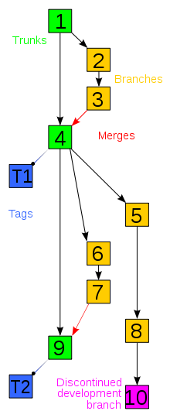
Version Control Systems
Management of changes to collections of information (source code, documents, etc)
Changes are usually identified by a number or letter code, termed the "revision number“, which can be compared, restored, merged, branched, etc.
If multiple people are working on a single data set or document, they are implicitly creating branches of the data (in their working copies), and thus issues of merging arise.
In terms of graph theory, revisions are generally thought of as a line of development (the trunk) with branches off of this, forming a directed tree, visualized as one or more parallel lines of development (the "mainlines" of the branches) branching off a trunk.
http://en.wikipedia.org/wiki/Revision_control

Slide 9
Build System
The advantages of build automation to software development projects are the following:
Improving product quality
Accelerating the compile and link processing
Eliminating redundant tasks
Minimizing "bad builds"
Eliminating dependencies on key personnel
Having history of builds and releases in order to investigate issues
Saving time and money - because of the reasons listed above

Slide 10
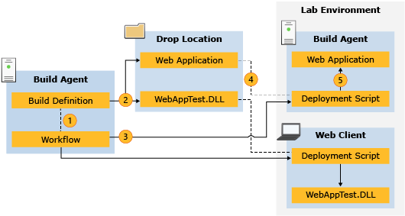
Automated Deployment
http://msdn.microsoft.com/en-us/library/hh191495.aspx

Slide 11
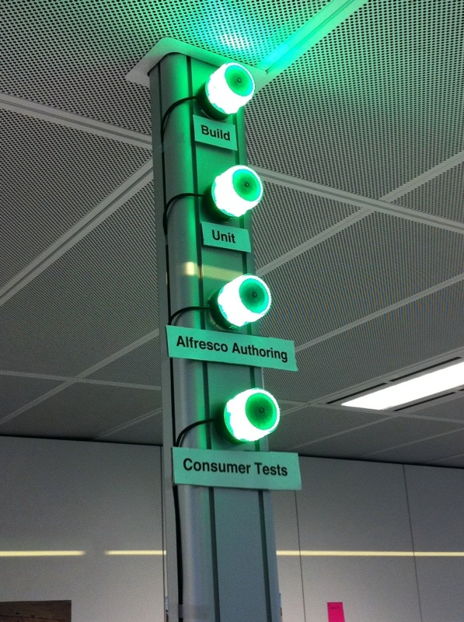
Continuous status checking
Configurable alerts
E-mail alerts
SMS alerts
Build lights
Live state of:
Builds
Unit test runs
Custom rules (code analysis)
Deployments

Slide 12
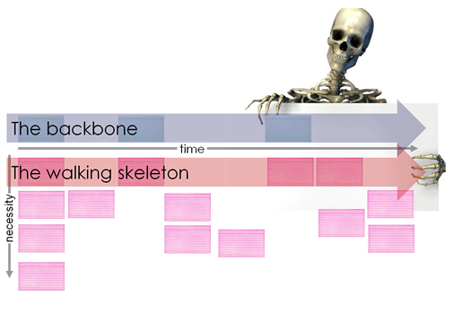
Walking Skeleton
A tiny implementation of the system that performs a small end-to-end function. It need not use the final architecture, but it should link together the main architectural components. The architecture and the functionality can then evolve in parallel.
http://www.agileproductdesign.com/blog/the_new_backlog.html

Slide 13
Costs and benefits
Benefits:
Integration bugs are detected early and are easy to track down due to small change sets. This saves both time and money over the lifespan of a project.
Avoids last-minute chaos at release dates, when everyone tries to check in their slightly incompatible versions
Easy to revert codebase in case of committed bugs or failures
Constant availability of a "current" build for testing, demo, or release purposes
Frequent code check-in pushes developers to create less complex code.
Enforces discipline of frequent automated testing
Immediate feedback on system-wide impact of local changes
Metrics generated from automated testing and CI focus developers on developing functional, quality code

Slide 14
Costs and benefits
Costs:
Can be enormous if introduced late in the project’s lifetime -> Walking skeleton!
Constructing and maintaining an automated test suite requires a considerable amount of work
There are off-the-shelf CI software solutions which can be used (both proprietary and open-source)
http://en.wikipedia.org/wiki/Comparison_of_continuous_integration_software

Slide 15
Demo
Using Visual Studio Online

Slide 16
Questions?

Slide 17
Thanks for Your attention!
EPAM Systems — Continuous Integration and delivery
By Tamas Santa
Software Engineer
EPAM Systems
41 University Drive, Suite 202 | Newtown, PA 18940
p: +1 267 759 9000 | f: +1 +1 267 759 8989 | e: info@epam.com | w: www.epam.com

