Slide 1

StealME
Theft prevention and vehicle tracking for Android

Slide 2
A brief history
I started this project in 2012 (in Uni), as a class assignment, creating the first prototype – with only SMS/GPS capabilities
After finishing the class, I worked on it (as a pet project) for 6 months – completely overhauling the finished assignment, introducing socket networking, web frontend, fancy UI, and more…
Eventually I gave up the development, because there were already better alternatives, and because reasons. ☺

Slide 3
Project goals
Create a cheap GPS tracking device for my car
While doing that, use/learn Android, and MVC
If it goes well, grow it into a commercial product (spoiler alert: haven’t succeeded ☺)
+1 as always: have fun while coding!

Slide 4
Features
Client
Accelerometer sensor alert
GPS/GSM Cell location report via SMS/Socket connection
Real-time control with SMS/Socket connection
Server
Support for distributed architectures (incomplete)
Handling high number of simultaneous connections with async sockets
Low bandwidth usage with MessagePack

Slide 5

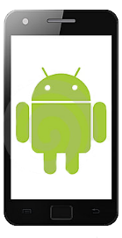
Architecture
Display devices
Plot positions on map
Send commands
Network / Load balancer
Web Frontend
DB
Authenticate
Set Protocol
Send Commands
Request Positon
Network / Load balancer
Server Node

Slide 6
Applied Technologies
Client
Android 2.1 (API level 7)
MessagePack (compiled for Android)
Sockets (java.net.Socket)
Server
.NET 4.0, async sockets for handling client phones
MSSQL Database
ASP.NET MVC4 + jQuery (ajax support)
OpenStreetMaps
Microsoft Azure (experimental)

Slide 7
Communication breakdown
MessagePack
Serializer
(java)
Network
Location
Message
Serialize()
Write byte[]
Network
Read byte[]
MessagePack
Serializer
(.NET)
DeSerialize()
Server Node
Location
Message

Slide 8
MessagePack - Overview
Efficient serialization library
Binary-based format
Smaller footprint than JSON
Supports Stream serialization/deserialization with ZipStream
Type support (fixed and variable length types)
Advertised to be 4x faster than ProtoBuf
Implemented to almost every available language/platform
(MessagePack-RPC)

Slide 9
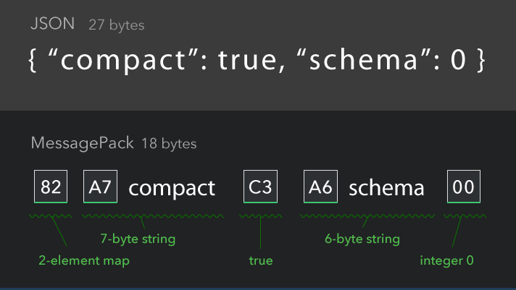
MessagePack - Format

Slide 10
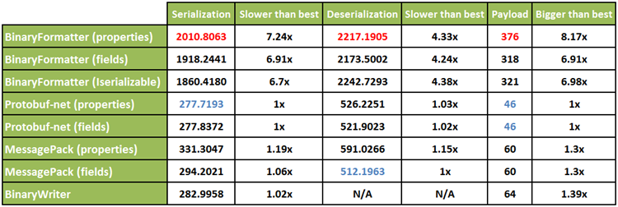
MessagePack - Performance
http://theburningmonk.com/2011/12/performance-test-binary-serializers-part-ii/

Slide 11
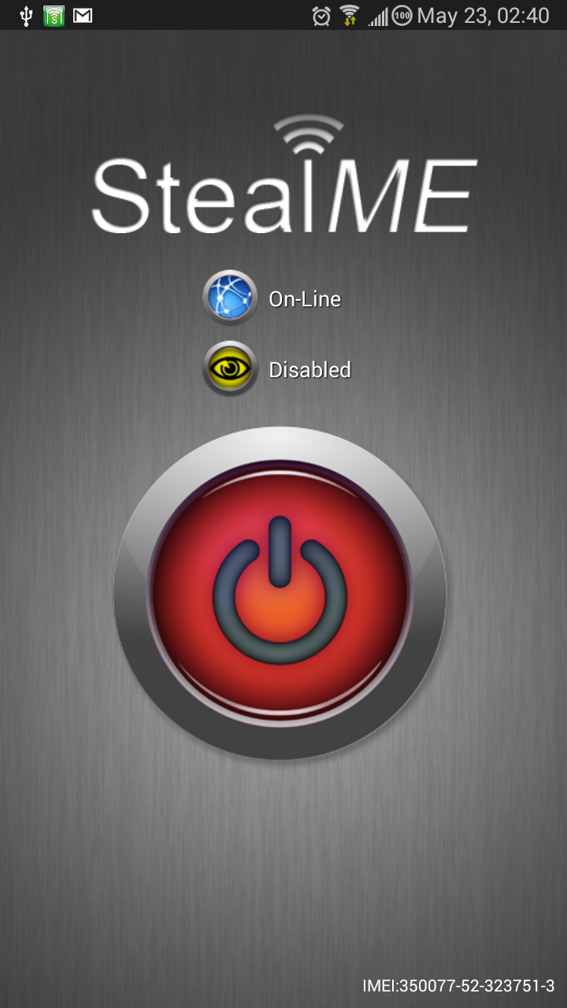
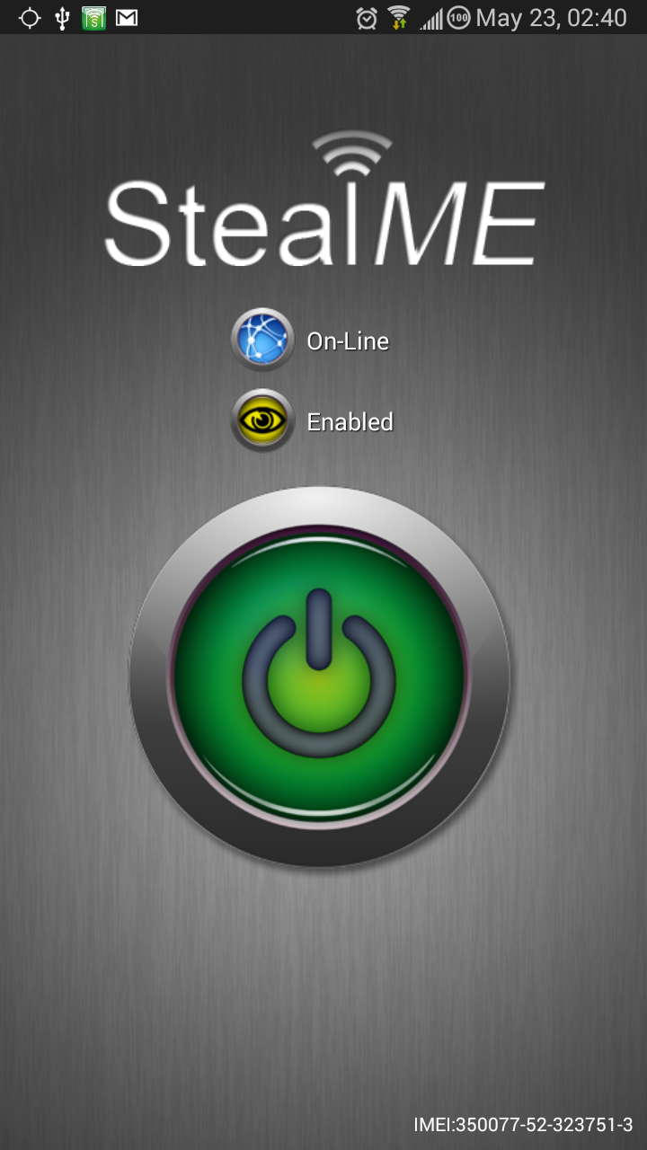
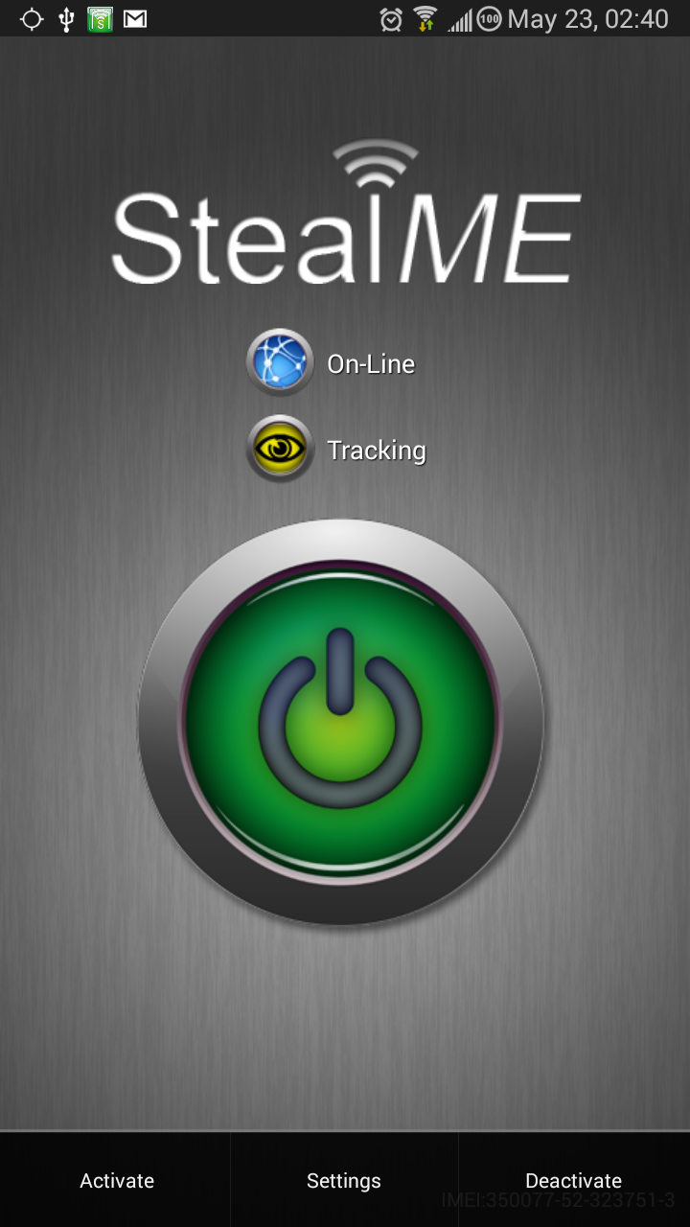
Client Application I.

Slide 12
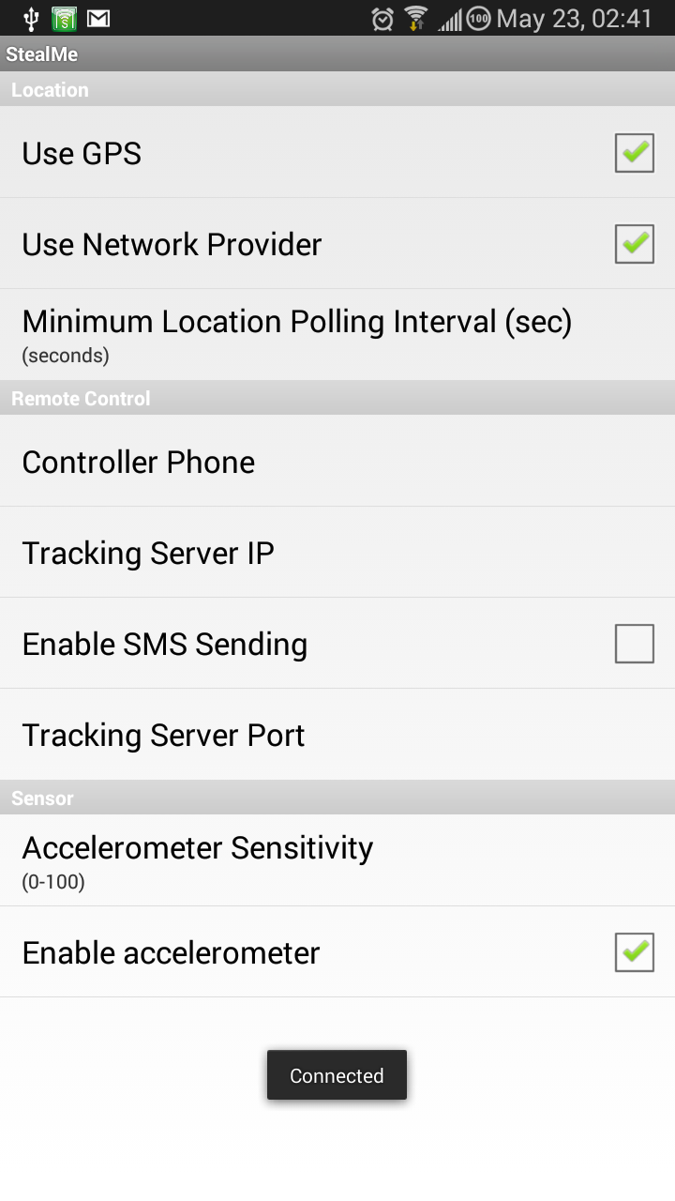
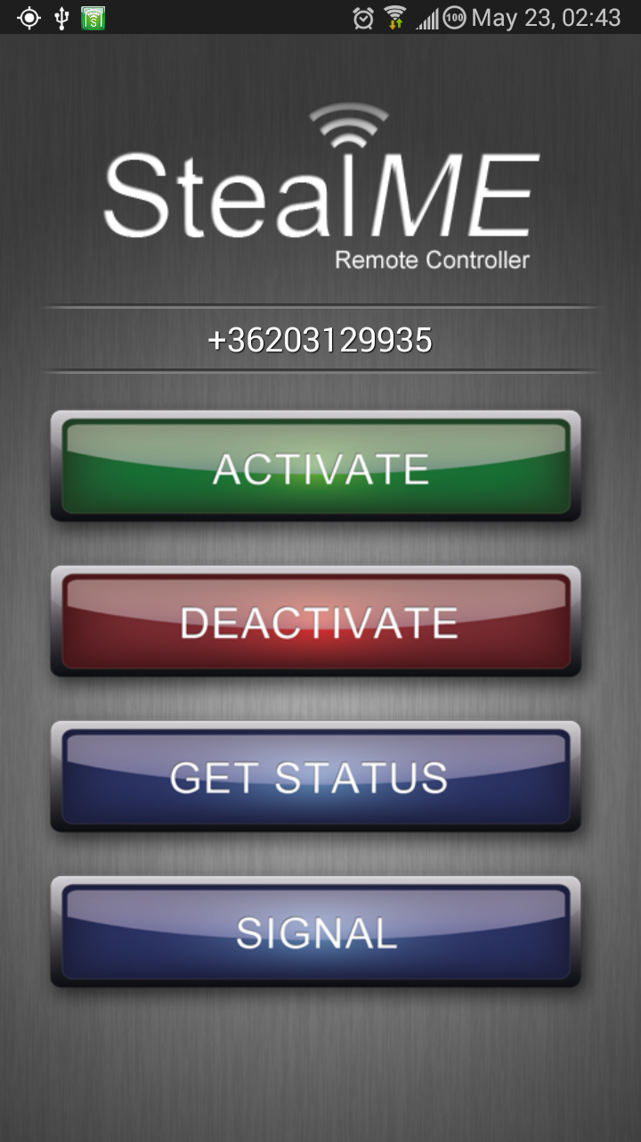
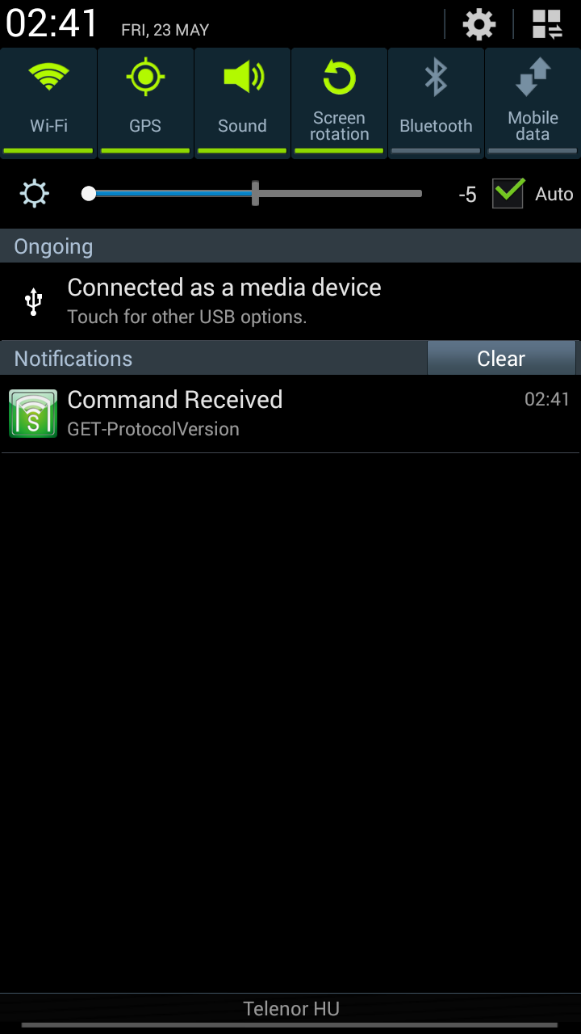
Client Application II.

Slide 13
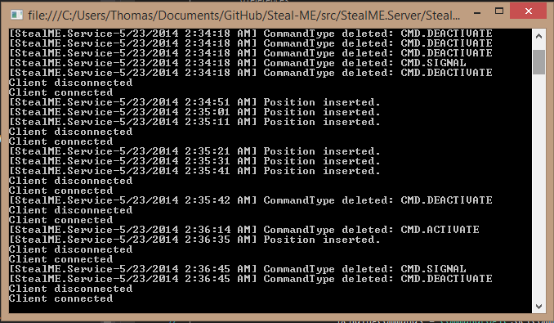
Server Application

Slide 14
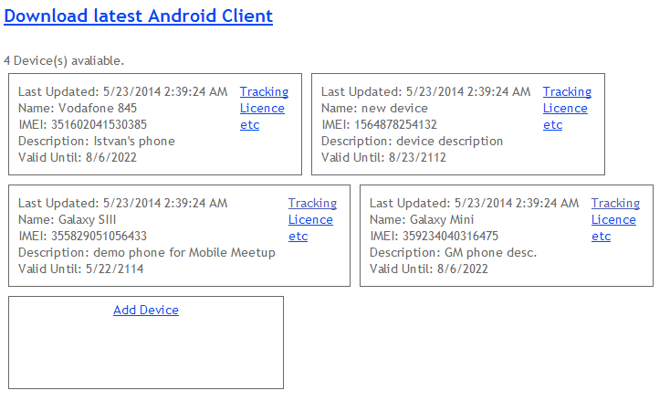
MVC Frontend - Devices

Slide 15
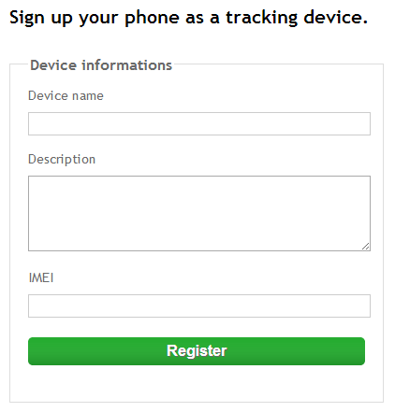
MVC Frontend – Device Registration

Slide 16
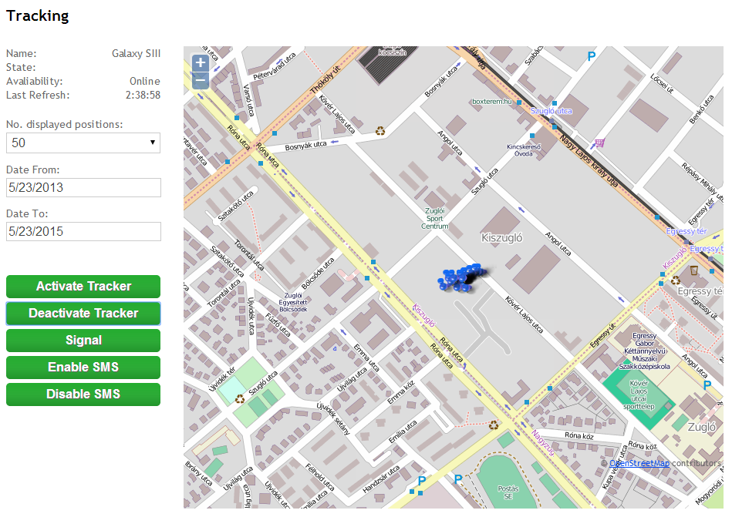
MVC Frontend - Tracking

Slide 17
Pitfalls
Working with async sockets provides the best performance – but it probably doesn’t worth the hassle
MessagePack is great – but it has hidden bugs and minor incompatibilities between the platform implementations (eg. Java vs. .NET)
Phone manufacturers tend to use custom hardware APIs and implementations – no restrictions from Android/Google on that (sensors).
OpenStreetMaps lacks documentation (state in 2012)

Slide 18
What would I do different now?
Use service bus / message queuing instead of DB polling.
Use cloud mobile service with json, instead of the custom networking (didn’t worth the effort really)
Or use google’s push notification service to send commands to app

Slide 19
Thanks!
https://github.com/santatamas/Steal-ME

