Slide 1
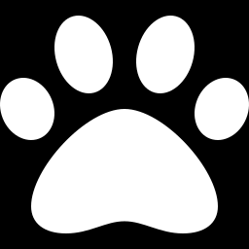
PROJECT 6
Image Classification
with Deep Learning
Teaching a neural network to tell a cat from a dog — and learning why the labels, not the model, are the tricky part.
Vernon T. Cox
Data Science Student, CNM · GitHub: santed7

Slide 2
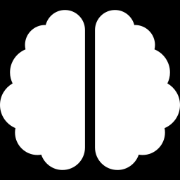
THE CHALLENGE
Easy for you, historically hard for a computer
A toddler can glance at a photo and say “dog.” For decades, getting a computer to do the same reliably was one of the hardest problems in the field.
Older approaches needed humans to hand-describe what a dog “looks like” — fur, ears, snout. That never generalized well.
Deep learning flipped the script: instead of being told the rules, the network learns the patterns directly from thousands of labeled examples.
OLD WAY — hand-coded rules
Humans write features. Brittle, slow, and poor on new images.
NEW WAY — learned patterns
The network discovers its own features from examples. Accurate and general.
Distinguishing a cat from a dog was an early flagship win for deep learning.

Slide 3
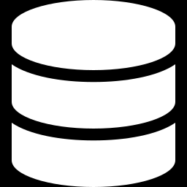
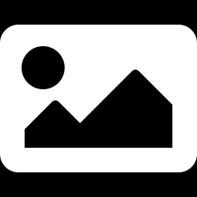
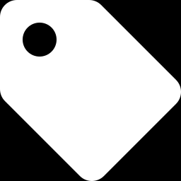
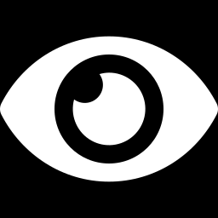
THE DATASET
What we feed the model
The images arrive pre-packaged as Python “pickle” files — not a folder of named pictures. That detail matters later.
X.pickle
y.pickle
0 / 1
dog.jpg
The images — a stack of grayscale pixel grids
The labels — a single 0 or 1 per image
Two classes: one is cat, one is dog
One held-out image the model never trains on
Pixel values are scaled from 0–255 down to 0–1 so the network trains faster and more stably.

Slide 4

THE INTUITION
How a convolutional network sees an image
Each layer spots bigger ideas than the one before — edges become fur, fur becomes ears, ears become “dog.”
1
2
3
4
Convolution
Pooling
Flatten
Output
Slides small filters across the image to find local patterns (edges, textures).
Shrinks the picture, keeping the strongest signals and dropping noise.
Unrolls the 2-D feature maps into one long list of numbers.
A dense layer plus sigmoid weighs everything into one probability (0–1).
We stack two convolution + pooling blocks — plenty for a teaching example.

Slide 5
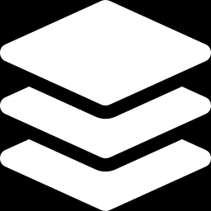
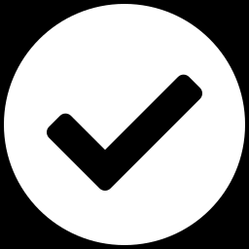
THE MODEL
The layer stack we actually built
Input
raw image (H × W × channels)
Conv2D + ReLU × 64 filters
find local patterns
Why one output neuron?
MaxPooling 2×2
shrink + keep strongest
Cat-vs-dog is a yes/no question, so a single sigmoid is all we need. It returns one number between 0 and 1 — the probability of class 1.
Conv2D + ReLU × 64 filters
combine into bigger shapes
MaxPooling 2×2
shrink again
Shapes are read straight from the data, so the model keeps working even if the image size changes.
Flatten → Dense (64) → Dropout 30%
weigh features, fight overfitting
Dense (1) + Sigmoid
one probability out

Slide 6
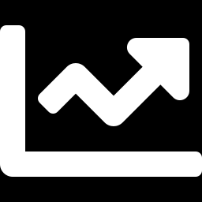
TRAINING
Watching it learn — and watching for overfitting
Each epoch is one full pass over the data. We hold back a slice the model never trains on so we can tell real learning from memorizing.
Read the gap
When training keeps climbing but validation flattens, the model is memorizing — not learning. That gap is your overfitting alarm.
The fix isn't always more epochs
Once validation stops improving, extra epochs just overfit. Dropout and a held-out split keep us honest.
Illustrative curves for teaching the shape of the result.

Slide 7
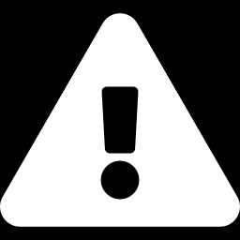
THE GOTCHA THAT BIT US
The model was right — the labels lied
What happened
The fix
The model output 0.841 — confident.
But the printout said the opposite animal.
Root cause: the data came from a pickle, not named folders. The numbers 0 and 1 carry no names — the cat/dog mapping isn't stored anywhere in the data.
A backwards label table flips every single answer, no matter how good the model is.
One source of truth. Define the 0/1 → word mapping once; every later cell reads from it.
Confirm by eye. Display labeled thumbnails. If a clear dog is titled “dog,” the mapping is right.
Never hardcode the animal. Print the probability and the prediction from the same table, so they can never disagree.

Slide 8
FROM PROBABILITY TO PREDICTION
Three takeaways
The model learns the features
Watch validation, not just training
Mind the labels
No hand-coded rules. Stacked convolutions turn raw pixels into the concept of “dog.”
The gap between the two curves is the clearest signal of overfitting.
A model is only as trustworthy as the 0/1 → word mapping you print it through.
The big idea: deep learning solved a problem that stumped researchers for decades — and the hardest bug was a label table, not the math.
Vernon T. Cox · Data Science Student, CNM · GitHub: santed7

