Slide 1
PROJECT REPORT
ATS RESUME ANALYSER
AND JOB RECOMMENDATION
SYSTEM
N. DANIEL
Reg. No: 2302112010
K. AADISHWARAN
Reg. No: 2302112004
Academic Year 2025 – 2026

Slide 2
Table of Contents
01
Introduction
06
System Design
02
Objective
07
System Implementation
03
Existing System
08
Testing and Results
04
Proposed System
09
Conclusion & Future Enhancements
05
Software Requirements Specification (SRS)
10
References
ATS Resume Analyser & Job Recommendation System

Slide 3
Introduction
DOMAIN: AI / NLP / WEB
The rapid growth of the digital job market has made Applicant Tracking Systems (ATS) the primary gatekeepers of modern hiring. Over 75% of resumes are rejected by ATS before reaching a human reviewer, creating a major barrier for qualified candidates.
The Problem
The Opportunity
Our Solution
Most candidates are unaware of ATS keyword requirements. Qualified profiles are rejected due to poor formatting and missing skills rather than lack of capability.
NLP and LLMs now enable intelligent, automated resume analysis. Real-time job APIs provide up-to-date matching. Free AI APIs make this accessible to everyone.
A unified platform that parses resumes with spaCy NLP, matches jobs via Adzuna API, scores ATS compatibility, and coaches users via Groq LLM — completely free.
Key Technologies Used:
Python + Flask
spaCy NLP
Adzuna API
Groq LLM (llama-3.1-8b)
ATS Resume Analyser & Job Recommendation System

Slide 4
Objective
01
Develop an intelligent web system to analyse resumes using NLP (spaCy) and extract skills, keywords, and professional entities.
02
Integrate with the Adzuna Jobs API to fetch real-time job listings matching the candidate's extracted skill profile.
03
Compute an ATS compatibility score comparing resume skills against matched job requirements.
04
Use Groq LLM to generate personalised feedback covering skill gaps, resume tips, and career strategy.
05
Provide an interactive AI Career Assistant chatbot to answer queries about scores, jobs, and improvement.
06
Present a visual dashboard with job cards showing match %, salary ranges, and direct apply links.
ATS Resume Analyser & Job Recommendation System

Slide 5
Existing System
Tool / Platform
Key Feature
Limitation
LinkedIn Resume Builder
Template creation + profile matching
No ATS scoring or real-time feedback
Jobscan
ATS keyword match analysis
Manual job input required; subscription-based
Resume Worded
AI grammar & keyword suggestions
No live job integration; limited LLM feedback
Indeed Resume Upload
Basic resume parsing + job matching
No skill gap analysis or personal coaching
Zety / Novoresume
Stylish templates & design tips
No ATS scoring, no career coaching features
⚠ Key Gap: No existing free tool combines ATS scoring + live job matching + conversational AI career coaching in a single platform.
ATS Resume Analyser & Job Recommendation System

Slide 6
Proposed System
A fully free, end-to-end intelligent platform combining resume NLP analysis, live job matching, ATS scoring, and AI career coaching.
Automated Resume Parsing
Live Job Matching
ATS Score Computation
spaCy NLP extracts skills, titles, experience, and education entities automatically from PDF/DOCX uploads.
Adzuna API fetches real-time job postings matched to extracted skills across all industries.
Jaccard similarity computes a transparent % match between resume skills and job requirements.
Groq LLM Feedback
AI Career Assistant Bot
Professional Dashboard
llama-3.1-8b generates personalised career advice, skill gap analysis, and interview prep tips.
Interactive chatbot answers user queries about scores, strategies, and job opportunities.
Job cards display salary, location, match %, employment type, and direct Apply links.
ATS Resume Analyser & Job Recommendation System

Slide 7
Software Requirements Specification (SRS)
Functional Requirements
Non-Functional Requirements
Accept resume uploads in PDF or DOCX format
Extract skills, entities, and keywords using spaCy NLP
Query Adzuna Jobs API with extracted keywords
Compute ATS match score (0–100%) per job listing
Generate personalised LLM feedback via Groq API
Display job dashboard with match %, salary, apply link
Provide interactive AI Career Assistant chatbot
Performance:
End-to-end analysis under 10 seconds
Scalability:
Flask supports concurrent user sessions
Security:
Session-based; no permanent resume storage
Reliability:
99% uptime with free API tiers
Portability:
Runs on Linux / Windows / macOS
Usability:
Intuitive dark-themed responsive UI
ATS Resume Analyser & Job Recommendation System

Slide 8
System Requirements
Hardware Requirements
Software Requirements
Processor:
Intel Core i3 / 2.0 GHz+
Python:
3.9+ – Core backend language
RAM:
4 GB min — 8 GB recommended
Flask:
2.3.x – Web framework
spaCy:
3.x – NLP engine (en_core_web_sm)
Storage:
10 GB free disk space
Groq SDK:
Latest – LLM inference
Network:
Stable internet (for API calls)
Adzuna API:
REST v1 – Live job listings
OS:
Windows 10 / Ubuntu 20.04 / macOS 11+
HTML/CSS/JS:
Frontend UI
PyMuPDF / python-docx:
Resume text extraction
ATS Resume Analyser & Job Recommendation System

Slide 9
System Design – Architecture & Workflow
System Architecture — Five-Component Pipeline
User
Interface
Flask
Backend
NLP Engine
(spaCy)
Adzuna
API
Groq
LLM
HTML/CSS/JS
REST API
Skill Extraction
Live Jobs
AI Feedback
Data Flow Sequence
1. User uploads resume (PDF/DOCX) via the web interface
5. Adzuna returns live job listings matching the skill profile
2. Flask Backend receives file → forwards to spaCy NLP engine
6. Backend sends resume + jobs to Groq LLM for ATS gap analysis
3. spaCy extracts skills, entities, and keywords → returns JSON
7. Groq LLM returns score, feedback, and career recommendations
4. Backend queries Adzuna API with extracted skill keywords
8. Dashboard renders job cards; Career Assistant chatbot is activated
ATS Resume Analyser & Job Recommendation System

Slide 10
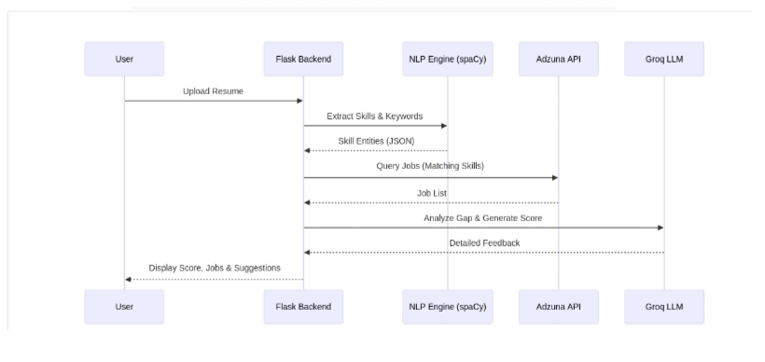
ATS Resume Analyser & Job Recommendation System
System Design – Sequence Diagram
Fig: End-to-End Data Flow Sequence — User → Flask Backend → NLP Engine → Adzuna API → Groq LLM

Slide 11
System Design – Module Description
Resume Upload Module
NLP Processing Module
Handles file upload, format validation (PDF/DOCX), and secure temporary session storage.
spaCy tokenises text, applies NER and PhraseMatcher to extract skills, job titles, and entities.
Job Matching Module
Scoring Engine
Constructs Adzuna API queries from top-ranked extracted skills; retrieves live job postings.
Computes Jaccard similarity between resume skill set and job description keywords for ATS score.
LLM Feedback Module
Dashboard Module
Sends structured resume-job gap data to Groq API; parses and formats personalised AI feedback.
Renders job cards with match %, salary, location, employment type tags, and apply buttons.
Career Assistant Module
Manages chatbot conversation state; routes user queries to Groq LLM with session context.
ATS Resume Analyser & Job Recommendation System

Slide 12
System Implementation – Tools & Technologies
Tools Used
Technologies
VS Code – Primary IDE
Postman – API Testing
Git / GitHub – Version Control
Google Colab – NLP Prototyping
Figma – UI/UX Wireframes
Chrome DevTools – Frontend Debug
Python 3.9
Core backend language
Flask 2.3.x
WSGI Web Framework
spaCy (en_core_web_sm)
NLP Engine – NER & skill extraction
Groq API (llama-3.1-8b)
LLM inference – feedback & chatbot
Adzuna Jobs API
Real-time live job listings (REST)
HTML5 / CSS3 / JS
Frontend responsive UI
PyMuPDF / python-docx
Resume text extraction
ATS Resume Analyser & Job Recommendation System

Slide 13
Dataset & Algorithm
Dataset Approach — Dynamic Pipeline (No Static Dataset)
Resume Data
Job Listings
Skills Vocabulary
Sourced from user-uploaded PDF/DOCX. Text extracted via PyMuPDF or python-docx, processed by spaCy.
Fetched in real-time from Adzuna API using extracted skills. Always current — never stale or pre-cached.
spaCy en_core_web_sm supplemented with a custom PhraseMatcher covering 500+ technical and soft skills.
Algorithm — 7-Step Processing Pipeline
1
Text Extraction: Raw text extracted from uploaded resume via PyMuPDF / python-docx.
5
ATS Score: Jaccard similarity = |resume_skills ∩ job_skills| / |resume_skills ∪ job_skills| × 100.
2
NLP Processing: spaCy applies tokenisation, POS tagging, NER, and PhraseMatcher for skill identification.
6
LLM Analysis: Resume text + job matches sent to Groq LLM with structured prompt for gap analysis.
3
Keyword Set: Extracted skills ranked by frequency → top-N keyword set constructed.
7
Rendering: All data returned as JSON → frontend renders dashboard and chatbot.
4
API Query: Adzuna API queried with keyword set → job listings returned as JSON.
ATS Resume Analyser & Job Recommendation System

Slide 14
Testing and Results
Test ID
Test Case
Result
TC-01
Upload valid PDF resume → Skills extracted
PASS
TC-02
Upload invalid file format (.txt) → Error shown
PASS
TC-03
Extract skills from Python-focused resume
PASS
TC-04
Adzuna API job retrieval with valid skills
PASS
TC-05
ATS score computation returns 0–100%
PASS
TC-06
Groq LLM feedback generation
PASS
TC-07
Career Chatbot query response
PASS
TC-08
Dashboard job card rendering and Apply link
PASS
Performance Metrics
~2.3s
~1.8s
~3.1s
~7.5s
ATS Score Accuracy
87%
NLP Processing
Job Retrieval
LLM Feedback
Total End-to-End
Skill Extraction Precision
84%
User Satisfaction (UAT)
86%
ATS Resume Analyser & Job Recommendation System

Slide 15
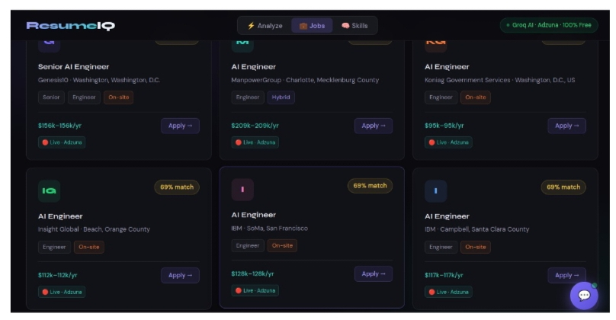
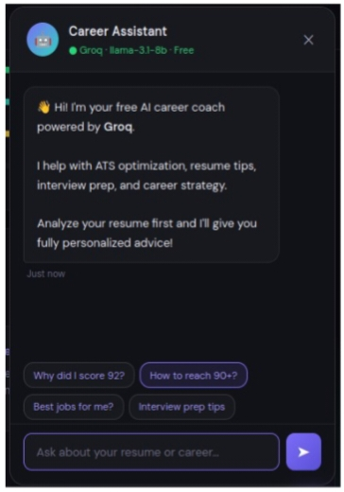
ATS Resume Analyser & Job Recommendation System
Testing and Results – Screenshots
Fig 1: Job Recommendations Dashboard
Fig 2: AI Career Assistant Chatbot

Slide 16
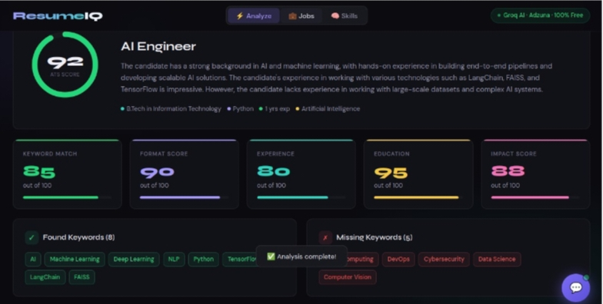
ATS Resume Analyser & Job Recommendation System
Screenshots – System Output
Fig: ATS Analyse Dashboard — ATS Score 92/100, Keyword Match, Format Score, Experience, Education & Impact Score with skill gap analysis

Slide 17
Conclusion & Future Enhancements
Conclusion
The ATS Resume Analyser and Job Recommendation System successfully integrates spaCy NLP, Adzuna live job API, and Groq LLM to deliver an end-to-end intelligent career assistance platform. It achieves 84% skill extraction precision, 87% ATS score accuracy, and ~7.5s end-to-end processing — all at zero cost to the user. The AI Career Assistant chatbot further elevates the experience with personalised, conversational coaching. The system democratises access to professional-grade resume intelligence for every job seeker.
Future Enhancements
Resume Auto-Optimisation – Auto-rewrite resumes to maximise ATS scores for specific roles
Interview Simulator – LLM-powered mock interview with role-specific Q&A evaluation
Skill Development Roadmap – Personalised course & certification recommendations
Multi-Language Support – NLP processing for resumes in multiple languages
Browser Extension – Analyse resume against any job posting directly on the web
Company Culture Matching – Match candidates on values & work style, not just skills
Thank You | N. Daniel (2302112010) & K. Aadishwaran (2302112004)

