Slide 1
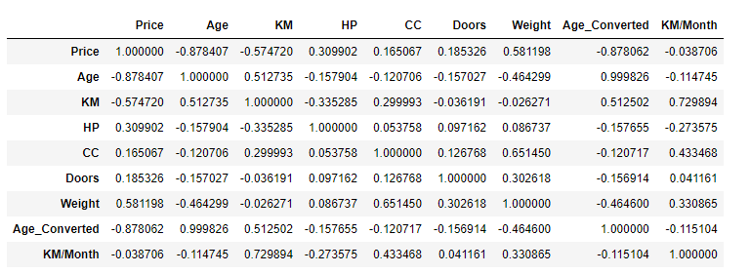
Correlation
corr = cars1.corr()
corr

Slide 2
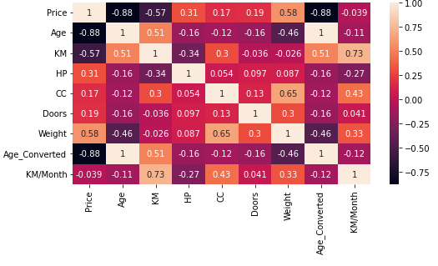
Heatmap
plt.figure(figsize=(8,4))
sns.heatmap(corr,annot = True)

Slide 3
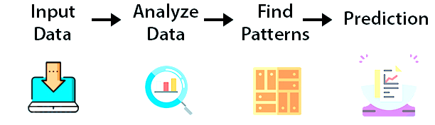
Machine Learning
The use and development of computer systems that are able to learn and adapt without following explicit instructions, by using algorithms and statistical models to analyse and draw inferences from patterns in data.

Slide 4
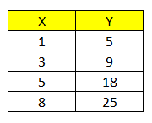

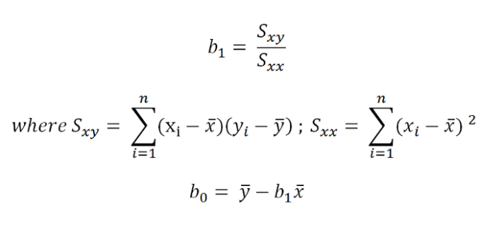
General Eq- Linear Regression
x̄ = (1+3+5+8)/ 4 = 4.25
ȳ = (5+9+18+25)/4 = 14.25
Sₓᵧ = (1–4.25)(5–14.25) + (3–4.25)(9–14.25) +(5–4.25)(18 –14.25) +
(8–4.25)(25–14.25) = 79.75;
Sₓₓ = (1–4.25)² + (3–4.25)² + (5–4.25)² +
(8–4.25)² = 26.75
Therefore b₁ = 79.75/26.75 = 2.98
while b₀ = 14.25–2.98 * 4.25 = 1.58
ŷ represents the estimated value of
ŷᵢ = b₀ + b₁ xᵢ

Slide 5
Step 1. Importing the Packages
import numpy as np
import pandas as pd
import matplotlib.pyplot as plt
Step 2. Importing the Dataset
cars2 = cars1.dropna()
s= cars2[‘Age']
c= cars2[‘Price’]
x = np.array(s).reshape(-1,1)
y = np.array(c)
cars2

Slide 6
Step 3. Fitting simple linear Regression
from sklearn.linear_model import LinearRegression
regressor = LinearRegression()
regressor.fit(x,y)
print('Slope:', regressor.coef_)
print("Intercept:", regressor.intercept_)
Step 4. Predicting the Price
y_predicted= regressor.predict(x)

Slide 7



Slide 8

Importing Libraries
import pandas as pd
import numpy as np
from matplotlib import pyplot as plt
import seaborn as sns
import plotly.express as px
import warnings
warnings.filterwarnings(action = 'ignore')

Slide 9
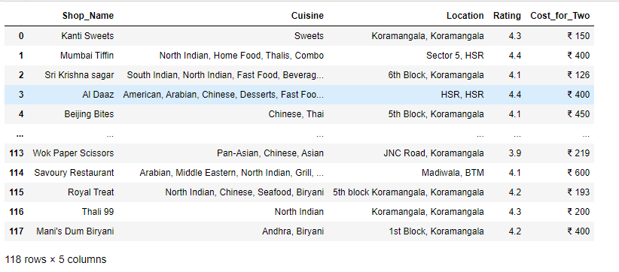
Importing the Dataset
df_Swiggy = pd.read_csv('Swiggy.csv', sep = ',')
df_Swiggy

Slide 10
Data Processing
df_Swiggy.columns
df_Swiggy.isnull().sum()
df_Swiggy.describe()
df_Swiggy.info()

Slide 11
Data Processing
df_Swiggy['Rating'].unique()
df_Swiggy['Rating'] = df_Swiggy['Rating'].str.replace('--', '0').astype(float)
df_Swiggy['Rating'].unique()

Slide 12
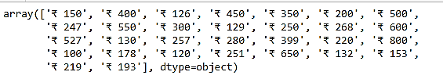
Cost for Two
df_Swiggy['Cost_for_Two'].unique()
def data_processing(string):
cost = string.split(' ')[1]
return cost

Slide 13
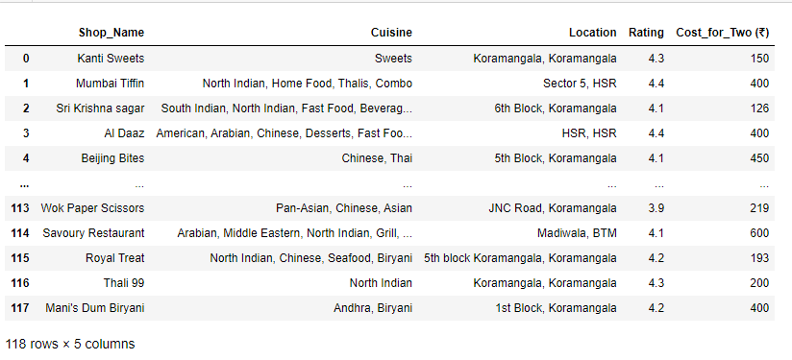
Cost for Two
df_Swiggy['Cost_for_Two’] = df_Swiggy['Cost_for_Two'].apply(data_processing)
df_Swiggy['Cost_for_Two'] = df_Swiggy['Cost_for_Two'].astype('int')
df_Swiggy['Cost_for_Two'].unique()
df_Swiggy.rename(columns = {'Cost_for_Two' : 'Cost_for_Two (₹)'}, inplace = True)
df_Swiggy

Slide 14
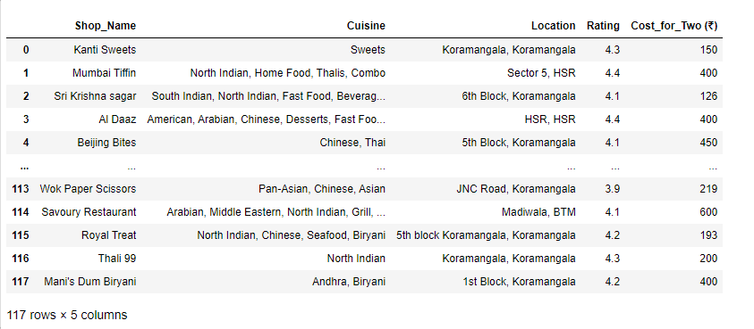
Distribution of 'Ratings':
df_valid_Ratings = df_Swiggy[df_Swiggy['Rating'] > 0]
df_valid_Ratings

Slide 15
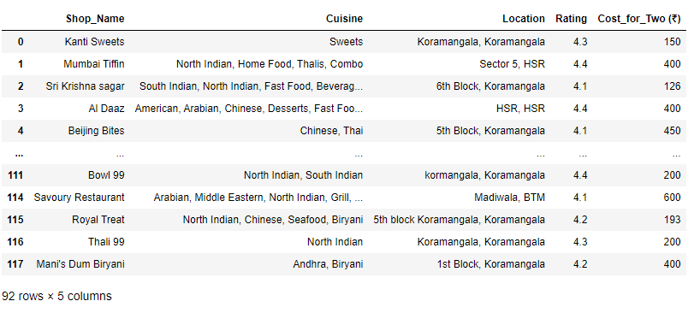
Analyse "Approx Cost of 2 People" vs "Rating". Find out the relationship between them
df_Highest_Rated_Restaurants = df_Swiggy[df_Swiggy['Rating'] >= 4.0]
df_Highest_Rated_Restaurants

Slide 16
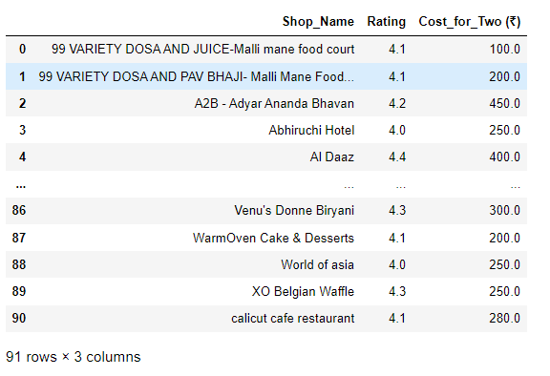
Highest Rated Restaurants
df_Highest_Rated_Restaurants = df_Highest_Rated_Restaurants.loc[:, ['Shop_Name', 'Rating', 'Cost_for_Two (₹)’]]
df_Highest_Rated_Restaurants =
df_Highest_Rated_Restaurants.groupby(['Shop_Name', 'Rating'])['Cost_for_Two (₹)'].agg('mean’)
df_Highest_Rated_Restaurants = df_Highest_Rated_Restaurants.reset_index()
df_Highest_Rated_Restaurants

Slide 17
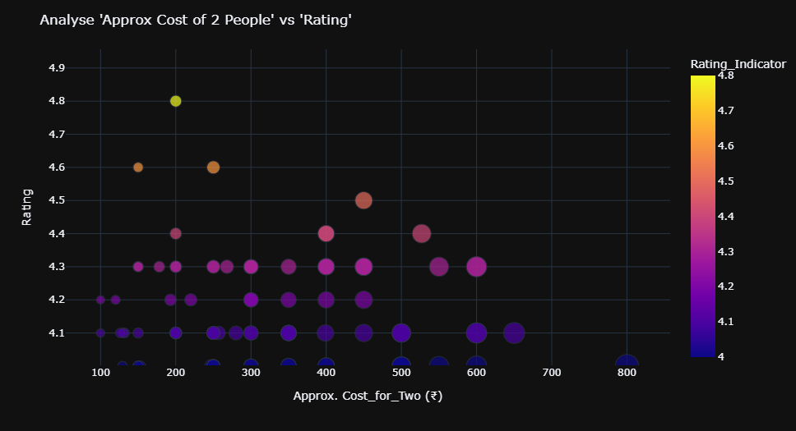
Plotly Plot
fig = px.scatter(x = df_Highest_Rated_Restaurants['Cost_for_Two (₹)'],
y = df_Highest_Rated_Restaurants['Rating'],
color = df_Highest_Rated_Restaurants['Rating'],
size = df_Highest_Rated_Restaurants['Cost_for_Two (₹)'],
labels = {'x' : 'Approx. Cost_for_Two (₹)', 'y' : 'Rating', 'color' : 'Rating_Indicator'})
fig.update_layout(template = 'plotly_dark', title = "Analyse 'Approx Cost of 2 People' vs 'Rating'")
fig.show()

Slide 18
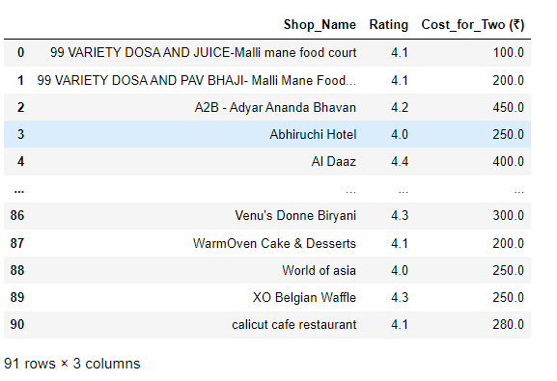
Top 15 Expensive & Highest Rated Restaurants with Approx. Cost for 2 People:
df_Expensive_Restaurants = df_Highest_Rated_Restaurants.sort_values(by = 'Cost_for_Two (₹)', ascending = False)
df_Expensive_Restaurants

Slide 19
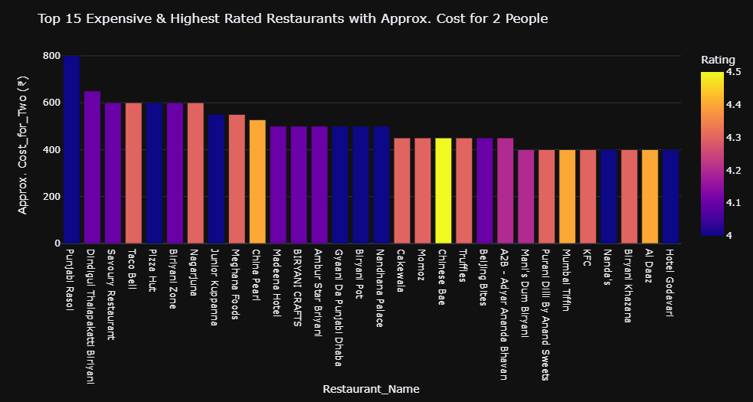
Plotly Plot
fig = px.bar(data_frame = df_Expensive_Restaurants,
x = df_Expensive_Restaurants['Shop_Name'][0:30],
y = df_Expensive_Restaurants['Cost_for_Two (₹)'][0:30],
color = df_Expensive_Restaurants['Rating'][0:30],
labels = {'x' : 'Restaurant_Name', 'y' : 'Approx. Cost_for_Two (₹)', 'color' : 'Rating'})
fig.update_layout(template = 'plotly_dark',
title = 'Top 15 Expensive & Highest Rated Restaurants with Approx. Cost for 2 People')
fig.show()

