Slide 1

Mepco Schlenk Engineering College (Autonomous)
Mamba-Powered Pavement Safety
GUIDED BY,
Mrs.M.Stella Inba Mary,M.E.,(Ph.D).
Assistant Professor (Sr.G.)
B.Ajeez Prabu 23BCS161
S.Santhana Pandi 23BCS182
R.Mohan 23BCSL08
Department of Computer Science and Engineering
1

Slide 2
Mepco Schlenk Engineering College (Autonomous)
Introduction
Highways play a vital role in transportation, economic development, and public safety. However, over time, asphalt pavements are prone to developing potholes due to continuous traffic load, weathering effects, and material deterioration. These potholes not only reduce road quality and driving comfort, but also increase the risk of accidents and can cause vehicle damage such as tire punctures, dents, and leaks. Therefore, regular and accurate detection of potholes is essential for effective highway maintenance and for ensuring safe road operation.
Department of Computer Science and Engineering
2

Slide 3
Mepco Schlenk Engineering College (Autonomous)
Problem Statement
Current road inspection methods largely depend on manual surveys, which are time-consuming, labor-intensive, and prone to human error, making it difficult to ensure consistent and timely detection of pavement damages such as potholes. Although machine learning and deep learning techniques have improved automated detection, challenges such as image distortion from oblique camera angles, limited feature extraction, and reduced detection efficiency still affect the accuracy and reliability of these systems. This project addresses the need for an efficient and accurate automated pothole detection framework that utilizes advanced image correction and deep learning–based segmentation techniques to improve detection performance and support safer and more effective road maintenance.
Department of Computer Science and Engineering
3

Slide 4
Mepco Schlenk Engineering College (Autonomous)
Objectives
To develop a robust deep learning pipeline for accurately segmenting road damage from input road images.
To integrate perspective correction to handle image distortion and improve geometric consistency of detections.
To introduce a novel ShadowNet module for suppressing shadow effects, improving performance under varying lighting conditions.
To build a modular system supporting training, inference, and comparative evaluation of model variants.
Department of Computer Science and Engineering
4

Slide 5
Mepco Schlenk Engineering College (Autonomous)
Expected Outcomes
Accurate segmentation results with improved IoU and Dice scores, producing precise damage masks.
Reduced geometric distortion errors, resulting in more reliable area estimation and spatial localization.
Improved robustness to shadows and lighting variations through the integration of ShadowNet, reducing false detections.
A complete and reproducible workflow with efficient inference, model evaluation, and multi-variant comparison capabilities.
Department of Computer Science and Engineering
5

Slide 6
Mepco Schlenk Engineering College (Autonomous)
Literature Survey Number -1
Zhang et al. (2023) proposed a deep learning–based method for automatic pothole detection using image
segmentation techniques. The study focused on improving road damage identification by applying
convolutional neural networks to extract pavement features from road images.
Merits:
Provides high accuracy in detecting potholes from complex road images.
Reduces the need for manual road inspection and improves monitoring efficiency.
Demerits:
Performance can be affected by poor lighting conditions and shadows.
Requires a large dataset of labeled road images for effective training.
Reference: Zhang et al., “Pavement Pothole Detection Using Deep Learning-Based Image Segmentation,” 2023.
Department of Computer Science and Engineering
6

Slide 7
Mepco Schlenk Engineering College (Autonomous)
Literature Survey Number -2
Li et al. (2022) conducted research on pavement damage detection using deep learning models combined with image preprocessing techniques.
Merits:
Improves detection accuracy by correcting image distortion before analysis.
Enhances feature extraction for better identification of pavement damage.
Demerits:
Image preprocessing increases computational complexity.
Detection performance may vary depending on camera position and image quality.
Reference: Li et al., “Automatic Road Damage Detection Using Image Correction and Deep Learning
Segmentation,” 2022.
Department of Computer Science and Engineering
7

Slide 8
Mepco Schlenk Engineering College (Autonomous)
Literature Survey Number-3
Maeda et al. (2018) conducted research on road damage detection using deep learning and image-based datasets. They developed a system that uses convolutional neural networks (CNNs) to automatically identify different types of road damages.
Merits:
Enables automatic and large-scale road damage detection using smartphone or vehicle cameras.
Provides a publicly available dataset that helps improve research in road damage detection.
Demerits:
Detection accuracy may decrease in complex environments with shadows or poor lighting.
Requires high computational resources for training deep learning models.
Reference: K. Maeda et al., “Road Damage Detection Using Deep Neural Networks with Images Captured Through a Smartphone,” Computer-Aided Civil and Infrastructure Engineering, 2018.
Department of Computer Science and Engineering
8

Slide 9
Mepco Schlenk Engineering College (Autonomous)
Literature Survey Number -4
Koch and Brilakis (2011) developed an automated pavement defect detection system using computer
vision techniques. Their approach used image processing algorithms to identify potholes and cracks
from road surface images captured by cameras.
Merits:
Reduces the need for manual road inspection.
Can detect multiple types of pavement defects.
Demerits:
Performance depends heavily on image quality.
Traditional image processing methods have limited accuracy compared to deep learning.
Reference: C. Koch and I. Brilakis, “Pothole Detection in Asphalt Pavement Images,” Informatics, 2011.
Department of Computer Science and Engineering
9

Slide 10
Mepco Schlenk Engineering College (Autonomous)
Literature Survey Number -5
Zhang et al. (2019) proposed a deep learning-based pothole detection method using Convolutional Neural Networks (CNNs) to automatically classify road surface images and detect pothole regions.
Merits:
High accuracy in detecting potholes in complex road environments.
Capable of learning important road surface features automatically.
Demerits:
Requires large labeled datasets for training.
Computationally expensive for real-time applications.
Reference: L. Zhang et al., “Road Damage Detection Using Deep Convolutional Neural Networks,” 2019.
Department of Computer Science and Engineering
10

Slide 11
Mepco Schlenk Engineering College (Autonomous)
Literature Survey Number -6
Fan et al. (2020) introduced a road damage detection system using deep learning and object detection models such as YOLO to detect potholes and cracks in real-time.
Merits:
Provides fast detection suitable for real-time monitoring.
Capable of detecting multiple road defects simultaneously.
Demerits:
Accuracy may reduce under poor lighting conditions.
Requires high-performance hardware for deployment.
Reference: R. Fan et al., “Road Damage Detection Based on Deep Neural Networks,” IEEE Intelligent Transportation Systems, 2020.
Department of Computer Science and Engineering
11

Slide 12
Mepco Schlenk Engineering College (Autonomous)
Literature Survey Number -7
Gopalakrishnan et al. (2017) proposed a deep learning-based pavement distress detection system using CNN models trained on road surface images to identify potholes and cracks.
Merits:
Achieves high detection accuracy using deep learning.
Improves efficiency of pavement condition monitoring.
Demerits:
Training requires large datasets and computational power.
Performance may vary with environmental conditions.
Reference: K. Gopalakrishnan et al., “Deep Learning-Based Pavement Distress Detection,” Transportation Research Board, 2017.
Department of Computer Science and Engineering
12

Slide 13
Mepco Schlenk Engineering College (Autonomous)
Literature Survey Number -8
Maeda et al. (2018) developed a road damage detection system using smartphone images and deep neural networks to detect different types of road damages including potholes.
Merits:
Enables large-scale road monitoring using smartphones.
Provides a publicly available dataset for research.
Demerits:
Detection accuracy may decrease in shadowed or unclear images.
Requires stable image capture for reliable detection.
Reference: K. Maeda et al., “Road Damage Detection Using Deep Neural Networks with Smartphone
Images,” Computer-Aided Civil and Infrastructure Engineering, 2018.
Department of Computer Science and Engineering
13

Slide 14
Mepco Schlenk Engineering College (Autonomous)
Literature Survey Number -9
Arya et al. (2020) proposed a pothole detection system using image processing and machine learning techniques to identify potholes from road surface images.
Merits:
Simple and cost-effective detection approach.
Reduces manual inspection workload.
Demerits:
Limited accuracy compared to deep learning models.
Sensitive to variations in lighting and road texture.
Reference: D. Arya et al., “Deep Learning-Based Road Damage Detection and Classification,” 2020.
Department of Computer Science and Engineering
14

Slide 15
Mepco Schlenk Engineering College (Autonomous)
Literature Survey Number -10
Silva and Jung (2021) introduced a road surface monitoring system using deep learning segmentation models to precisely locate pothole regions in pavement images.
Merits:
Provides accurate segmentation of pothole areas.
Helps in detailed pavement damage analysis.
Demerits:
Segmentation models require high computational resources.
Training complexity is higher compared to simple detection models.
Reference: S. Silva and C. Jung, “Real-Time Road Surface Monitoring Using Deep Learning Segmentation,” 2021.
Department of Computer Science and Engineering
15

Slide 16
Mepco Schlenk Engineering College (Autonomous)
Literature Survey
Consolidation of the literatures:
S. No. | Author(s) & Year | Methodology used | Limitations
1 | Gadekar et al. (2024) | Sonar-assisted YOLO Model. | Sonar integration adds sensor complexity and calibration needs.
2 | Lakshminarayanan et al. (2024) | CNN + IoT-based Cloud Reporting | Latency issues in regions with poor network connectivity.
3 | Khan et al. (2024) | YOLOv8-based Pipeline | Struggles with "false potholes" caused by complex road shadows.
4 | Zanevych et al. (2024) | YOLOv7 & YOLOv8 (Low-light) | Still faces significant accuracy drops in complete darkness.
Department of Computer Science and Engineering
16

Slide 17
Mepco Schlenk Engineering College (Autonomous)
S.No. | Author(s) & Year | Methodology used | Limitations
5 | Reddy et al. (2024) | Custom Deep Learning Model. | Model optimization for mobile edge devices remains a challenge.
6 | Vinodhini et al. (2024) | Transfer Learning + CNN | Requires a massive and diverse dataset for generalizability.
7 | Safyari et al. (2024) | Comprehensive YOLO Review | Existing models still struggle with varying road textures.
8 | Yao et al. (2025) | Binocular Vision + Deep Learning | High hardware cost compared to monocular camera systems.
Department of Computer Science and Engineering
17

Slide 18
Mepco Schlenk Engineering College (Autonomous)
S.No. | Author(s) & Year | Methodology used | Limitations
9 | Boosam et al. (2025) | Comparative study: YOLOv1 to YOLOv5 vs. SSD | High dependence on high-quality annotated training data.
10 | Chandra et al. (2025) | YOLOv5 on Drivable Area Dataset | Performance drops under low-light or night conditions.
Department of Computer Science and Engineering
18

Slide 19
Mepco Schlenk Engineering College (Autonomous)
Dataset Details
S.No. | Dataset Name | Description | Purpose
1 | Mendeley Road Distress (Passos, 2020). | 2,235 Images : High-resolution images from Brazilian highways with multiple defect masks. | The datasets provide Pixel-level Binary Masks, which are essential for training the Mamba-based segmentation engine.
Department of Computer Science and Engineering
19

Slide 20
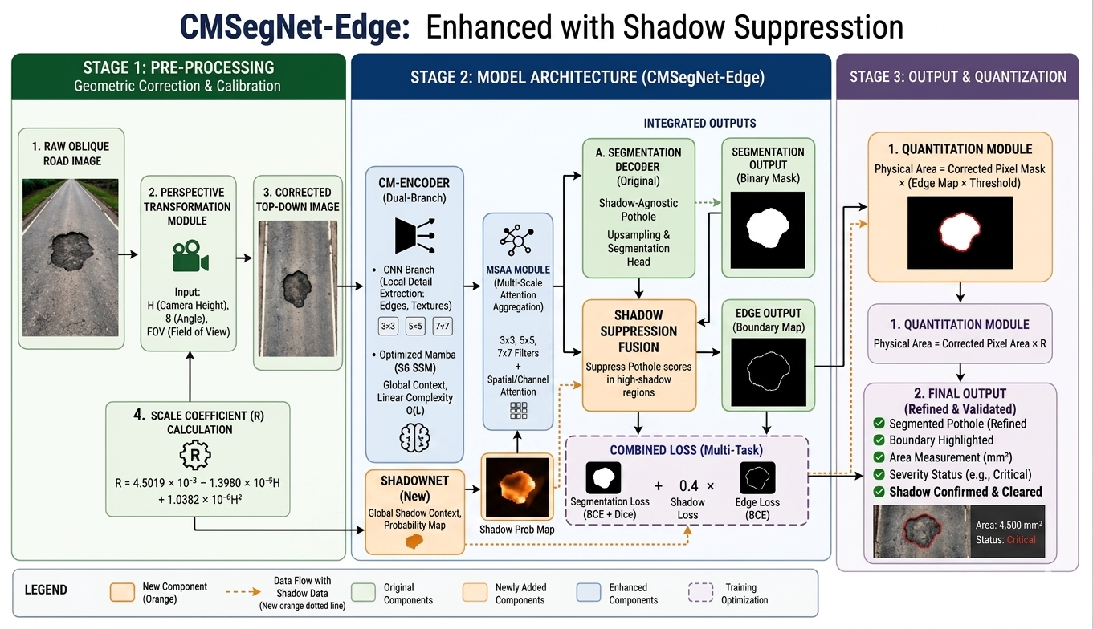
Mepco Schlenk Engineering College (Autonomous)
System Design Architecture
DATASET
Department of Computer Science and Engineering
20

Slide 21
Mepco Schlenk Engineering College (Autonomous)
Model Description
1. CM-Encoder (Convolution-Mamba Encoder)
The CM-Encoder integrates convolutional modules and optimized Mamba modules at each encoder stage. The convolutional branch extracts high-resolution local spatial features of pavement damage using three residual convolution blocks: 1×1 channel compression, 3×3 spatial convolution, and 3×3 dilated spatial convolution. The optimized Mamba module, built on a Structured State Space Model (SSM), captures long-range global context with linear time complexity O(L), avoiding the O(L²) bottleneck of Transformer self-attention. Channel and spatial attention sub-modules enhance feature selectivity, and the two branches are merged through element-wise multiplication and projected back to the original channel dimension.
Department of Computer Science and Engineering
21

Slide 22
Mepco Schlenk Engineering College (Autonomous)
2. Multi-Scale Attention Aggregation (MSAA) Module
The MSAA module enriches encoder output feature maps by fusing multi-scale local and global information. Parallel 3×3, 5×5, and 7×7 convolutions perform multi-scale feature extraction, followed by spatial aggregation through 7×7 convolution with sigmoid gating, and channel aggregation using global average pooling with two 1×1 convolutional layers. The fused output enhances both spatially and channel-wise important features, improving discrimination between true potholes and visually similar regions such as debris or aggregate patches.
3. Lightweight Feature Decoder
A lightweight MLP-based decoder is employed to reduce computational cost. Multi-scale features from the MSAA module are combined through 1×1 convolution, upsampled, and processed by 8×8 convolution. The merged features are mapped to 1-D tokens, and spatial and channel modeling is performed via MLP layers. A final upsampling step produces the pixel-level segmentation mask predicting pothole regions at the original image resolution.
Department of Computer Science and Engineering
22

Slide 23
Mepco Schlenk Engineering College (Autonomous)
4. ShadowNet - Shadow Suppression Module
ShadowNet is a dedicated shadow detection sub-network integrated into the full inference pipeline. Road shadows from trees, buildings, and vehicles frequently create dark regions that resemble potholes in color and texture, leading to false positives in conventional models. ShadowNet generates a probability map of shadow regions from the input image. This map is fused with CMSegNet-Edge's segmentation output to suppress false detections in shadowed areas. A safety fallback mechanism ensures that if ShadowNet's output appears near-constant (indicating unstable prediction), inference reverts to the CMSegNet-Edge mask alone.
Department of Computer Science and Engineering
23

Slide 24
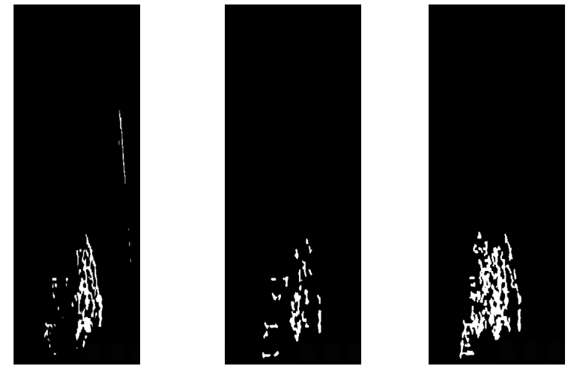
Mepco Schlenk Engineering College (Autonomous)
Visual Analysis
CMSegNet
CMSegNet + EdgeHead
CMSegNet + ShadowNet
Department of Computer Science and Engineering
24

Slide 25
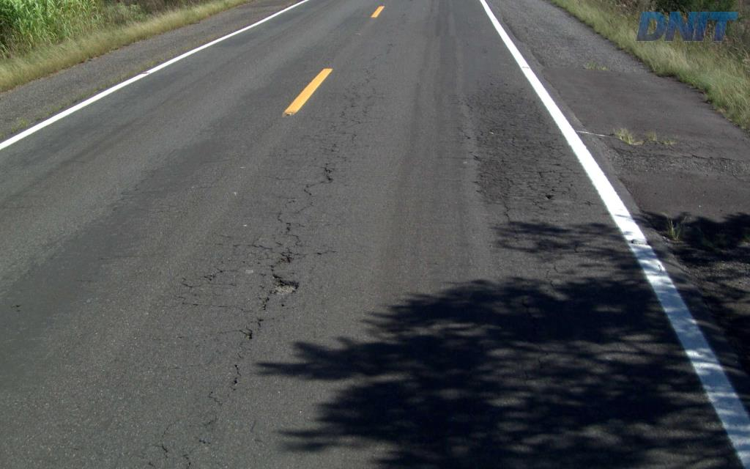
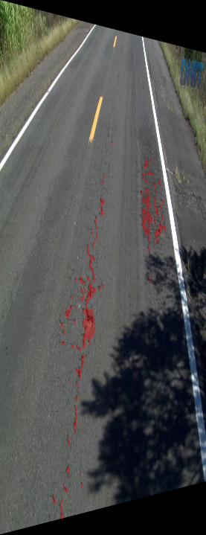
Mepco Schlenk Engineering College (Autonomous)
Implementation Result
Original Photo Pothole Identified
Department of Computer Science and Engineering
25

Slide 26
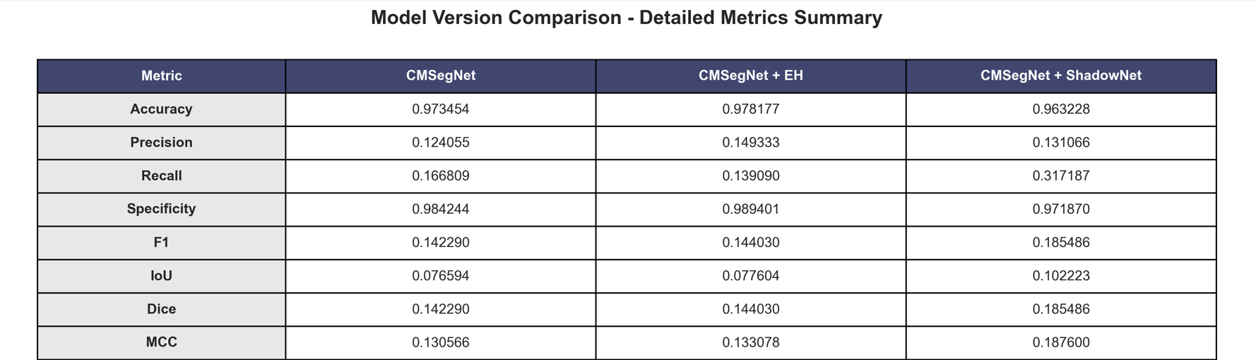
Mepco Schlenk Engineering College (Autonomous)
Evolutional Metrics
Department of Computer Science and Engineering
26

Slide 27
Mepco Schlenk Engineering College (Autonomous)
Purposed Novelty
Adds explicit class-imbalance handling to lift recall/IoU beyond the CMSegNet training setup.
Introduces ShadowNet-based shadow suppression with a reliability fallback to reduce shadow‑driven false positives during inference.
Provides a unified multi‑model comparison pipeline that outputs CSV metrics plus 6 visualizations for fast model selection.
Delivers a reproducible end‑to‑end workflow .
Department of Computer Science and Engineering
27

Slide 28
Mepco Schlenk Engineering College (Autonomous)
Working Environment
Hardware:
RTX 3050 GPU
16GB RAM
Windows 11
Software:
Python
TensorFlow / PyTorch
Open CV
VS Code
Department of Computer Science and Engineering
28

Slide 29
Mepco Schlenk Engineering College (Autonomous)
Social Impact
Improvement in Road Safety:
The proposed pothole detection system has a significant positive impact on road safety by enabling early identification and timely repair of road surface damages. Potholes are one of the major causes of road accidents, especially for two-wheelers and small vehicles, as they can lead to sudden loss of control, vehicle damage, or even fatal injuries.
Efficient Road Maintenance and Cost Reduction:
Another important social benefit of the system is its ability to improve the efficiency of road maintenance operations. Traditional methods of road inspection are manual, timeconsuming, and often inefficient, leading to delayed repairs and increased maintenance costs.
Support for Smart City Development:
The integration of the pothole detection system with modern technologies such as IoT and cloud computing supports the development of smart cities. By enabling real-time data collection and analysis.
Department of Computer Science and Engineering
29

Slide 30
Mepco Schlenk Engineering College (Autonomous)
Future Enhancement
Real-Time Implementation and Edge Deployment:
One of the major future enhancements of the proposed pothole detection system is its deployment in real-time environments using edge devices such as mobile phones, embedded systems, or vehicle-mounted cameras.
Dataset Expansion and Generalization:
Another important enhancement involves expanding the dataset used for training the model. The current system may be limited by the diversity of training data, which can affect its ability to generalize to new environments.
Multi-Damage Detection System:
The current system is primarily focused on detecting potholes; however, road surfaces often suffer from multiple types of damage such as cracks, patches, and surface wear. A future enhancement would be to extend the system to detect and classify multiple categories of road damage within a single framework.
Department of Computer Science and Engineering
30

Slide 31
Mepco Schlenk Engineering College (Autonomous)
Future Enhancement
Integration with IoT and Smart City Systems:
Integrating the proposed system with Internet of Things (IoT) technology and smart city infrastructure can significantly enhance its practical usability. In this approach, detected pothole data can be transmitted in real time to a centralized cloud platform using connected devices.
Advanced Analytics and Decision Support System
Another promising enhancement is the development of an advanced analytics and decision support system based on the output of the pothole detection model. Instead of simply identifying potholes, the system can be extended to analyze patterns such as frequency of occurrence, severity levels, and high-risk zones.
Department of Computer Science and Engineering
31

Slide 32
Mepco Schlenk Engineering College (Autonomous)
Conclusion
The proposed pothole detection and segmentation system presents a robust and efficient solution for identifying road surface damages using advanced deep learning techniques. By integrating a multi-stage pipeline consisting of preprocessing, CMSegNetbased segmentation, auxiliary prediction, and shadow suppression through Shadow SegNet, the system effectively addresses key challenges present in real-world environments. The incorporation of perspective transformation ensures geometric consistency, while the dual-branch architecture enhances feature extraction and improves segmentation accuracy. The auxiliary prediction mechanism further strengthens the learning process by providing intermediate supervision, enabling the model to capture fine-grained details and improve boundary detection.
Department of Computer Science and Engineering
32

Slide 33
Mepco Schlenk Engineering College (Autonomous)
Base Paper (Hyperlink: IEEE Xplore - SDLMA-IITS)
Citation:
Mohammad Wazid, Jaskaran Singh, Charvi Pandey, R. Simon Sherratt, Ashok Kumar Das, Debasis Giri and Youngho Park, “Explainable Deep Learning-Enabled Malware Attack Detection for IoT-Enabled Intelligent Transportation Systems”, IEEE Transactions on Intelligent Transportation Systems, Vol. 26, issue no.: 5, pp.: 7231 – 7244, 2025.
Reference Papers
1. Gadekar et al., "Sonar-assisted YOLO model for weather-resistant pothole identification," IJSART, 2024
2. Lakshminarayanan et al., "IoT-based reporting for real-time pothole identification using CNN," IJSART, 2024.
3. Khan et al., "YOLOv8-based pipeline for pothole detection in autonomous vehicles," IGI Global, 2024.
REFERENCES
Department of Computer Science and Engineering
33

Slide 34
Mepco Schlenk Engineering College (Autonomous)
4. Zanevych et al., "Comparative Study Between YOLOv7 and YOLOv8 under LowLight Conditions," IGI Global, 2024.
5. N. Rakesh Reddy et al., "Pothole Detection using Deep Learning," IJIRSET, Vol. 13, Issue 5, 2024.
6. K. A. Vinodhini and K. R. A. Sidhaarth, "Pothole detection in bituminous road using CNN with transfer learning," Measurement: Sensors, Vol. 31, 2024.
7. Safyari et al., "Vision-based detection methods: A comprehensive review of YOLO models," IGI Global, 2024.
8. Yao et al., "Pavement pothole detection system based on deep learning and binocular vision," ScienceDirect, 2025.
9. Boosam et al., "Survey on Pothole Detection Techniques Using Deep Learning," IJSART, Vol. 11, 2025.
10. Chandra et al., "Pothole Detection in Drivable Area using Deep Learning," IRJMS, Vol. 6, Issue 1, 2025.
Department of Computer Science and Engineering
34

Slide 35
Mepco Schlenk Engineering College (Autonomous)
Review Comments
Align the equal no of objectives and outcomes
Dataset not included in system diagram
Not cleaned with existing and proposed model
Include review comments and actions taken in presentation slide
Fine tune the objectives and outcomes
Represent the result in a table format
Action taken
Equal no of objectives and outcomes are placed
Dataset Added
Done
Added
Modified successfully
Result Table Added Successfully
Department of Computer Science and Engineering
35

Slide 36
Mepco Schlenk Engineering College (Autonomous)
Review Comments
Include review comments and actions taken in presentation slide
Fine tune the objectives and outcomes
Represent the result in a table format
Action taken
Added
Modified successfully
Result Table Added Successfully
Department of Computer Science and Engineering
36

Slide 37
Mepco Schlenk Engineering College (Autonomous)
THANK YOU
Department of Computer Science and Engineering
37

