Slide 1
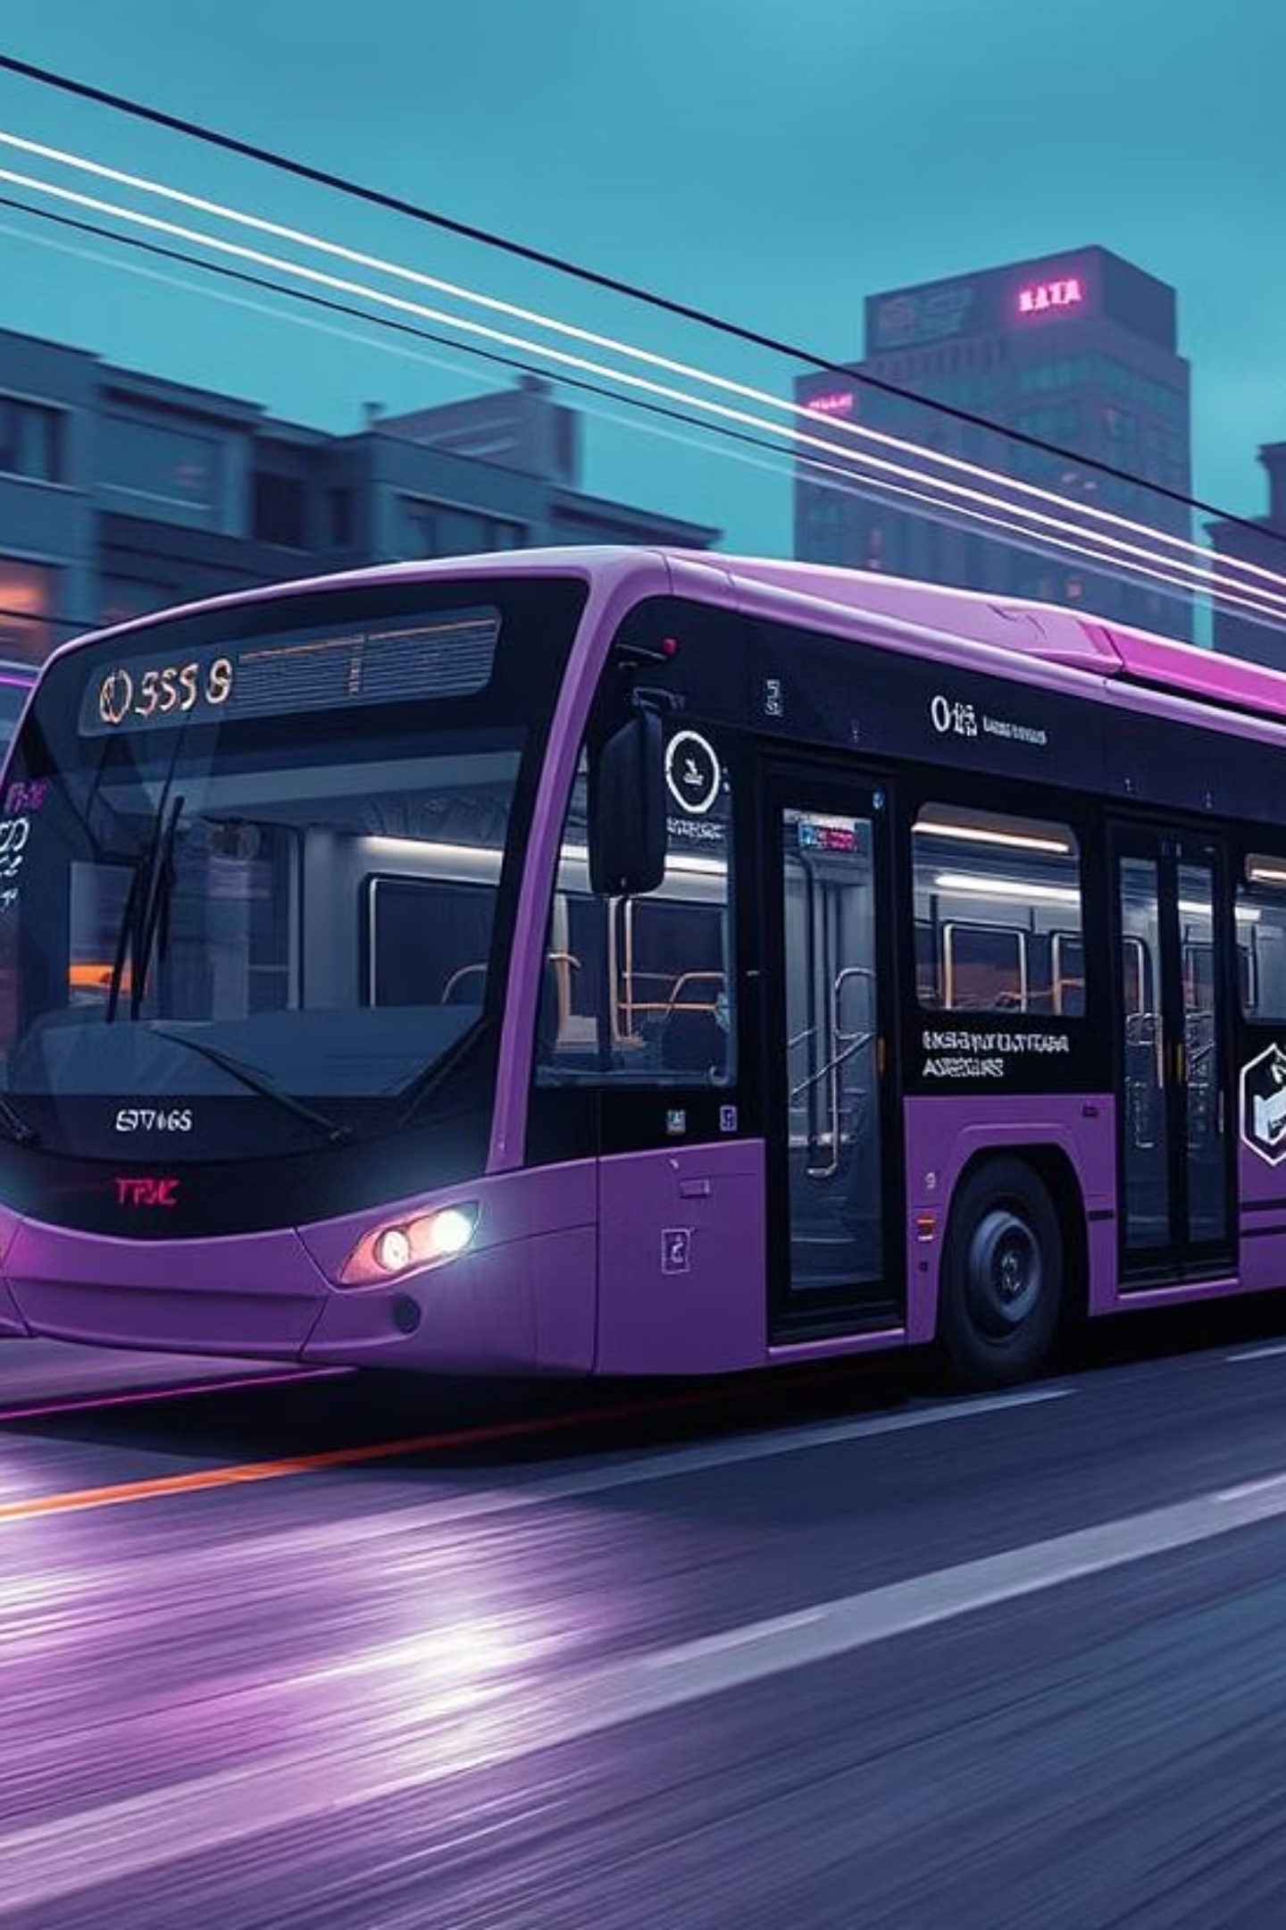
Redbus Data Scraping & Dynamic Filtering
Revolutionizing transportation with data-driven insights. This project automates bus travel data collection, analysis, and visualization from Redbus, enhancing operational efficiency and strategic planning.
sm
by santhana mariappan
Notes:
redbus icon

Slide 2
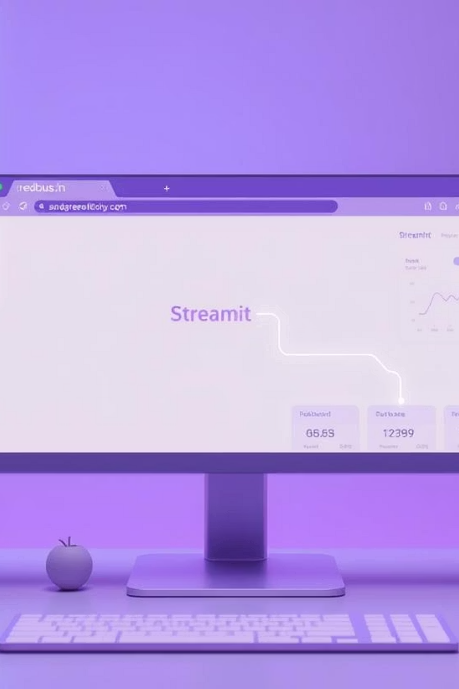



Project Overview & Core Technologies
Web Scraping (Selenium)
Data Storage (SQL)
Structuring and storing scraped information in a relational database.
Automating data extraction from Redbus for routes, schedules, and more.
Interactive App (Streamlit)
Building a user-friendly interface for dynamic data filtering and display.
Notes:
This slide provides an overview of the core technologies used in the project We'll be using Selenium for web scraping to automate the extraction of data from Redbus, including routes, schedules, and more The scraped data will be stored in a relational database, allowing us to structure and organize the information To make the data accessible and interactive, we'll be building a user-friendly interface using Streamlit, enabling dynamic filtering and display of the information

Slide 3

Tackling the Transportation Data Challenge
The Redbus project addresses the critical need for comprehensive bus travel data. By automating the extraction of bus routes, schedules, prices, and seat availability, it provides a solution for better decision-making in the transportation sector.
This project streamlines data collection and offers powerful tools to improve operational efficiency and strategic planning for various stakeholders.

Slide 4






Unlocking Business Value: Key Use Cases
Travel Aggregators
Real-time schedules and seat availability for customers.
Market Analysis
Insights into travel patterns and customer preferences.
Customer Service
Personalized travel options based on data insights.
Competitor Analysis
Benchmarking pricing and service levels against rivals.

Slide 5
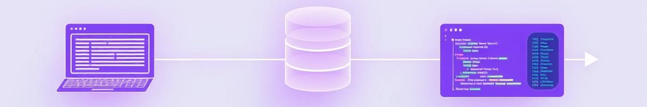
Our Approach: From Scraping to Streamlit
SQL Database Storage
Data Scraping with Selenium
Efficiently store the collected data in a structured SQL database for easy retrieval.
Automate the extraction of bus routes, schedules, prices, and seat availability from Redbus.
Interactive Data Analysis
Streamlit Application Development
Enable users to filter data by bus type, route, price, rating, and availability using SQL queries.
Create an intuitive application for dynamic display and filtering of scraped bus data.

Slide 6
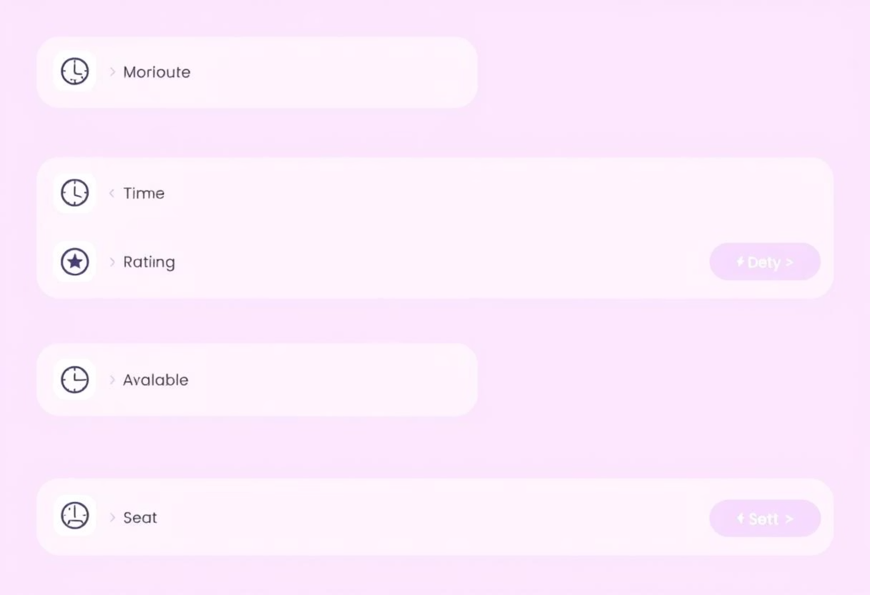
Key Data Fields & Structure
The scraped dataset from Redbus includes comprehensive information vital for travelers and service providers. Key fields capture essential details for each bus service:
Bus Routes Name & Link: Start/end locations and detailed links.
Bus Name & Type: Operator identification and seating configuration.
Time & Duration: Scheduled departure, arrival, and journey length.
Star Rating & Price: Quality indication and ticket cost.
Seat Availability: Real-time occupancy levels.

Slide 7
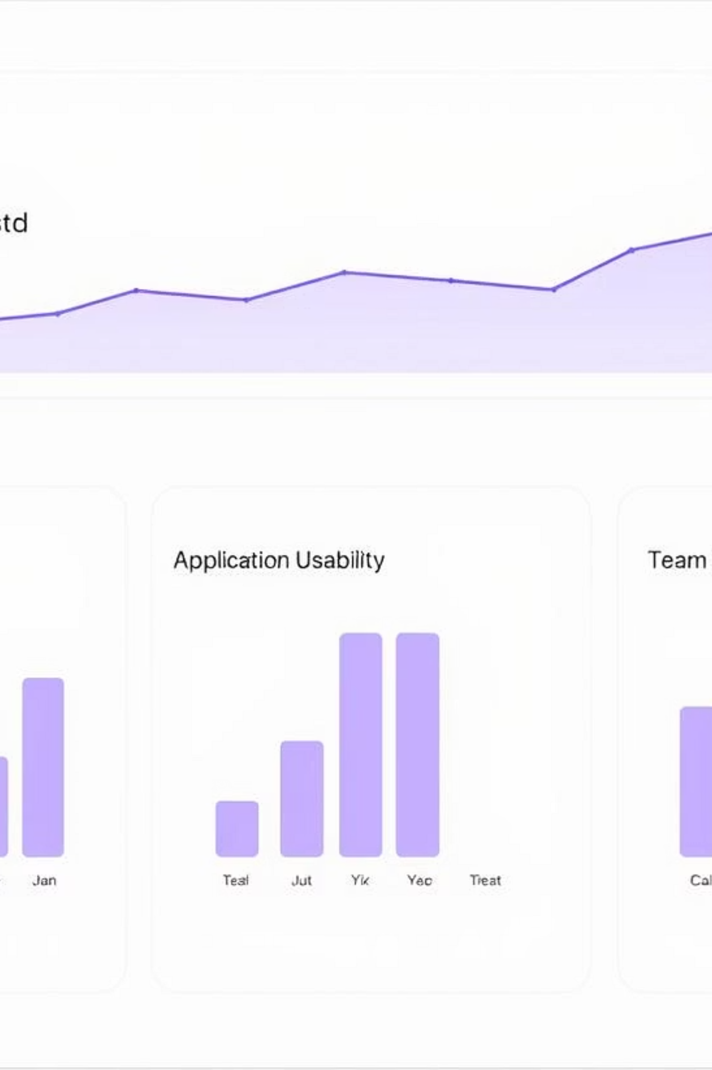
Expected Outcomes & Evaluation
10+
Our success will be measured by the accuracy of scraped data, the efficiency of the database design, and the usability and responsiveness of the Streamlit application's filters.
Government & Private Bus Data Scraped
Code quality, adherence to PEP 8, and effective version control with Git are also crucial evaluation metrics.
SQL
Structured Database for Data Storage
User-Friendly
Interactive Streamlit Application

Slide 8
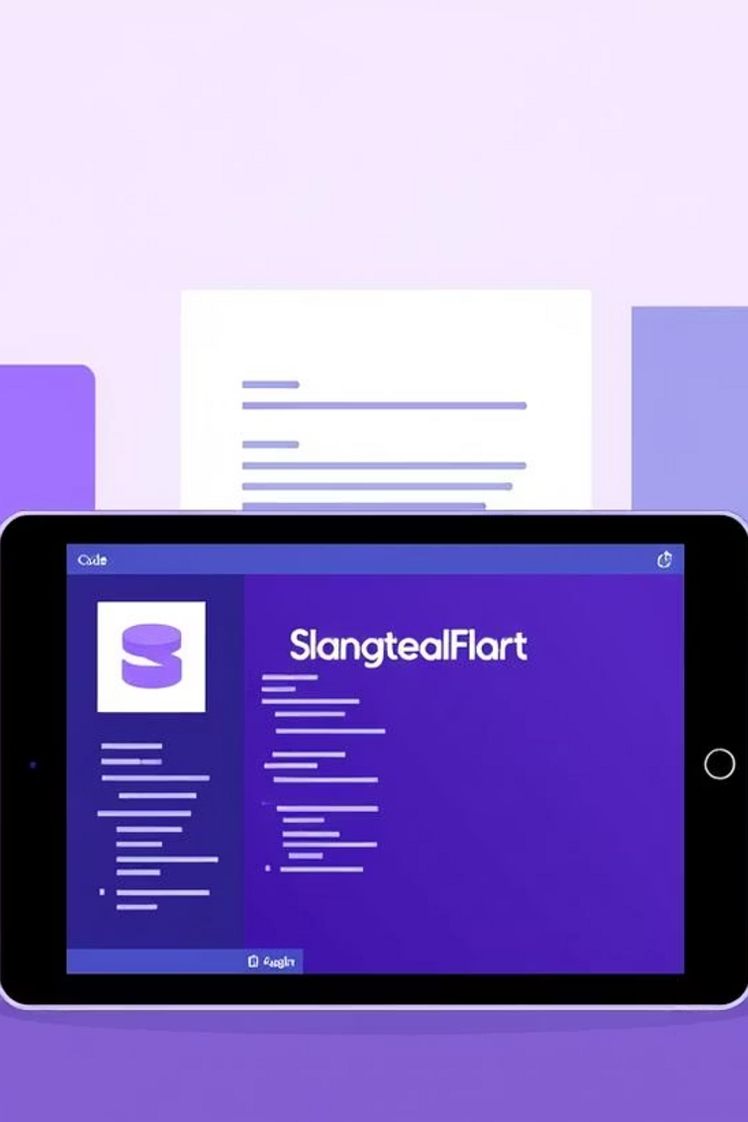
Deliverables & Next Steps
Source Code
Python scripts for scraping, database interaction, and Streamlit app.
Documentation
Detailed explanations for code, data collection, and application usage.
Database Schema
SQL scripts for creating and populating the bus_routes table.
Streamlit Application
Screenshots/links showcasing interactive data filtering and analysis.

