Slide 1
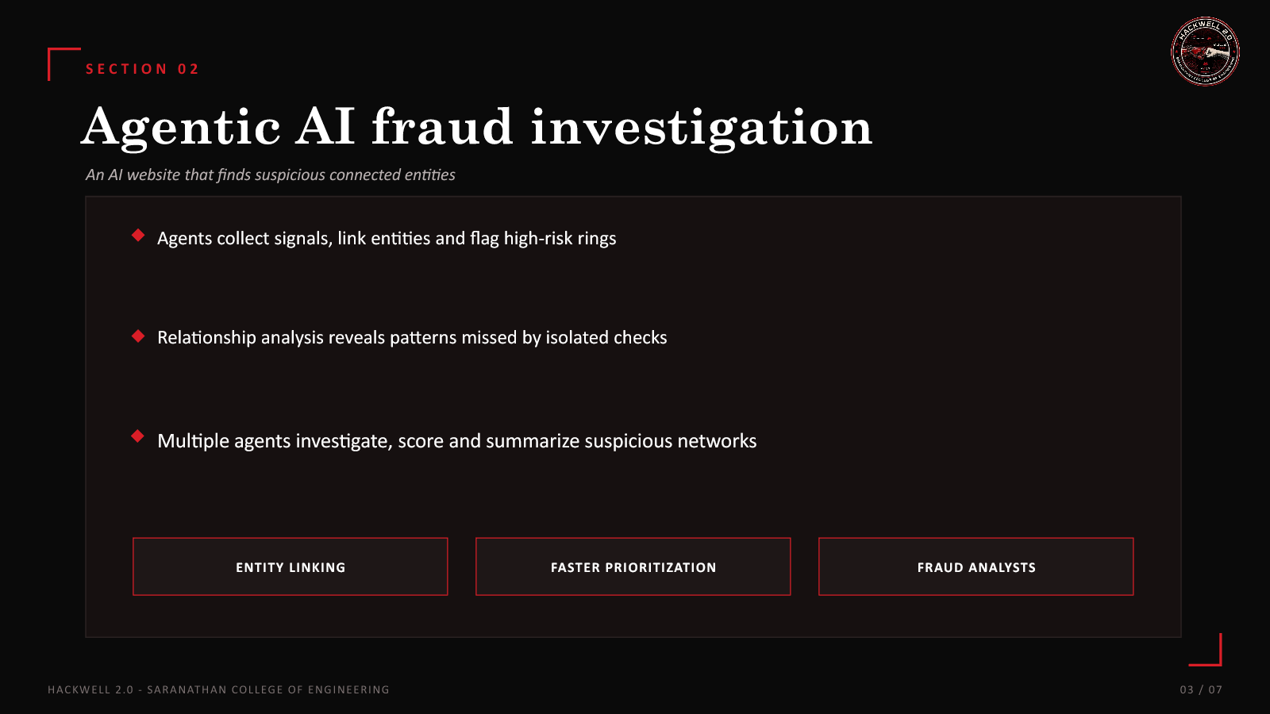
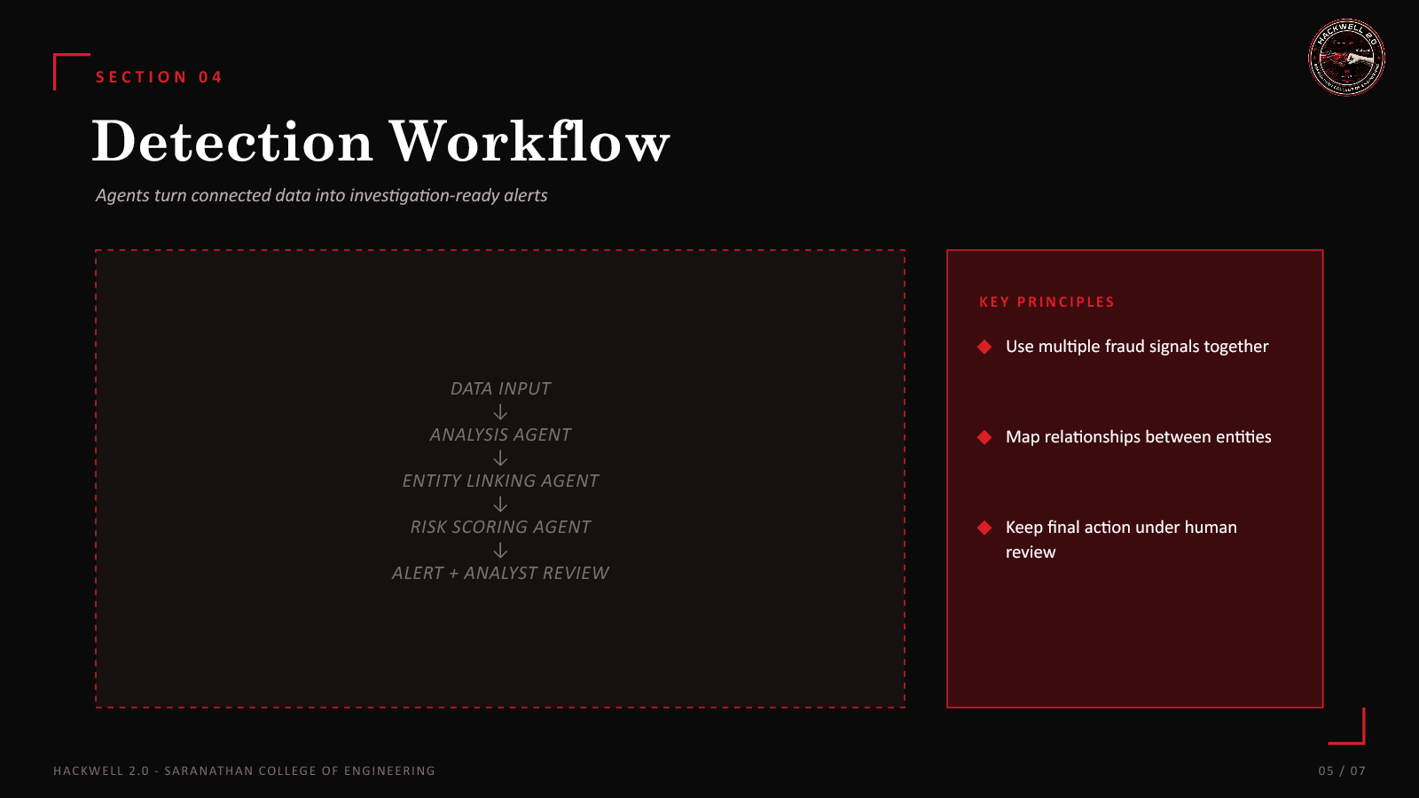
HACKWELL 2.0
AGENTIC AI FRAUD RING DETECTION
B
A
C
E
D
F
TEAM • GRAPH GRAUDIANS
DOMAIN • AUTONOMOUS AI AGENTS
PROJECT • FRAUD RING DETECTION WEBSITE
VIJAYASARATHI.B • SANJAY.B • VISHAL.B.S • SANTHANA THANUSH.M
HACKWELL 2.0 • SARANATHAN COLLEGE OF ENGINEERING
01 / 07

Slide 2
SECTION 01
Fraud rings hide in connections
Single-event checks can miss coordinated fraud
THE PROBLEM
WHY RING DETECTION MATTERS
Linked accounts and transactions can conceal fraud rings
Linked accounts
Financial platforms and fraud investigation teams need a connected view
Shared devices
Repeated patterns
Manual review is slow; rules can miss relationship patterns
Connected analysis
C
A
B
RING
HACKWELL 2.0 • SARANATHAN COLLEGE OF ENGINEERING
02 / 07

Slide 3
SECTION 02
Agentic AI fraud investigation
An AI website that finds suspicious connected entities
WHAT THE AGENTS DO
CONNECTED VIEW
Collect signals, link entities and flag high-risk rings
Reveal relationship patterns missed by isolated checks
DEV
TXN
ACC
Investigate, score and summarize suspicious networks
DEV
ID
ACC
ENTITY LINKING
FASTER PRIORITIZATION
FRAUD ANALYSTS
HACKWELL 2.0 • SARANATHAN COLLEGE OF ENGINEERING
03 / 07

Slide 4
SECTION 03
Technology layers
A website for agent-led fraud ring analysis
END-TO-END FLOW
TECH STACK
Ingest signals
→
WEB DASHBOARD
Link entities
→
AGENT WORKFLOW
Score risk
→
DATA STORE
Alert analyst
GRAPH + RISK ANALYSIS
Agent workflows combine data analysis, graph links and explainable alerts
Start with sample data; validate results through analyst review
HACKWELL 2.0 • SARANATHAN COLLEGE OF ENGINEERING
04 / 07

Slide 5
SECTION 04
Detection workflow
Agents turn connected data into investigation-ready alerts
AGENT PIPELINE
KEY PRINCIPLES
Use multiple fraud signals together
1
2
3
4
5
Map relationships between entities
DATA INPUT
ANALYSIS AGENT
ENTITY LINKING AGENT
RISK SCORING AGENT
ALERT + ANALYST REVIEW
Keep final action under human review
HACKWELL 2.0 • SARANATHAN COLLEGE OF ENGINEERING
05 / 07

Slide 6
SECTION 05
Impact & viability
Find high-risk networks before they grow
EXPECTED IMPACT
Fraud analysts and financial platforms
Earlier detection of suspicious connected activity
Prioritize cases by network risk and evidence
USE CASE
SCALABILITY
FEASIBILITY
An analyst investigates linked accounts after a high-risk alert.
Add data sources and specialist agents over time.
A web dashboard can begin with sample transaction data.
HACKWELL 2.0 • SARANATHAN COLLEGE OF ENGINEERING
06 / 07

Slide 7
THANK YOU
GRAPH GRAUDIANS
AGENTIC AI • FRAUD RING DETECTION
HACKWELL 2.0
HACKWELL 2.0 • SARANATHAN COLLEGE OF ENGINEERING
07 / 07

