Slide 1

SREENIVASA INSTITUTE OF TECHNOLOGY AND MANAGEMENT STUDIES
(Autonomous)
DEPARTMENT OF ELECTRONICS AND COMMUNICATION ENGINEERING
(2025-2026)
A FINAL YEAR PROJECT REPORT PRESENTATION
ON
AIR DEFENCE AND TARGETING SYSTEM
BY
Name : P. Shivaji Rao | 22751A04A4
Name: S. Nandhini | 22751A04C1
Name: S. Karthik | 22751A04C2
Name: S. Nandhini | 23755A0418
Under the Guidance of
Mr, S. Ashmad., M.Tech.,
Assistant Professor
Department of Electronics and Communication Engineering,
Sreenivasa Institute of Technology and
Management Studies, Chittoor, A.P.

Slide 2
Abstract
This project presents an Air Defense and Targeting System designed to detect and respond to nearby aerial objects using a low-cost embedded setup. The system uses 3 ultrasonic sensors as short-range radar units to measure the distance of objects in real time. A 4-servo motor mechanism is used to scan a wider area and to provide smooth directional movement for tracking. When an object enters the predefined danger zone, the ESP32 controller processes the sensor readings and identifies the target direction. Based on the detected position, the servo motors align a laser module toward the target, simulating an automatic aiming process. The proposed system demonstrates how sensing, scanning, and automated targeting can replicate the basic working principle of an air defense surveillance model. This prototype is compact, low cost, and can be extended further by adding wireless monitoring and improved tracking algorithms.

Slide 3
Problem Identification
Manual tracking of moving objects is slow and inaccurate.
High-end radar-based defense systems are costly and complex.
Single-sensor setups provide limited coverage and poor direction detection.
Need a compact, low-cost system that can detect, track, and target in real time.

Slide 4
Objectives
Detect objects using 3 ultrasonic sensors and measure distance continuously.
Scan and track target direction using 4 servo motors.
Aim a laser module automatically towards detected target.
Provide fast, stable control using ESP32.
Build a low-cost, scalable prototype for educational demonstration.

Slide 5
Methodology
Ultrasonic sensors continuously measure target distance in Left / Center / Right directions.
ESP32 reads sensor data and checks predefined danger zone threshold.
Nearest object and direction are selected based on minimum distance.
Servo motors rotate and tilt the mechanism to align with target direction.
Laser module is activated to indicate targeting; optional alarm can be triggered.
System keeps tracking until the target exits the range.

Slide 6
Introduction
Air defense systems require fast detection and accurate tracking of targets.
This project demonstrates a low-cost prototype using ESP32 and ultrasonic sensors.
Servo motors provide controlled scanning and aiming movement.
A laser module is used for visual confirmation of targeting.

Slide 7
Literature Survey
Paper Title: “Air Defense Mechanism Using Radar System” explains a low-cost air defence prototype using radar-like scanning.
Publication Details: ISSN 2347–3657, Volume 13, Issue 2, 2025.
The system uses Arduino UNO, HC-SR04 ultrasonic sensor, and a servo motor for 0°–180° scanning like radar.
Distance is detected using echo timing and alerts are given using buzzer/LED, with possible laptop radar visualization.
The paper reports limitations like short range, noise interference, false detection, and delayed response, motivating improved proposed systems.

Slide 8
Materials and Methods
Hardware: ESP32 development board, 3× HC-SR04 ultrasonic sensors,
4× servo motors, laser module, buzzer (optional).
Power: 5V regulated supply for servos; ESP32 powered via USB/5V.
Software: Arduino IDE / ESP-IDF, Embedded C, Servo control library,
distance calculation logic.

Slide 9
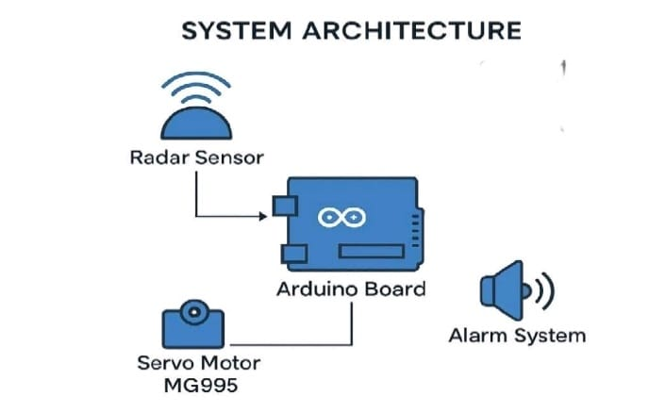
Existing Method – Arduino Radar System
Arduino UNO with single ultrasonic sensor and servo motor.
Ultrasonic sensor scans 0°–180° like radar.
Distance calculated using echo timing.
Alerts generated using buzzer and LED.
Laptop-based radar visualization possible.

Slide 10
Disadvantages of Existing Method
Limited detection range.
Single sensor causes blind spots.
Slow scanning for fast-moving targets.
High false detection rate.
No automatic targeting mechanism.

Slide 11
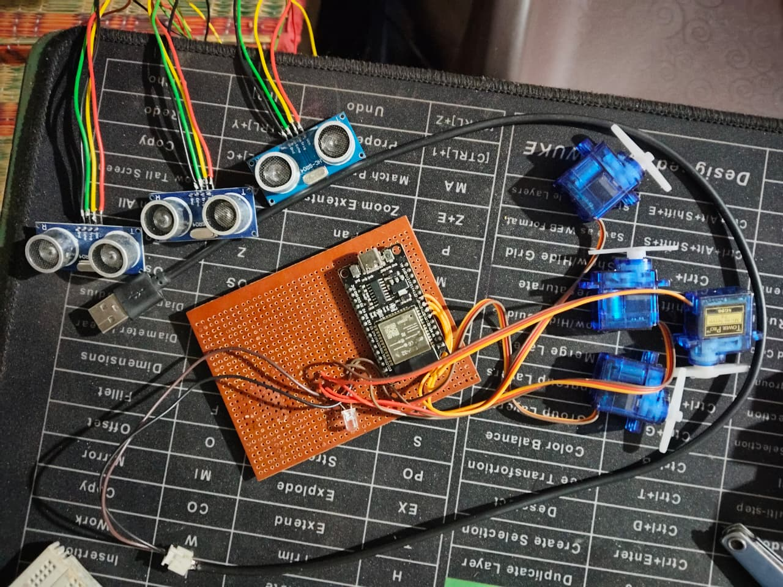
Proposed System Block Diagram
ULTRASONIC SENSORS
SERVO MOTRS
LASER
ESP32

Slide 12
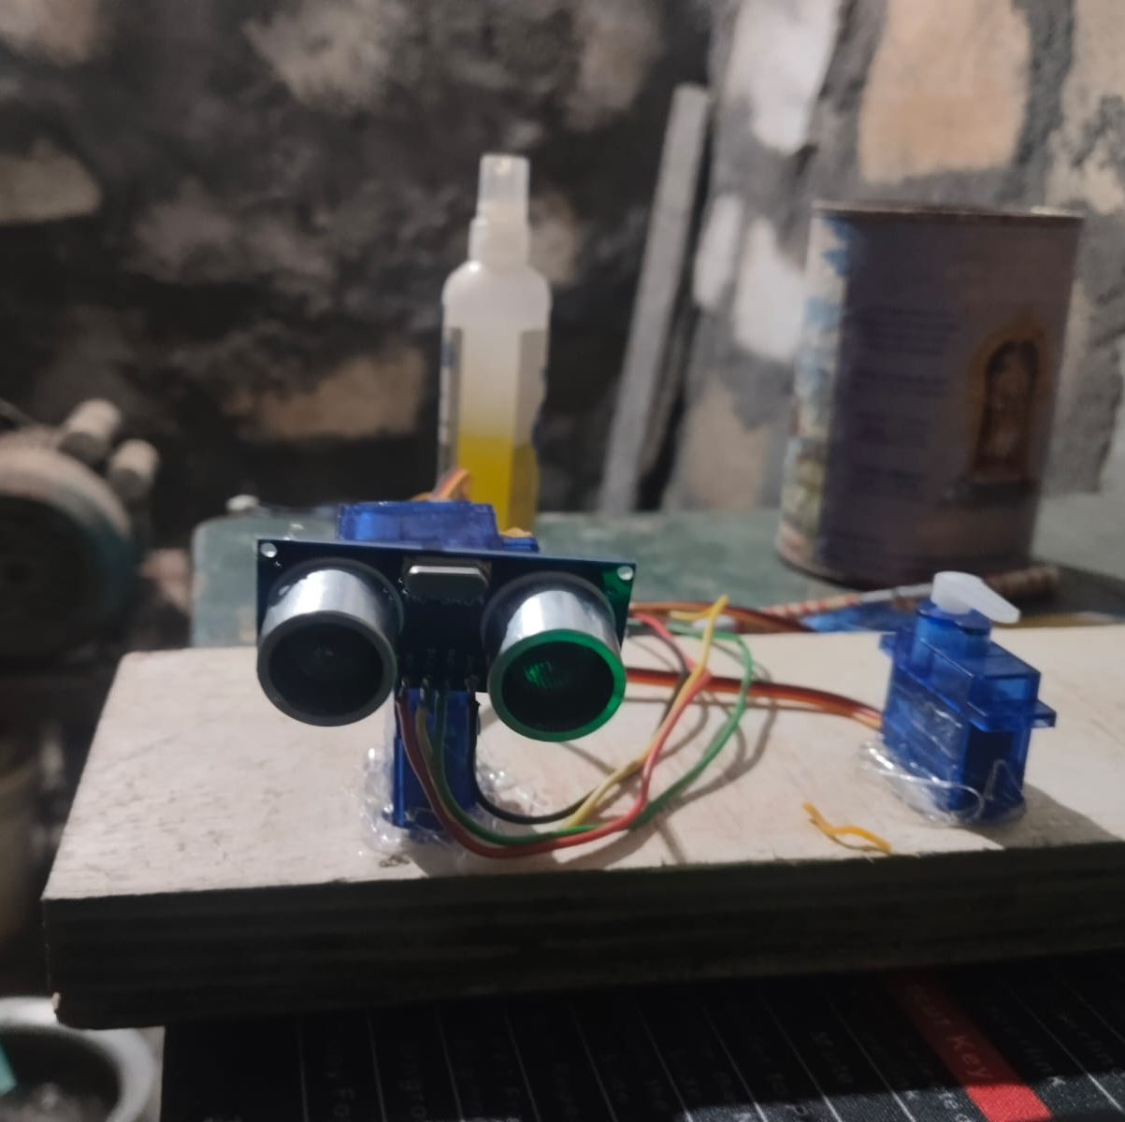
Proposed Method – ESP32 Targeting System
ESP32 controller for faster processing.
Three ultrasonic sensors for multi-direction coverage.
Four servo motors for smooth tracking.
Laser module for target simulation.
Automatic alignment towards detected object.

Slide 13
Advantages of Proposed System
Better coverage and reduced blind spots.
Faster detection and response.
Improved direction accuracy.
Automatic targeting simulation.
Low-cost and scalable design.

Slide 14
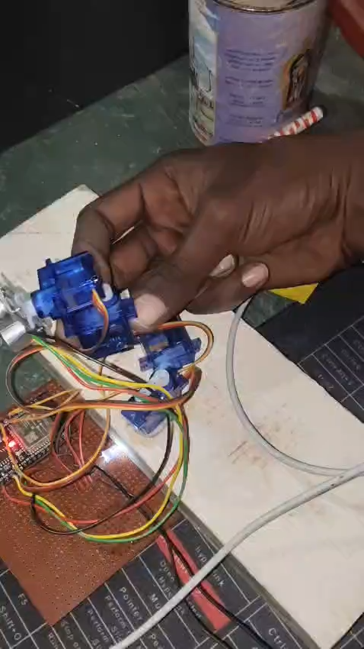
Results and Discussion
Objects were detected successfully using ultrasonic sensors in real time.
We working on using Left / Center / Right sensor comparison.
Servo motors tracked and aligned the laser towards the target direction.
3-sensor setup improved coverage and reduced blind spots compared to
single-sensor scanning.
System response time was stable for short-range detection scenarios.

Slide 15
Conclusion
The Air Defense and Targeting System using ESP32 was designed and
demonstrated successfully.
3 ultrasonic sensors provided effective short-range object detection
and direction identification.
4 servo motors enabled smooth scanning and accurate aiming alignment.
Laser targeting offered a clear visual indication of tracking and aim direction.
The prototype is low cost, compact, and extendable with wireless monitoring
and advanced tracking.

Slide 16
References
ESP32 Technical Documentation
HC-SR04 Ultrasonic Sensor Datasheet
Servo Motor Control References
Arduino IDE / ESP-IDF Documentation

