Slide 1
Seven-segment display
Includes anode testing, blanking behavior, seven-segment decoder waveforms, and photographs of the Nexys A7 displaying digits at different refresh rates. This is useful evidence of both simulation and hardware testing.

Slide 2
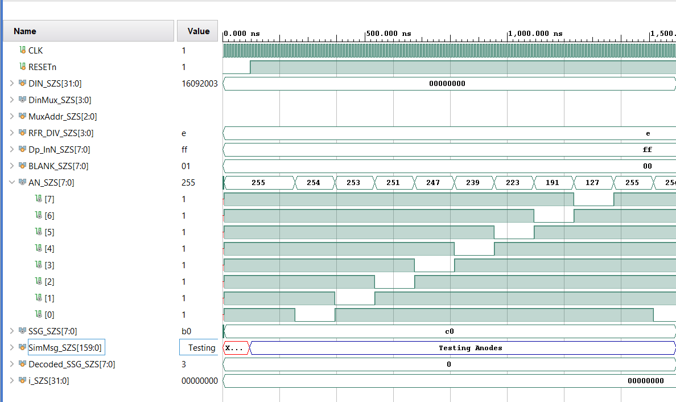
Testing Anodes

Slide 3
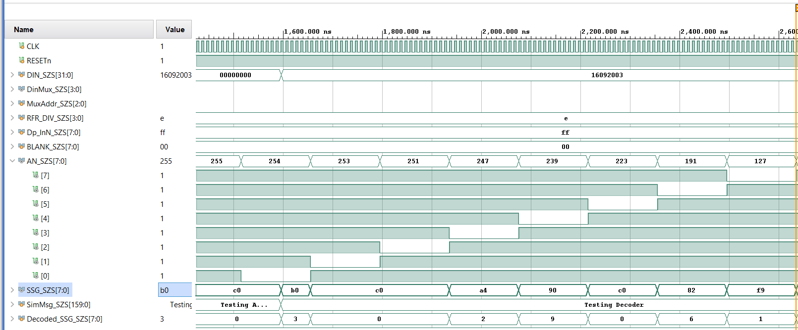
Date of birth (16.09.2003)

Slide 4
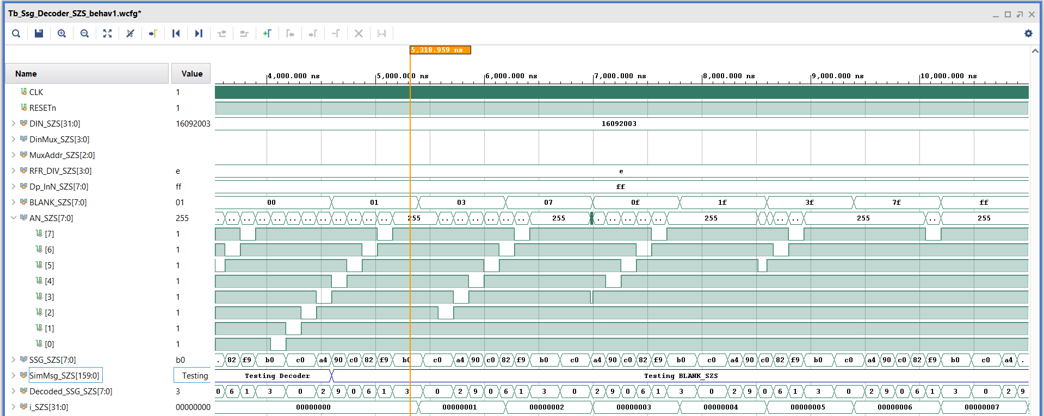
Blank check simulation tests the blanking functionality of the seven-segment display decoder using a Verilog testbench in Vivado

Slide 5
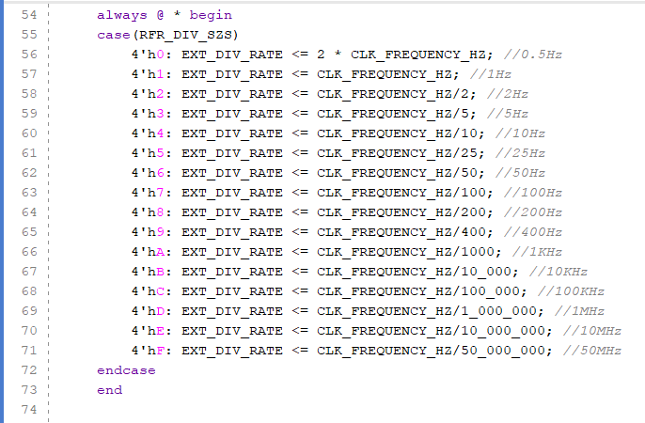
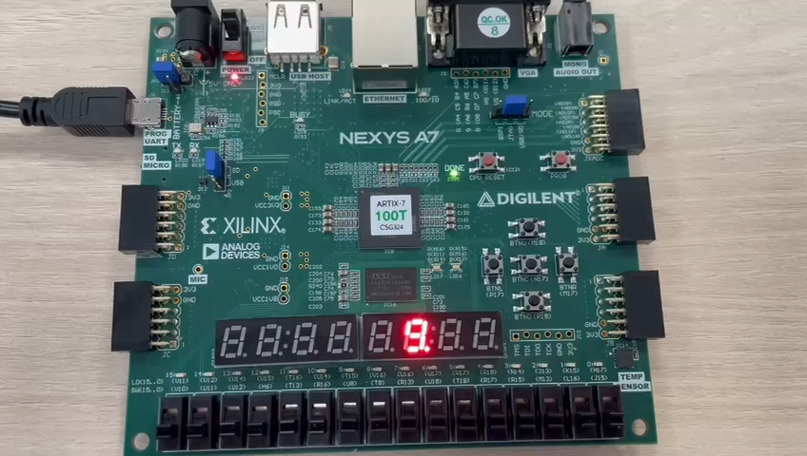
Video showing the value
The digits light up one by one: Frequency below 25 Hz
- The display refresh rate is below 25/8 = 3.1 Hz
SW[15:12] = 1’b 1001

Slide 6
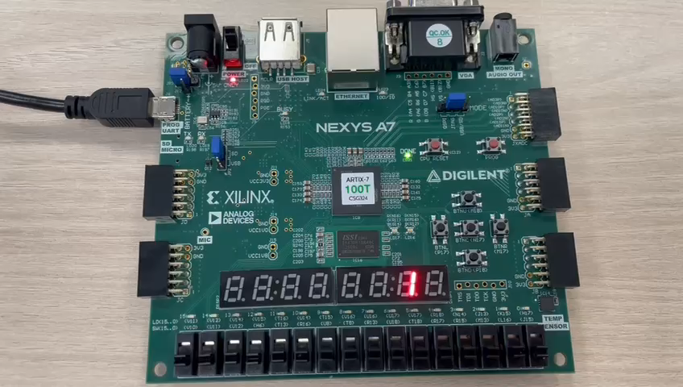
2. All the figures are visible, but with a ‘flickering’ effect:
Frequency between 50 Hz and 200 Hz
— that is, a refresh rate between 6.25 Hz and 25 HzI chose 100 Hz – that is, a refresh rate between 12.5 Hz
SW[15:12] = 1’b 0011

Slide 7
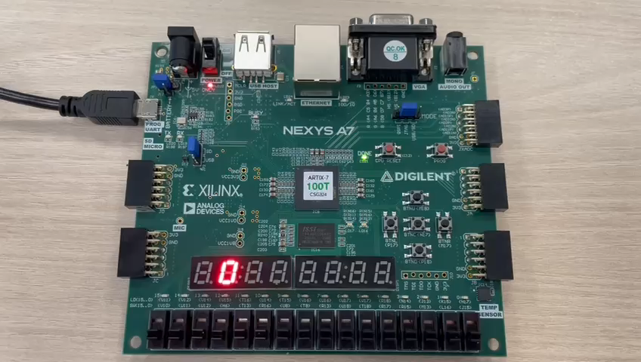
3. All the figures are visible; the display is static:
Frequency between 400 Hz and 100 kHz – that is, a refresh rate between 50 Hz and 12.5 kHz
I have selected: 10 kHz — that is, the refresh rate is 1.25 kHz
SW[15:12] = 1’b 1011

Slide 8
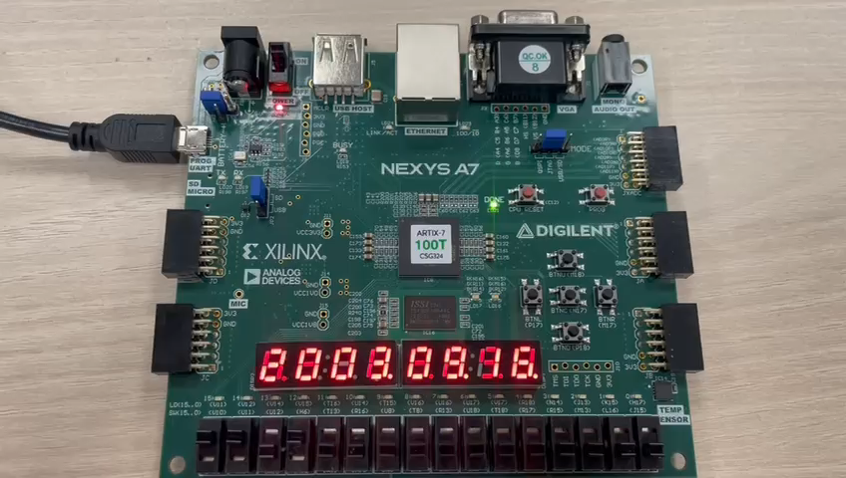
4-5. The figures overlap: a frequency of 1 MHz, i.e. a refresh rate of 125 kHz
SW[15:12] = 1’b 1101

Slide 9
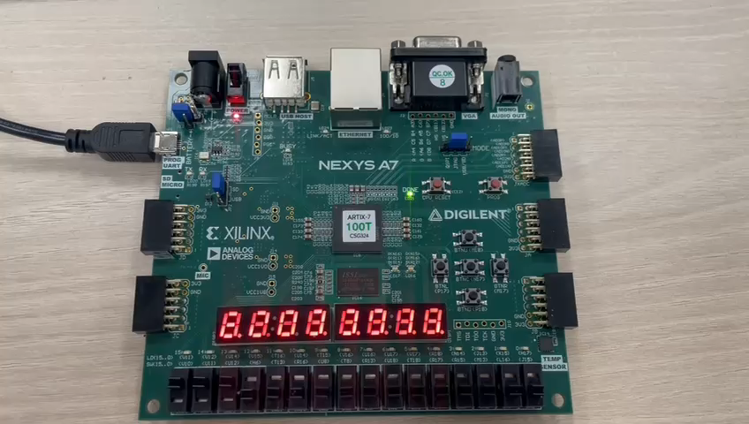
4-5. The figures overlap: a frequency of 10 MHz, i.e. a refresh rate of 1.25 MHz
SW[15:12] = 1’b 1110

Slide 10
4. b) Set your ILA triggers to the following values:
The SSG_SZS value is 8’hC0 and a Fall event occurs on the anode corresponding to the second digit from the left
Capture an entire WALK0 period, together with the corresponding SSG codes
  The capture must contain the trigger position (the moment of triggering)!
  The trigger conditions must be visible on the capture!
In the documentation, indicate for each SSG code: the corresponding digit and the decimal point value (on/reached)

Slide 11
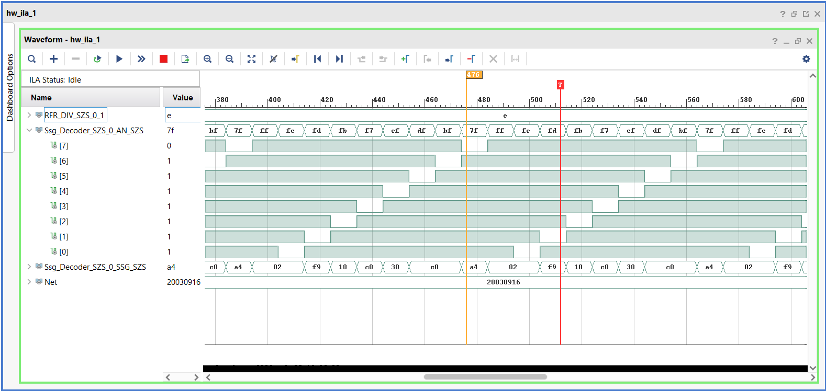
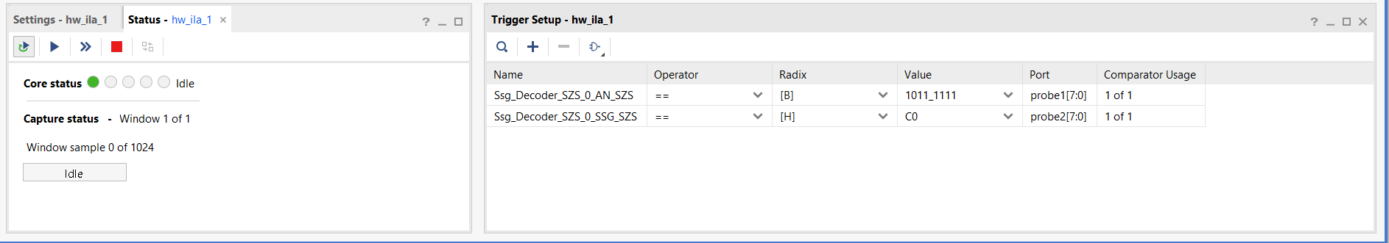
4. b)

Slide 12
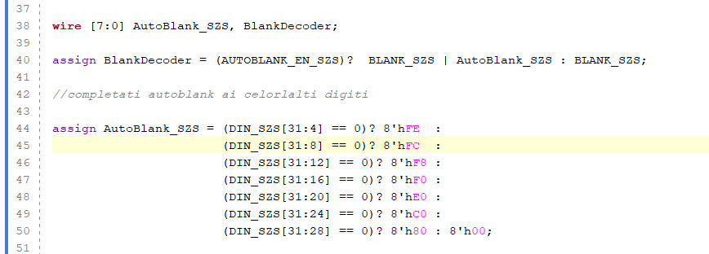
6.a. The Autoblank logic code sequence

Slide 13
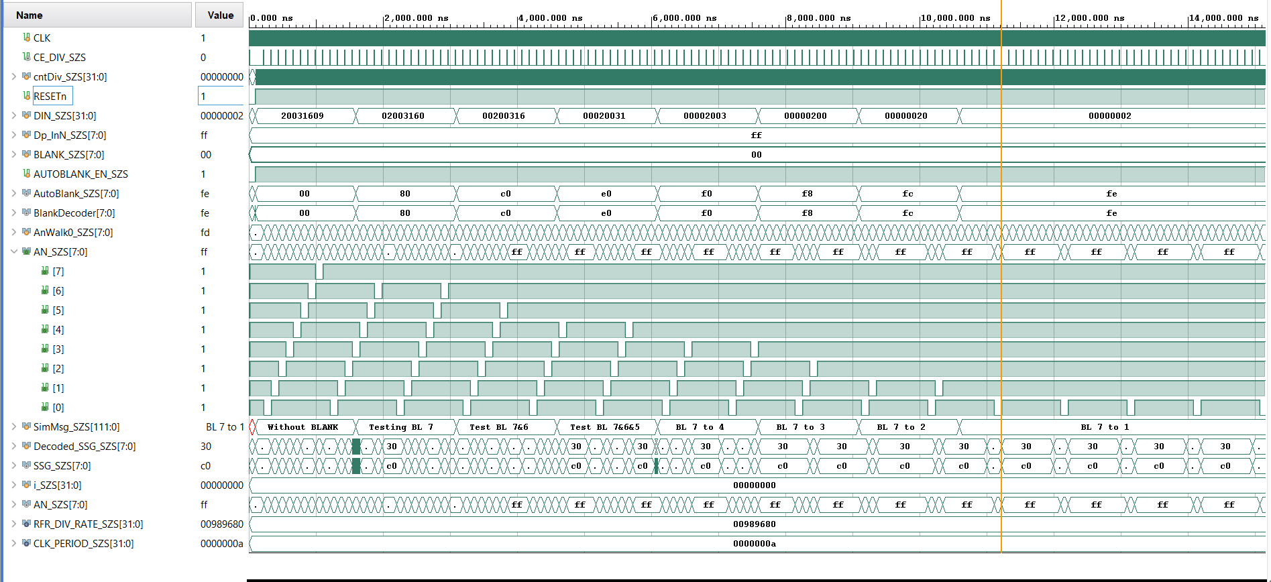
6.b. Simulation results demonstrating the logic behind Autoblank

