Slide 1
Clock divider and ILA
Documents configurable clock division, frequency calculations, measured signal behavior and on-chip Integrated Logic Analyzer (ILA) captures. This demonstrates debugging and verification skills beyond basic Verilog coding.

Slide 2
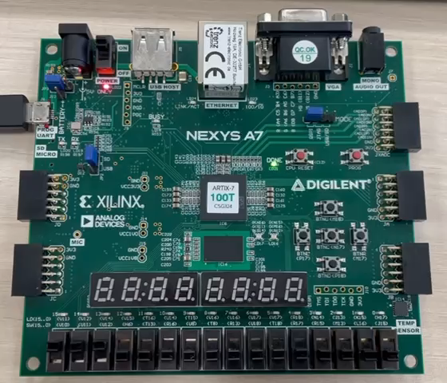
1. Video showing various division rates - A
The LED frequency is generally 50 MHz
The LED frequency based on DIV_RATE is 50 × 10⁶ / 10⁸ = 0.5 HzT = 1 / f = 1 / (0.5) = 2 s T = 1 / f = 1/(0,5) = 2s
The duration of the video is approximately 5 seconds, during which there are 2 periods, with a duty cycle of 50% (Ton = 1 s, Toff = 1 s) => this confirms the calculations
SW[15:13] is set to 3’b111 => DIV_RATE = 10^ 7
SW[1:0] is set to 2’b00 => A is selected

Slide 3
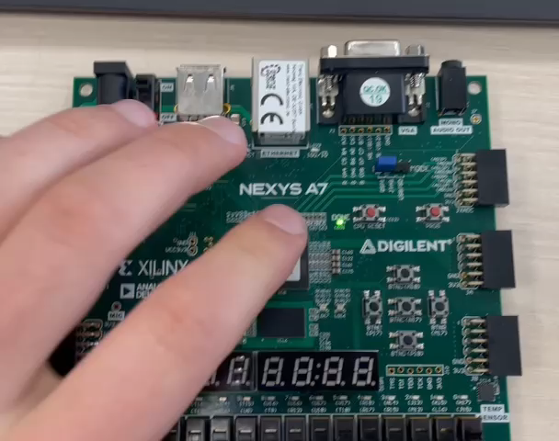
1. Video showing various division rates - B
The LED frequency based on DIV_RATE 50*10^6/10^8 = 0,5 Hz
T = 1 / f = 1/(0,5) = 2s in case of A
But the frequency of B = A / 2 => 0,5Hz / 2 = 0,25Hz
The duration of the period is T = 1 / (1/4) = 4s
The duration of the video clip is 4 seconds. It starts at 3:38s and runs until 7:40, with a fill factor of 50% (Ton = 2s, Toff = 2s)
SW[1:0] is set to 2’b01 => B has been selected => the frequency of A / 2

Slide 4
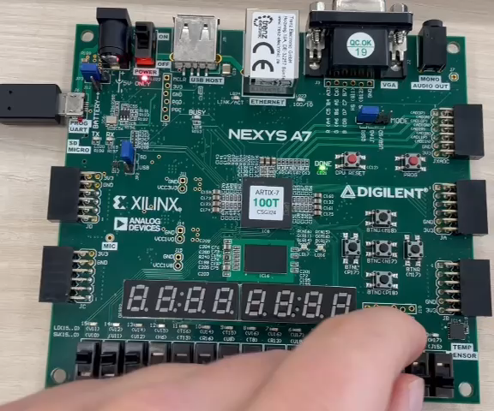
1. Video showing various division rates - C
T = 1 / f = 1/(0,25) = 4s in case of B
Frequency of C = B / 2 => 0,25Hz / 2 = 0,125Hz
The duration of the period is T = 1 / (1/8) = 8s
The duration of the section in the video is 8 seconds; it starts at 6:70s and lasts until 14:74s, which shows that the calculations are correct, with a duty cycle of 50 per cent (Ton = 4s, Toff = 4s)
SW[1:0] is set to 2’b10 => C has been selected => the frequency of B / 2

Slide 5
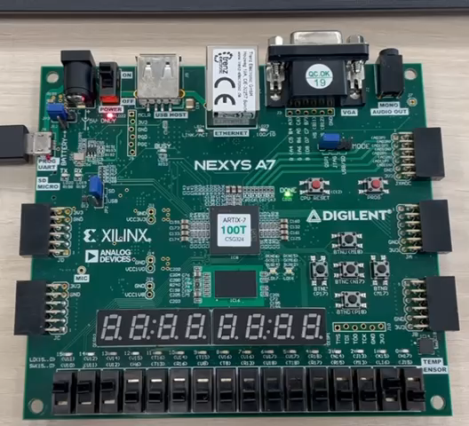
1. Video showing various division rates - D
T = 1 / f = 1/(0.125) = 8 s in the case of C
But the frequency of D = C / 2 => 0.125 Hz / 2 = 0.0625 Hz
The period is T = 1 / (1/16) = 16 s
The period in the video is 16 seconds and runs from 11:94 to 28:09, so the calculations are correct with a duty cycle of 50 per cent (Ton = 8 s, Toff = 8 s)
SW[1:0] is set to 2’b11 => D has been selected => the frequency of C / 2

Slide 6
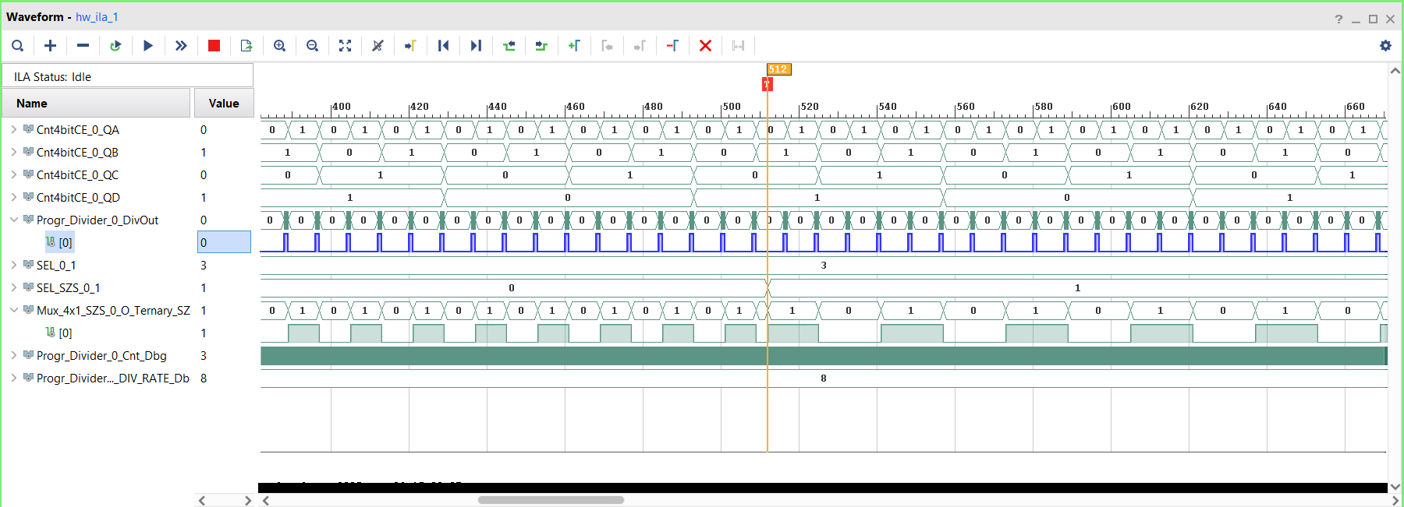
Monitoring signals using ILA
DIV_RATE = 8 => SEL = 3 => SW[15:13] = b’011
when SW[1:0] = b’00, frequency = 5*10^7/8
when SW[1:0] = b’01, frequency = 5*10^7/(8*2)
Changing SEL_MUX from 0 to 1
It can be seen that, after the orange line at T = 512, the duration doubles => the frequency halves
It can be seen that, in the ‘Change on upper input 0 → 1’ column, the condition is satisfied => SEL_SZS_0_1

Slide 7
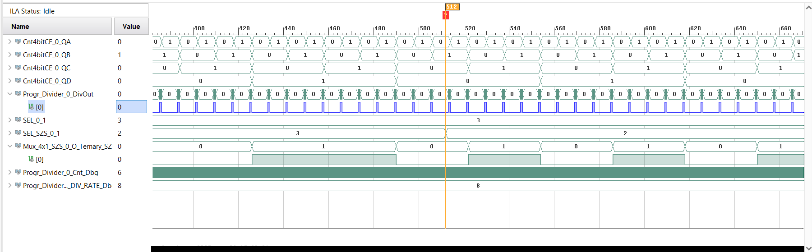
Monitoring signals using ILA
DIV_RATE = 8 => SEL = 3 => SW[15:13] = b’011 => SEL_0_1 shows
when SW[1:0] = b’11, frequency = 5*10^7/(8*8)
when SW[1:0] = b’10, frequency = 5*10^7/(8*4)
Changing SEL_MUX from 0 to 1
It can be seen that, after the orange line at T = 512, the duration is halved => the frequency doublesIt can be seen that, for the ‘Change on upper input 3 → 2’ section, the condition is satisfied => SEL_SZS_0_1

Slide 8
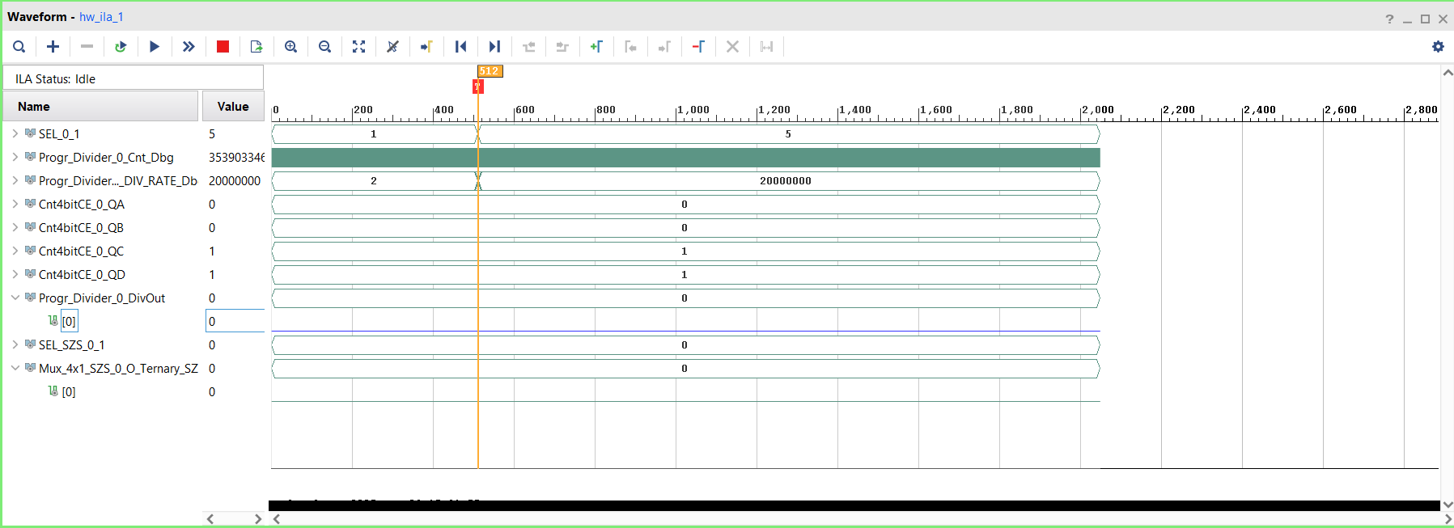
The shift from low DIV_RATE to high DIV_RATE
If SEL_0_1 = 5 then SW[15:13] = 3’b101
Before that, SEL_0_1 = 1 then SW [15:13] = 3’b001

Slide 9
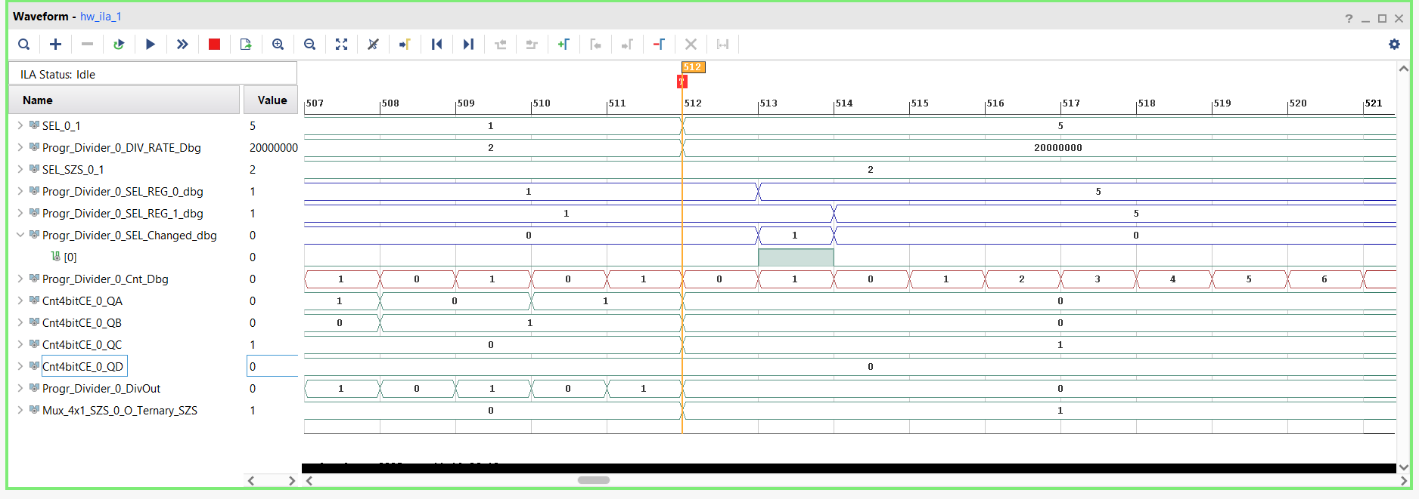
Bug – LED freezes
There was an issue, when SW[15] going from 1 to 0 causes the LED to freeze. I have fixed the bug so that it now works correctly. As you can see in the image, when I change SW[15] from 0 to 1, it changes SEL, triggers SEL_Changed and resets the counter.

Slide 10
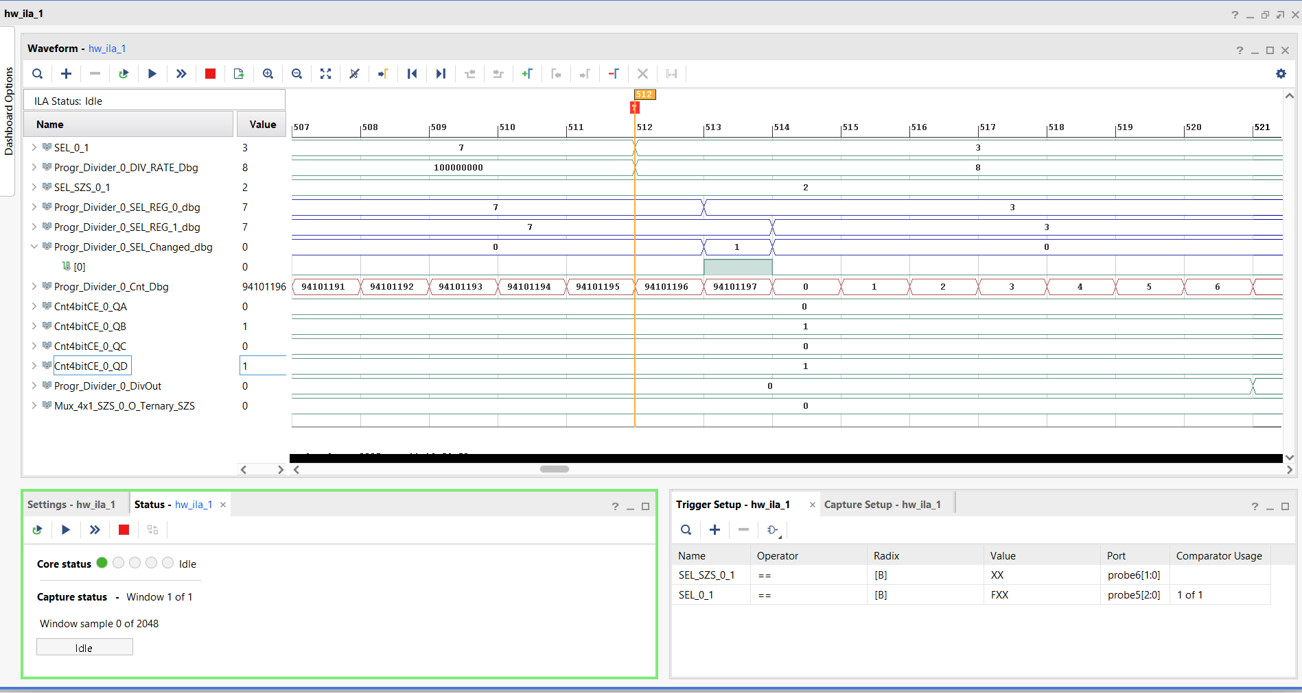
Without bug
Here we can see that SW[15] → changes from 1 to 0; there is no bug, the programme is running correctly

Slide 11
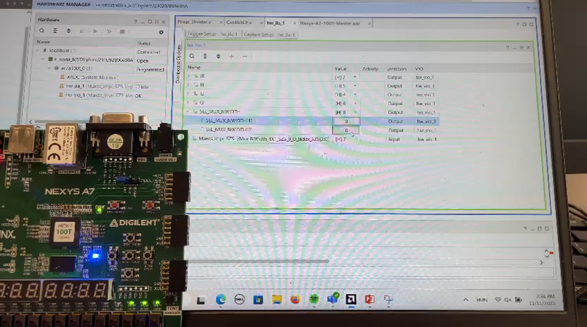
Short video on all four SEL values

