Slide 1
Digital clock
Covers hour-counter rollover, seconds adjustment, increment/decrement behavior and testbench waveforms. It also records debugging of an hour-counter reset problem, which can demonstrate your problem-solving process.

Slide 2
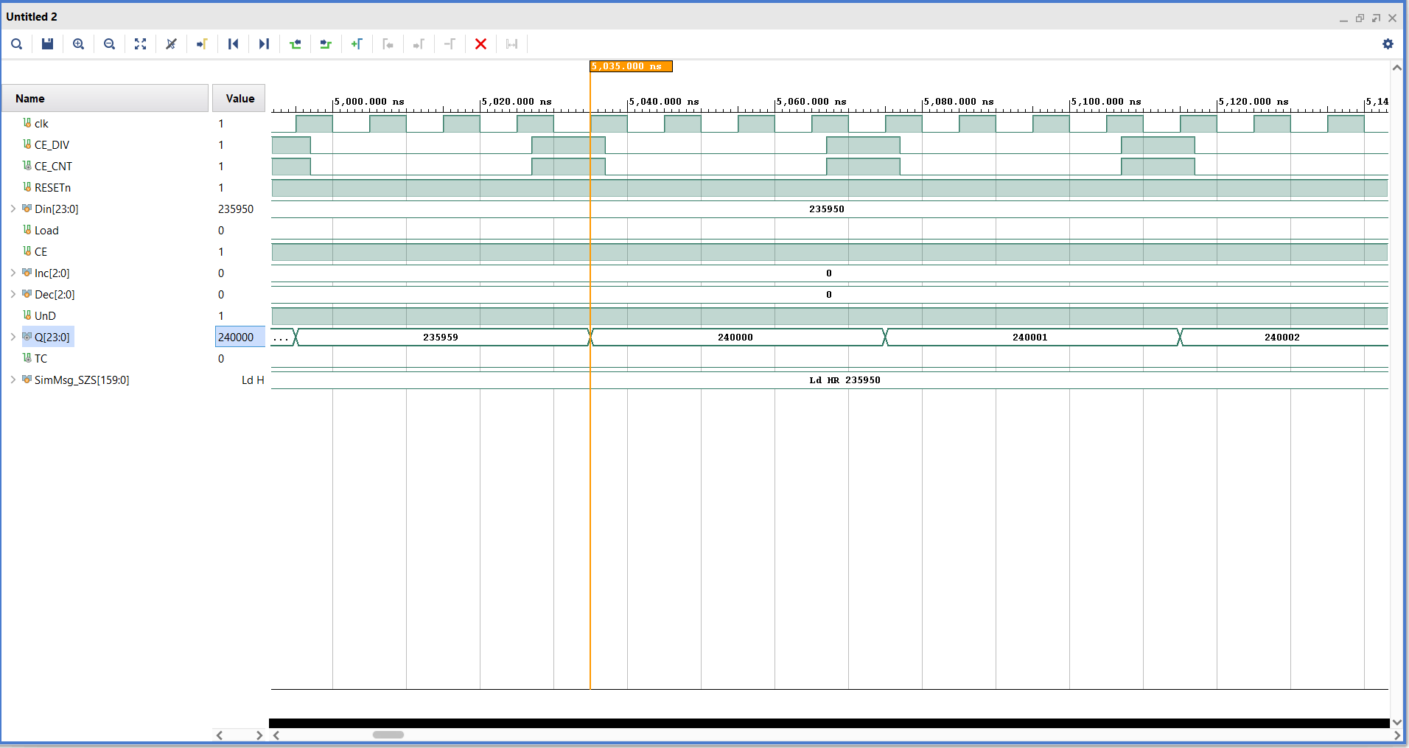
The hour counter does not reset

Slide 3
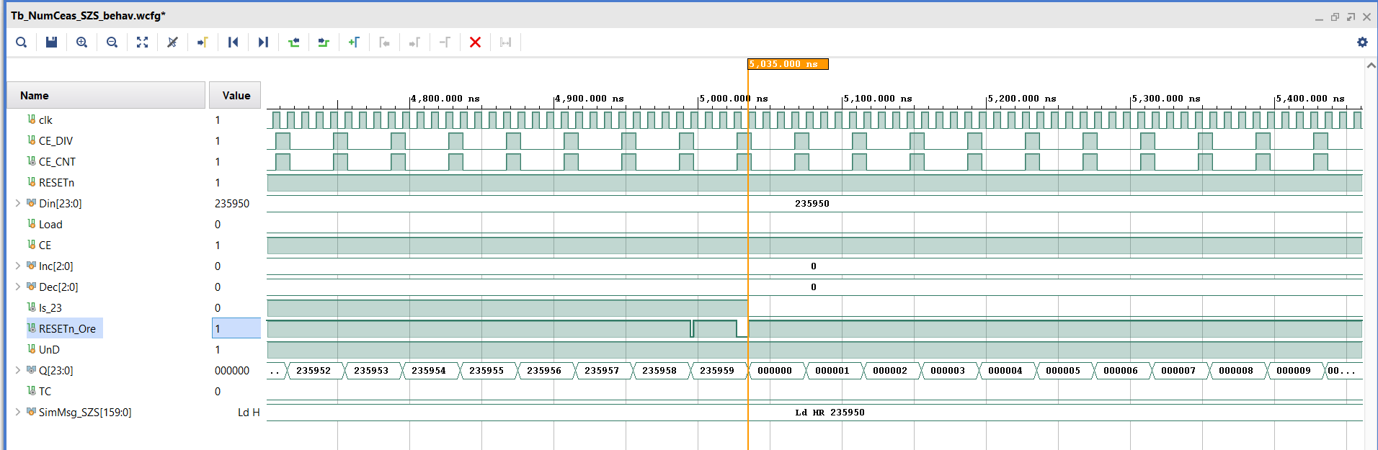
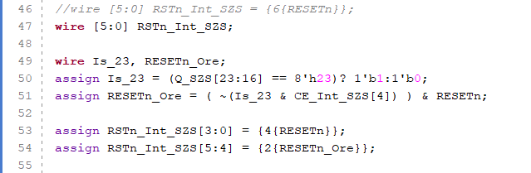
The hour counter resets

Slide 4
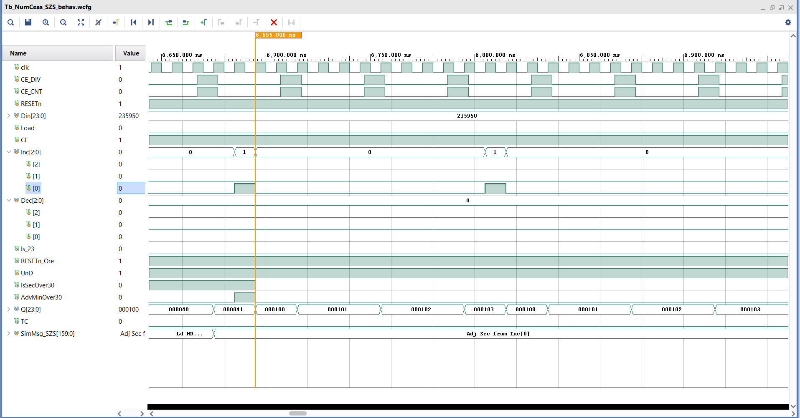
Demonstrating that the seconds adjustment works correctly on Inc[0]

Slide 5
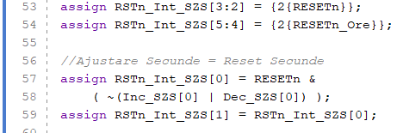
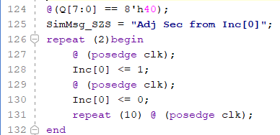

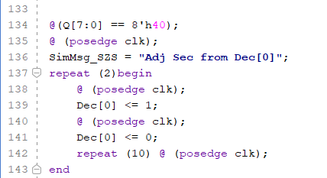

Code
TB_NumCeas

Slide 6
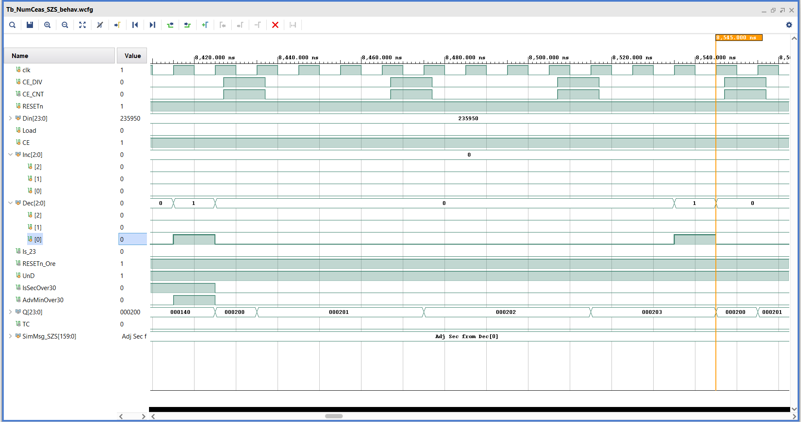
Demonstrating that the seconds adjustment works correctly on Dec[0]

Slide 7
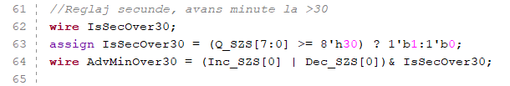
Code

Slide 8
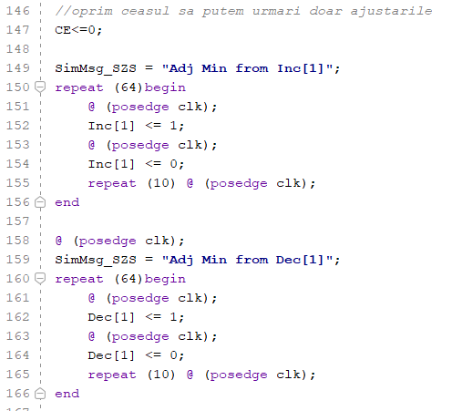

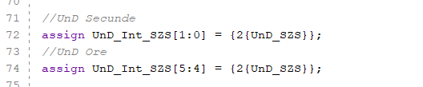

The logic of adjustment ports
TB_NumCeas

Slide 9
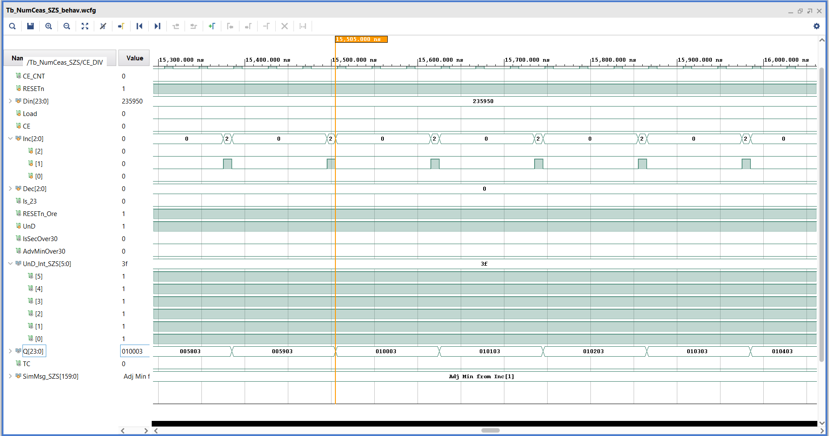
Increment – by mistake

Slide 10
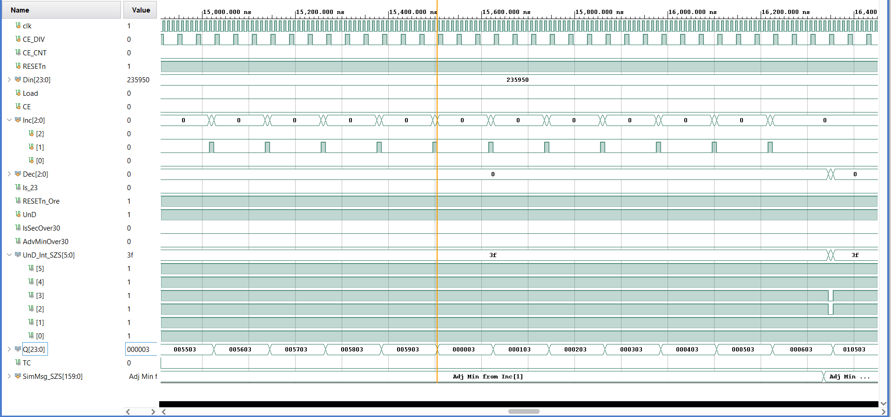
Increment – without error

Slide 11
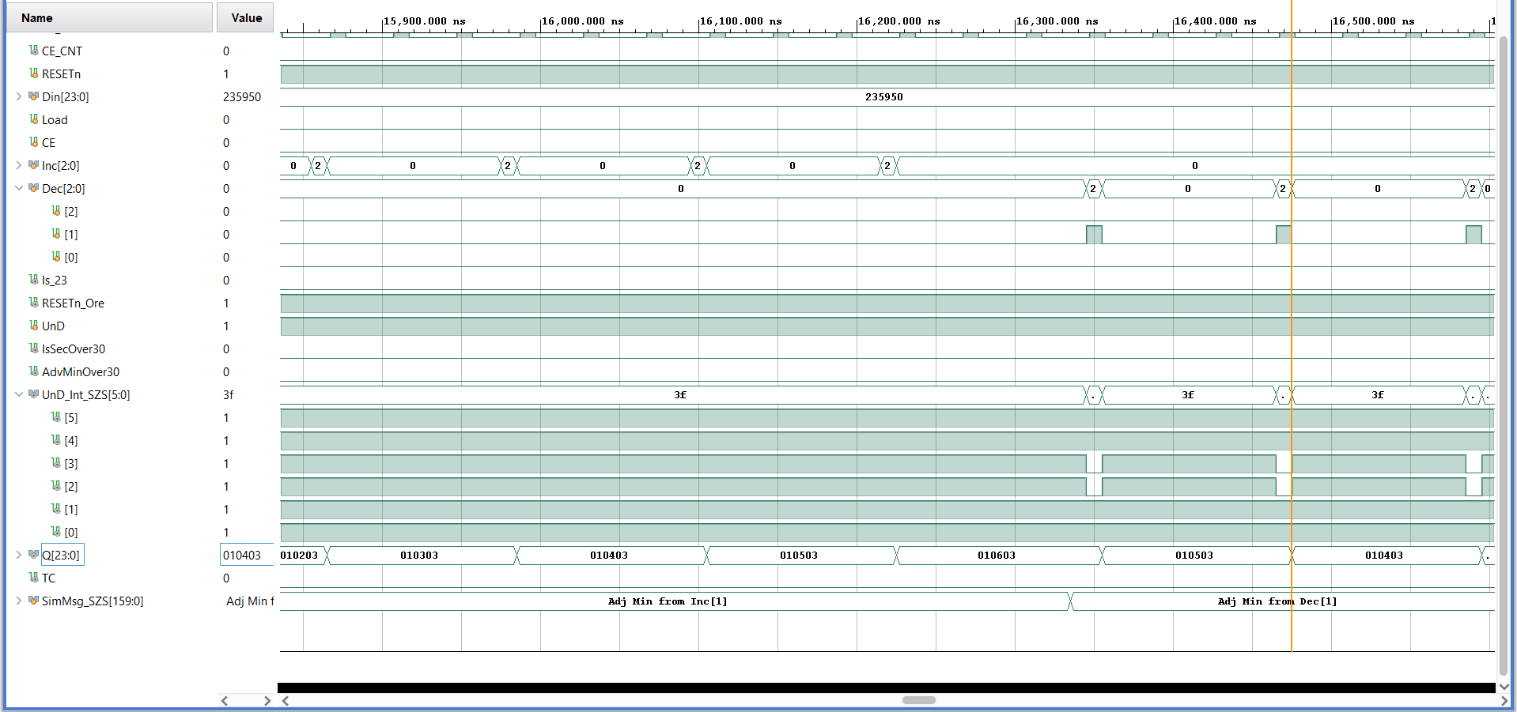
Decrement

Slide 12
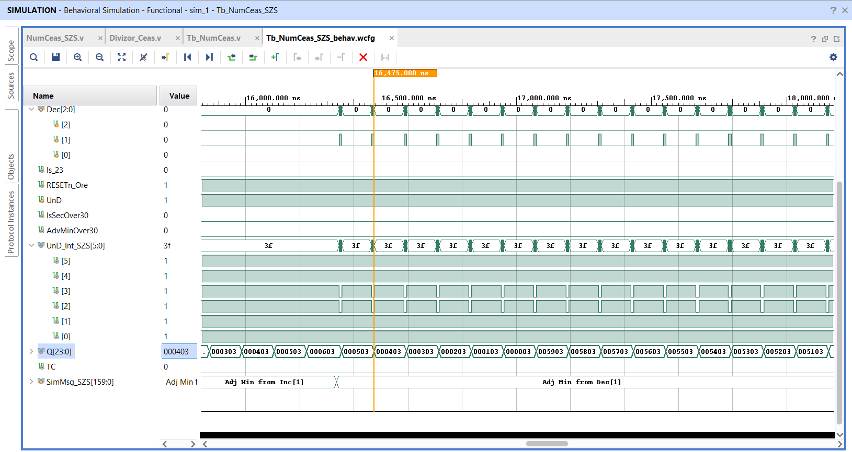
Decrement – without mistake

Slide 13
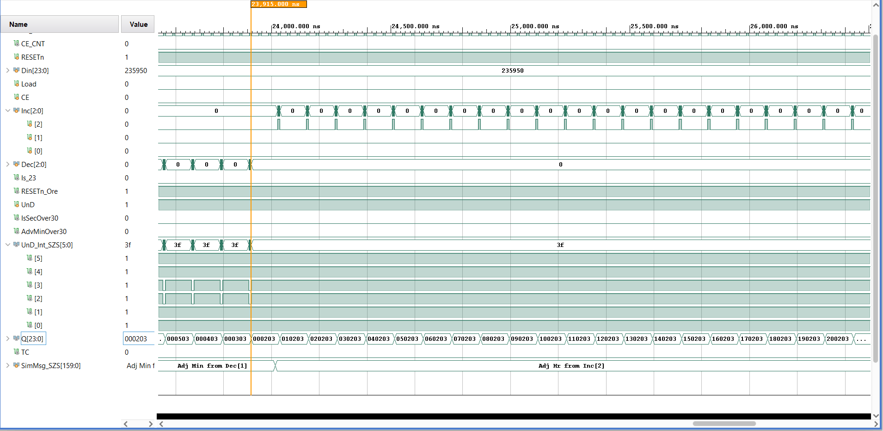
Time adjustment – increment

Slide 14
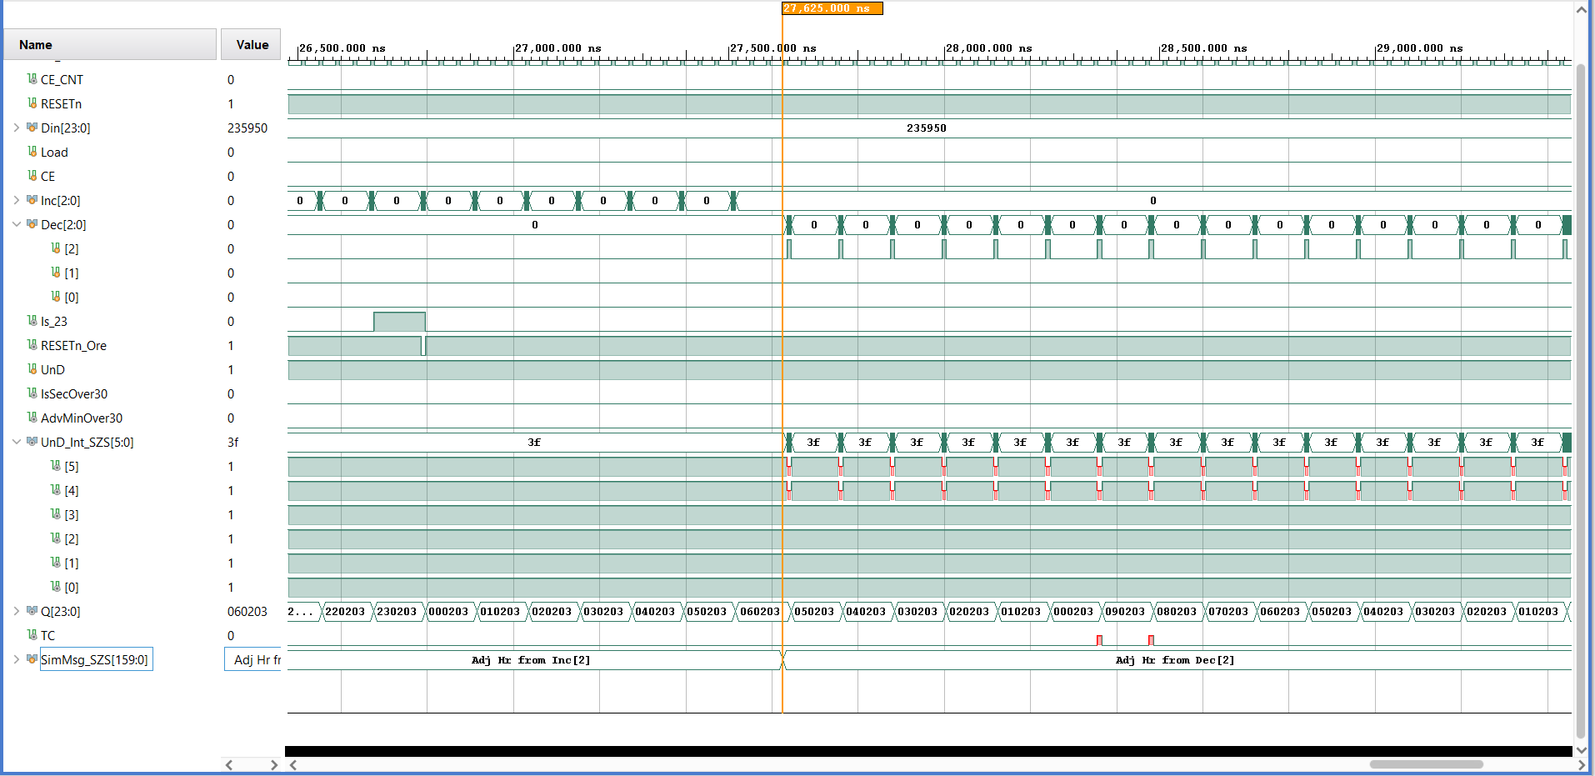
Time adjustment – decrement

Slide 15

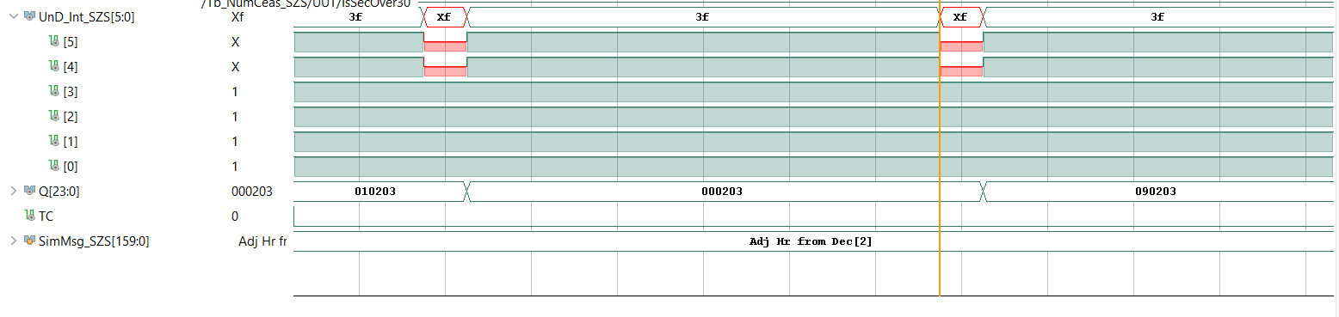
TC

Slide 16

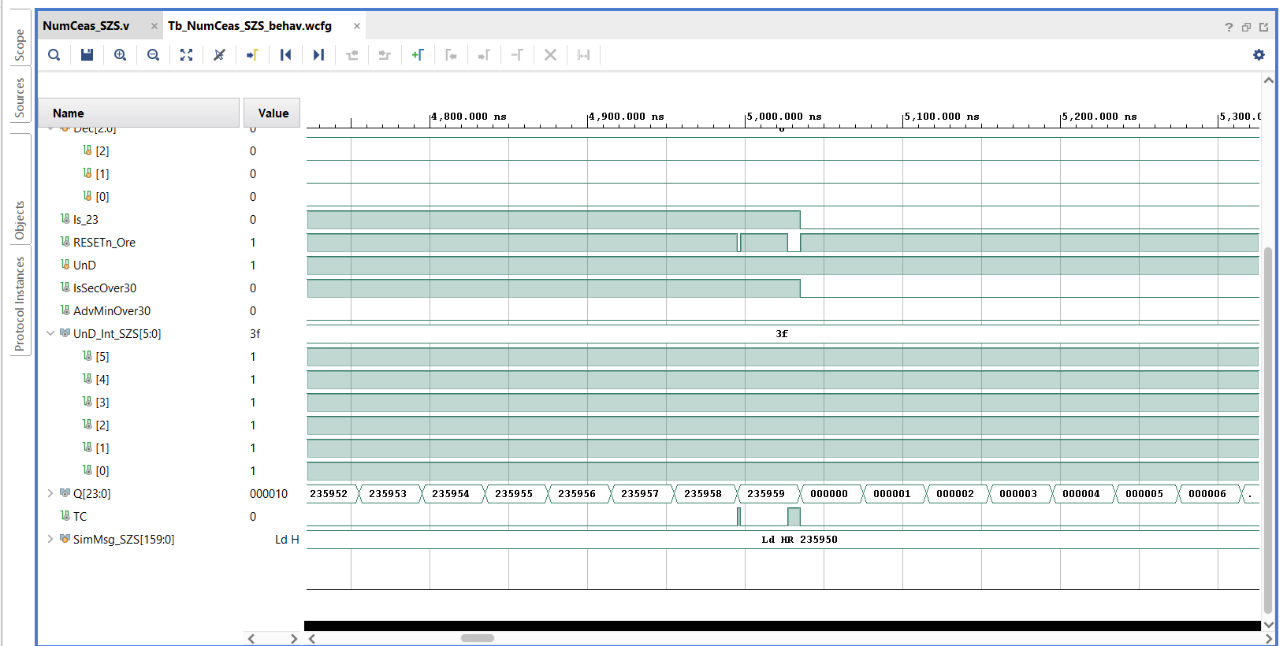
TC

Slide 17
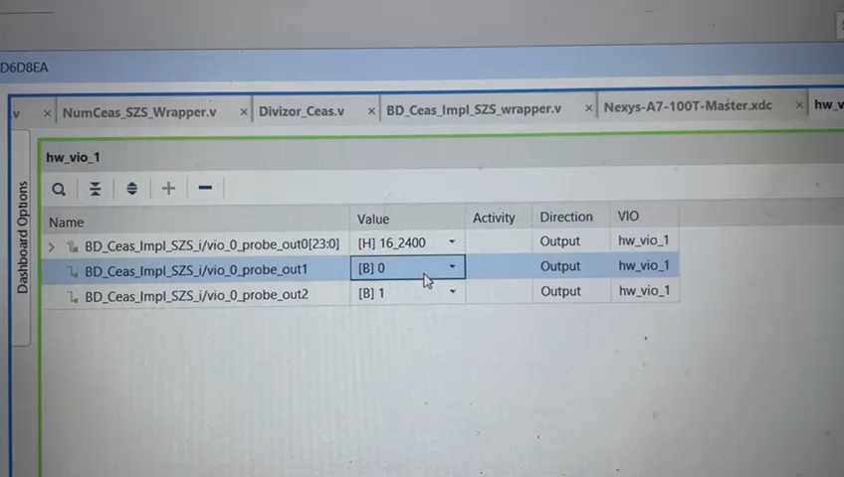
Setting the time to the current time using VIO (the DIN_SZS and Load signals)

Slide 18
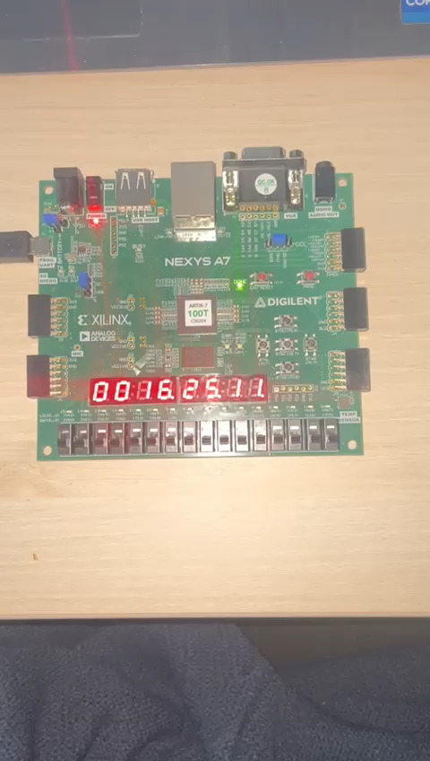
Adjusting (resetting) the seconds (from both SW[1] and SW[0])

Slide 19
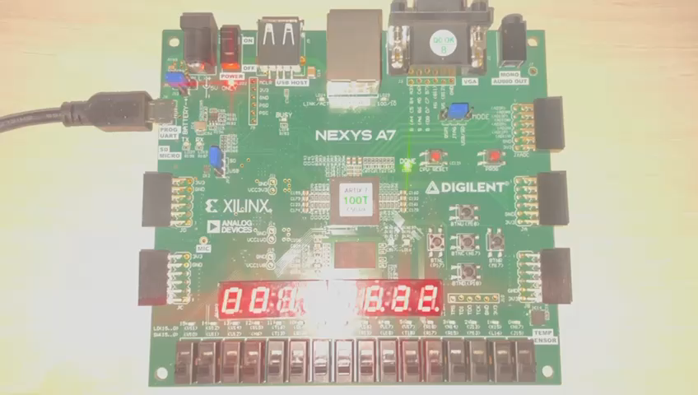
Adjusting the minutes (from BTNU and BTND)

Slide 20
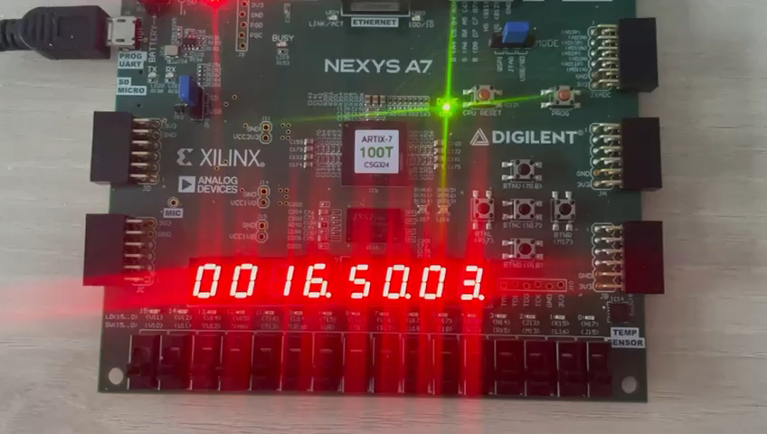
Adjustment of hours (from BTNR and BTNL)

Slide 21
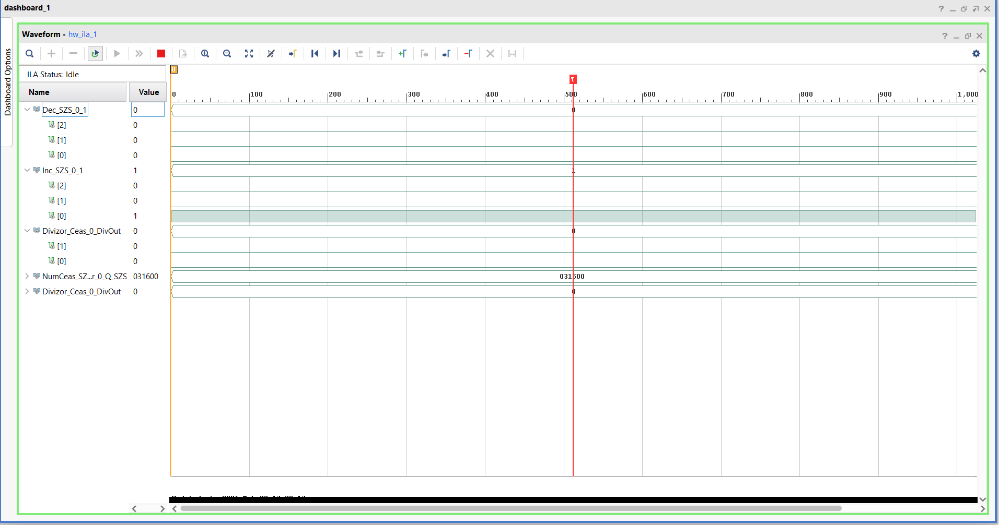
Increment buttons – ILA screenshot

Slide 22
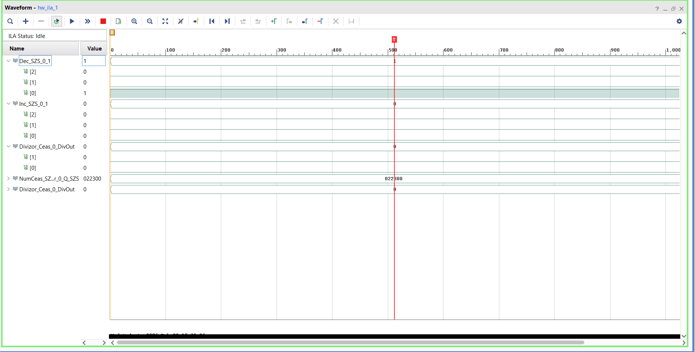
Decrement buttons – ILA screenshot

Slide 23
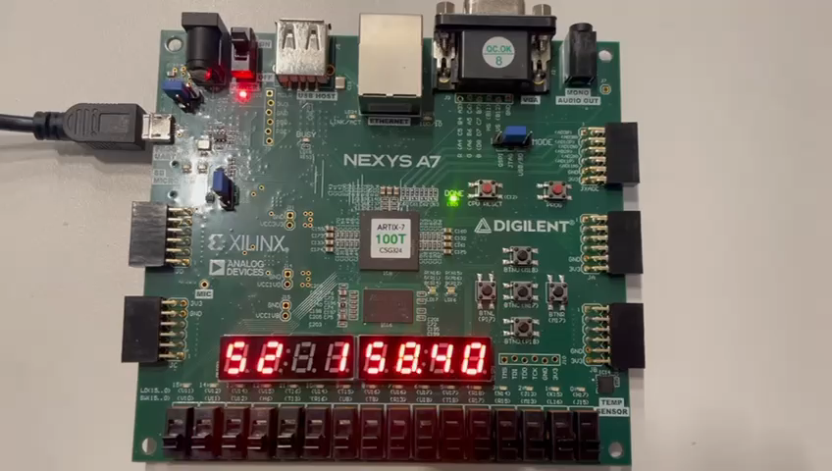
Demonstration that, after inserting the debouncers, the hours and minutes can be incremented or decremented

