Slide 1
Drone-based precision agriculture system
An embedded flight controller built from low-level principles, with real-time attitude estimation — developed for precision-agriculture applications.
Thesis supervisor:
S.l.dr.ing. Călin FĂRCAȘ
Student:
Zsolt Sántha
Faculty of Electronics, Telecommunications and Information Technology
Technical University of Cluj-Napoca
Notes:
Good morning. My thesis is the design and implementation of a quadcopter whose flight-control firmware I built entirely from low-level embedded principles, rather than using a ready-made controller. I'll cover the motivation, the system, how I built and tested the control, and where it goes next.

Slide 2
WHY THIS MATTERS
Feeding more people, under more pressure
~10 bn
+70%
4+
world population by 2050
more food to be produced
climate stressors on yield*
*drought · hail · strong winds · waterlogging
Precision agriculture answers this with data.
Drones are a key instrument — they combine mobility, remote sensing and automation on a single platform, monitoring crop health, mapping fields and targeting inputs where they are needed.
Sántha Zsolt · Quadcopter flight-control system
2
Notes:
The core problem: we must grow much more food while climate stress makes yields less predictable. Precision agriculture tackles this with data, and drones are one of the most versatile tools — mobility, sensing and automation in one platform. That is the application that motivated the build.

Slide 3
OBJECTIVE & CONTRIBUTION
Build the flight controller — not just fly a drone
Goal: design and construct a quadcopter from its fundamental components, with a flight-control system developed in full from low-level embedded-systems principles rather than a pre-configured commercial controller.
In scope
Beyond this work (future)
Airframe & propulsion assembly
Autonomous GPS navigation
Sensor integration (SPI + DMA)
Barometric altitude hold
Real-time attitude estimation
Obstacle avoidance
Closed-loop PID stabilisation
On-board mission payloads
Decoding the RC radio link
Field mapping & crop analytics
Sántha Zsolt · Quadcopter flight-control system
3
Notes:
The contribution is the firmware. The goal was to build the aircraft from components and write the whole control stack myself. On the left is what the thesis delivers; on the right is what I deliberately left for future work, so the scope is clear from the outset.

Slide 4
THE BUILD
Hardware at a glance
Airframe
Motors
ESCs
DJI F450
2212 · 920 KV
30 A · BEC 5 V
450 mm · glass-fibre arms
brushless DC, ×4
PWM speed control, ×4
Battery
IMU
Controller
3S LiPo · 11.1 V
ICM-20948
STM32F411 (Black Pill)
≈ 66 A delivery
9-axis · SPI
Cortex-M4 · 100 MHz · FPU
Sántha Zsolt · Quadcopter flight-control system
5
Notes:
The components. Four 2212 motors on 30-amp ESCs give about 3.2 kg of thrust against a 1.0–1.3 kg aircraft — enough margin for stable flight. The two parts that matter most for the firmware are the ICM-20948 IMU and the STM32F411 controller.

Slide 5
SYSTEM OVERVIEW
How the pieces fit together
ICM-20948 IMU
SPI + DMA
gyro · accel · mag
4 × ESC
30 A each
PWM
FlySky receiver
STM32F411
6-ch radio · IBUS
Flight controller
4 × BLDC motor
3S LiPo
2212 · 920 KV
11.1 V power
Sántha Zsolt · Quadcopter flight-control system
4
Notes:
At a glance: the STM32 reads the IMU over SPI with DMA and the radio receiver over IBUS, runs the estimation and control loops, and drives the four motors through the ESCs with PWM. The LiPo powers the stack. Everything after this slide zooms into one of these blocks.

Slide 6
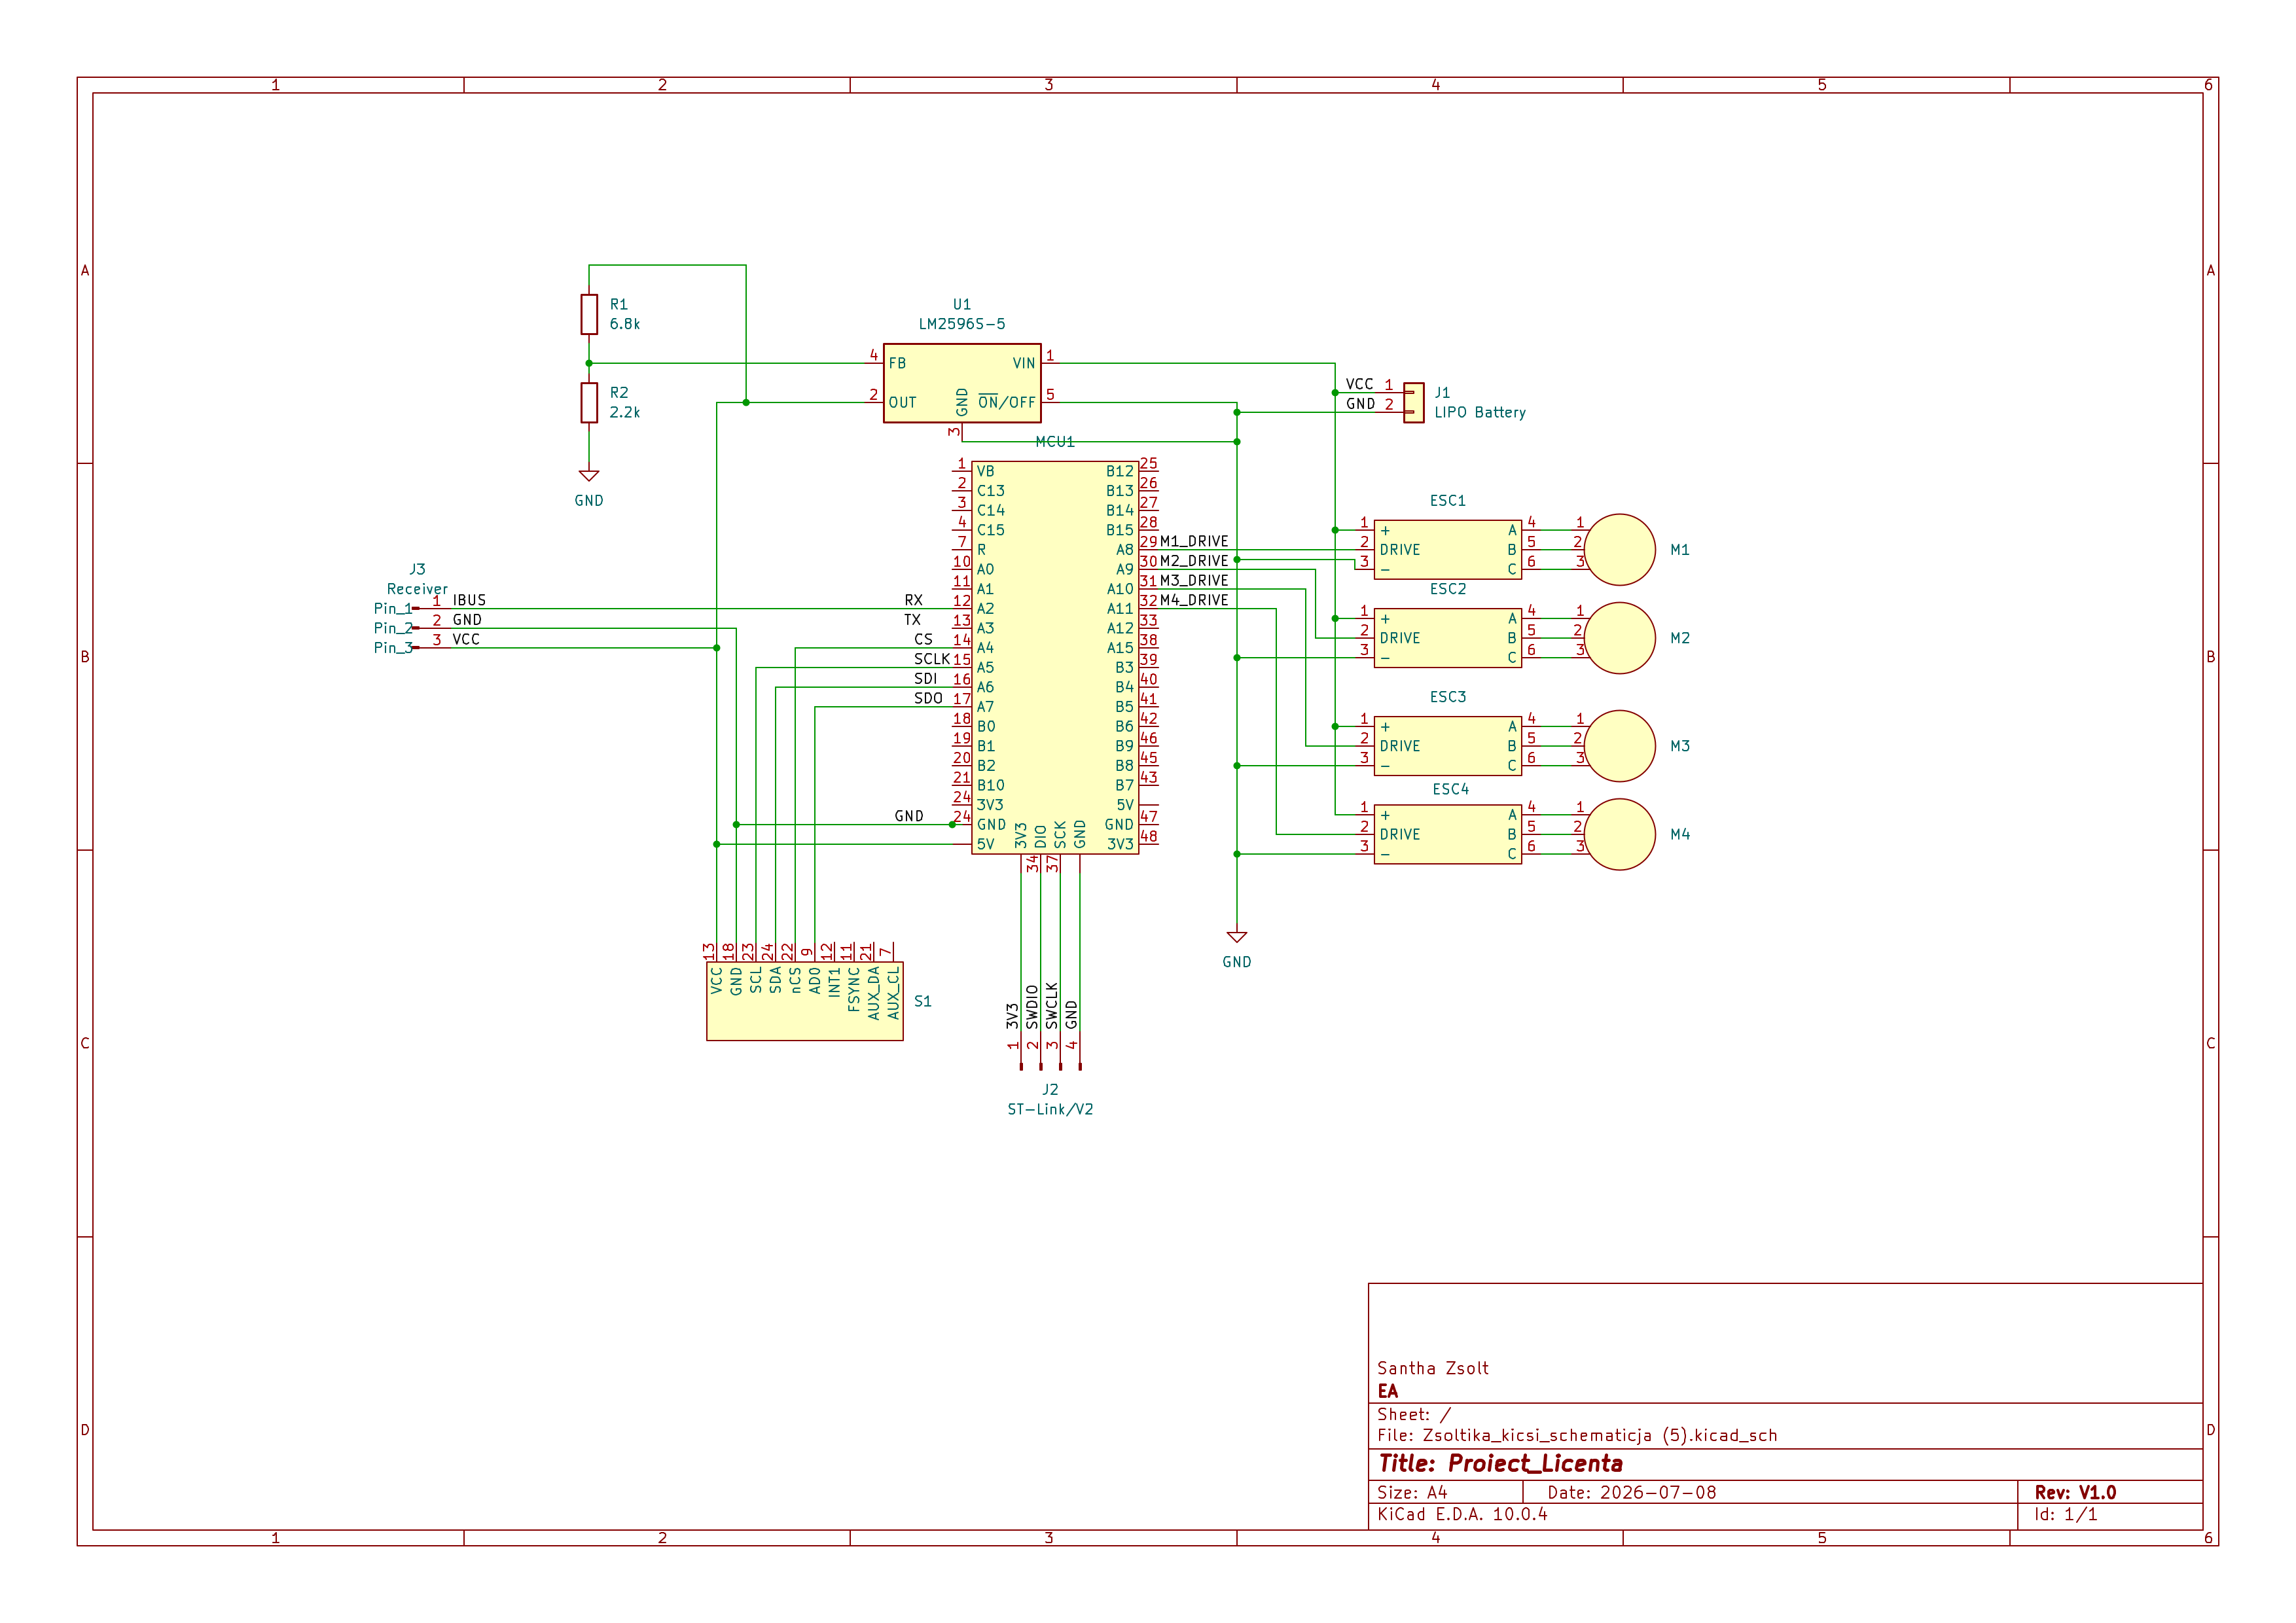
SYSTEM OVERVIEW
Schematic

Slide 7
BACKUP
Microcontroller comparison
Arduino Uno
STM32F103C8
STM32F411CE
Architecture
AVR 8-bit
Cortex-M3
Cortex-M4
Clock
16 MHz
72 MHz
100 MHz
FPU
none
none
single-precision HW
Flash / RAM
32 KB / 2 KB
64 KB / 20 KB
512 KB / 128 KB
SPI / UART / timers
few
several
many
Fit for flight control
poor
adequate
strong
Sántha Zsolt · Quadcopter flight-control system
B2

Slide 8
GETTING DATA IN
Reading the IMU: SPI with DMA
ICM-20948
SPI bus
DMA
RAM
9-axis sensor
up to 7 MHz
autonomous copy
Why DMA matters
Frees the CPU
Deterministic timing
Head-room for control
the processor never waits on byte-by-byte transfers
samples arrive on a fixed 100 Hz cadence
more cycles left for estimation and PID
Sántha Zsolt · Quadcopter flight-control system
7
Notes:
The IMU is read over SPI. Rather than have the CPU shift every byte, I used DMA, which copies the sensor data into memory on its own. That keeps timing deterministic at 100 Hz and leaves the processor free for the estimation and control maths. The magnetometer sits behind an internal I2C-master interface, which I configure through the same chip.

Slide 9
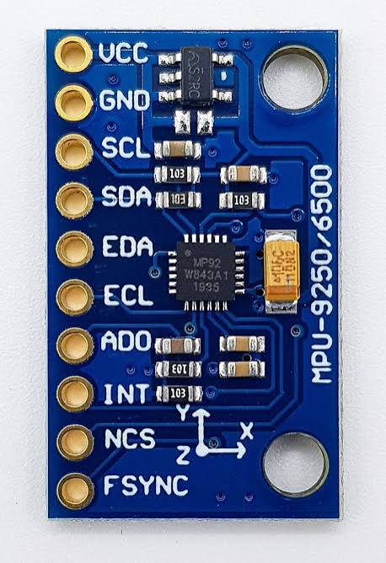
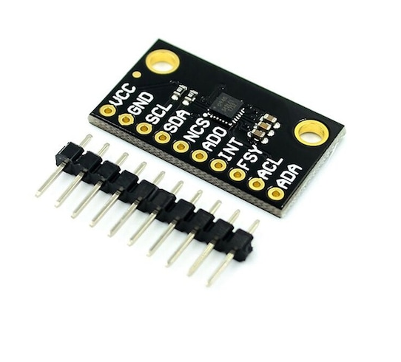
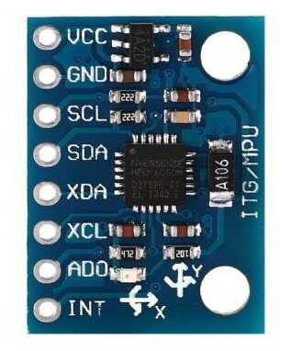
The right IMU
MPU6050
MPU9250
ICM20948
6-axis device
without magnetometer, yaw drifts without bound
9-axis device
InvenSense discontinued -> hard to source reliably
9-axis device
Low power, newer generation
Large accuracy

Slide 10
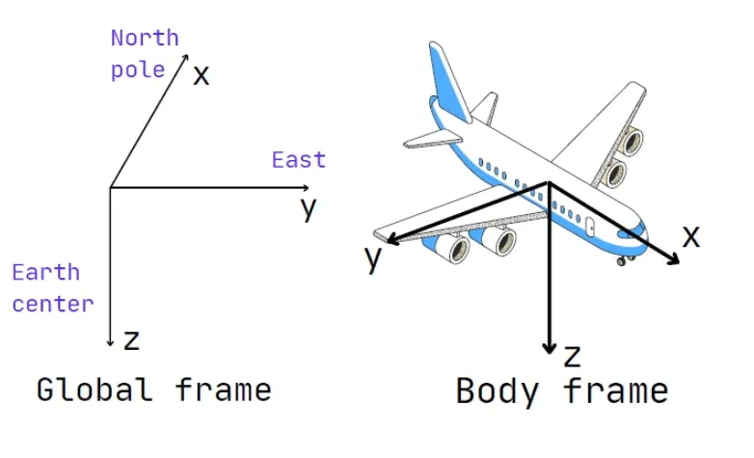
ATTITUDE ESTIMATION — THE PROBLEM
No single sensor is enough
Two frames of reference
Each sensor is flawed alone
The world frame is fixed to the Earth; the body frame moves with the aircraft as it rolls, pitches and yaws. Control needs the rotation that relates the two — the drone's orientation.
Gyroscope
fast and smooth — but drifts over time
Accelerometer
absolute tilt — but noisy under vibration
Magnetometer
gives heading (yaw) — but sensitive to interference
roll · pitch · yaw
The accelerometer alone cannot recover yaw — hence the magnetometer.
Sántha Zsolt · Quadcopter flight-control system
8
Notes:
Control needs orientation — the rotation between the Earth frame and the aircraft frame. No single sensor gives it cleanly: the gyroscope is smooth but drifts, the accelerometer gives absolute tilt but is noisy, and the magnetometer supplies heading but picks up interference. The accelerometer can't recover yaw at all, which is why the magnetometer is there.

Slide 11
ATTITUDE ESTIMATION — THE SOLUTION
Complementary filter + quaternions
Gyroscope
Why quaternions?
high-freq path
Complementary
filter
Orientation
Euler angles hit a singularity — gimbal lock — at ±90° pitch. Quaternions represent any orientation continuously, with no singularities and stable maths.
quaternion
Accel + Mag
low-freq path
θ = α·(θ + gyro·dt) + (1−α)·θ(accel, mag)
The gyro sets the fast response; the accelerometer and magnetometer correct its slow drift. α weights the two.
Sántha Zsolt · Quadcopter flight-control system
9
Notes:
The fix is sensor fusion with a complementary filter: trust the gyroscope for fast motion, and use the accelerometer and magnetometer to correct its slow drift — one weighting parameter, alpha, blends them. Orientation is stored as a quaternion rather than Euler angles, because Euler angles suffer gimbal lock at ninety degrees of pitch; quaternions avoid that entirely and are numerically stable.

Slide 12
CLOSING THE LOOP
PID stabilisation & RC input
Setpoint
−
PID
Motors
Drone
pilot / hold
P · I · D
ESC → BLDC
actual attitude
estimated attitude (feedback)
P
reacts to present error → response speed
I
removes steady-state error
D
damps overshoot & oscillation
RC input · IBUS
All channels on one UART wire; each packet checksum-verified, so corrupt frames are rejected.
Sántha Zsolt · Quadcopter flight-control system
10
Notes:
Stabilisation is a closed PID loop: it compares the desired attitude with the estimated attitude and corrects continuously. P sets response speed, I removes steady-state error, D damps oscillation. Pilot commands come in over IBUS — all channels on one wire, each packet checksummed so corrupted frames are dropped.

Slide 13
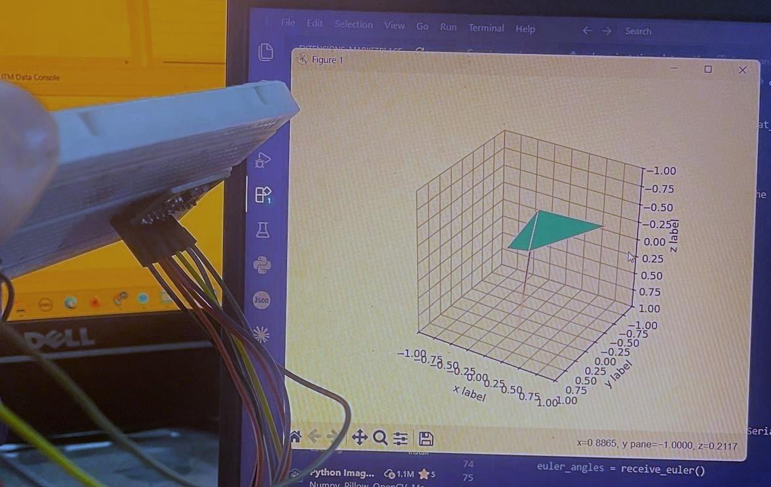
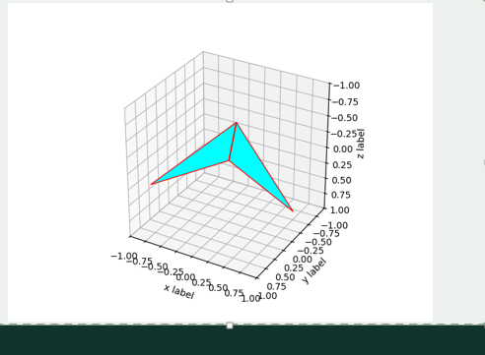
RESULTS
It estimates orientation in real time
Estimated attitude, rendered at 100 Hz (USART2).
The board is tilted by hand — the on-screen model tracks it live.
A custom Python tool renders the estimate live — my main diagnostic for verifying axis alignment, filter stability and data integrity.
Sántha Zsolt · Quadcopter flight-control system
11
Notes:
For validation I wrote a Python tool that receives the Euler angles over serial at 100 Hz and draws the aircraft's orientation live. On the left you can see the actual test — as I tilt the board by hand, the on-screen model tracks it in real time. This was my main diagnostic: it let me confirm the axes were mapped correctly, the filter was stable, and the data link was intact.

Slide 14
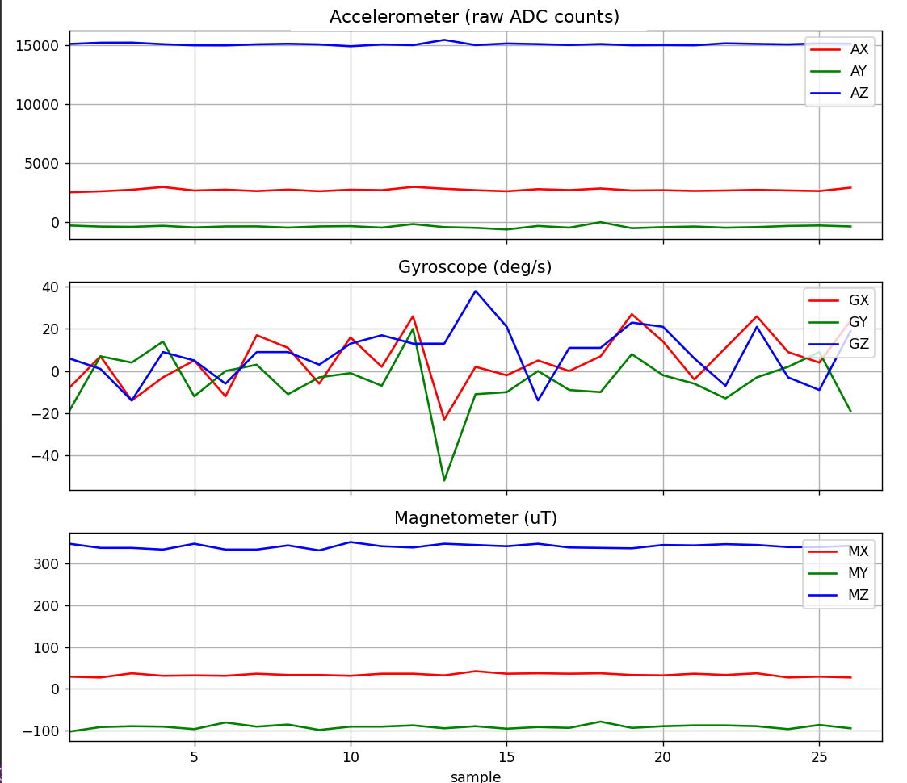
HONEST ASSESSMENT
What I found — and current limits
What the static test shows
Accelerometer — a small offset/bias on the resting axes
Gyroscope — sits near zero — as expected at rest
Magnetometer — a large hard-iron offset → needs calibration
Current limitations
No altitude hold — throttle is manual (no barometer)
No GPS — no autonomous navigation or position hold
Filter sensitive to sustained linear acceleration
Flight endurance bounded by battery capacity
Static test — raw, uncalibrated register values.
No obstacle avoidance yet
Sántha Zsolt · Quadcopter flight-control system
12
Notes:
Being candid earns credibility. This is the raw static-test data straight off the sensor. The accelerometer shows a small offset I calibrate out; the gyroscope sits near zero, as it should at rest; and the magnetometer shows a clear hard-iron offset from nearby metal, which biases yaw until it's calibrated. Note the accelerometer trace is in raw ADC counts, not g. The system limitations — no altitude hold or GPS yet, and the filter's sensitivity to sustained acceleration — map directly onto my future work.

Slide 15
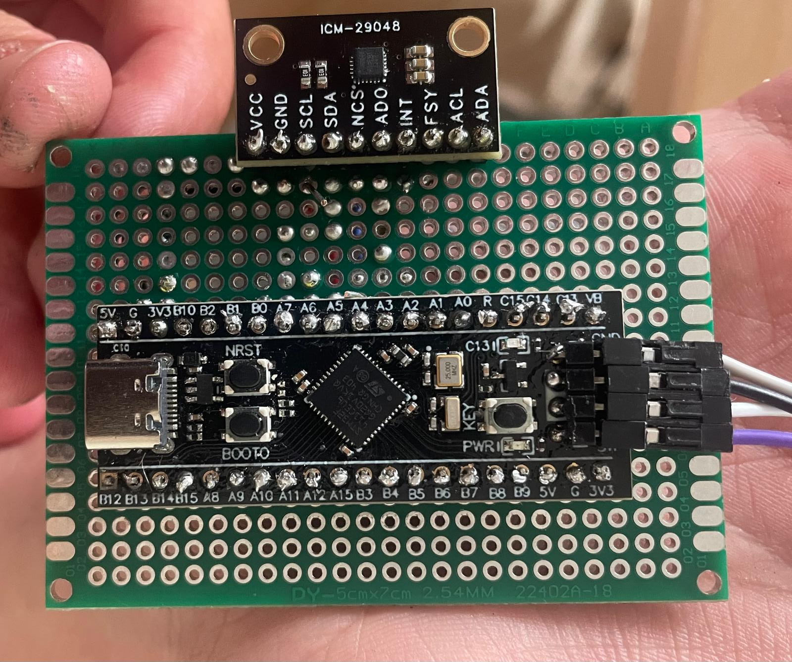
FROM BREADBOARD TO FLIGHT-READY
A consolidated, soldered avionics board
1
Mechanically robust
survives vibration far better than jumper wires
2
Compact & integrated
+
all flight-critical electronics on one board
Drop in: soldered flight-control board
(Black Pill + IMU on a single compact board)
3
Serviceable
USB-C stays accessible for flashing & debug
4
Flight-ready
mounts cleanly onto the F450 airframe
Sántha Zsolt · Quadcopter flight-control system
13
Notes:
Finally I moved the circuit off the breadboard onto a soldered board. That makes it mechanically robust under vibration, compact, and flight-ready on the F450, while keeping the USB-C port accessible for reprogramming. [Drop your board photo into the slot.]

Slide 16
CONCLUSION & FUTURE WORK
A working foundation — and a clear road ahead
Delivered: a quadcopter with a custom STM32 flight controller — SPI+DMA sensing, complementary-filter attitude estimation with quaternions, and closed-loop PID stabilisation.
Near term
Long term
Barometric altitude hold
Raspberry Pi + camera companion computer
GPS module → position hold
Georeferenced field mapping
PCB design
Return-to-home safety feature
Crop-health analysis (vegetation indices)
→ a manually piloted craft becomes semi-autonomous
→ a flight experiment becomes a precision-agriculture tool
Sántha Zsolt · Quadcopter flight-control system
14
Notes:
To conclude: the thesis delivers a working quadcopter with a fully custom control stack. The near-term road adds a barometer and GPS with return-to-home, taking it from manual to semi-autonomous. The longer-term vision adds a Raspberry Pi and camera for field mapping and crop-health analysis — turning the flight experiment into a genuine precision-agriculture tool. Thank you.

Slide 17
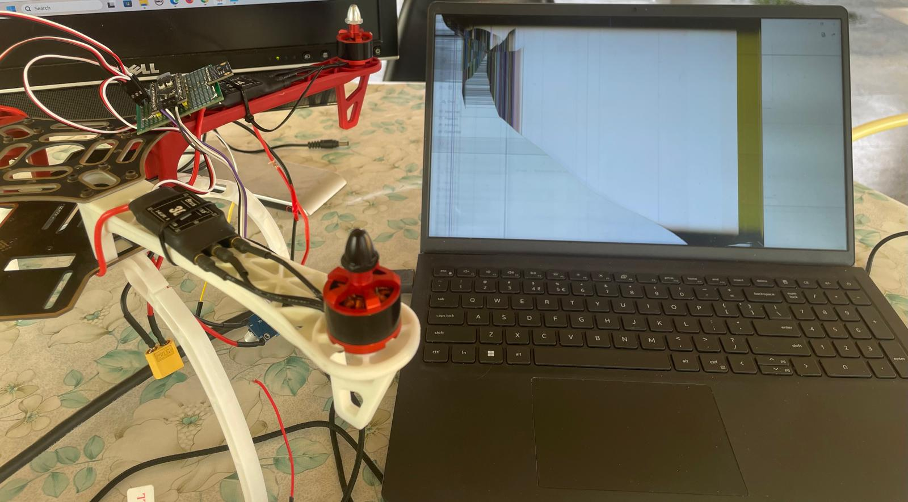
One Mistake I'll Never Make Again

Slide 18
Thank you!
Questions & discussion
Notes:
Thank you — I'm happy to take questions.

Slide 19
BACKUP
Supporting material for Q&A
Detail slides held in reserve — quaternion maths, full MCU comparison, magnetometer calibration, and the thrust budget.

Slide 20
DESIGN DECISION
Choosing the microcontroller
Arduino Uno
STM32F103
STM32F411
Core
8-bit · 16 MHz
Cortex-M3 · 72 MHz
Cortex-M4 · 100 MHz
Floating point
software
software
hardware FPU
Peripherals
limited
good
rich (SPI/UART/timers)
Real-time control
weak
adequate
strong
Selected — the hardware FPU and timer peripherals make the control and sensor-fusion loops run comfortably in real time.
Sántha Zsolt · Quadcopter flight-control system
6
Notes:
I compared three boards. The F411 won because of the hardware floating-point unit and the rich timer and SPI peripherals — the quaternion maths and the control loop need floating point at 100 Hz, and software floating point on the others would have been tight.

Slide 21
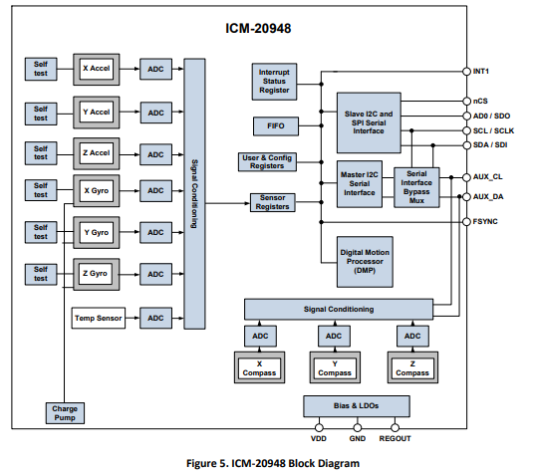
Block Diagram

Slide 22
BACKUP
Euler angles vs. quaternions
Gimbal lock
Quaternion form
At ±90° pitch two rotation axes align and a degree of freedom is lost. Near this point Euler-angle rates blow up, making the estimate unstable exactly where a drone may operate.
q = w + xi + yj + zk , |q| = 1
A unit quaternion encodes any 3-D rotation with four numbers — no singularities, smooth interpolation, and cheap normalisation each step to stay valid.
Sántha Zsolt · Quadcopter flight-control system
B1

Slide 23
BACKUP
Magnetometer: hard-iron calibration
Raw readings
Estimate bias
Subtract & scale
offset sphere
centre offset
centred data
Idea
Ferromagnetic material near the sensor shifts the field measurements off-centre. Rotating the sensor through all orientations traces a sphere; its displacement from the origin is the hard-iron bias, which is subtracted so heading (yaw) reads true.
Sántha Zsolt · Quadcopter flight-control system
B3

Slide 24
BACKUP
Thrust-to-weight budget
Per-motor thrust
800–900 g
10×4.5 prop, 3S
Total thrust (×4)
≈ 3.2 kg
Aircraft mass
1.0–1.3 kg
Thrust-to-weight
≈ 2.5 : 1
comfortable for stable flight
Sántha Zsolt · Quadcopter flight-control system
B4

