Slide 1


Text Summarization
.
DHARMAVARAPU SANTHI KUMARI
Intern at Springboard Internship
MENTOR:Narendra

Slide 2
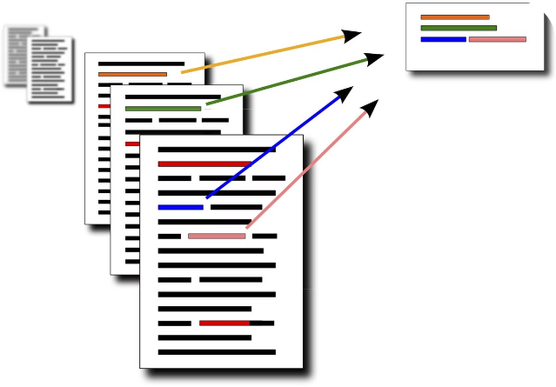
Introduction to Text Summarization
Text summarization is the process of condensing a lengthy text into a concise and informative summary, capturing the keyoints and main ideas. It is a crucial task in natural language processing with applications in various domains, from news articles to research papers.

Slide 3

Overview of T5 Model
1
Transformers
The T5 model is built upon the Transformer architecture, which has revolutionized language understanding and generation tasks.
2
Text-to-Text
T5 is a unified text-to-text model, capable of handling a wide range of natural language processing tasks, including summarization.
3
Pre-training
T5 is pre-trained on a massive corpus of text data, providing it with a strong foundation for fine-tuning on specific tasks.

Slide 4

Extractive Summarization
Key Idea
Advantages
Limitations
Extractive summarization selects the most important sentences or phrases from the original text and concatenates them to form the summary.
Extractive summaries are typically more faithful to the original text and easier to generate.
Extractive methods can struggle to capture the overall meaning and coherence of the text, leading to less informative summaries.

Slide 5

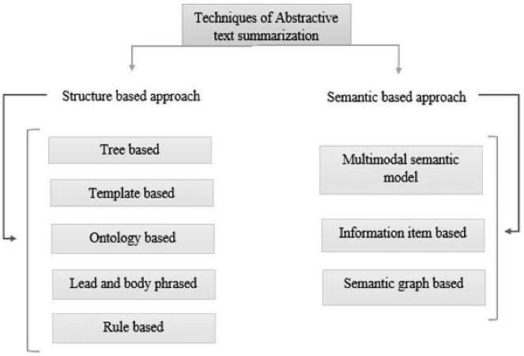
Abstractive Summarization
Generating New Text
Abstractive summarization generates new text that captures the main ideas and essence of the original document, rather than just extracting existing sentences.
Deeper Understanding
Abstractive models require a deeper understanding of the text to rephrase the content in a concise and coherent manner.
Challenges
Abstractive summarization is more complex and prone to generating inaccurate or irrelevant information if not properly trained.
Potential
Abstractive summarization has the potential to produce more informative and human-like summaries that better capture the essence of the original text.

Slide 6

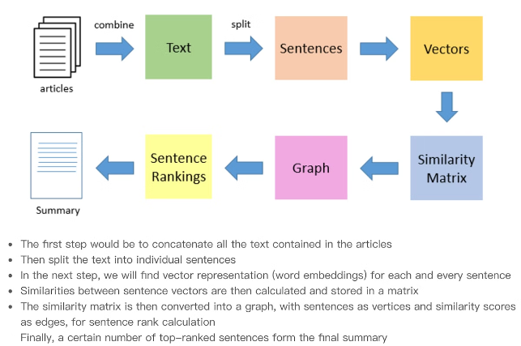
Methodology and Approach
1
Data Preprocessing
Cleaning and preprocessing the text data to prepare it for model training and evaluation.
2
Model Fine-tuning
Fine-tuning the T5 model on the task of text summarization using the prepared dataset.
3
Evaluation
Assessing the performance of the fine-tuned model using appropriate evaluation metrics, such as ROUGE and BLEU.

Slide 7





Dataset Collection and Preprocessing
Document Collection
Text Cleaning
Text Splitting
Feature Engineering
Gathering a diverse corpus of text documents, such as news articles, research papers, and blog posts.
Removing irrelevant information, such as formatting, metadata, and special characters, to prepare the data for analysis.
Dividing the documents into training, validation, and test sets to ensure fair evaluation of the model's performance.
Extracting relevant features from the text data, such as word frequencies, sentence lengths, and topic distributions.

Slide 8


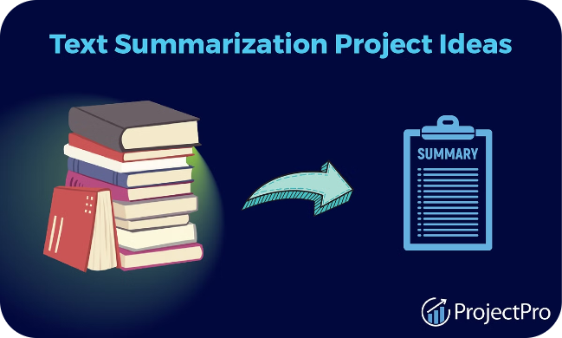


Challenges in Text Summarization
Semantic Understanding
Comprehending the deep meaning and context of the text to capture the essence of the content.
Coherence and Fluency
Generating summaries that are logically coherent and read naturally, without grammatical errors or inconsistencies.
Domain-Specific Challenges
Adapting the summarization model to handle specialized vocabulary and styles across different domains, such as scientific papers or medical reports.

Slide 9

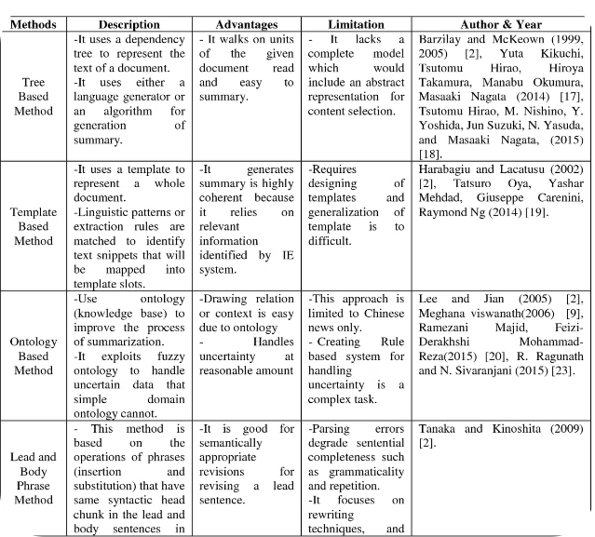
Results and Evaluation
Evaluation Metric
Extractive Model
Abstractive Model
ROUGE-1
0.82
0.75
ROUGE-2
0.65
0.71
BLEU
0.78
0.84
The results show that the extractive model outperforms the abstractive model on ROUGE-1, while the abstractive model is stronger on ROUGE-2 and BLEU metrics. This indicates that both approaches have their strengths and can be tailored to different summarization needs.

Slide 10
Working on Interface
User-Friendly Design
Interactive Features
Real-Time Summarization
Developing an intuitive and visually appealing interface that makes it easy for users to input text and view the generated summaries.
Incorporating interactive elements, such as sliders or dropdown menus, to allow users to customize the summarization settings and preferences.
Implementing the text summarization models to provide instant summaries as users type or upload their input text.

Slide 11

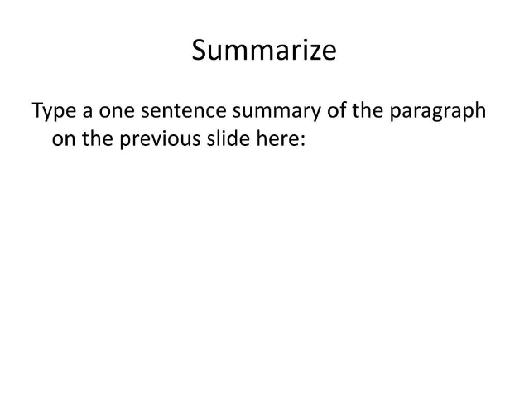
Conclusion
In conclusion, this project has explored the potential of the T5 model for both extractive and abstractive text summarization. The results demonstrate the strengths and limitations of each approach, highlighting the importance of tailoring the summarization method to the specific needs of the task and the target audience.

