Slide 1

Maze Project
Prepared For: Prepared By:
Mr. Henry Chaung
Algorithms & Structured Programming CS455 Ms. Nagalla, Santhi Sree ID:19568
Spring 2021
Northwestern Polytechnic University

Slide 2

Agenda
Introduction
Maze-solving algorithms
Shortest path algorithm
Graph Theory
Dijkstra’s Algorithm
Find the shortest path
Find the minimum distance
References

Slide 3
Introduction
Maze solving is the act of finding a route through the maze from the start to finish. Some maze solving methods are designed to be used inside the maze by a traveler with no prior knowledge of the maze, whereas others are designed to be used by a person or computer program that can see the whole maze at once.

Slide 4
Maze-solving algorithm
There are a number of different maze-solving algorithms, that is, automated methods for the solving of mazes.
Wall follower
Random mouse algorithm
Pledge algorithm
Trémaux's algorithm
Dead-end filling

Slide 5
Maze-solving algorithm - Continues
Maze-routing algorithm
Recursive algorithm
Shortest path algorithm
Mazes containing no loops are known as "simply connected", or "perfect" mazes, and are equivalent to a tree in graph theory. Thus many maze-solving algorithms are closely related to graph theory.

Slide 6
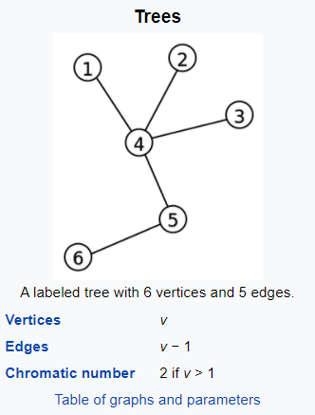
What is a Graph Theory?
In graph theory, a tree is an undirected graph in which any two vertices are connected by exactly one path, or equivalently a connected acyclic undirected graph. A forest is an undirected graph in which any two vertices are connected by at most one path, or equivalently an acyclic undirected graph, or equivalently a disjoint union of trees.

Slide 7
Shortest path algorithm
When a maze has multiple solutions, the solver may want to find the shortest path from start to finish. One such algorithm finds the shortest path by implementing a breadth-first search, while another, the A* algorithm, uses a heuristic technique. The breadth-first search algorithm uses a queue to visit cells in increasing distance order from the start until the finish is reached.

Slide 8
Dijkstra’s Algorithm
One algorithm for finding the shortest path from a starting node to a target node in a weighted graph is Dijkstra's algorithm.The algorithm creates a tree of shortest paths from the starting vertex, the source, to all other points in the graph.Each visited cell needs to keep track of its distance from the start or which adjacent cell nearer to the start caused it to be added to the queue. When the finish location is found, follow the path of cells backwards to the start, which is the shortest path. The breadth-first search in its simplest form has its limitations, like finding the shortest path in weighted graphs.

Slide 9
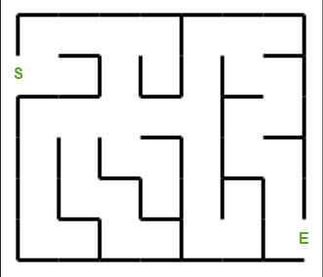
Steps to follow Shortest-Path
Initialize distances according to the
algorithm.
Pick first node and calculate distances
to adjacent nodes.
Pick next node with minimal distance
repeat adjacent node distance calculations.
Final result of shortest-path tree.

Slide 10
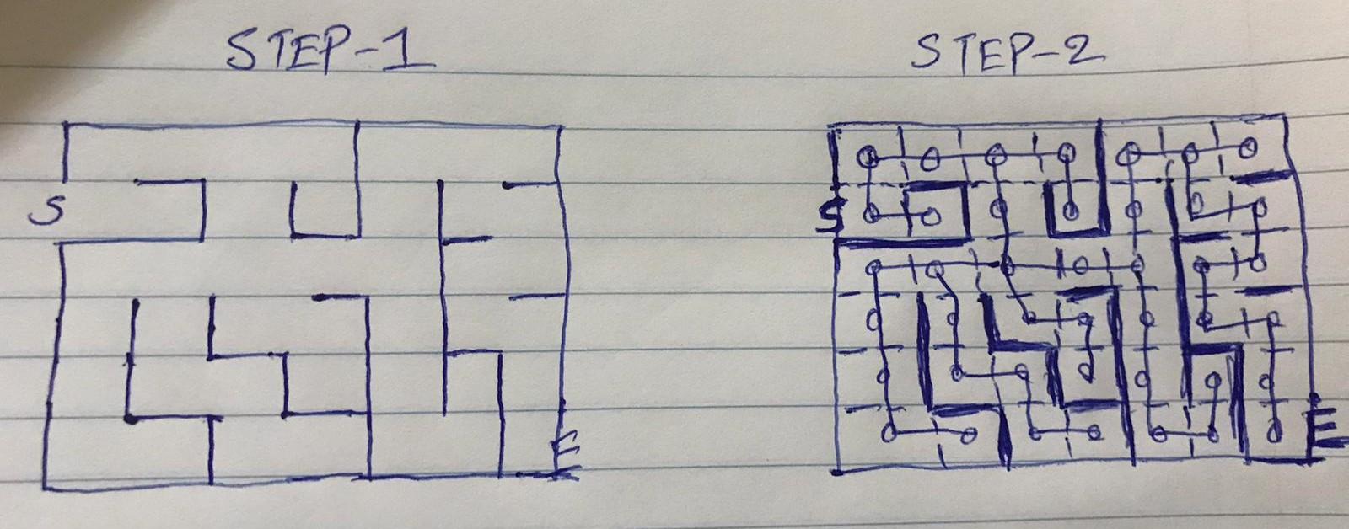
Dijkstra’s Algorithm to find the shortest path
Step 1: Initialize distances according to the algorithm.

Slide 11
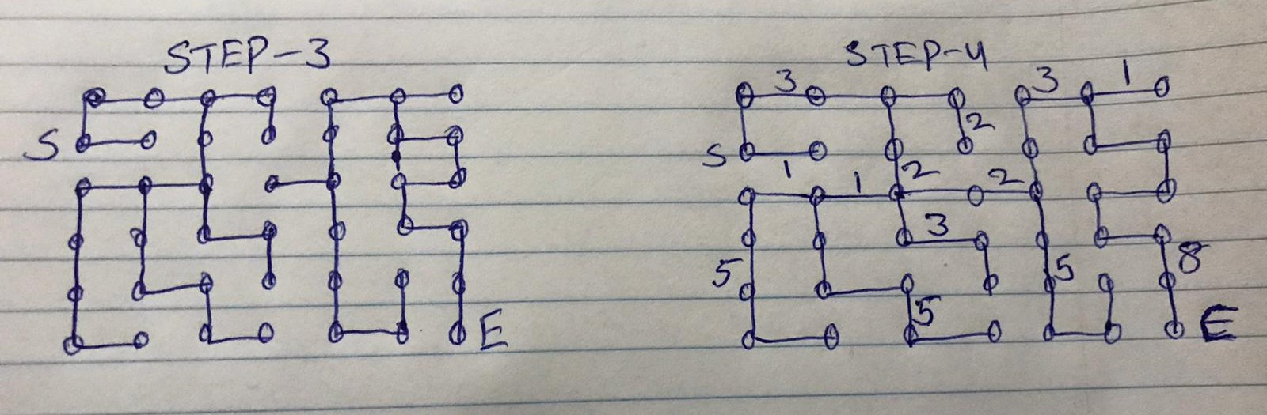
Dijkstra’s Algorithm to find the shortest path
Step 2: Pick first node and calculate distances to adjacent nodes.
Step 3: Pick next node with minimal distance repeat adjacent node distance calculations.

Slide 12
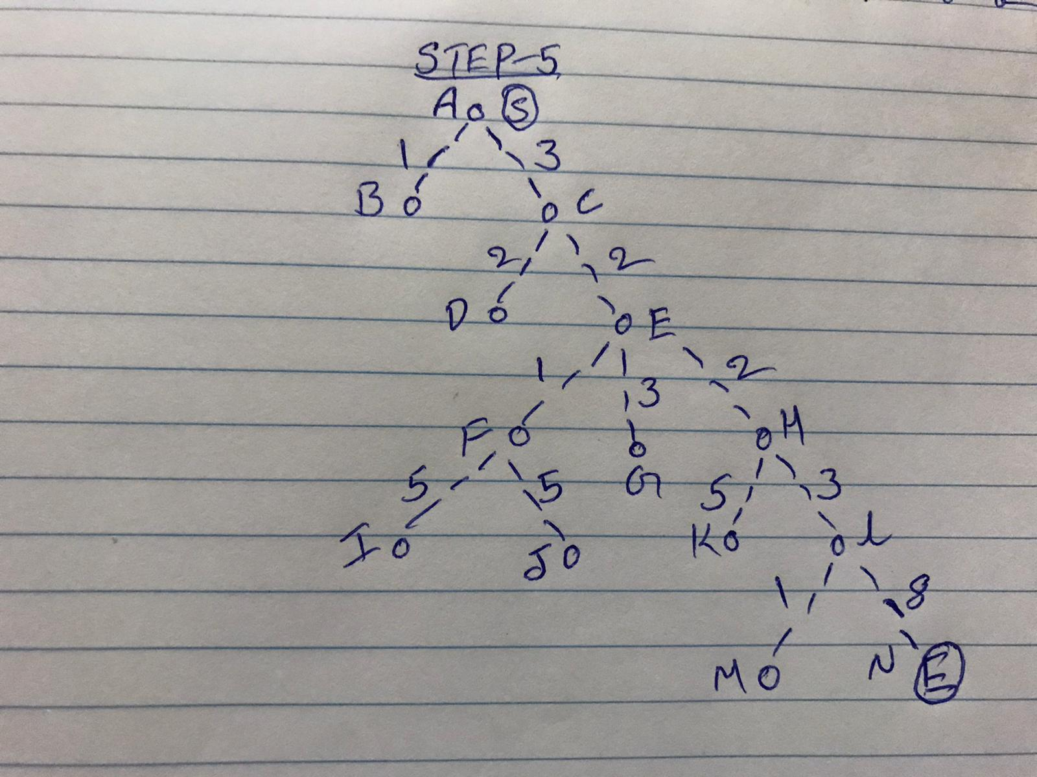
Tree
A tree is an undirected graph in which any two vertices are connected by exactly one path, or equivalently a connected acyclic undirected graph

Slide 13
Find the Path using Tree
This path is determined based on predecessor information.

Slide 14
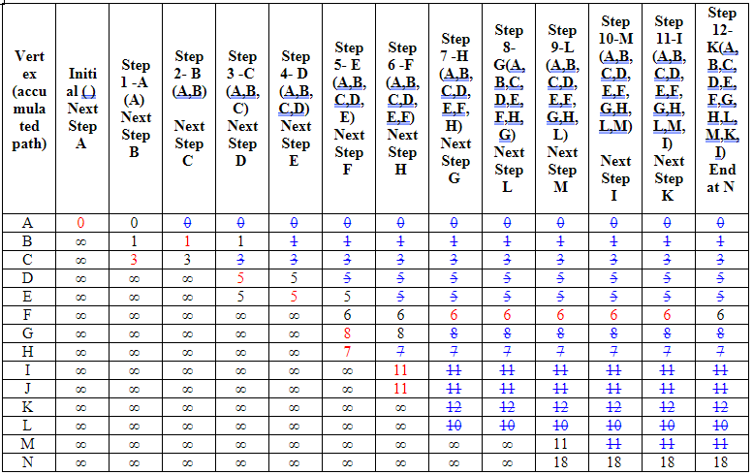
Find the minimum distance using Table

Slide 15
Steps to follow Minimum Distance
Let us consider vertex A and N as the start and destination vertex respectively.
Initially, all the vertices except the start vertex A are marked by ∞ and the start vertex A is marked by 0.
Step X - represents: the current visiting node
Next Step represents: the next node to visit
V: this node has been visited
Initial
0 is smallest cost on Initial step.
Thus, A is selected as the starting point for Step 1.

Slide 16
Steps - Continues
Step 1
A is selected as the starting point for Step 1.
From A, one can go to A or B or C
The accumulated cost on A is not changed. It is still 0.
The accumulated cost on B is 1.
The accumulated cost on C is 3.
1 is smaller than 3.
Thus, B is selected as the starting point for Step 2.
Stop if the destination node N is reached
Continue this process, you will find the minimum distance of N from A is 18. And the path is
3→ 2→ 2→ 3→ 8

Slide 17
References:
Maze
https://npu85.npu.edu/~henry/npu/classes/algorithm/graph_alg/slide/maze.html
Shortest Path
https://npu85.npu.edu/~henry/npu/classes/algorithm/tutorialpoints_daa/slide/shortest_paths.html

