Slide 1

Maze Project
Prepared For: Prepared By:
Mr. Henry Chaung
Algorithms & Structured Programming CS455 Ms. Nagalla, Santhi Sree ID:19568
Spring 2021
Northwestern Polytechnic University

Slide 2

Maze-solving algorithm
There are a number of different maze-solving algorithms, that is, automated methods for the solving of mazes.
Mazes containing no loops are known as "simply connected", or "perfect" mazes, and are equivalent to a tree in graph theory. Thus many maze-solving algorithms are closely related to graph theory.

Slide 3
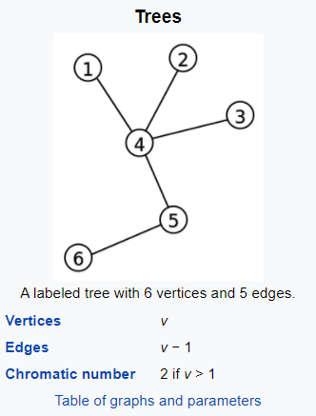
What is a Graph Theory?
In graph theory, a tree is an undirected graph in which any two vertices are connected by exactly one path, or equivalently a connected acyclic undirected graph. A forest is an undirected graph in which any two vertices are connected by at most one path, or equivalently an acyclic undirected graph, or equivalently a disjoint union of trees.

Slide 4
Dijkstra’s Algorithm
There are several algorithms to find shortest paths, most of them coming from graph theory.
One such algorithm finds the shortest path by implementing a breadth-first search, while another, the A* algorithm, uses a heuristic technique. The breadth-first search algorithm uses a queue to visit cells in increasing distance order from the start until the finish is reached. Each visited cell needs to keep track of its distance from the start or which adjacent cell nearer to the start caused it to be added to the queue. When the finish location is found, follow the path of cells backwards to the start, which is the shortest path. The breadth-first search in its simplest form has its limitations, like finding the shortest path in weighted graphs.
Mazes for Programmers implementing Dijkstra’s algorithm to solve a maze by finding the shortest path between two points using the notion of cost.

Slide 5
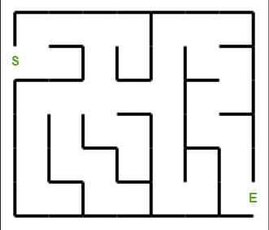
Dijkstra’s Algorithm
Determine the starting point of the grid
Record the cost of reaching that cell: 0.
Find that cell’s navigable neighbors.
For each neighbor, record the cost of reaching the neighbor: 1.
For each neighbor, repeat steps 3-5, taking care not to revisit already-visited cells.

Slide 6
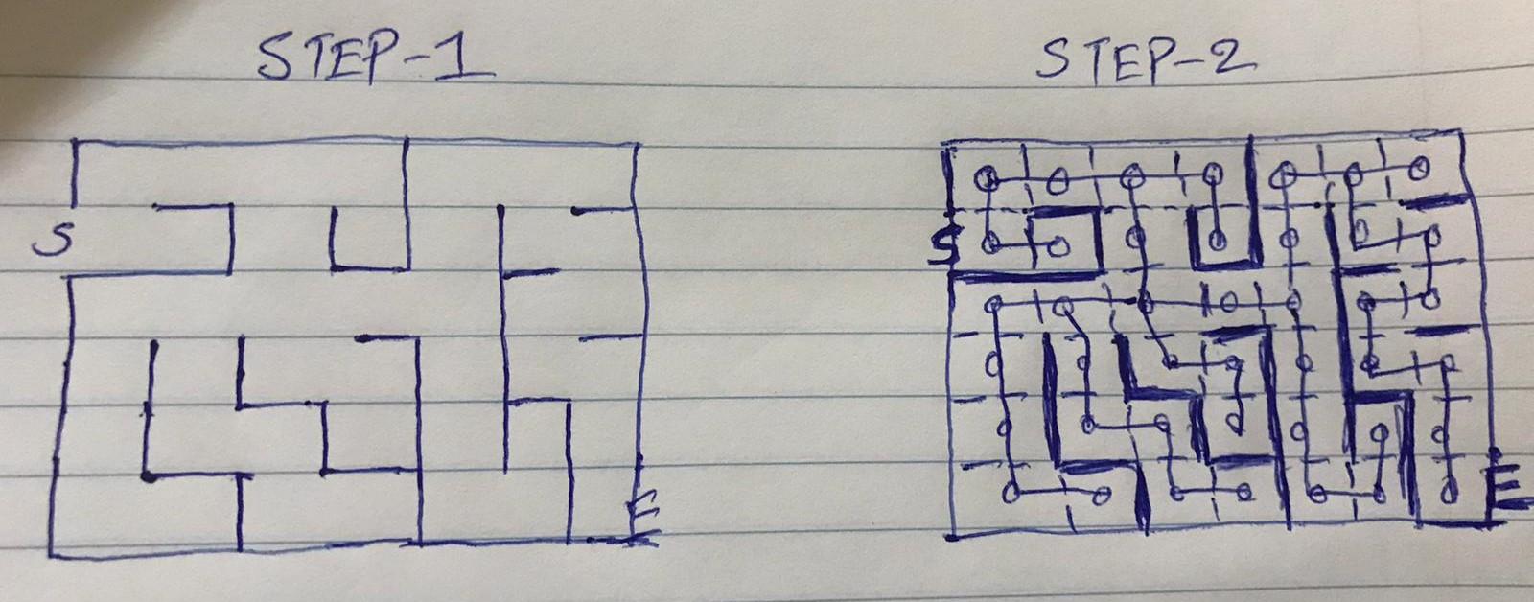
Dijkstra’s Algorithm to find the shortest path
When complete, we’ll have a record of the cost of reaching each cell iteratively from the starting point. This data tells us how far each cell is from the root, and you can imagine this being perfectly useful in its own right.

Slide 7
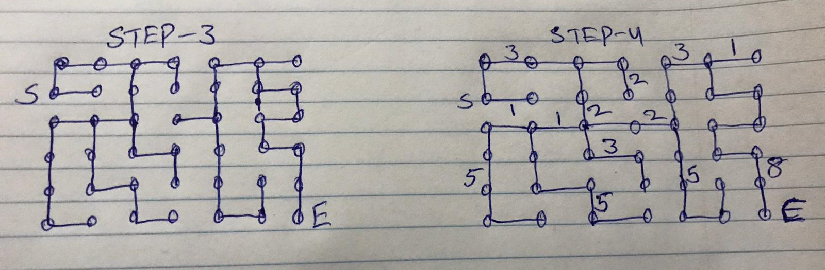
Dijkstra’s Algorithm to find the shortest path
If we now traverse that body of data with cost information in reverse, starting from the desired endpoint and stepping through cells that bear a cost less than the cost of the current cell, we’ll eventually reach the root cell via the shortest path possible.

Slide 8
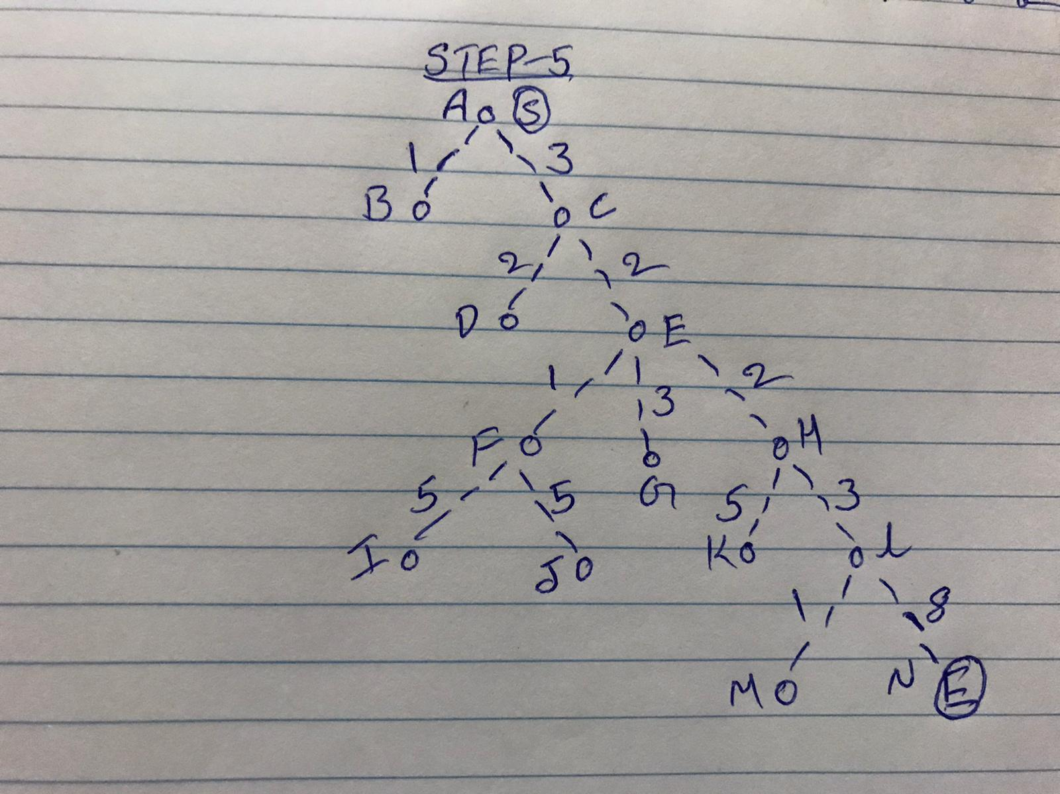
Tree
A tree is an undirected graph in which any two vertices are connected by exactly one path, or equivalently a connected acyclic undirected graph

Slide 9
Find the Path using Tree
This path is determined based on predecessor information.
Let us consider vertex A and N as the start and destination vertex respectively.
Initially, all the vertices except the start vertex A are marked by ∞ and the start vertex A is marked by 0.

Slide 10
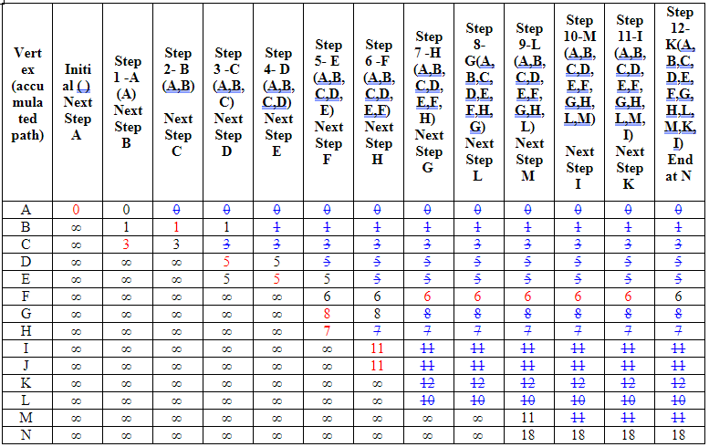
Find the minimum distance using Table

Slide 11
Steps to follow Minimum Distance
Step X - represents: the current visiting node
Next Step represents: the next node to visit
V: this node has been visited
Initial
0 is smallest cost on Initial step.
Thus, A is selected as the starting point for Step 1.

Slide 12
Steps - Continues
Step 1
A is selected as the starting point for Step 1.
From A, one can go to A or B or C
The accumulated cost on A is not changed. It is still 0.
The accumulated cost on B is 1.
The accumulated cost on C is 3.
1 is smaller than 3.
Thus, B is selected as the starting point for Step 2.
Stop if the destination node N is reached
Continue this process, you will find the minimum distance of N from A is 18. And the path is
3→ 2→ 2→ 3→ 8

Slide 13
References:
Maze
https://npu85.npu.edu/~henry/npu/classes/algorithm/graph_alg/slide/maze.html
Shortest Path
https://npu85.npu.edu/~henry/npu/classes/algorithm/tutorialpoints_daa/slide/shortest_paths.html

