Slide 1
SANTHIYA M
Final Project
3/21/2024 Annual Review

Slide 2
PROJECT TITLE
Brain Tumor Detection
3/21/2024 Annual Review

Slide 3


AGENDA
Problem Statement
Project Overview
Who are the end users?
Solutions and value of propositions
WOW factor in the solution
Modelling
Results
3/21/2024 Annual Review

Slide 4

PROBLEM STATEMENT
Brain tumors are abnormal growths of tissue within the brain or the central spinal canal. Detecting brain tumors accurately and early is crucial for effective treatment and patient outcomes. Medical imaging techniques such as magnetic resonance imaging (MRI) and computed tomography (CT) scans are commonly used for brain tumor detection. Developing an accurate and efficient system for detecting brain tumors from medical imaging data is essential for improving diagnosis and treatment planning.
3/21/2024 Annual Review

Slide 5

PROJECT OVERVIEW
The brain tumor detection project aims to develop a computer-aided detection (CAD) system to assist medical professionals in accurately identifying brain tumors from medical imaging data. The system utilizes deep learning techniques to analyze MRI images and classify them as either tumor-present or tumor-absent, providing valuable support for early diagnosis and treatment planning.
3/21/2024 Annual Review

Slide 6

WHO ARE THE END USERS?
The primary end users of the brain tumor detection system include:
Radiologists and medical professionals who interpret MRI scans and diagnose brain tumors.
Healthcare facilities and hospitals where MRI imaging is performed.
Patients who benefit from early detection and treatment of brain tumors, leading to improved prognosis and outcomes.
3/21/2024 Annual Review

Slide 7

YOUR SOLUTION AND ITS VALUE PROPOSITION
Our solution employs a deep learning model trained on a dataset of labeled brain MRI images. The model is designed to accurately classify brain images as tumor-present or tumor-absent, enabling quick and reliable detection of brain tumors. Key components of our solution include,Resizing and normalization of MRI images to ensure consistency and compatibility with the model.Utilization of a CNN-based model for feature extraction and classification of brain images.
Training the model on a dataset of labeled brain MRI images, using techniques such as data augmentation to enhance model generalization.Assessment of model performance using metrics such as accuracy, precision, recall, and F1 score to ensure reliable detection of brain tumors.Integration of the trained model into a user-friendly interface for seamless interaction with medical professionals.
3/21/2024 Annual Review

Slide 8

THE WOW IN YOUR SOLUTION
Accurate Detection: Our deep learning model achieves high accuracy in detecting brain tumors, providing reliable support for medical professionals in diagnosis.
Efficient Processing: The model operates efficiently, enabling real-time analysis of MRI images and prompt identification of brain tumors.
User-Friendly Interface: The system features an intuitive user interface, allowing medical professionals to easily upload MRI scans and receive instant diagnostic results.
Scalability: Our solution is scalable and adaptable to different healthcare settings, facilitating widespread adoption and use in various medical facilities.
Improved Patient Outcomes: By enabling early detection and treatment of brain tumors, our solution contributes to improved patient outcomes and prognosis, enhancing the quality of healthcare delivery.
3/21/2024 Annual Review

Slide 9
MODELLING
Data Collection: Acquire a diverse dataset of brain MRI images, including both tumor-present and tumor-absent cases.
Preprocessing: Preprocess the MRI images by resizing, normalization, and augmentation to enhance model robustness and generalization.
Model Architecture: Design a CNN-based architecture tailored for brain tumor detection, incorporating convolutional, pooling, and fully connected layers.
Training: Train the model on the labeled dataset using an appropriate loss function and optimization algorithm, adjusting hyperparameters as needed.
Evaluation: Evaluate the trained model using validation data and metrics such as accuracy, precision, recall, and F1 score to assess its performance.
Deployment: Deploy the trained model into a production environment, integrating it with a user interface for seamless interaction with medical professionals.
3/21/2024 Annual Review

Slide 10
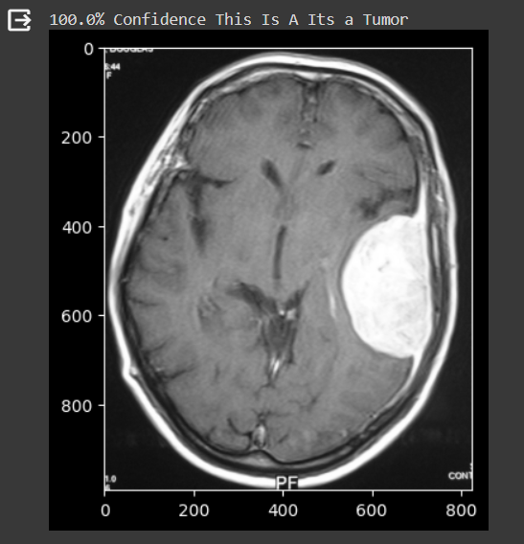
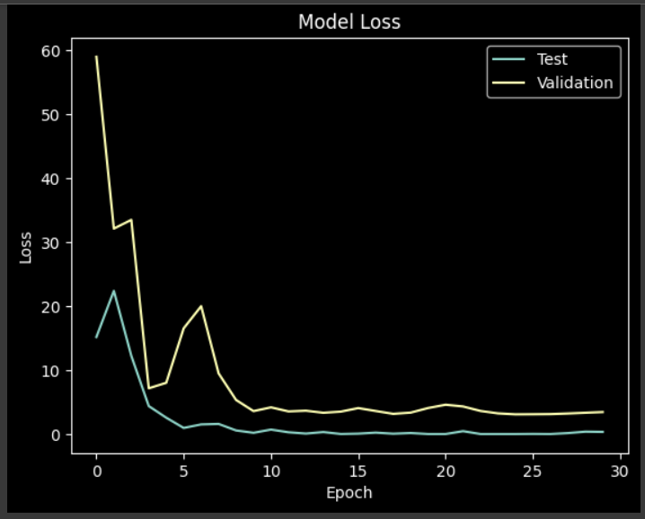
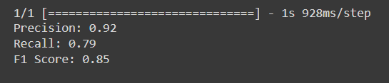
RESULTS
3/21/2024 Annual Review

