Slide 1
Super Store Sales & Profit Dashboard
Task 3 - Interactive Dashboard Design
Data Analyst Internship - DataX Labs
Name :R.SANTHIYA
Intern : Data Analyst Internship
Company : DataX Labs
Date : 19 June 2026

Slide 2
Project Overview
🔧 Tool Used: Power BI
📊 Dataset: Superstore Sales Dataset
🎯 Objective: Interactive dashboard
for business stakeholders
⭐ Key Features:
• KPI Cards — Sales, Profit, Orders
• Slicers — Year, Region, Category
• Time Series Analysis
• Interactive Charts

Slide 3
Key Performance Indicators (KPIs)
💰 Total Sales : 2.56M
📈 Total Profit : 2.30M
📦 Total Orders : 5K
🎯 Avg Discount : 0.12

Slide 4
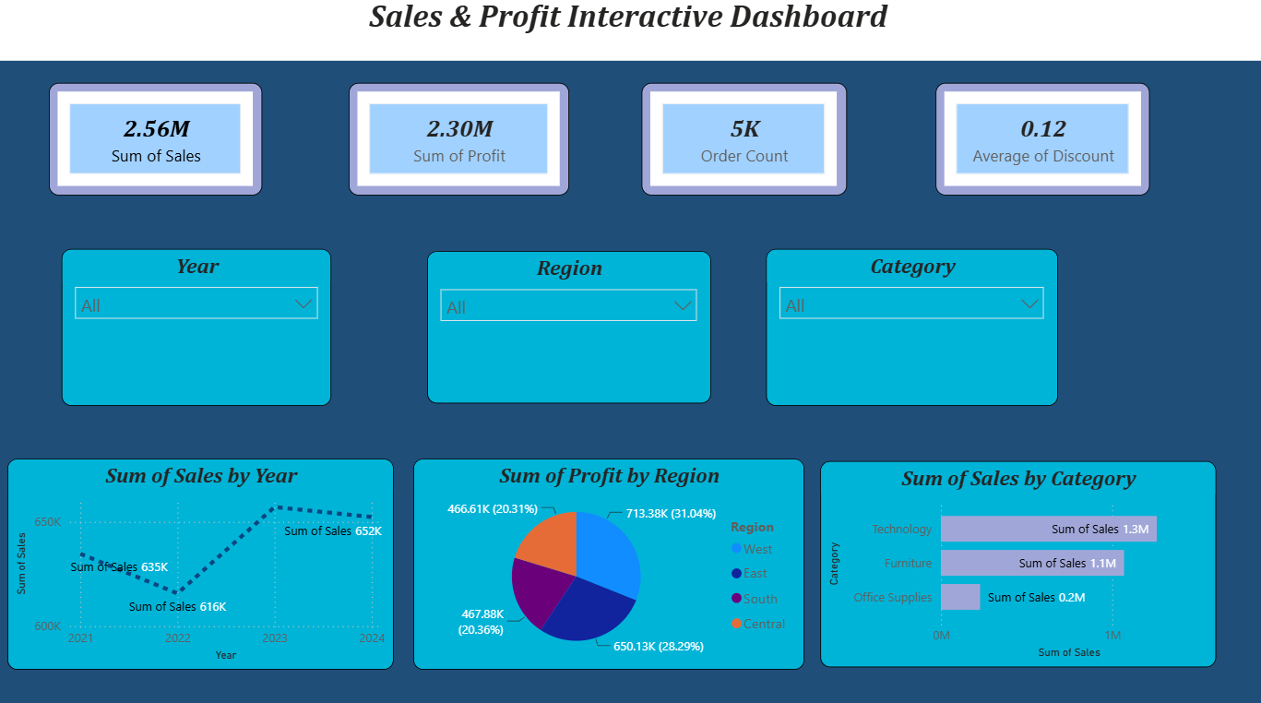
Interactive Dashboard

Slide 5
Key Business Insights
📈 2023 recorded highest sales year
💻 Technology category leads
with highest sales (1.3M)
🌍 West region best performance
(31.04% of total profit)
💸 High discount leads to low profit
📊 Sales showing growth trend
from 2021 to 2023
🏆 Top product: Motorola Edge

Slide 6
Conclusion
✅ Interactive dashboard successfully created
✅ Business KPIs clearly displayed
(Sales, Profit, Orders, Discount)
✅ Slicers enable dynamic filtering
(Year, Region, Category)
✅ Time series analysis shows
yearly sales trend
✅ Charts reveal business patterns
and insights
✅ Dashboard helps business make
data-driven decisions
🎯 Tool Used: Power BI
📊 Dataset: Superstore Sales

