Slide 1

Edubridge Learning Pvt Ltd Pune
Topic: E-Commerce Application using Spring Boot.
Presented By:
Ms. Santhiya
Mr. Nithiyanantham Manikandan
Mr. Palanikumar A
Ms. Kowsalya Elumalai
Ms. Harathi MB
Guided By:
Trainer. Yogesh Gopal Jangle
(EduBridge Learning Pvt.Ltd)

Slide 2
Contents
Introduction
Main Modules
Features of eCommerce
Advantages of eCommerce Website
Software Requirement
Screenshots

Slide 3
Introduction
E-commerce (electronic commerce) is the buying and selling of goods and services, or the transmitting of funds or data, over an electronic network, primarily the internet.
These business transactions occur either as business-to-business (B2B), business-to-consumer (B2C), consumer-to-consumer or consumer-to-business.
E-commerce web-page can be accessed throughout the customers with proper login provided.

Slide 4
Main Modules
Admin Module: Admin can able to handle User portal and Registration portal. It provides access to the User for uploading new product as well as to track the order of product with a username and password.
User Module: Recruiter can access this website by signing up. User can search for the product, access to save it for later, monitoring their order and Payments.
Register Module:In this module a new user cansigning up using their Username, Email ID, password and their address.
Index Module: In this Module the user can view the name, price and rating for the products. And have access to buy the product. Also, having the customer supports and can view the best deal of the day.

Slide 5
Features of eCommerce
Provide Ubiquity to Increase Sales
Strike an Information
Density Balance
Ensure Global Reach and Security
Have Universal Standards
Don't Skimp on Richness
Think About Interactivity

Slide 6
Advantages of eCommerce Website
Faster buying process
Store and product listing creation
Cost reduction
Product and price comparison
Faster response to buyer/market demands
Affordable advertising and marketing
Flexibility for customers
No reach limitations.

Slide 7
Software Requirement
Front end: Java/J2EE technologies (Servlet, JSP), HTML, CSS,
JavaScript, Bootstrap and Hibernate.
Back end: MySQL workbench.
Middleware/Server: Apache Tomcat v8.5. IDE: Spring tool suite for Java EE Developers
Browser: Google Chrome
Operating System: Windows

Slide 8
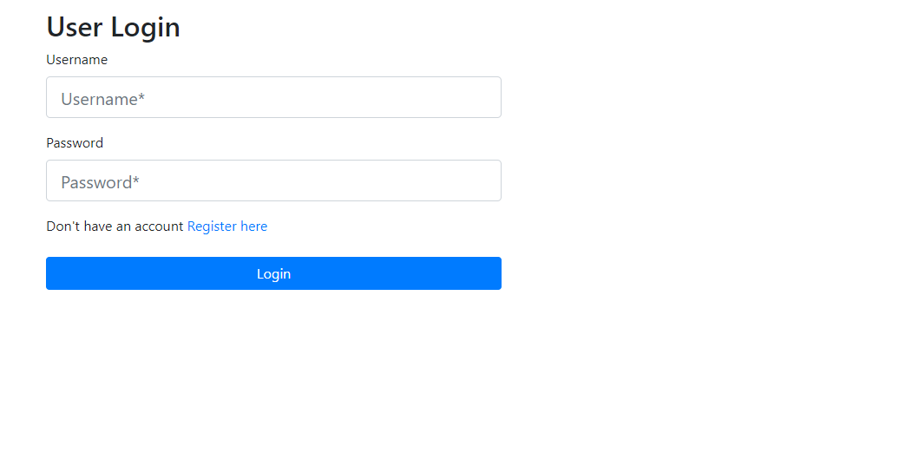
Screenshots
Home page:

Slide 9
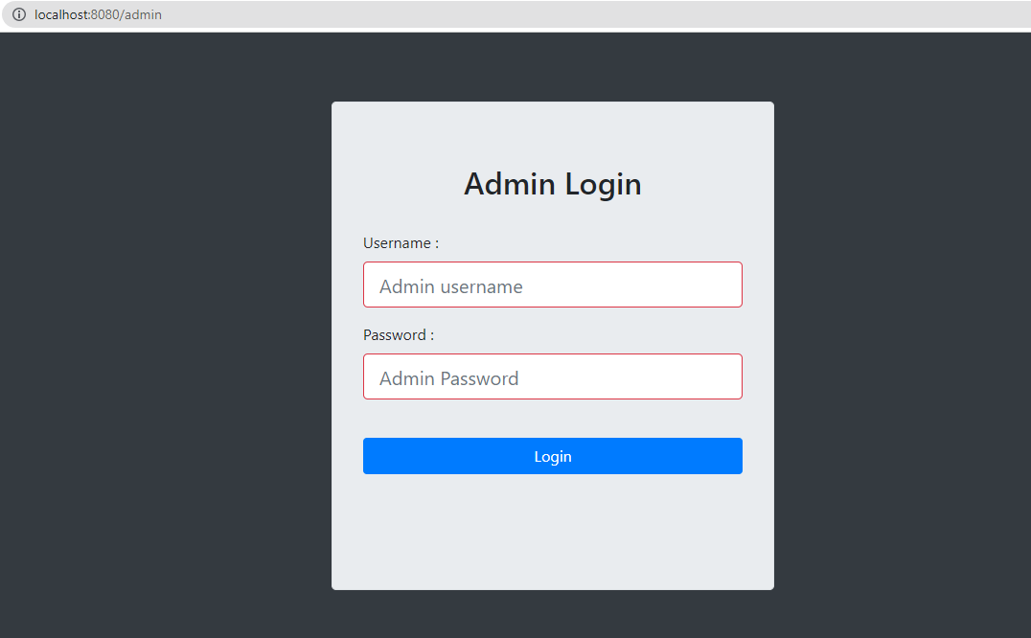
Admin Page:

Slide 10
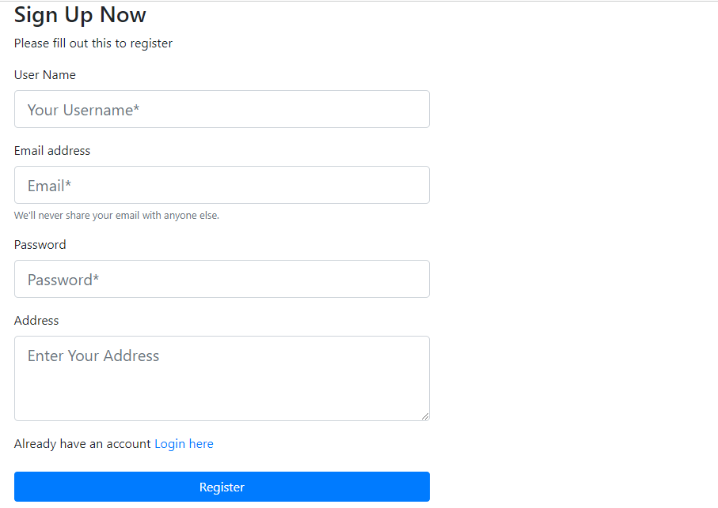
New Registration page:

Slide 11
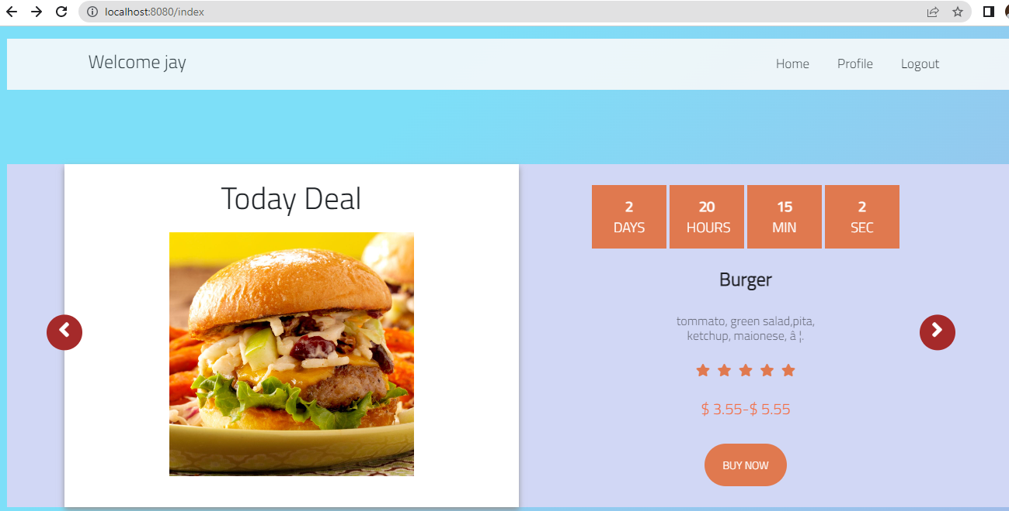
User Index:

Slide 12


