Slide 1
SOCIAL IMPACT PROJECT
STUDENTS NAME:S.Santhiya
REGISTER AND NlMD:
24131131802522015/asanm11324131131802522015
DEPARTMENT:Bsc(cs)
COLLEGE NAME: Vallalar arts and science College 113/Annamalai University

Slide 2
Project title
Social impact project

Slide 3
AGENDA
Environment And Sustainability
Health And Well being
Education and skill Development
Social Equality And Inclusion
Technology for Good
Community Development

Slide 4
Environment And Sustainability Waste management & recycling awareness Clean energy adoption (solar, wind, biogas) Water conservation & rainwater harvesting Afforestation & urban gardening Reducing plastic usage

Slide 5
Health And Well-being Mental health awareness campaigns Nutrition & healthy lifestyle education Accessible healthcare for rural areas Sanitation & hygiene awareness Drug and alcohol de-addiction programs

Slide 6
Education And Skill Development Digital literacy for rural/elderly communities Free tutoring/mentorship for underprivileged students Women empowerment through skill training Promoting STEM education for girls Career guidance workshops

Slide 7
Social Equality And Inclusion Women safety & empowerment Child rights & anti-child labor campaigns Disability inclusion & accessibility projects Supporting LGBTQ+ rights and awareness Bridging urban-rural development

Slide 8
Technology for Good AI/tech solutions for social challenges Mobile apps for farmers (weather, crop price info) Online platforms for blood/organ donation E-learning platforms for remote education Crowdfunding platforms for social

Slide 9
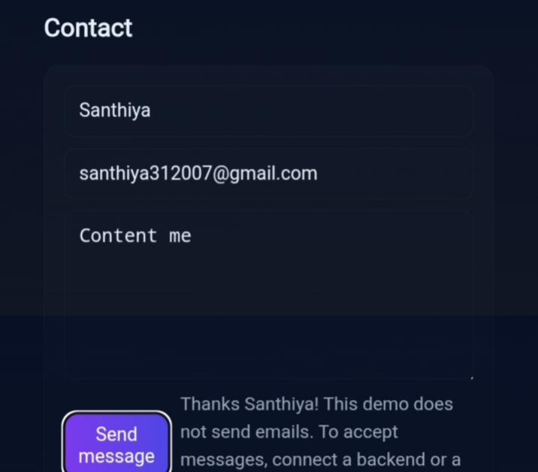

Slide 10
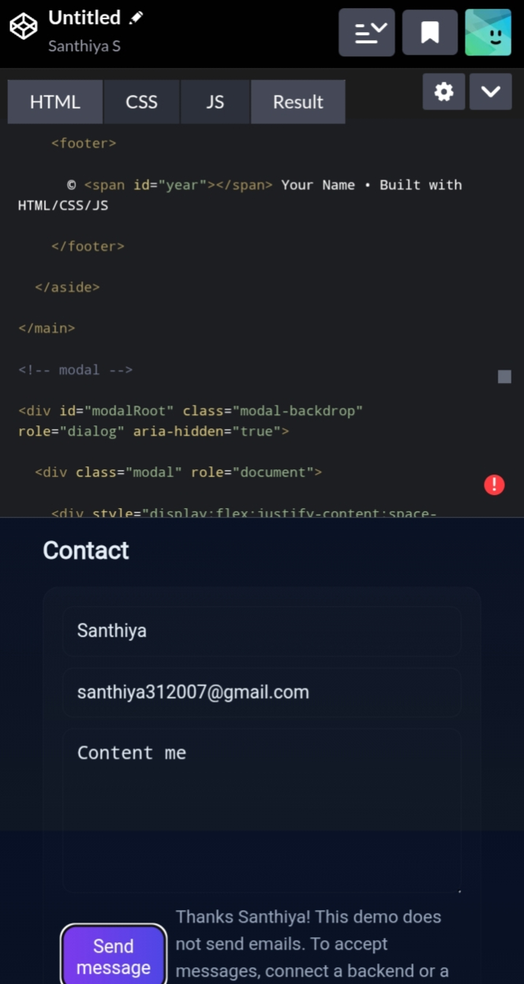

Slide 11
Conclusion :
The project ha demonstrated the meaningful change is possible when
communities technology and collective action comedy together with a
Shared purpose.By addressing inseetissu e g education incoguality environment
sustainable health awareness.

