Slide 1
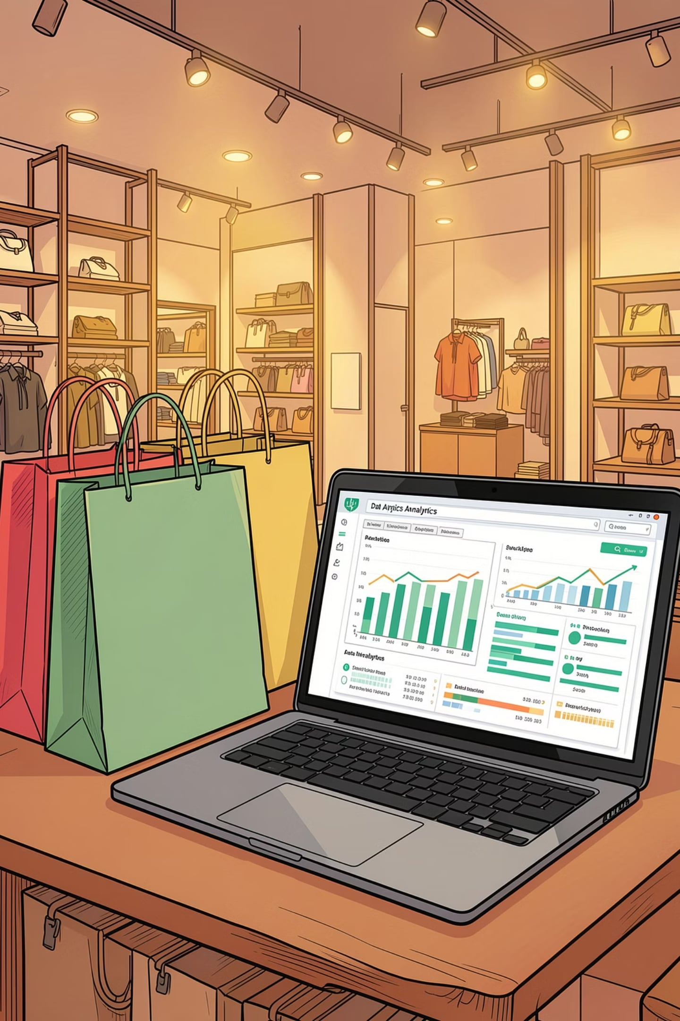
Customer Shopping Behavior Analysis
Uncovering insights from 3,900 transactions across demographics, product preferences, and subscription behavior.

Slide 2
Dataset at a Glance
3,900
18
Purchases
Columns
37
$59.76
Missing Values
Avg Purchase
Review Rating only
Features span demographics, purchase details, and shopping behavior.

Slide 3


Data Preparation in Python
Load & Explore
pandas, df.info(), .describe()
Clean
Median imputation for Review Rating; snake_case renaming
Engineer
age_group bins; purchase_frequency_days; dropped redundant promo_code_used
Integrate
Loaded cleaned DataFrame into PostgreSQL

Slide 4
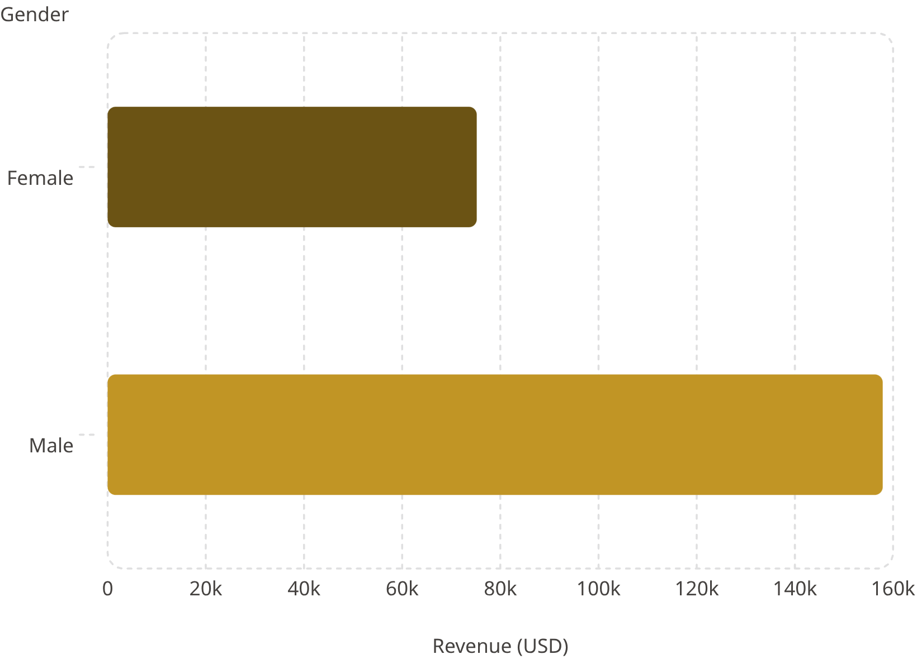
Revenue & Spending Insights
Key Findings
Male customers generated 2.1× more revenue
839 high-spending discount users spent above average despite discounts
Express shipping avg: $60.48 vs Standard $58.46

Slide 5
Products, Ratings & Discounts
Top 5 by Avg Rating
Most Discounted Products
Item
Rating
Item
Discount Rate
Gloves
3.86
Hat
50.00%
Sandals
3.84
Sneakers
49.66%
Boots
3.82
Coat
49.07%
Hat
3.80
Sweater
48.17%
Skirt
3.78
Pants
47.37%

Slide 6
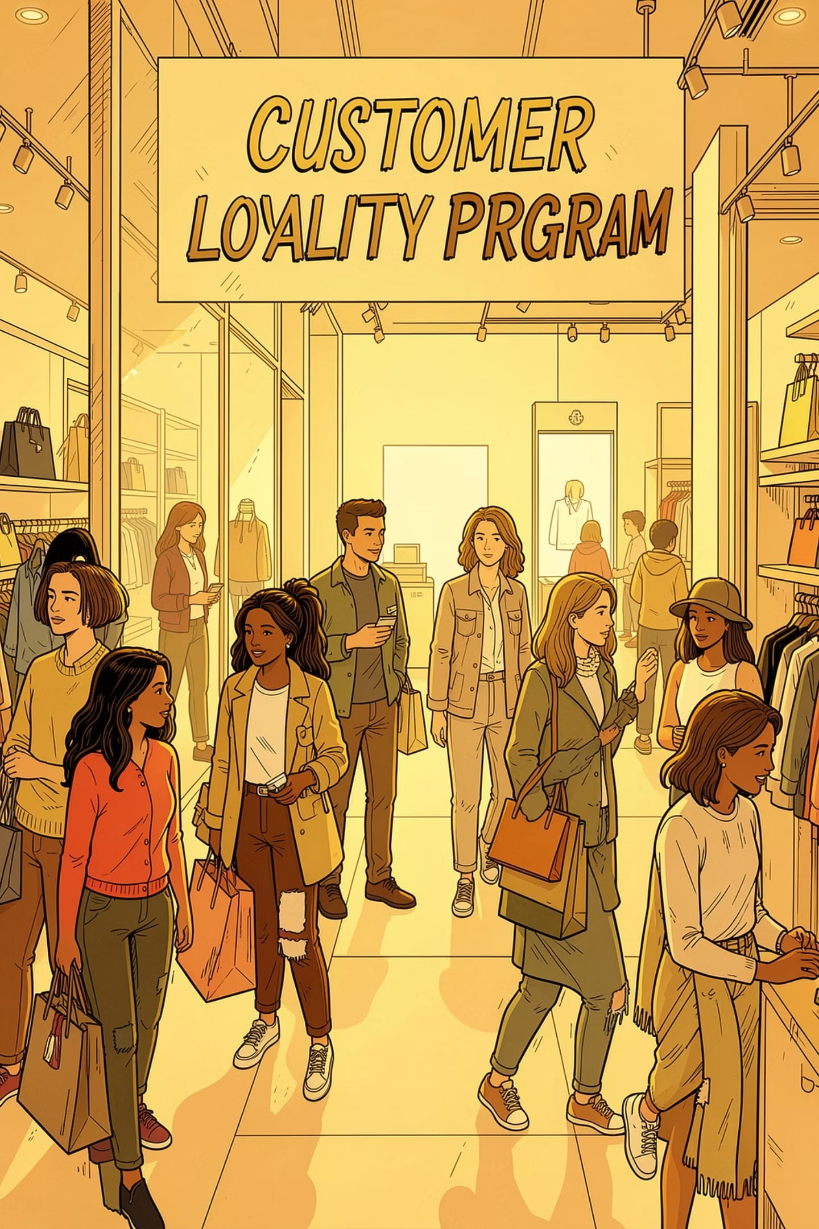
Customer Segmentation
🏆 Loyal
🔄 Returning
3,116 customers
701 customers
🆕 New
83 customers
Of customers with >5 purchases: 958 subscribed vs 2,518 non-subscribers.

Slide 7
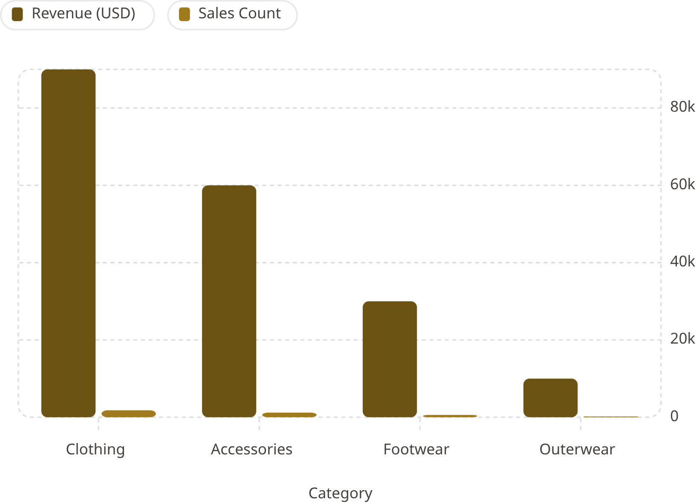
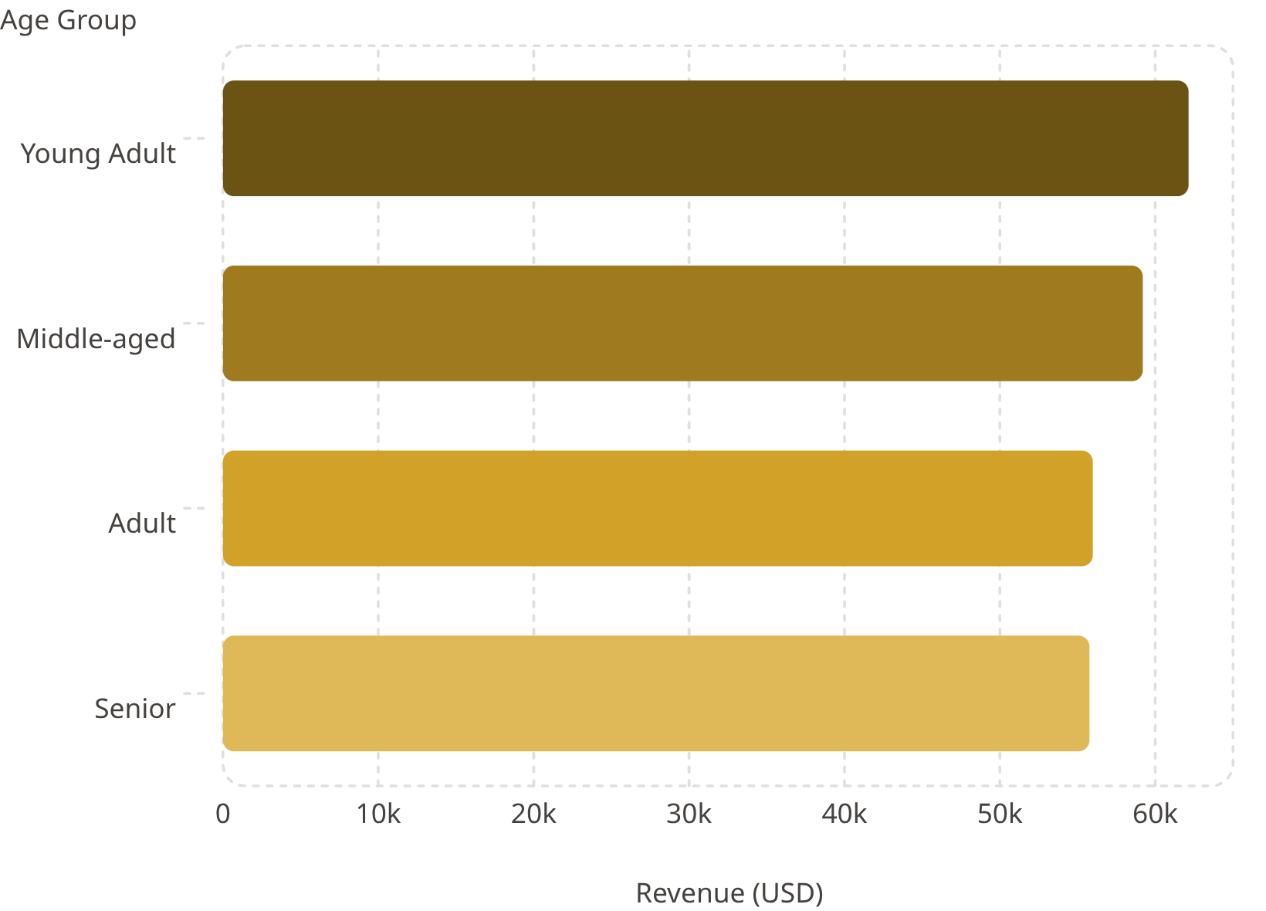
Revenue by Category & Age Group
Revenue by Age Group

Slide 8
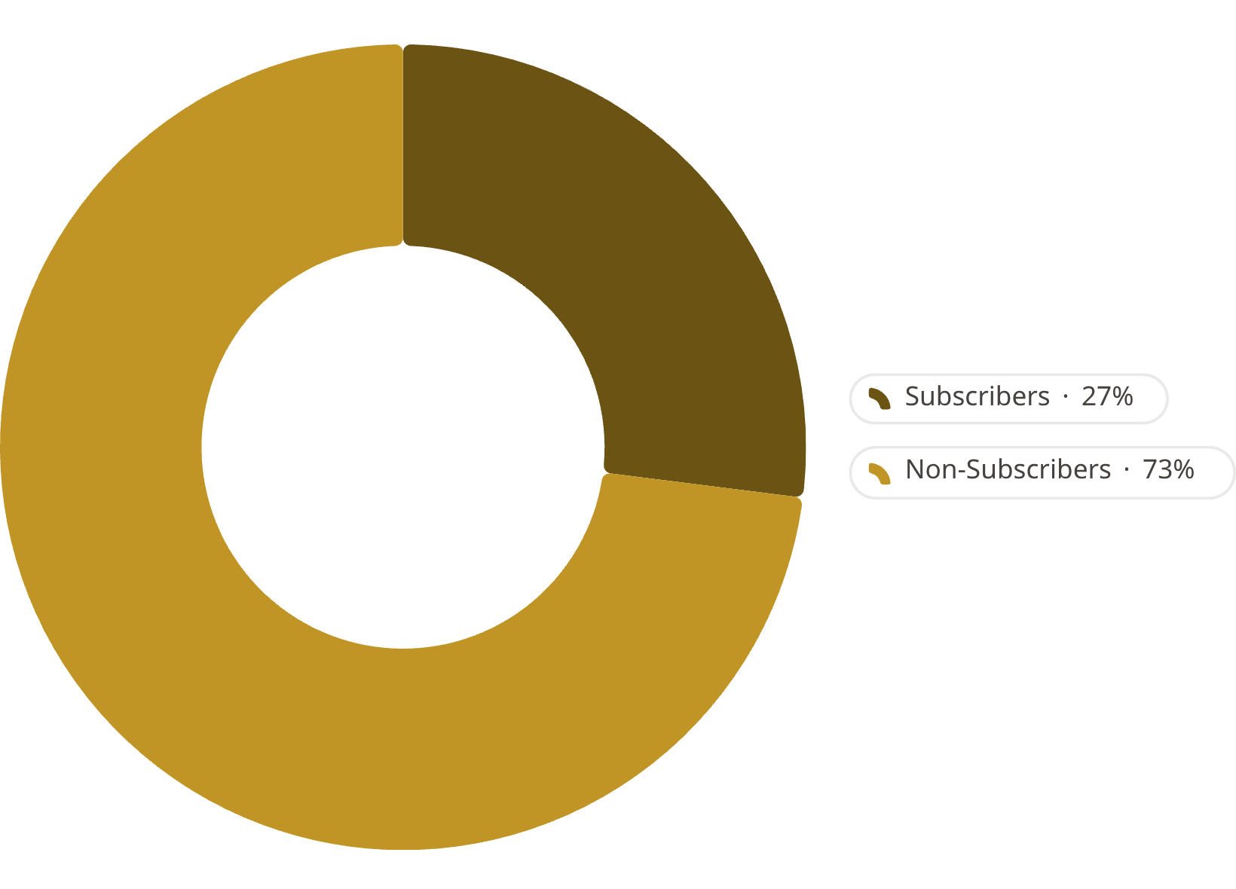

Subscription Behavior
Subscriber vs Non-Subscriber
Metric
Yes
No
Customers
1,053
2,847
Avg Spend
$59.49
$59.87
Total Revenue
$62,645
$170,436
Non-subscribers drive 73% of revenue — growth opportunity.

Slide 9

Power BI Dashboard
3.9K
$59.76
Customers tracked
Avg purchase amount
3.75
Avg review rating
Interactive filters: Subscription · Gender · Category · Shipping Type with revenue and sales breakdowns by category and age group.

Slide 10





Business Recommendations
Boost Subscriptions
Promote exclusive subscriber benefits
Loyalty Programs
Reward repeat buyers → Loyal segment
Review Discount Policy
Balance sales lift with margin control
Targeted Marketing
Focus on high-revenue age groups & express-shipping users

