Slide 1
Good morning

Slide 2
Last class
Linear basis function models
Bias-variance decomposition

Slide 3
Today’s class
Decision trees
Random forest

Slide 4
Decision Trees
What is a decision .
How to build a DT.
How to Implement a DT.
How to Validate a DT.

Slide 5
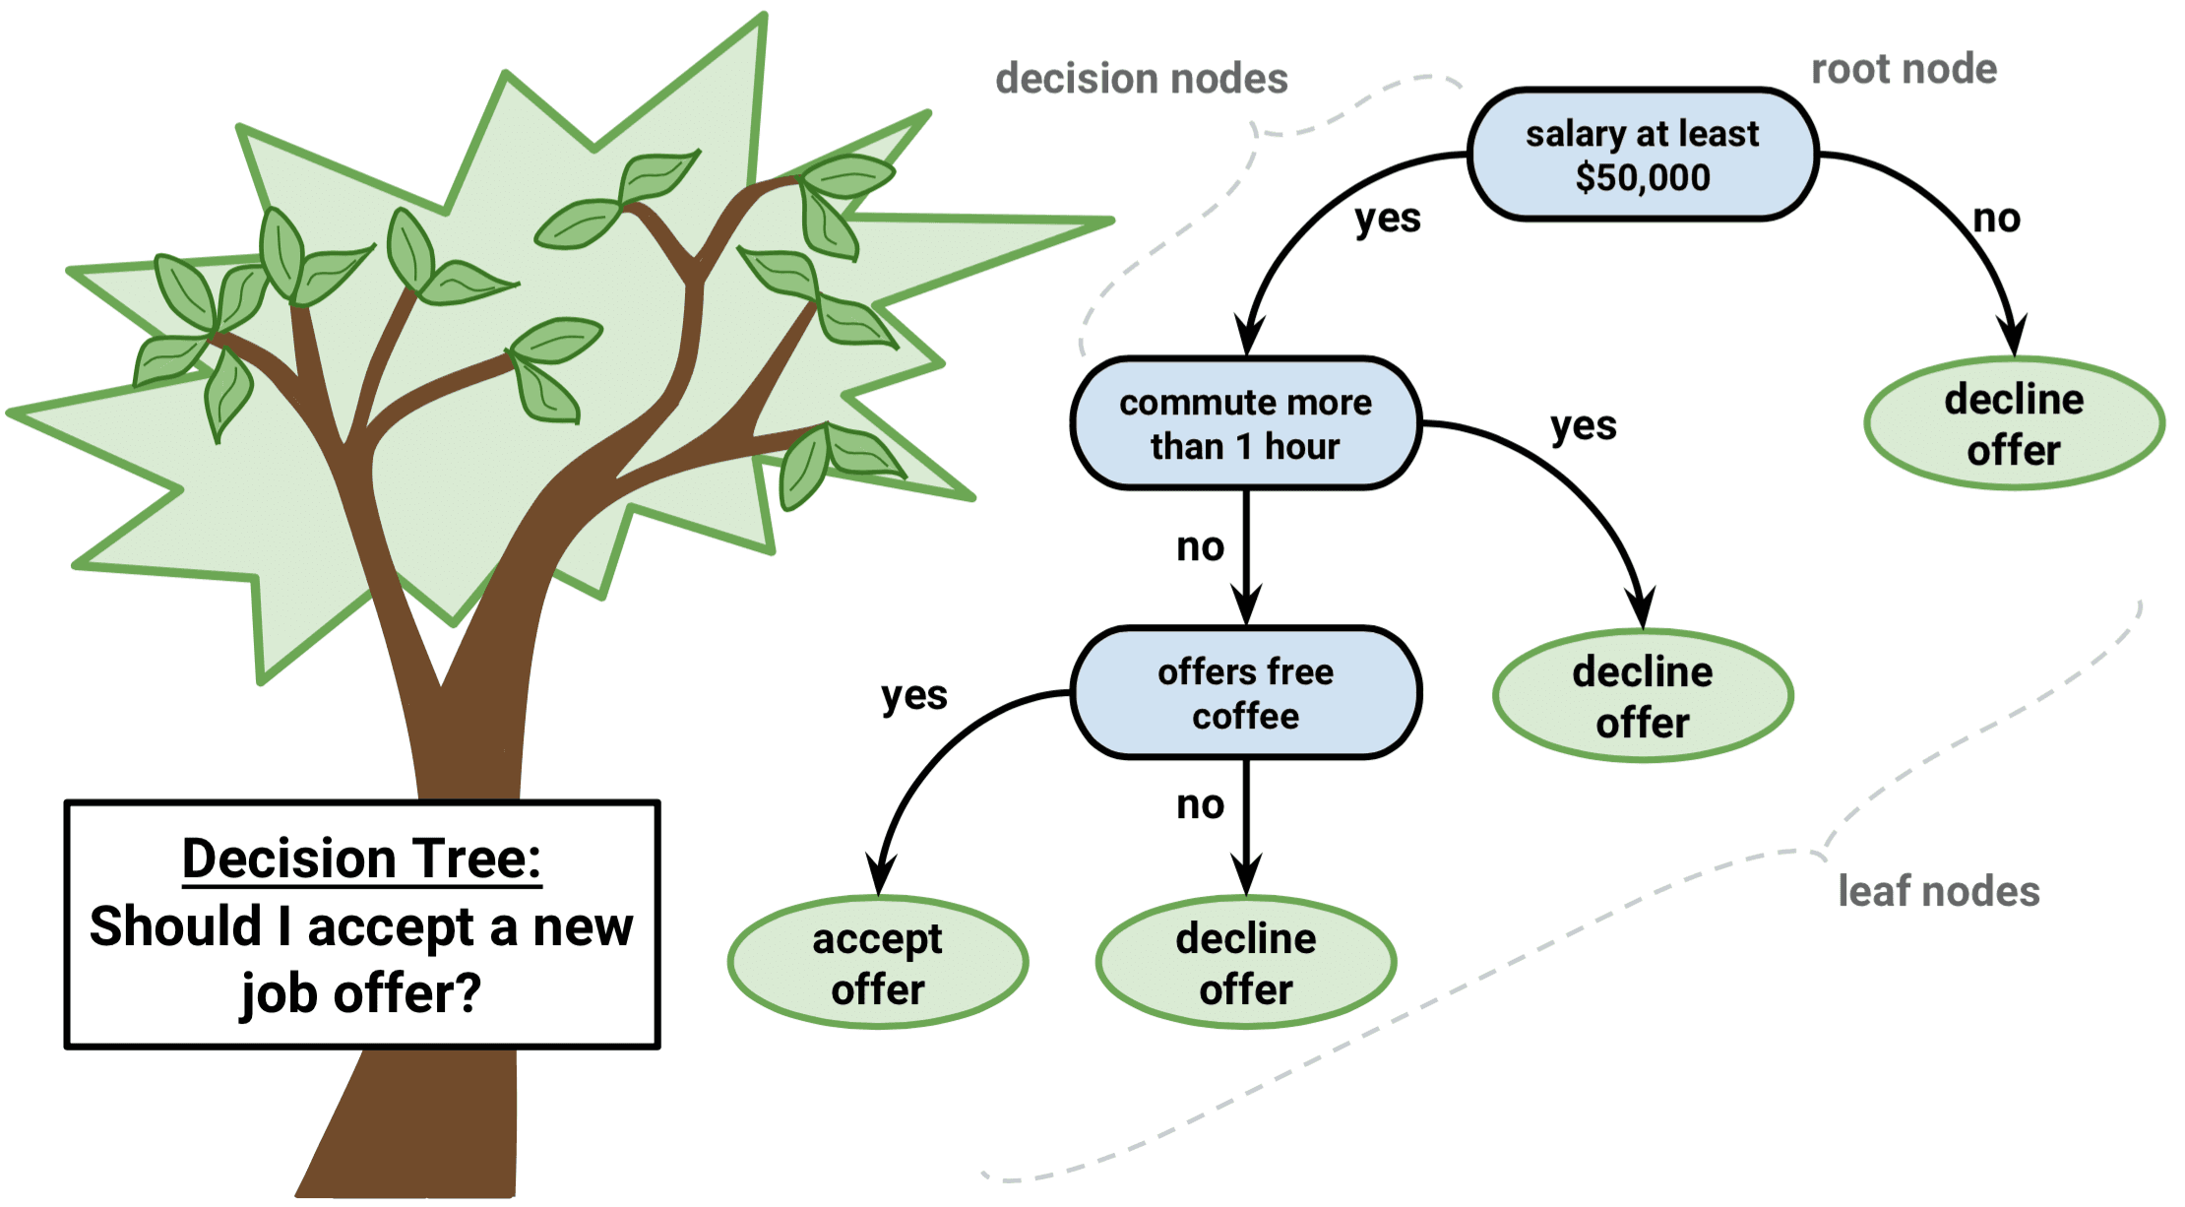
Decision Tree
Nodes
Root, Leaves, Decision nodes
Entropy, Information Gain, Gini Index…
Decision rules
Classification, Regression
Types

Slide 6
Decision Tree
Construction:
Select a root node based on the measure used and split. Continue splitting with reduced data until no further split is needed(leaves are obtained).
Implementation:
Pass a new data from the root node, through a sequence of branches until it reaches a leaf node and classify or regress based on that leaf node.

Slide 7
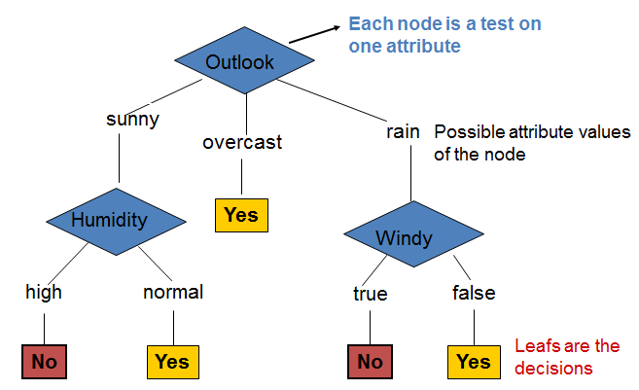
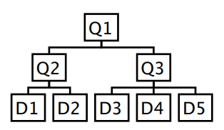
Decision Tree
Root Node: Starting (or) Entry point to a data
Inner nodes: Queries/Questions and data, resulting in one
child node for every value.
Leaf node: Decision rule nodes.

Slide 8
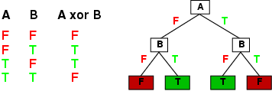
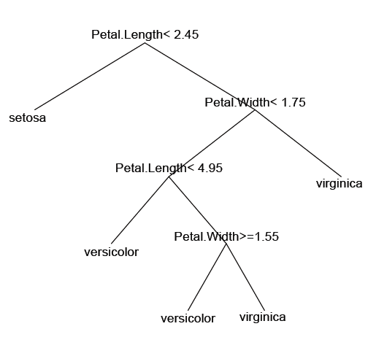
Decision Tree Applications
Discrete Mathematics
Biology: Classification

Slide 9
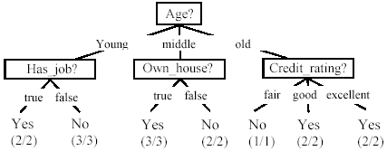
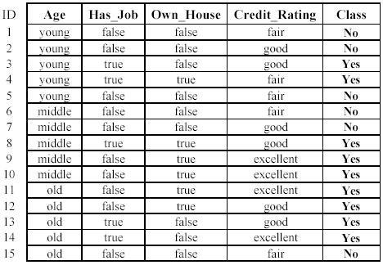
Decision Tree Loan Application
Classify the following data .
Data: Loan application data
Task: Predict whether a loan should be approved or not.
Performance measure: accuracy.

Slide 10
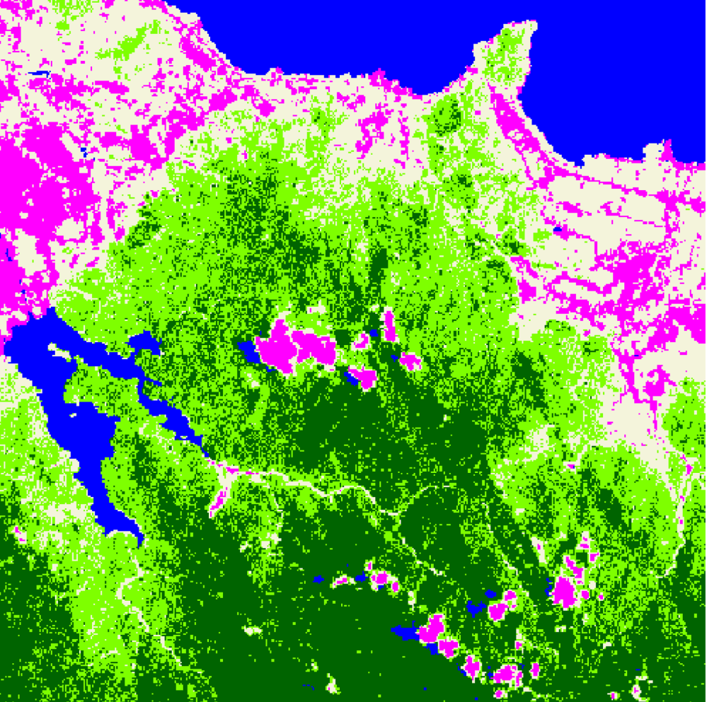
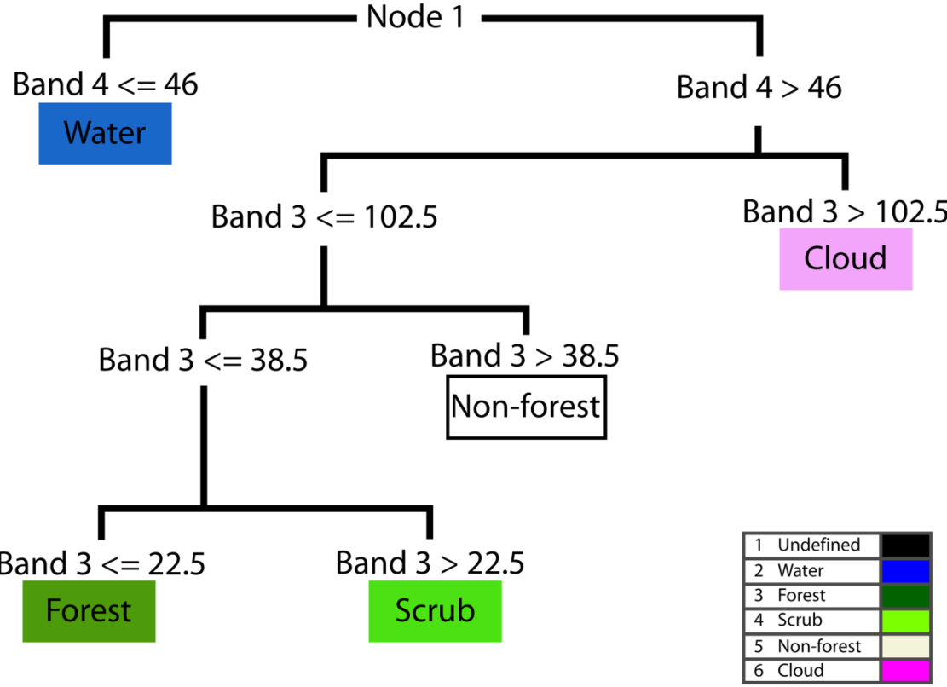
Decision Tree-Research
DT

Slide 11
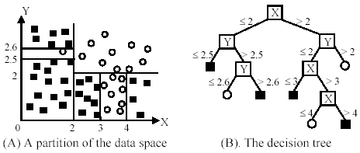
Decision tree-Example
For the diagram below, perform classification

Slide 12
Decision tree-Example
For the diagram below, perform classification

Slide 13
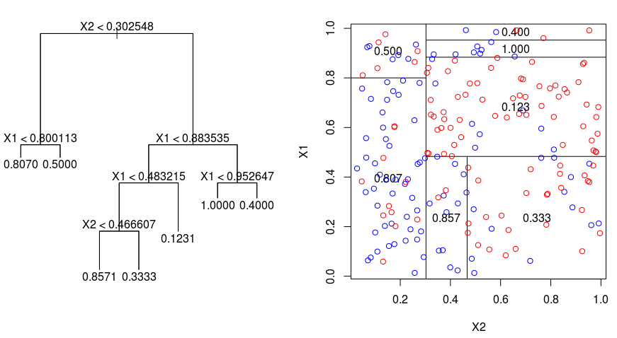
Decision tree-Regression
For the diagram below,

Slide 14
Types of trees

Slide 15
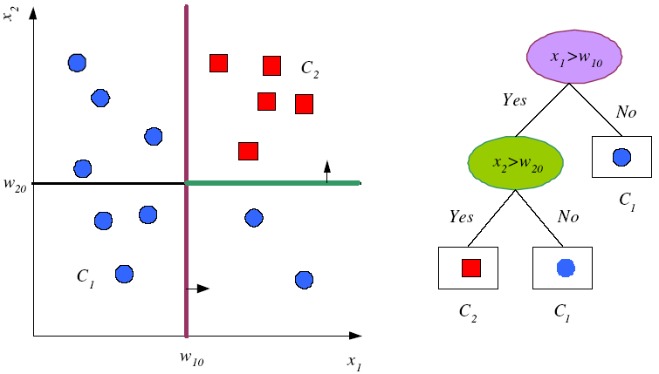
Decision trees
Look at the picture
Uni-variate, Binary split, Leaves are in classification.

Slide 16
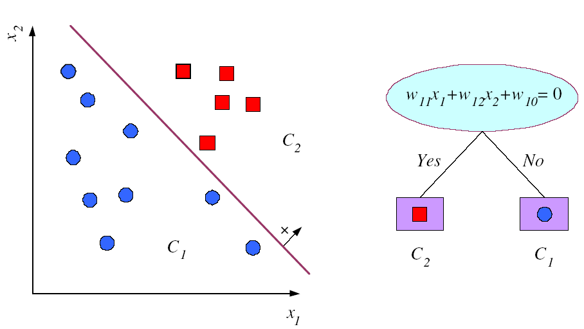
Decision Trees Multivariate Split
Regression like lines based.

Slide 18
ID3
Use ID3 to form a Decision tree for the following data
Class | Size | Color | Surface
A | Small | Yellow | Smooth
A | Medium | Red | Smooth
A | Medium | Red | Smooth
A | Big | Red | Rough
B | Medium | Yellow | Smooth
B | Medium | Yellow | Smooth

Slide 19
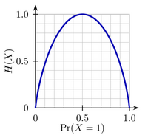
ID3
ID3 uses Entropy.
The Entropy measures the amount of uncertainty. The expected amount of information when observing the output of a random variable X
If we are tossing a coin, frequency of heads is ,say p. The entropy measures the uncertainty in
any actual outcome (toss).
Note, the uncertainty is zero if p=0 or 1and maximal if we have p=0.5.

Slide 20
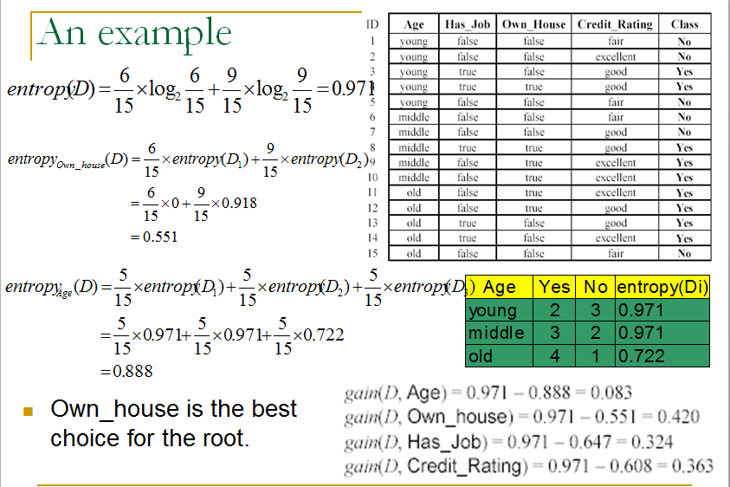
ID3
Ex

Slide 21
ID3
Ex

Slide 22
ID3
Use ID3 to form a Decision tree for the following data
Select Color as the root node, as it has minimum entropy
Class | Surface | Color | Size
A | Smooth | Yellow | Small
A | Smooth | Red | Medium
A | Smooth | Red | Medium
A | Rough | Red | Big
B | Smooth | Yellow | Medium
B | Smooth | Yellow | Medium
Feature | Entropy
Size | 0.462
Color | 0.318
Surface | 0.560

Slide 23
ID3
The tree is
Class | Size | Color | Surface
A | Small | Yellow | Smooth
A | Medium | Red | Smooth
A | Medium | Red | Smooth
A | Big | Red | Rough
B | Medium | Yellow | Smooth
B | Medium | Yellow | Smooth
Color
Yellow
.
.
Red
A

Slide 24
ID3
Now calculate Entropy for the remaining two features with the reduced matrix
Select Size as the root node,
as it has minimum entropy
Class | Size | Color | Surface
A | Small | Yellow | Smooth
A | Medium | Red | Smooth
A | Medium | Red | Smooth
A | Big | Red | Rough
B | Medium | Yellow | Smooth
B | Medium | Yellow | Smooth
Feature | Entropy
Size | 0.0
Color | 0.636
Surface | -

Slide 25
ID3
The tree is
Color
Yellow
Size
Red
A
Small
Medium
A
B

Slide 26
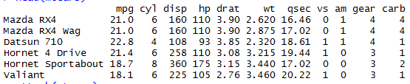
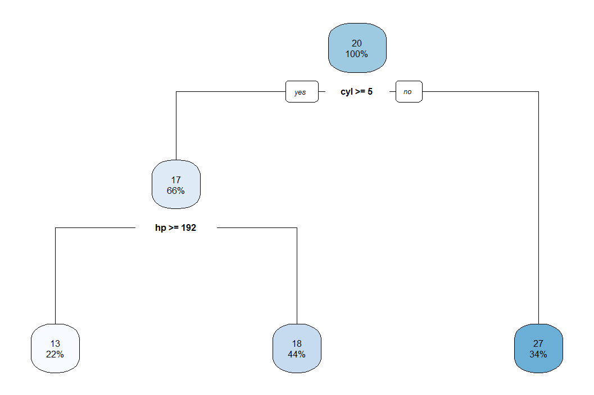
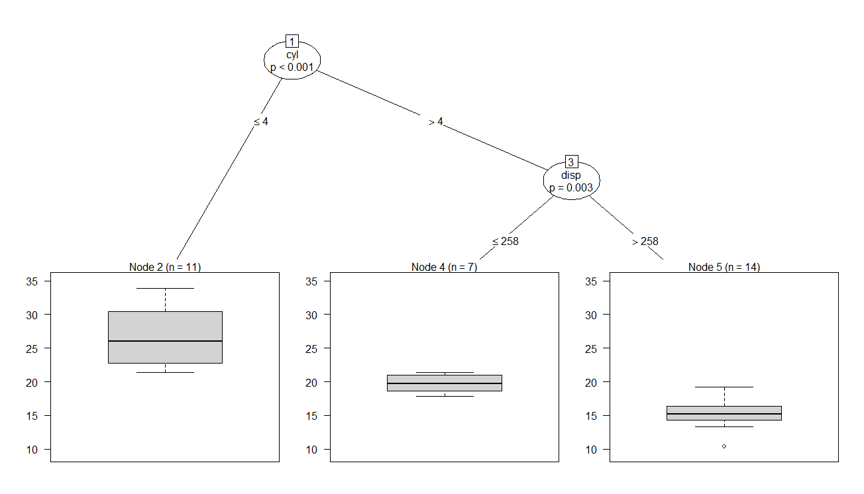
Decision tree R Studio
Data

Slide 27
Decision Tree-Example
Decide whether to wait for a table at a restaurant, based on the following attributes:
Alternate: is there an alternative restaurant nearby?
Bar: is there a comfortable bar area to wait in?
Fri/Sat: is today Friday or Saturday?
Hungry: are we hungry?
Patrons: number of people in the restaurant (None, Some, Full)
Price: price range ($, $$, $$$)
Raining: is it raining outside?
Reservation: have we made a reservation?
Type: kind of restaurant (French, Italian, Thai, Burger)
WaitEstimate: estimated waiting time (0-10, 10-30, 30-60, >60)

Slide 28
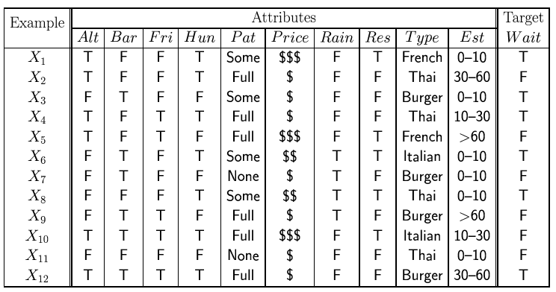
Decision Tree-Example
In this case, the Decision (Class vector) variable is binary. I will/will not wait.
Classification of examples is positive (T) or negative (F)
General form for data: a number N of instances, each with attributes (x1,x2,x3,...xd) and target value y

Slide 29
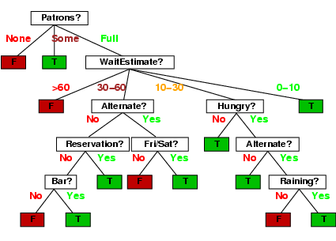
Decision Tree-Example
In this case, the Decision Tree may be

Slide 31
Random Forest
Issues with a Decision tree
Easy to build but not flexible and efficient, Over-fitting
Many trees, with a subset of features(RF)
Aggregation of all trees.
Bootstrapping, Bagging

Slide 32
Random Forest
Random forest is an ensemble classifier that consists of many decision trees and outputs the class that is the mode of the class's output by individual trees.
For a given dataset(with p feature vectors), create many datasets from it using random sampling with replacement(Bootstrapping) , create one Decision tree using each generated dataset with m(<p) randomly selected feature vectors. Run a new case on each of the DT ‘s , then use mode of the classes(Classification) or average (Regression) to finalize.
For classification, the default value for m is √p and the minimum node size is one.
For regression, the default value for m is p/3 and the minimum node size is five.

Slide 33
General Idea
S
Training Data
Multiple Data Sets
S1
S2
Sn
Multiple Classifiers
C1
C2
Cn
Combined Classifier
H

Slide 34
Random Forest
We are creating a forest with many trees . Each DT may be simple model but together the ensemble is a better model as can be seen by the reduction in error.
If for example we have 25 DT’s, each independent but with identical error of 0.35which is either the product of all the errors or a Binomial distributed value, will surely be very less than 0.35.

Slide 35
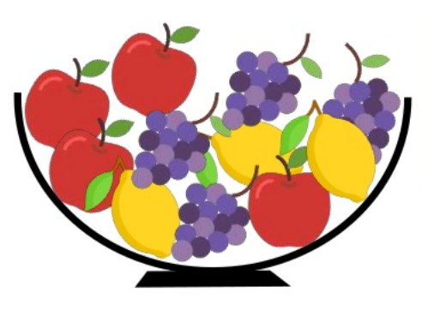
Random Forest -Example
Suppose we wish to classify the fruits
The feature vectors are ,
Color, Diameter, Shape, Grows in summer….
A Decision tree considers all four attributes at any branching stage.
A Random forest grows many DT’s using lesser features, like m=2 here to build many trees.

Slide 36
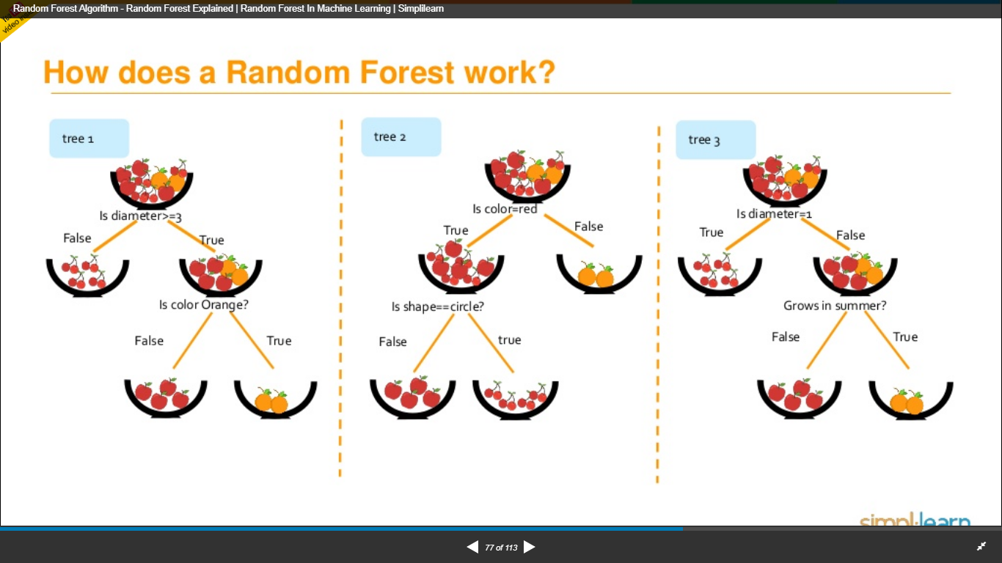
Random Forest -Example
Random Forest

Slide 37
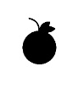
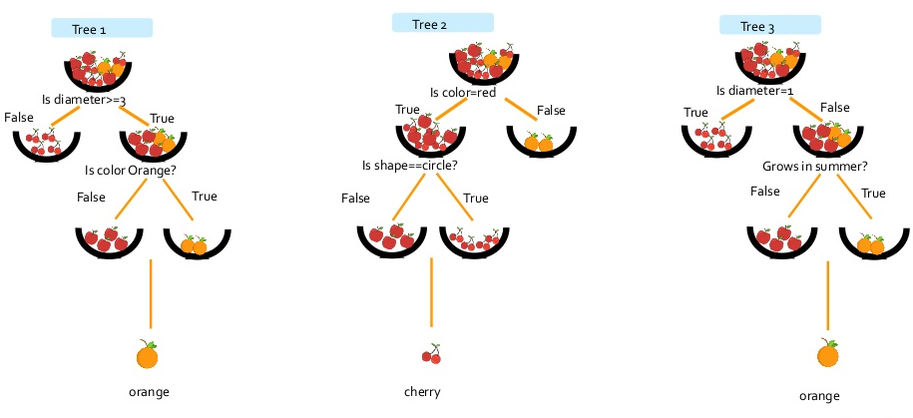
Random Forest -Example
Now for Implementation, what is the class of the fruit?

Slide 38
Random Forest Advantages
The advantages of random forest are:
It is one of the most accurate learning algorithms available. For many data sets, it produces a highly accurate classifier.
It runs efficiently on large databases.
It can handle thousands of input variables without variable deletion.
It gives estimates of what variables are important in the classification.
It generates an internal unbiased estimate of the generalization error as the forest building progresses.
It has an effective method for estimating missing data and maintains accuracy when a large proportion of the data are missing.

Slide 39
Random Forest Advantages
It has methods for balancing error in class population unbalanced data sets.
Generated forests can be saved for future use on other data.
Prototypes are computed that give information about the relation between the variables and the classification.
It computes proximities between pairs of cases that can be used in clustering, locating outliers, or (by scaling) give interesting views of the data.
The capabilities of the above can be extended to unlabeled data, leading to unsupervised clustering, data views and outlier detection.
It offers an experimental method for detecting variable interactions.

Slide 40
Random Forest Disadvantages
Random forests have been observed to overfit for some datasets with noisy classification/regression tasks.
For data including categorical variables with different number of levels, random forests are biased in favor of those attributes with more levels. Therefore, the variable importance scores from random forest are not reliable for this type of data.
Note: For each tree grown, 33-36% of samples are not selected in bootstrap, called out of bootstrap (OOB) samples

Slide 41
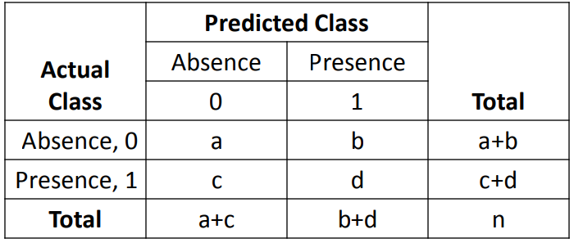
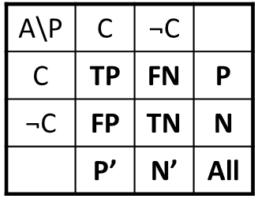
Random Forest
When we build a random forest for classification, the error and efficiency are measured based on the consolidated/ confusion matrix
Sensitivity[True positive recognition]=[a/a+b] ;
Specificity [True negative recognition]=[d/c+d]
Accuracy=[a+d]/n
Error rate (c+b)/n

