Slide 1

Good morning

Slide 2
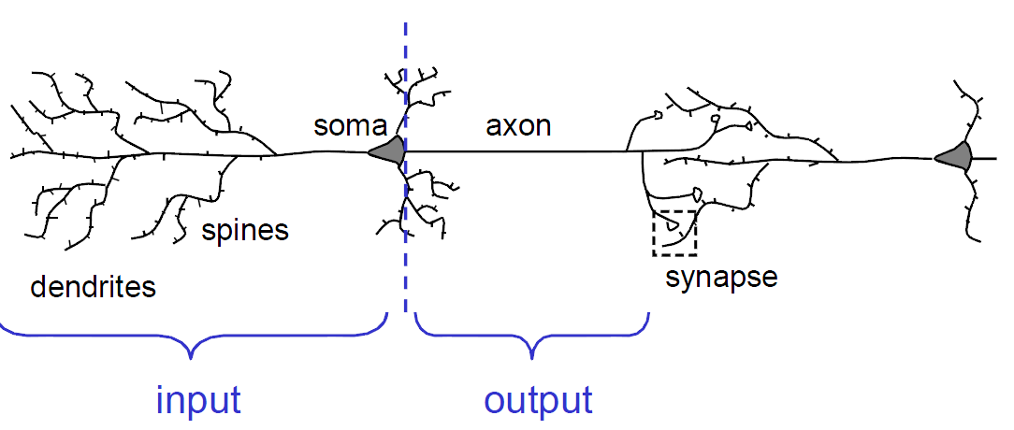
Biological neuron
Human brain is made up of neurons.

Slide 3
Neural Networks
The central idea of artificial neural networks (ANN) is to extract linear combinations of the inputs as derived features, and then model the target as a nonlinear function of these features.

Slide 4
Neural Networks
The general procedure is to have the network learn the appropriate weights from a representative set of training data.
In all but the simplest cases, however, direct computation of the weights is intractable.
Instead, we usually start off with random initial weights and adjust them in small steps until the required outputs are produced.

Slide 5
Neural Networks
Construction of a NN needs,
Network properties:
Network Topology, types of connections…
Node Properties:
Activation function…
System Dynamics:
Weight Initialization, activation calculation, learning rule.

Slide 6
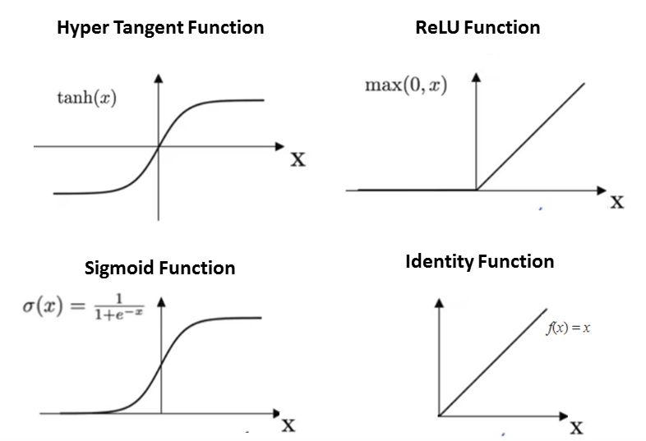
NN-Activation functions
AF

Slide 7
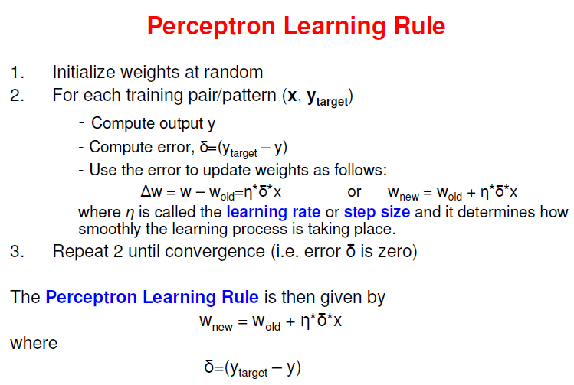
ANN-Perceptron
Perceptron Learnng rule

Slide 8
NN-Applications
Classification
Association
Optimization
Self-Organization

Slide 9
Good morning

Slide 10
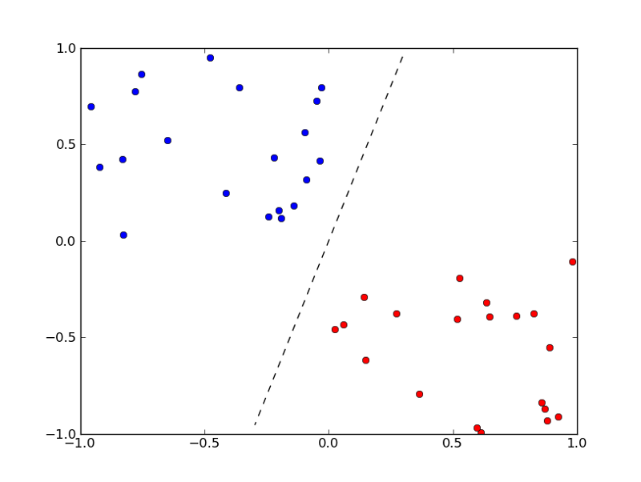
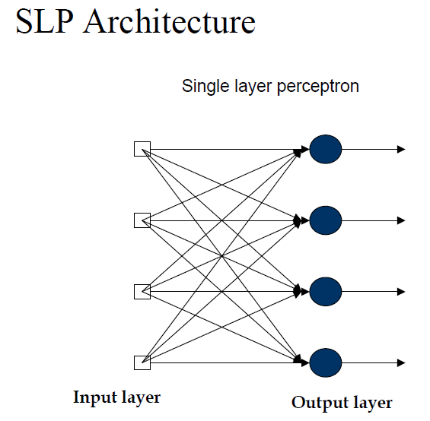
Perceptron
Perceptron is a supervised learning for binary classification, created by Rosenblatt.
It is a Linear classifier.

Slide 11
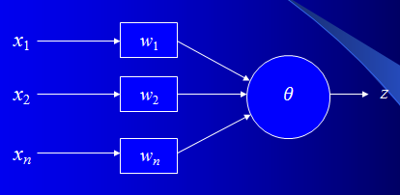
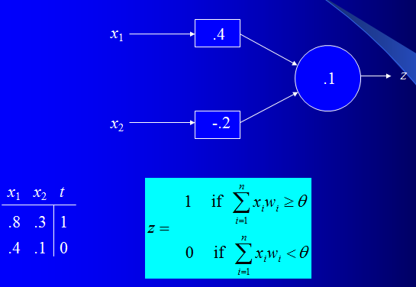
Perceptron
This is the earliest ann model.

Slide 12
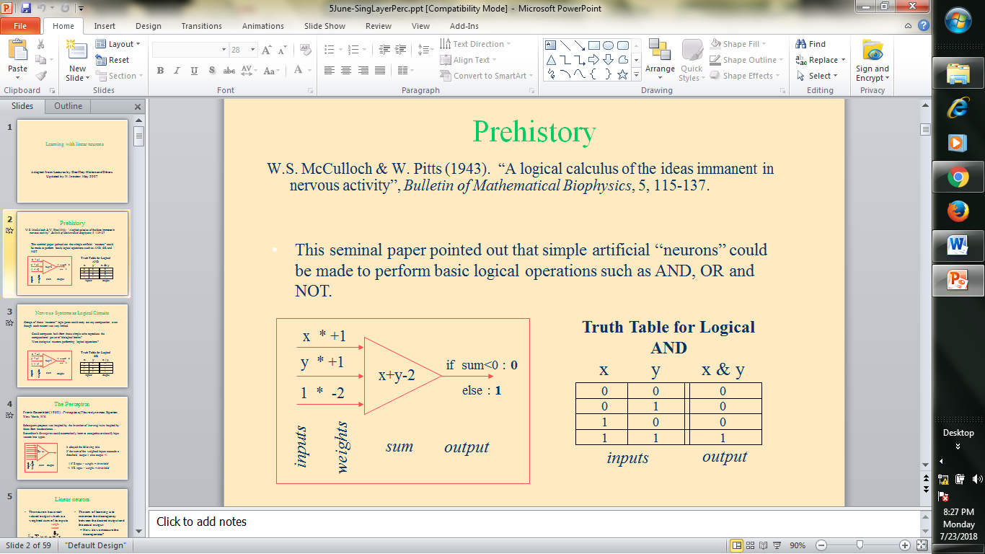
ANN-Perceptron
P

Slide 13
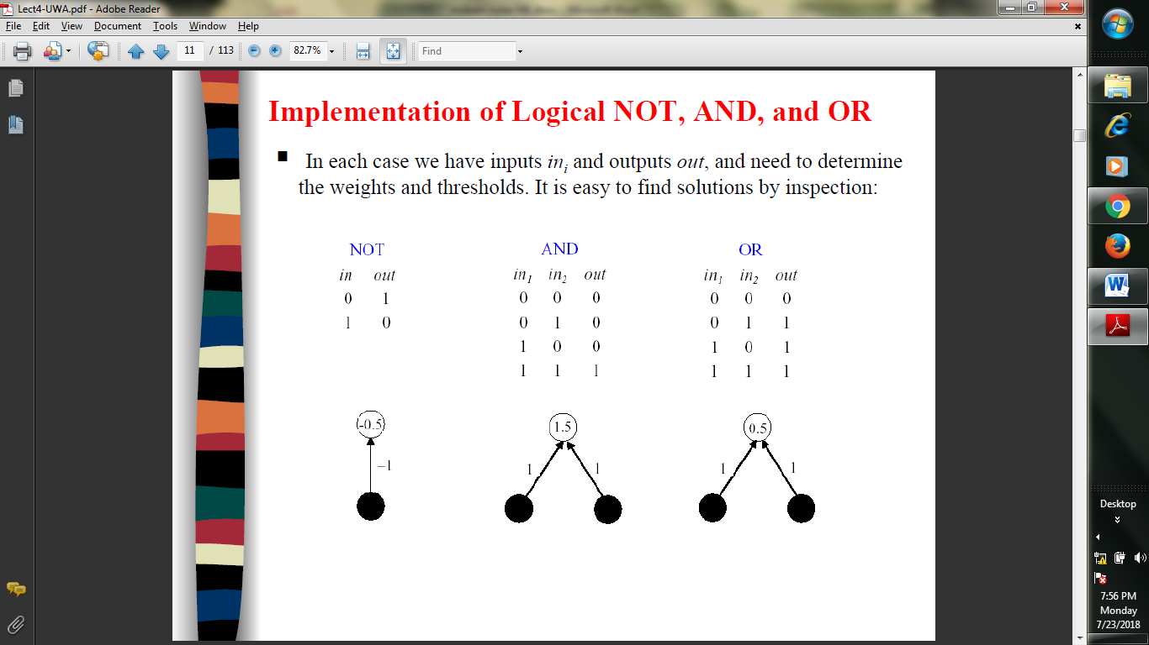
SLP
SLP

Slide 14
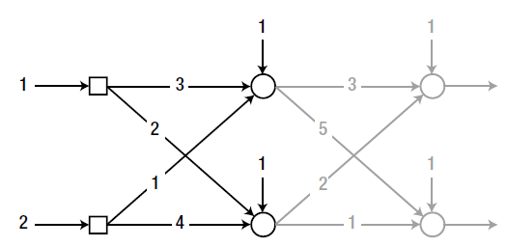
ANN
Example:
The first node of the hidden layer calculates the output as:
Weighted sum: v = (3*1) + (1*2) + 1 = 6
Output: y = j (v) = v = 6
In a similar manner, the second node of the hidden layer calculates the
output as:
Weighted sum: v = (2*1) + (4*2) + 1 = 11
Output: y = j (v) = v = 11

Slide 15
Perceptron
This is the earliest ann model.
Assume a 3 input perceptron plus bias (it outputs 1 if net > 0, else 0)
Assume a learning rate c of 1 and initial weights all 0: Δw_{i} = c(t – z) x_{i}
Training set 0 0 1 -> 0
1 1 1 -> 1
1 0 1 -> 1
0 1 1 -> 0
Pattern Target Weight Vector Net Output ΔW
0 0 1 1 0 0 0 0 0 0 0 0 0 0 0
1 1 1 1 1 0 0 0 0 0 0 1 1 1 1
1 0 1 1 1 1 1 1 1

Slide 16
Good morning

Slide 17
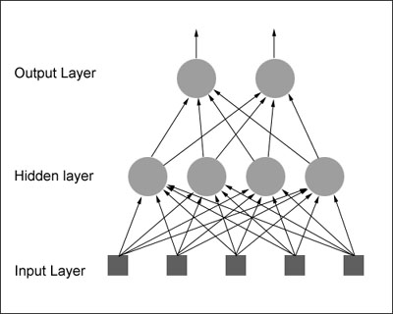
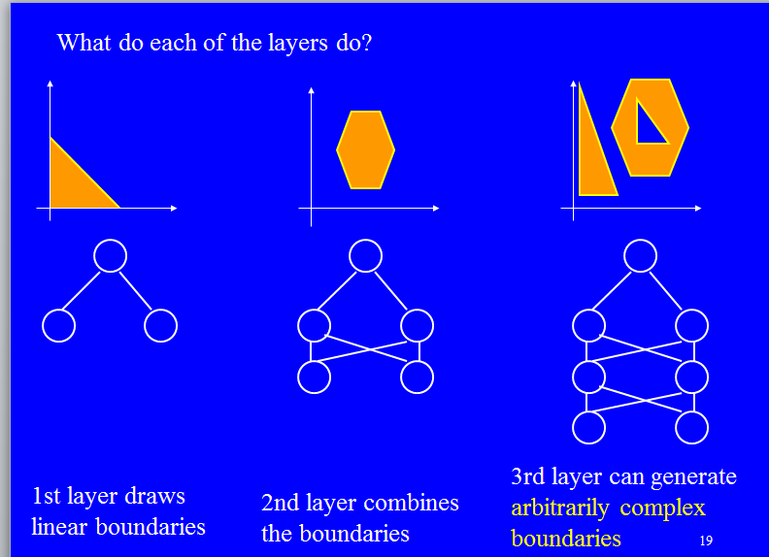
Multilayer Perceptron
MLP

Slide 18
Gradient Descent
Perceptron learning rule is for linearly separable data, separating the input space into two by the hyper-plane W^{T}X+b=0.
Gradient descent is for data which are not.
ANN can be seen as a regression without the threshold, as is the case with gradient descent, searching for the optimal weight vector(hypothesis vector in the hypotheses space)

Slide 19


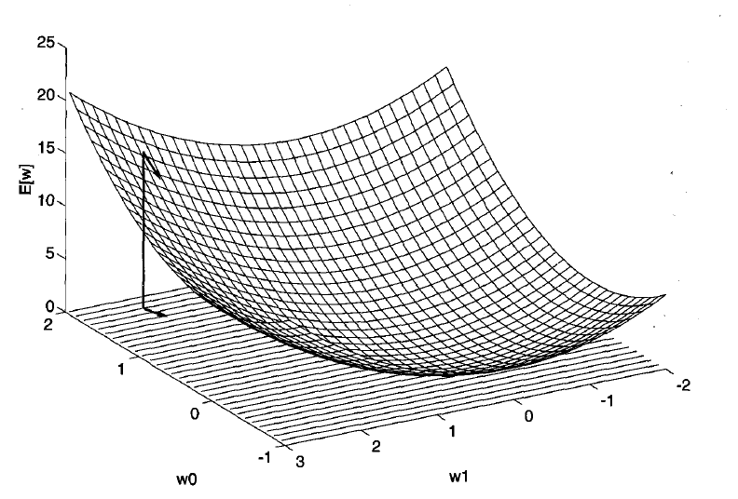
Gradient Descent
For a simple two element vector discussion,

Slide 20





Gradient Descent
For a simple two element vector discussion,
For every single component,

Slide 21
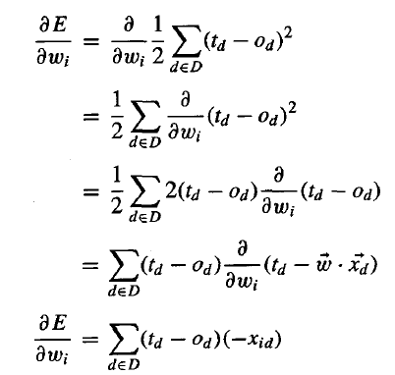
Gradient Descent
The general GD is ,

Slide 22
Good morning

Slide 23
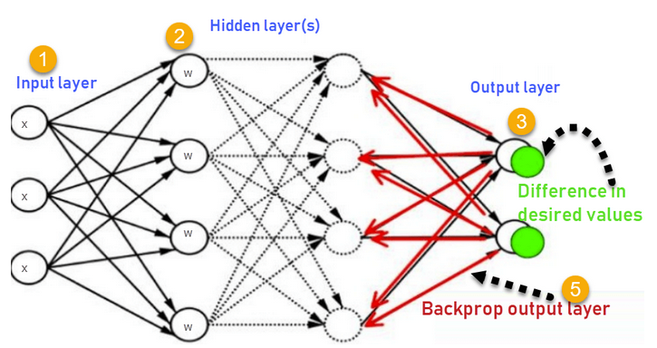
Backpropogation
So far we have seen only “Feedforward “ networks.
BP networks propogate the error backwards for training the network and minimizing the errors

Slide 24
Backpropogation
The activation function in BP is Sigmoid function F(a)=1/[1+exp(-a)]
Weight training is Wji(t+1)=Wji(t)+∆Wji.

Slide 25
BackPropogation-XOR gate
Construct a MLP with 2 input neurons, one hidden neuron, one output neuron and a bias for both layers with the weights
W13=0.02, W14=0.03,W12=-0.02,W23=0.01,W24=0.02,W1b=-0.01,W2b=-0.01
Note: Numbering from top to bottom.
Activation fn is sigmoid.

Slide 26
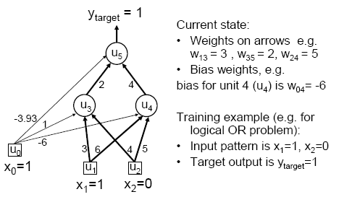
MLP-Backpropogation
Consider a MLP

Slide 27
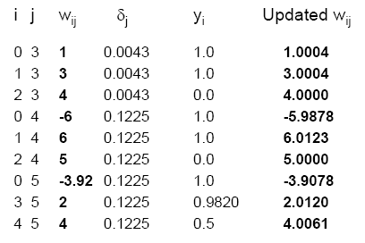
MLP-Backpropogation
Consider a MLP

Slide 28
Good morning

