Slide 1
Good morning

Slide 2
Last class
Naïve Bayes classifier
NB optimal classifier

Slide 3
This class
Logistic regression

Slide 4
Logistic regression
Odds: The odds in favor of an event is the ratio of the number of ways the outcome can occur to the number of ways the outcome cannot occur.
Difference between fraction and ration.
Probability(event)=
No.of favorable outcomes/Total no.of outcomes
Odds(event)=
No.of Favorable outcomes/No.of Unfavorable outcomes
So,odds=p/(1-p)

Slide 5
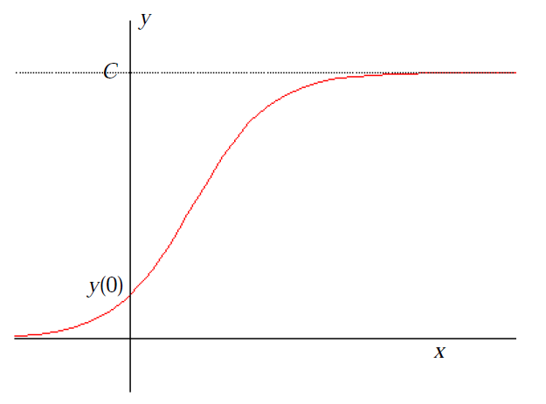
Logistic function
logistic function, occurs in describing kinds of growth.
These functions, like exponential functions, grow quickly at first, but because of restrictions that place limits on the size of the underlying population, eventually grow more slowly and then level off, defined by

Slide 6

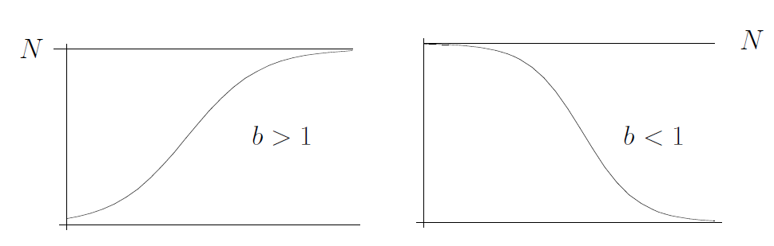
Logistic function
C represents the limiting value of the output
A is the number of times that the initial population must grow to reach C
if B is positive, the logistic function will always increase, while if B is negative, the function will always decrease.

Slide 7
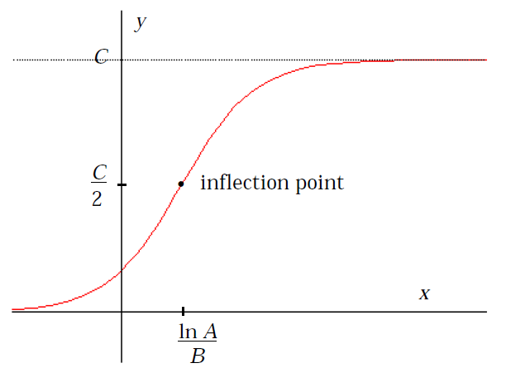
Logistic function
Logistic curves have an inflexion point which separates the curve into two equal regions of opposite concavity.
{lnA/B, C/2}

Slide 8
Logistic function
Actually logistic equation is the solution of the Logistic model , used for population growth ,
Where K is called the carrying capacity.
Solving for P actually gives the logistic function

Slide 9
Logistic Model
The population of the US in 1800 and 1850 was 5.3 and 23.1 million people respectively. Predict its population in 1900 and in 1950 using the exponential model of population growth. Then considering that the population of the US in 1900 was actually 76 million people correct your prediction for 1950 using the logistic model of population growth (help: with this data k = 0.031476 in the logistic model). What is the carrying capacity of the US according to this model?

Slide 10


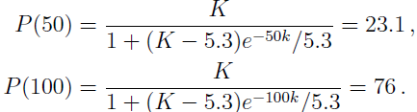
Logistic Model
The exponential model gives
P(t)=P(0) exp(kt)
P(50)=23.1=5.3exp(50k), giving k=0.029443. Hence
Now, with added information of P(100)=76, we use the logistic model where A=(K-P0)/P0.
giving K=189.4

Slide 11
Logistic Model
K=189.4 gives A=(K-P0)/P0=34.74.
Hence in 1950, P(150)=144.7

Slide 12
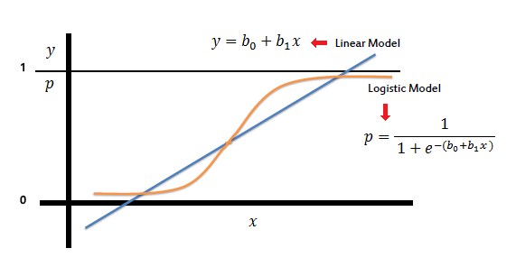
Logistic regression
Logistic regression measures the relationship between the categorical dependent variable and one or more independent variables by estimating probabilities using a logistic function,

Slide 13
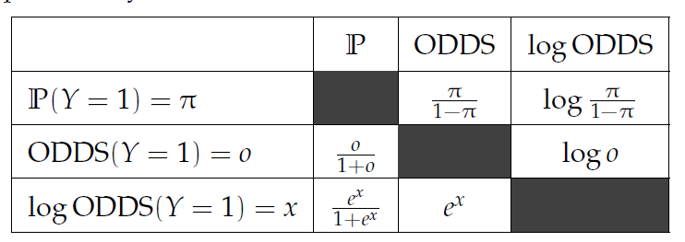
Logistic regression
Logistic regression analysis studies the association between a categorical dependent variable and a set of independent (explanatory) variables. The name logistic regression is used when the dependent variable has only two values, such as 0 and 1 or Yes and No

Slide 14
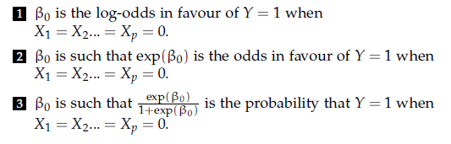
Logistic regression
So, logistic regression is
Log[odds(p)]=β0+β1x[In case of single explanatory variable]

Slide 15
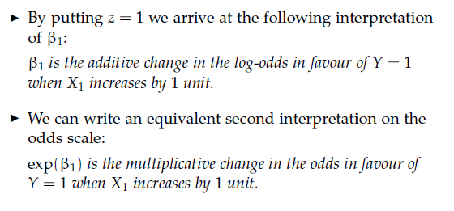
Logistic regression
So, logistic regression is
Log[odds(p)]=β0+β1x[In case of single explanatory variable]

Slide 16
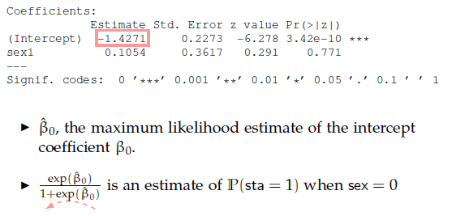
Logistic regression
Using packages, logistic regression gives
Log[odds(p)]=β0+β1x[In case of single explanatory variable]

