Slide 1

Good morning

Slide 2
Last class
Logistic regression

Slide 3
Today’s class
Linear basis function models
Bias-variance decomposition

Slide 4
Basic Measures Mean Vector
For a data with p variables, each of size n, we have the mean vector
For example, Two measurements x1; x2 made at the same position on each of 3 cans of food, resulted in the following X matrix:
The mean vector is

Slide 5

Basic Measures Variance-Covariance matrix
For a data with p=3 variables, each of size n, we have the V-CV matrix
For the above data,

Slide 6
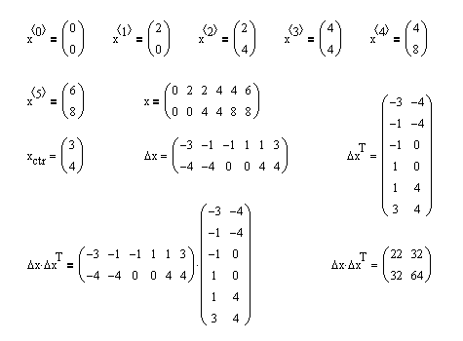
Basic Measures Variance-Covariance matrix
Aliter-For 6 subjects used to measure 2 variables

Slide 7
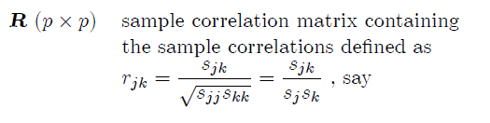
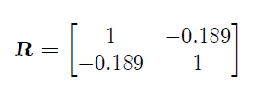
Basic Measures Correlation matrix
The correlation matrix is
For the above data,

Slide 8
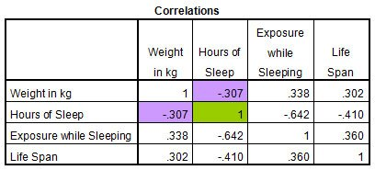
Basic Measures Correlation matrix
The correlation matrix is for a data of 62 mammals

Slide 9
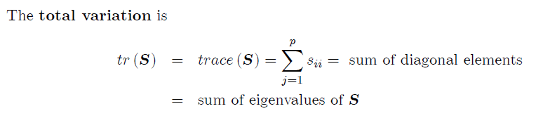

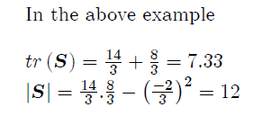
Measures Based on S matrix
Measures are

Slide 10
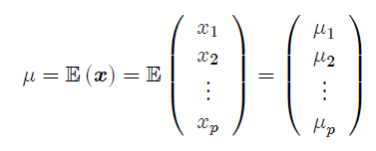

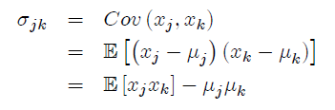
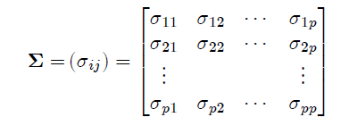

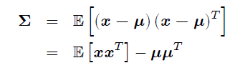

Continuous data
For a continuous data,Mean vector, V-CV matrix

Slide 11

Multiple regression
Find mean vector and V-CV matrix for the data

Slide 12
Multiple regression Method 2
Step1: Obtain mean, SD of all variables
Step2: Obtain correlation of all pairs of variables
Step3: The multiple correlation coefficient is

Slide 13
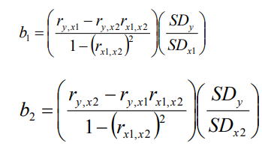
Multiple regression method 2
The multiple regression is

Slide 14
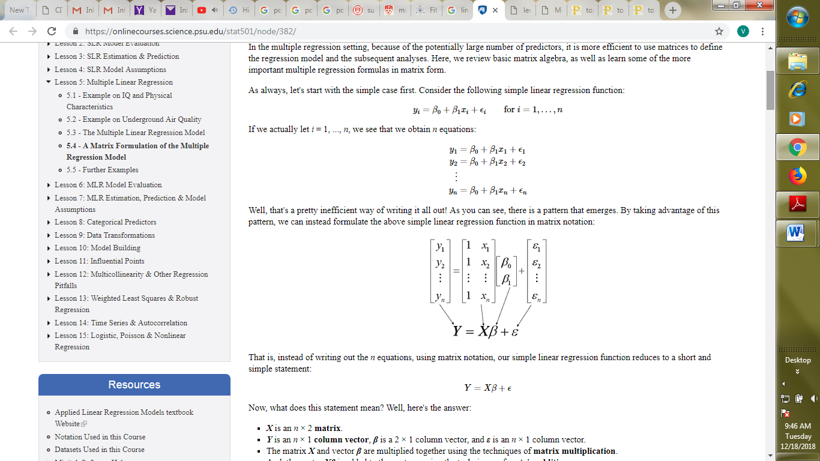
MLR-matrix method
The system of equations resulting from the regression equation y= a+bx+ε is

Slide 15
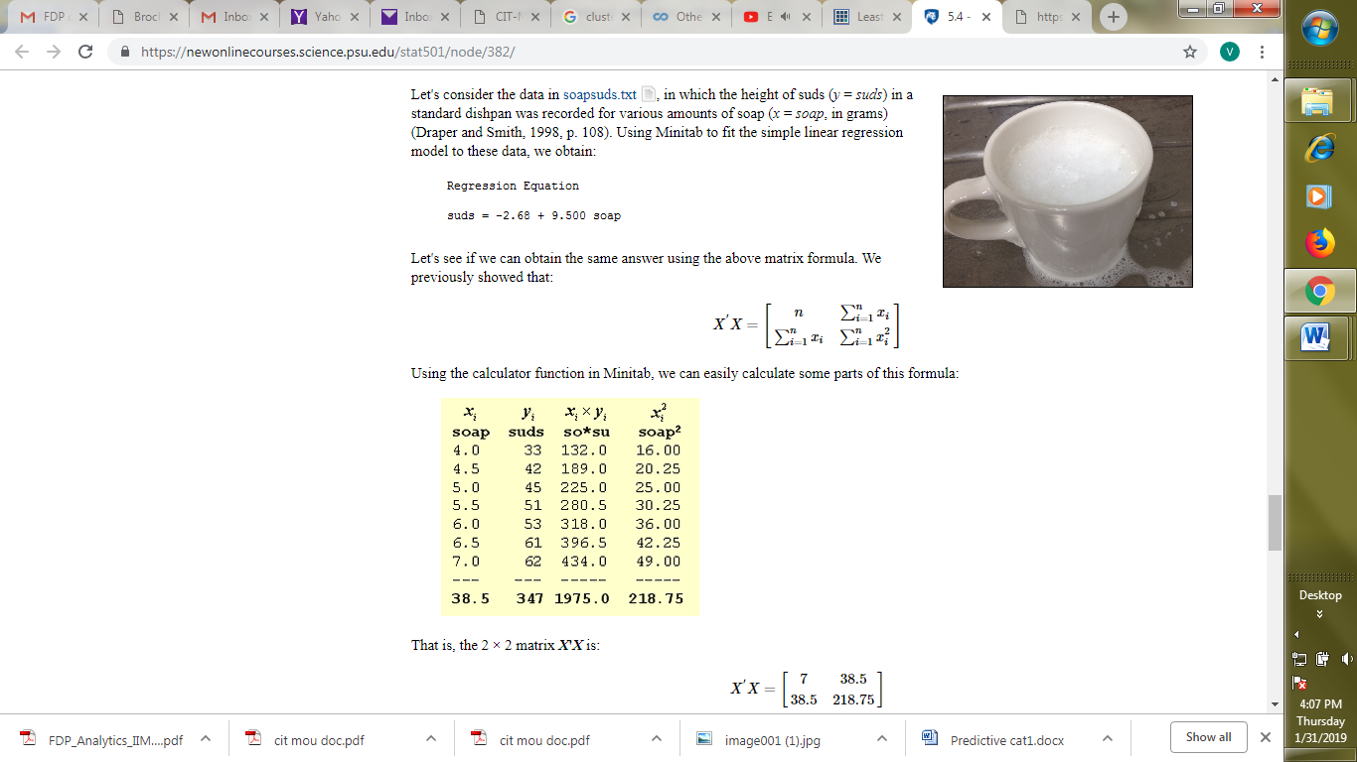
MLR-matrix method
For simplification, we can remove the error term and proceed as Y=Xβ.
Pre-multiplying by X’, X’Y=X’Xβ which gives us the equation for the coefficients β=(X’X)⁻¹X’Y.
For a two variable problem

Slide 16
MLR-matrix method
Example: Consider the soap problem where height of suds (y = suds) in a standard dishpan was recorded for various amounts of soap (x = soap, in grams) .

Slide 17
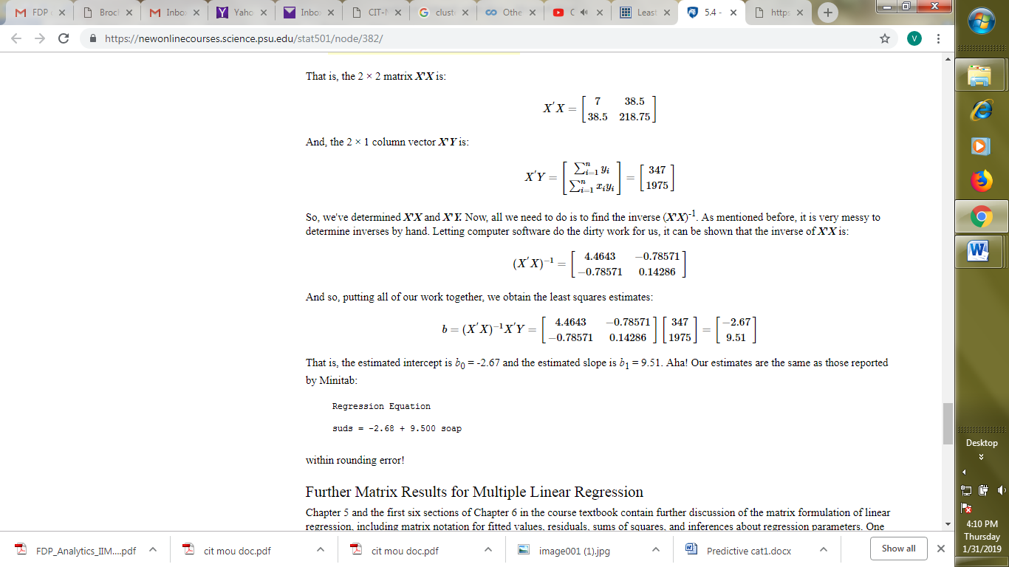

MLR-matrix method
Then
That is, the estimated intercept is b₀ = -2.67 and the estimated slope is b₁ = 9.51

Slide 18
Good morning

Slide 19
Polynomial regression
A polynomial regression equation is an equation
y=akx^{k}+⋯ a2x² +a1x+a0+ϵ
The maximum order of the polynomial is dictated by the number of data points used to generate it. For a set of N data points, the maximum order of the polynomial is k=N−1
Estimating the regression coefficients is based on the solution of the following system

Slide 20
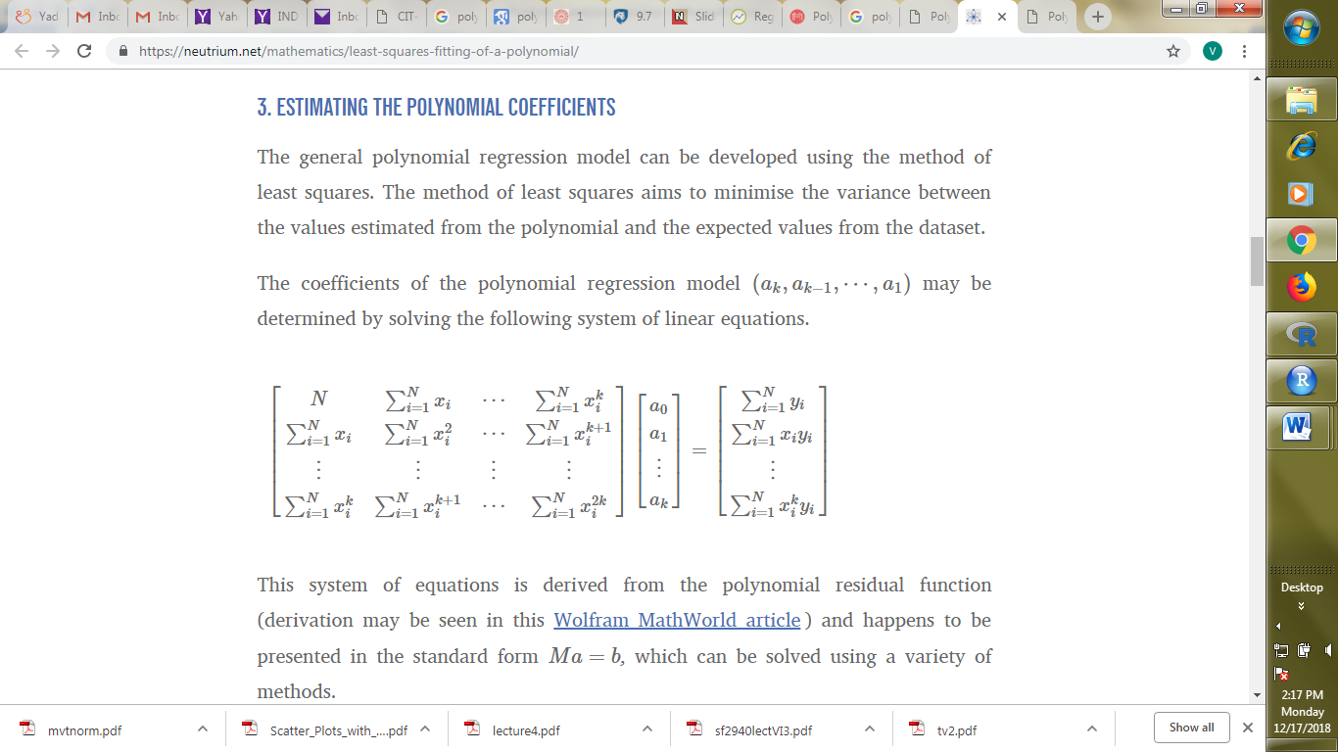
Polynomial regression
PRE: y=akx^{k}+⋯ a2x² +a1x+a0+ϵ

Slide 21
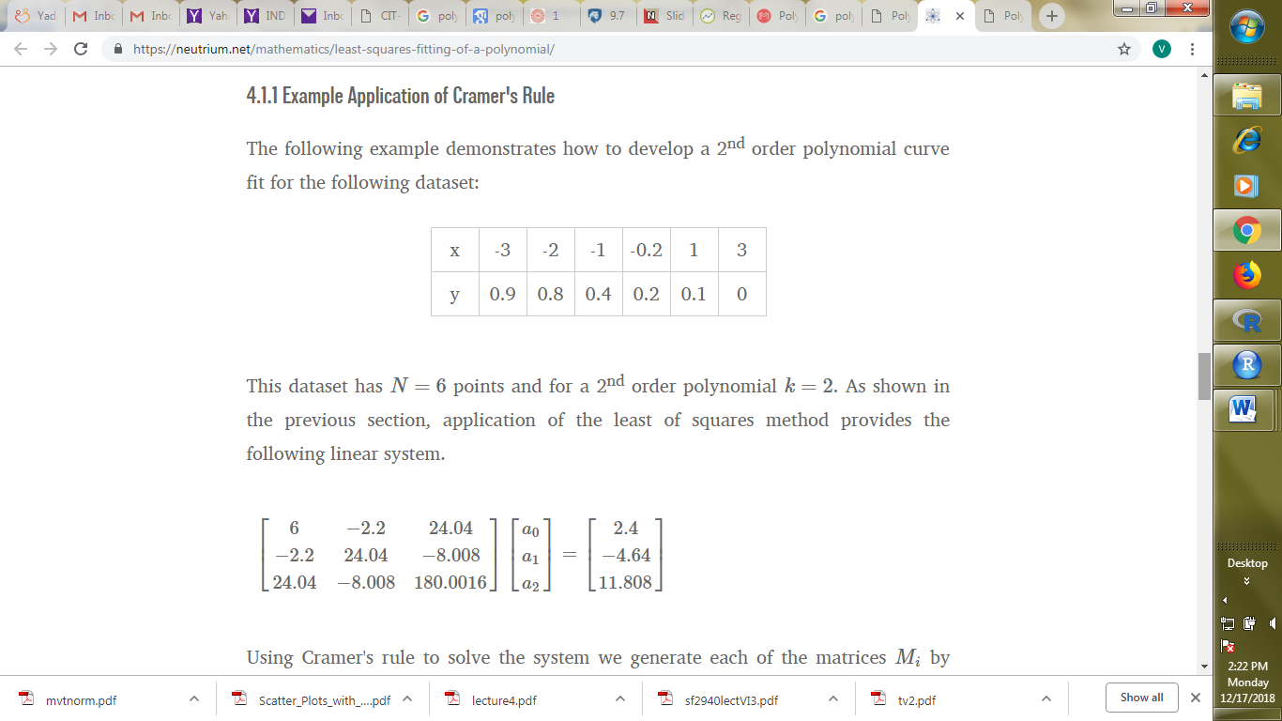
Polynomial regression
PRE: y=akx^{k}+⋯ a2x² +a1x+a0+ϵ
The following data is for 2nd order polynomial
Dataset has N=6 points and for second order polynomial k=2.
X | -3 | -2 | -1 | -0.2 | 1 | 3
y | 0.9 | 0.8 | 0.4 | 0.2 | 0.1 | 0

Slide 22
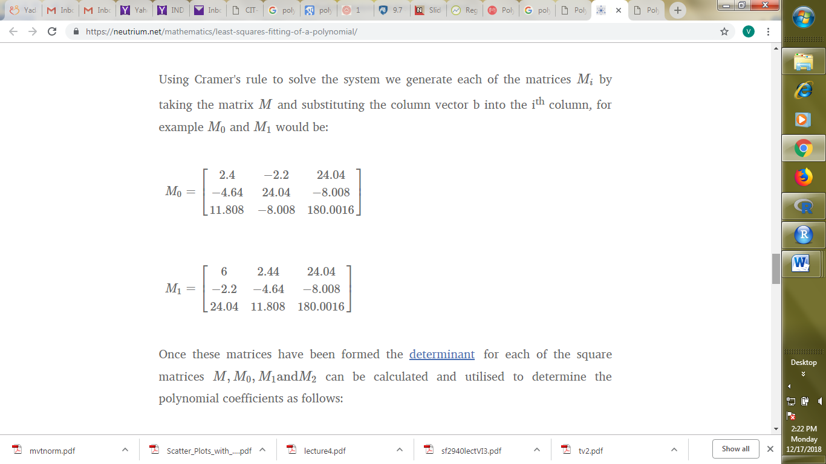
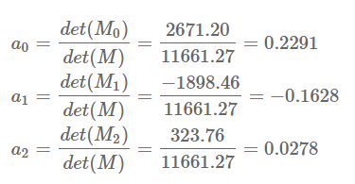
Polynomial regression
Cramer’s rule
Hence the regression equation is y=0.0278x²-0.1628x+0.2291.

Slide 23
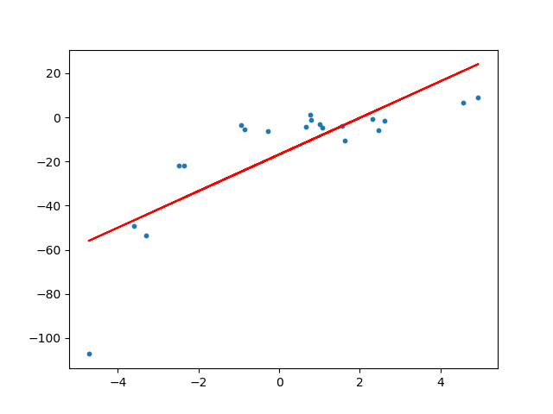
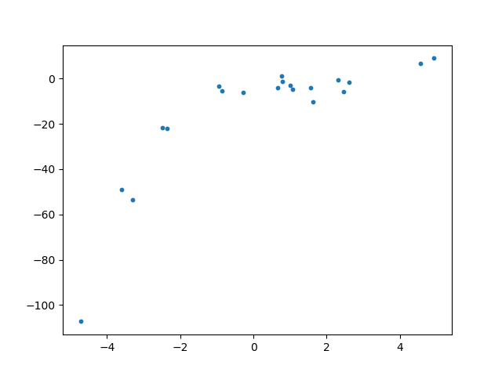
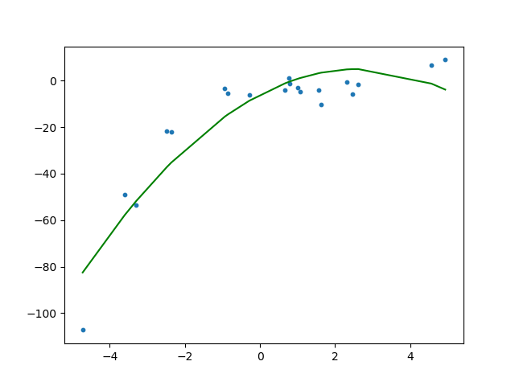
Polynomial regression
The need for this.
RMSE (quadratic)is 10.120437473614711. R2 is 0.8537647164420812.

Slide 24
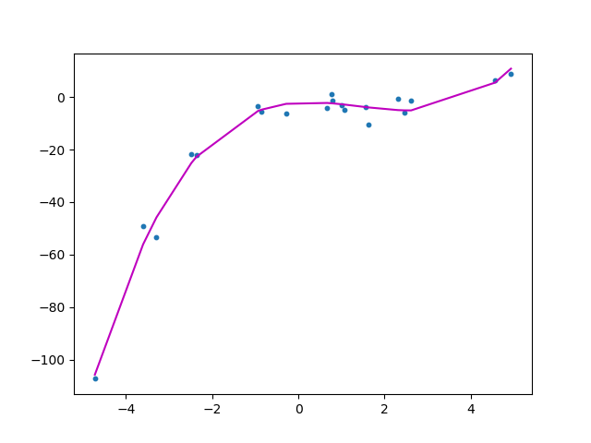
Polynomial regression
The need for this.
RMSE-Cubic- is 3.449895507408725 R2 score is 0.9830071790386679

Slide 25
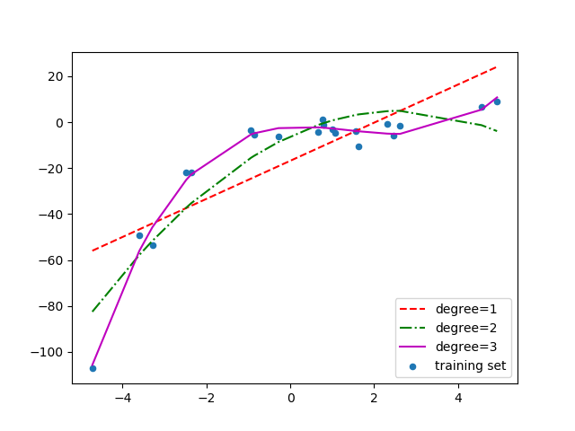
Polynomial regression
The need for this.

Slide 26
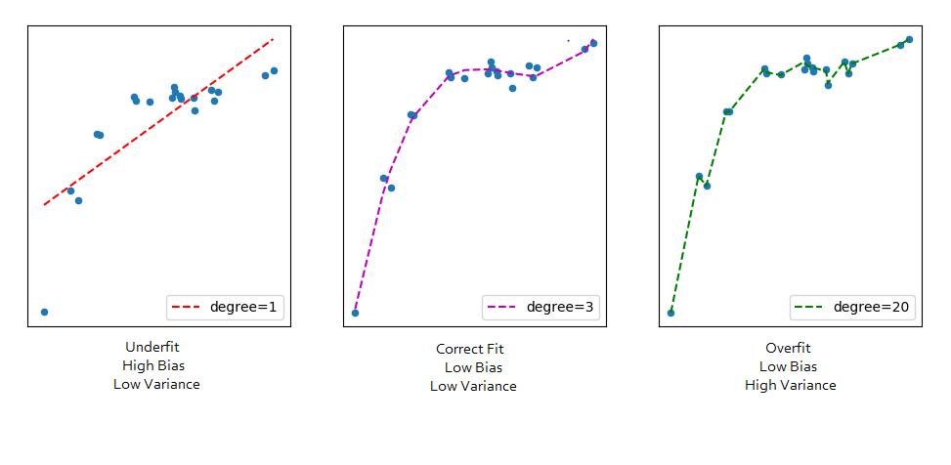
Polynomial regression
The need for this.

Slide 27

Linear basis function models
LBF models
These are generalizations of the linear regressions in that the coefficients of the predictors are not constants but functions.
In general, we do linear regression of t on φ1(x), φ2(x), . . . , φ_{M−1}(x), where the φj are basis functions, that we have selected to allow for a non-linear function of x. This gives the following model:
where w is the vector of all M regression coefficients (including the intercept, w0) and φ(x) is the vector of all basis function values at input x, including φ0(x) = 1 for the intercept.

Slide 28
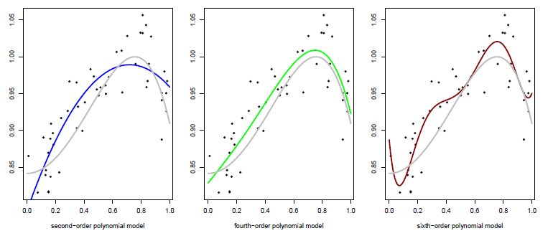
Linear basis function models
The following are results of LBF models, where the gray curve is the true noise-free function.

Slide 29
Multi-collinearity
In regression, "multi-collinearity" refers to predictors that are correlated with other predictors.
Multi-collinearity occurs when your model includes multiple factors that are correlated not just to your response variable, but also to each other.
Multi-collinearity exists when two or more of the predictors in a regression model are moderately or highly correlated

Slide 30
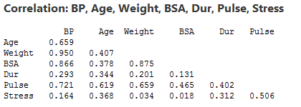
Multi-collinearity
MC can
be studied
Blood pressure appears to be related fairly strongly to Weight (r = 0.950) and BSA (r= 0.866), and hardly related at all to Stress level (r = 0.164). And, Weight and BSA appear to be strongly related (r = 0.875), while Stress and BSA appear to be hardly related at all (r = 0.018). The high correlation among some of the predictors suggests that data-based multi-collinearity exists.

Slide 31
Good morning

Slide 32

Bias-Variance
Bias: the class of models can’t fit the data.
Fix: a more expressive model class.
Variance: the class of models could fit the data, but doesn’t because it’s hard to fit.
Fix: a less expressive model class.

Slide 33
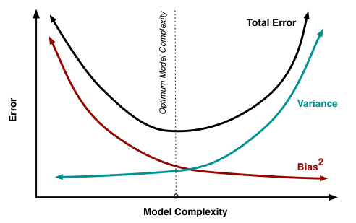
Bias-Variance
Bias: the class of models can’t fit the data.
Fix: a more expressive model class.
Variance: the class of models could fit the data, but doesn’t because it’s hard to fit.
Fix: a less expressive model class.

Slide 34
Bias-Variance Decomposition
In regression, we assume that the actual relation is y=f(x)+ε, where we assume that the error is normally distributed with zero mean and SD=σ. But the regressed line is our fit, a best line, based on the data , denoted by h(x)=w*x + b.
The “best” tag for the line is because of the fact we minimize the squared error
For the data (yi,xi).
Now we’ll decompose the expected value of the square for a random data point.

Slide 35
Bias-Variance Decomposition
We are actually decomposing E_{P} [ (y – h(x))² ] where h(x) is the expected value of the y.
If for convenience we call ‘y’ a r.v and ‘y1’, its expected value w.r.t a distribution, then we know that

Slide 36
Bias-Variance Decomposition
Using the result , we obtain for our problem that
E[ (h(x) – y)² ] = E[h(x)² – 2 h(x) y + y² ]
= E[h(x)² ] – 2 E[ h(x) ] E[y] + E[y²]
= E[ (h(x) – h’(x))² ] + h’(x)² (result)
– 2 h’(x) f(x)
+ E[ (y – f(x))² ] + f(x)² (result)
= E[ (h(x) – h’(x))² ] [variance]
+(h’(x) – f(x))² [bias²]
+ E[ (y – f(x))² ] [noise²]
Expected prediction error = Variance + Bias² + Noise².

