Slide 1

Good morning

Slide 2
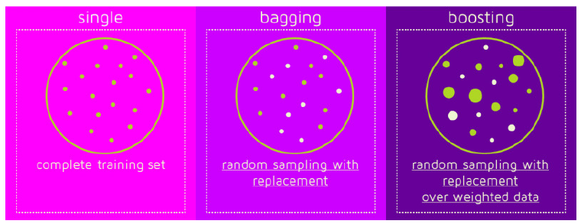
Ensemble Methods
Ensemble Methods:
Combines works of many Experts.

Slide 3
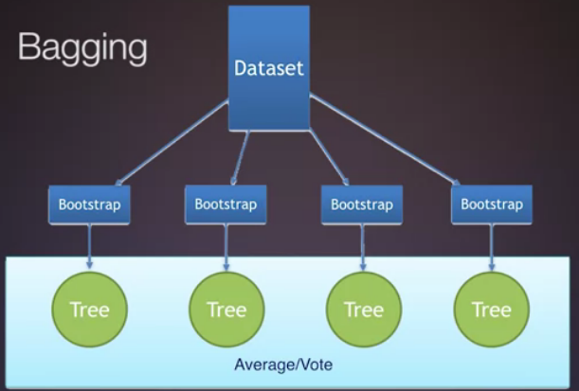
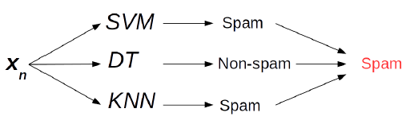
Bagging
Bootstrap Aggregation
Uses many/different models with different samples(Bootstrap) and uses the method of Voting to make decisions.

Slide 4
Bagging
The error rate for a particular learning algorithm is called its bias for the learning problem and measures how well the learning method matches the problem.
A second source of error in a learned model, in a practical situation, stems from the particular training set used, which is inevitably finite and therefore not fully representative of the actual population of instances. The expected value of this component of the error, over all possible training sets of the given size and all possible test sets, is called the variance of the learning method for that problem
Combining multiple classifiers decreases the expected error by reducing the variance component.

Slide 5
Bagging
Takes original data set D with N training examples
Creates M copies [Dm], m=1,2…M
Each Dm is generated from D by sampling with replacement
Each data set Dm has the same number of examples as in data set D
These data sets are reasonably different from each other (since only about 63% of the original examples appear in any of these data sets)
Train models h1,h2,… hM using D1,D2… , DM, respectively
Use an averaged model/Voting to make the final decision.
Useful for models with high variance and noisy data

Slide 6
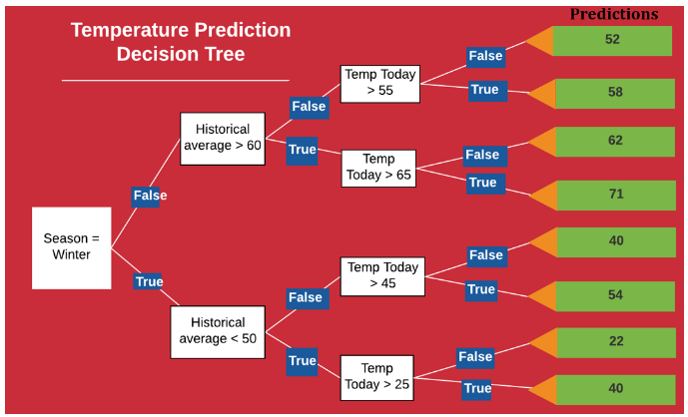
Bagging
Recall Decision tree
If the accuracy of the DT is to be improved, we move to Random forest which is nothing but a group of DT’s and we do voting or averaging.

Slide 7
Good morning

Slide 8
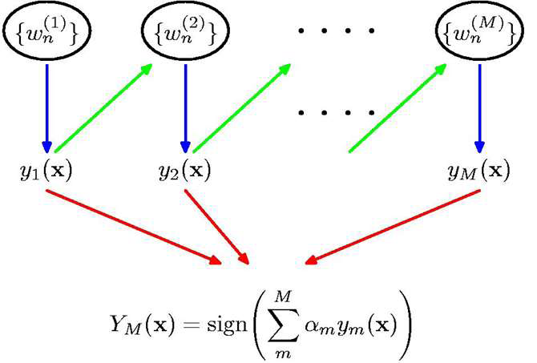
Boosting
The boosting method seeks models that complement one another just like Bagging but it takes the route of minimizing the errors by focusing on the errors themselves more along with the models.
It is iterative.
Each model depends on the
previous unlike Bagging
where models are
independently built.

Slide 9
Boosting
Boosting weighs the instances according to their error factor.
By weighting instances, the learning algorithm can be forced to concentrate on a particular set of instances, namely, those with high weight.
How much should the weights be altered after each iteration? The answer depends on the current classifier’s overall error. More specifically, if e denotes the classifier’s error on the weighted data (a fraction between 0 and 1), then weights are updated by
new weight of instance =weight * e /(1- e)
for correctly classified instances.

Slide 10
Boosting
Whenever the error on the weighted training data exceeds or equals 0.5, the boosting procedure deletes the current classifier and does not perform any more iterations. The same thing happens when the error is 0, because then all instance weights become 0.

Slide 11
Boosting
To form a prediction, their output is combined using a weighted vote. To determine the weights, note that a classifier that performs well on the weighted training data from which it was built (e close to 0) should receive a high weight, and a classifier that performs badly (e close to 0.5) should receive a low one. More specifically,
Weight of classifier=-log[e/1-e]
which is a positive number between 0 and infinity.
This formula explains why classifiers that perform perfectly on the training data must be deleted, because when e is 0 the weight is undefined. To make a prediction, the weights of all classifiers that vote for a particular class are summed, and the class with the greatest total is chosen.

Slide 12
Combining Classifiers
Is a class better than a single student?

Slide 13
AdaBoost
Start with a supervised training data (x1,y1), (x2,y2),…(xn,yn) where yn ε[-1,1], as we are in Binary classification .
Initialize weight of each example
(xn, yn):D1(n)=1/N for all n

Slide 14
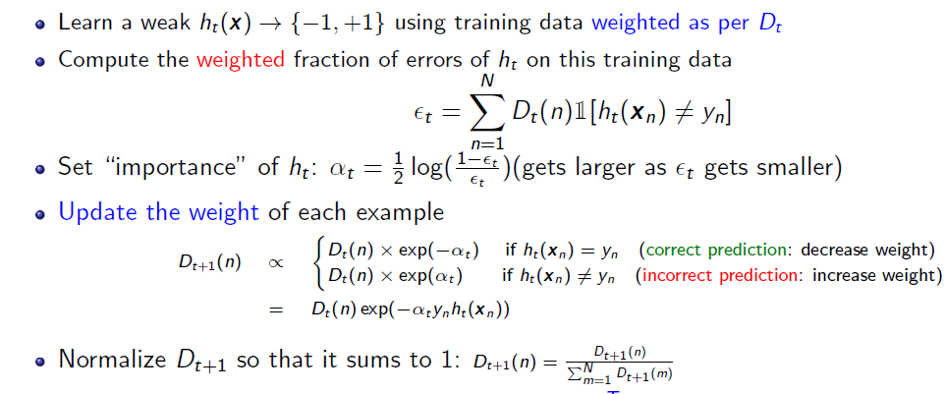

AdaBoost
For t=1:T
The final boosted hypothesis is

Slide 15
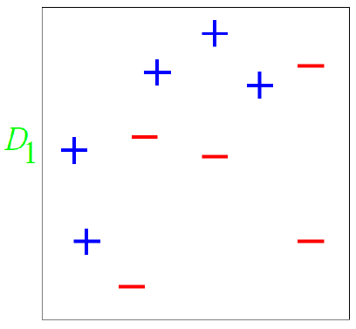
AdaBoost Example
Consider binary classification with 10 training examples.
Initial weight distribution D1 is uniform (each point has equal weight = 1/10)
In this case, all classifiers
which are parallel to the
axes can be the weak
classifiers to start with.

Slide 16
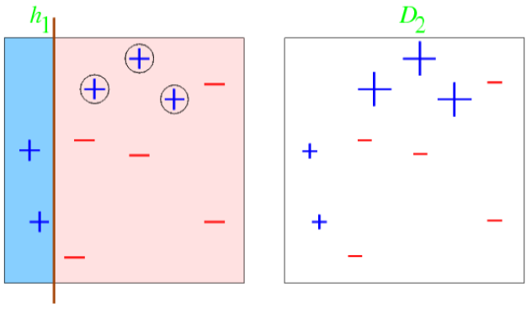
AdaBoost Example
After
iteration 1,
Error rate of h1: ε1 = [0.1+0.1+0.1]/1=0.3; weight of
h1: α1=1/2 ln[(1- ε1)/ ε1] = 0.42
Each misclassified point’s weight is increased (weight multiplied by exp(α1))
Each correctly classified point’s weight is decreased(weight multiplied by exp(-α1))

Slide 17
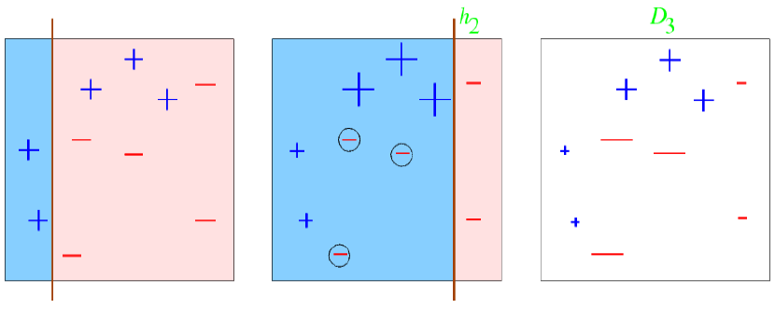
AdaBoost Example
After
iteration
2,
Error rate of h2: ε2 = 0.21;
weight of h2: α2=1/2 ln[(1- ε2)/ ε2] = 0.65
Each misclassified point’s weight is increased (weight multiplied by exp(α2))
Each correctly classified point’s weight is decreased(weight multiplied by exp(-α2))

Slide 18
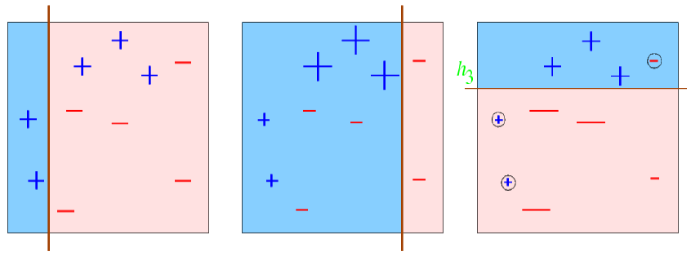
AdaBoost Example
After
iteration
3,
Error rate of h3: ε3 = 0.14;
weight of h3: α3=1/2 ln[(1- ε3)/ ε3] = 0.92
Suppose we decide to stop after round 3
Our ensemble now consists of 3 classifiers: h1, h2, h3

Slide 19
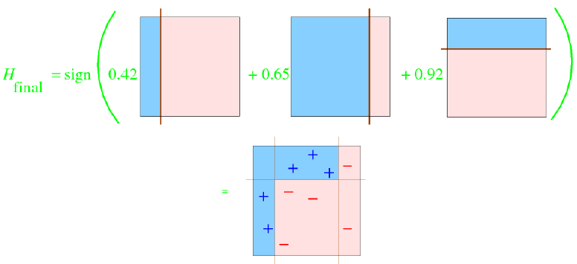
AdaBoost Example
Final Classifier is a Weighted Linear Combination of
All three, hi with weight αi,
Multiple weak, linear classifiers combined to give a strong, nonlinear classier

Slide 20
Gradient Boosting
Recall, adaptive boosting changes the sample distribution by modifying the weights attached to each of the instances. It increases the weights of the wrongly predicted instances and decreases the ones of the correctly predicted instances.
On the other hand, gradient boosting doesn’t modify the sample distribution. Instead of training on a newly sample distribution, the weak learner trains on the remaining errors (so-called pseudo-residuals) of the strong learner , just like in the case of Gradient descent.

Slide 21
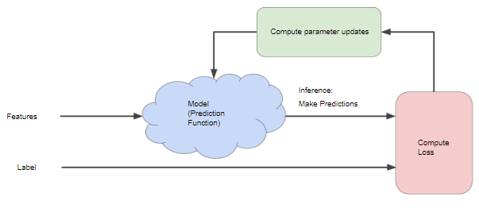
Gradient Descent
Suppose we are using Regression, predicting sales(y) for amount spent in ads (x). Predicted value is

Slide 22
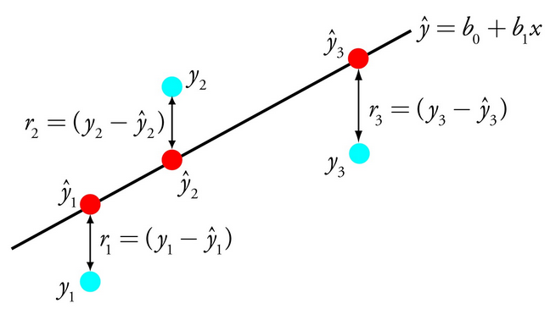
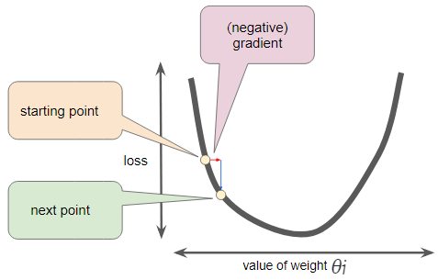
Gradient Descent
Suppose we are using Regression, predicting sales(y) for amount spent in ads (x). Predicted value is

Slide 23
Gradient Boosting
GB has three major ideas.
Loss function: Is different for different problems, measuring fit of the model, but we always try and minimize it. For regression we may use a squared error and classiﬁcation may use logarithmic loss.

Slide 24
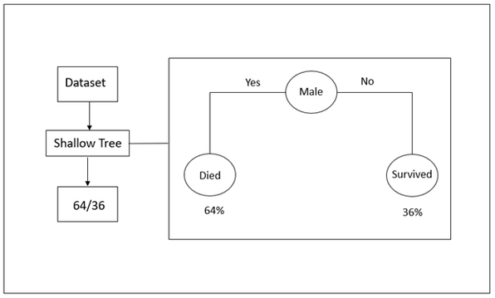
Gradient Boosting
GB has three major ideas.
Weak Learner: In GB these are generally Decision stumps(DT with single split). Also called Shallow trees.

Slide 25
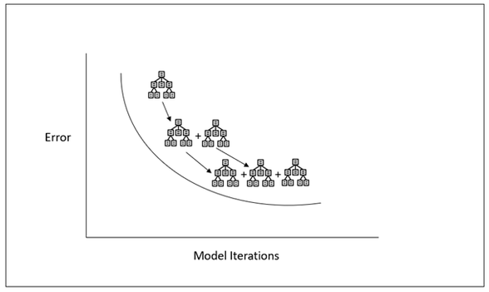
Gradient Boosting
GB has three major ideas.
Adding classifiers: Generally the Decision stumps are added sequentially, one at a time in such a way that it reduces the loss. This is where we use the Gradient descent idea.

Slide 26
Gradient Boosting
Given a training data {xi,yi}, i=1,2…N , we need to find a model F(x) that map x to y . We will measure the mapping effectiveness by choosing a loss function L(y,F(x)) and then minimize it:
The model F(x) is constructed in the form:
This is called boosting where:
F0(x)is a initial guess, the first starting point of the model.
hm(x) is called “weak learner” or “base learner”.

Slide 27
Gradient Boosting
We start the process by choosing F₀(x), then measure the error between target y and prediction F₀(x) : y−F₀(x). Next, we try to find a new function h0(x)so that:
F₀(x)+ρ₀h₀(x)=y
The role of h₀ is to reduce the error of predictive model F(x). This step is proceeded recursively, we can add up another h1,…,hm until the best F∗ is found. Each new hm will try to correct errors made by previous h_{m−1}so that:
F_{m}(x)+ρ_{m}h_{m}(x)=y.
We use gradient descent to guide h

Slide 28
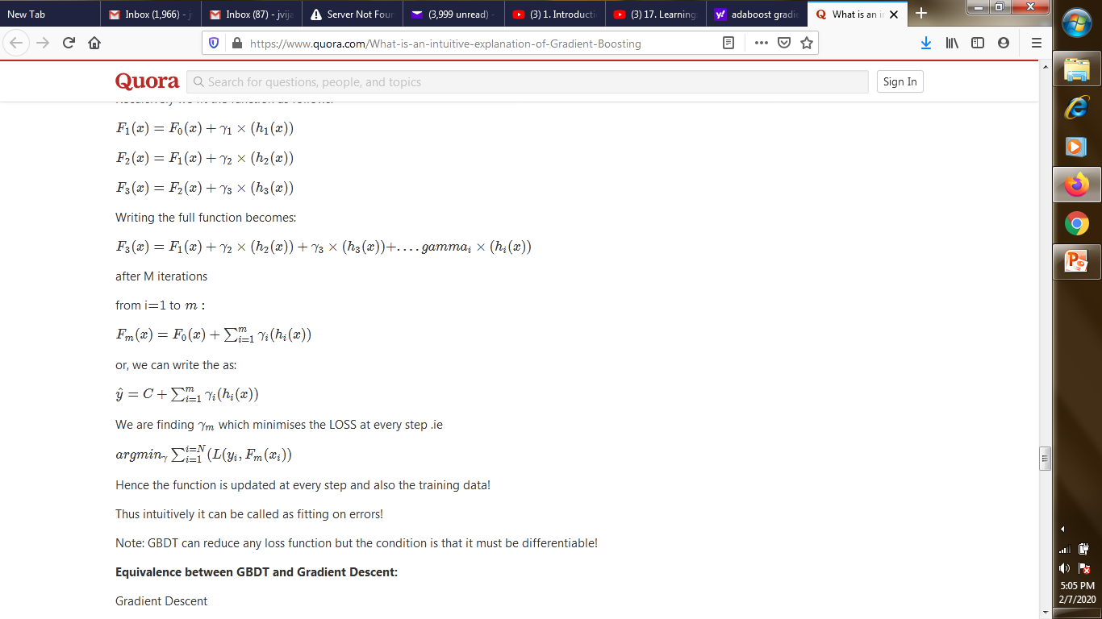
Gradient Boosting
If we are using squared loss function, then
We want to fit h(x)(shallowtrees)such that it reaches close to the actual model:
F(x1)+h(x1)=y1
F(x2)+h(x2)=y2.......
We find the γ which minimizes the loss

Slide 29
Gradient Boosting
Gradient Descent
Gradient Boosting Decision Trees
The difference is just the fact that instead of updating the point we are updating the function at every time step.

Slide 30
Good morning

Slide 31
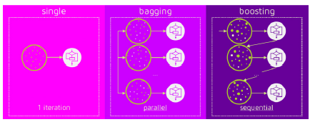
Bagging Vs Boosting
No clear winner; usually depends on the data

Slide 32
Bagging Vs Boosting
Bagging is computationally more efficient than boosting (note that bagging can train the M models in parallel, boosting can't).
Both reduce variance (and over-fitting) by combining different models
The resulting model has higher stability as compared to the individual ones
Bagging usually can't reduce the bias, boosting can (note that in boosting, the training error steadily decreases).
Bagging usually performs better than boosting if we don't have a high bias and only want to reduce variance (i.e., if we are over-fitting)

Slide 33
Good morning

